Slide 1
Risk Analysis on Lending Club Loan Investments

Slide 2
Overview
Lending Club
Data
Lending Club
Data
Exploration
Feature Engineering
Secondary
Credit Model
Model and
Evaluation

Slide 3
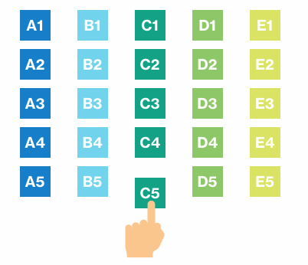


Lending Club Basics
Peer to Peer (P2P) lending company
Provide assessment of the credit risk of the corresponding loan
Each loan has grade A (lower risk and interest) – E (higher risk and interest)
Investment strategies
Automated investing
Platform mix
Custom mix
Lending Club
Manual strategies

Slide 4
Secondary Credit Model
A secondary credit model/algorithm allows investors to instantly calculate the likely ROI (Return of Investment) of each available loan, identifying where there is an opportunity to earn above average returns.
LendGuardian by Bryce Mason of P2P-Picks.com
Secondary
Credit Model
Notes:
The goal is to optimize ROI. But it is hard to directly do that, so predict the possibility of default for each loan instead.

Slide 5
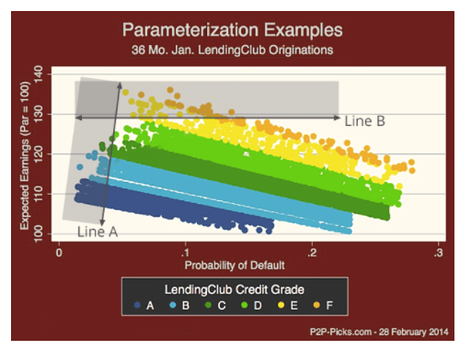
Lending Club Graded Loans
The vertical axis is ROI
The horizontal axis is the default rate
Line A is the buy-line for an investor who is trying to minimize their risk
Line B buy-line solely seeks to maximize returns, ignoring risk altogether)

Slide 6
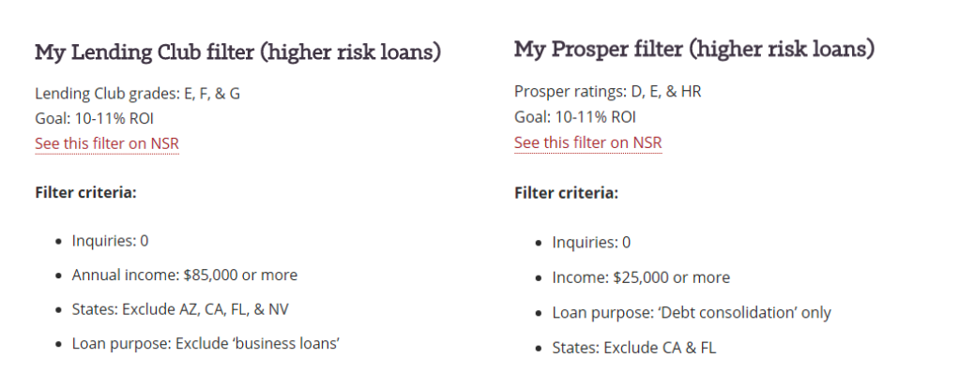
Traditional Filters

Slide 7
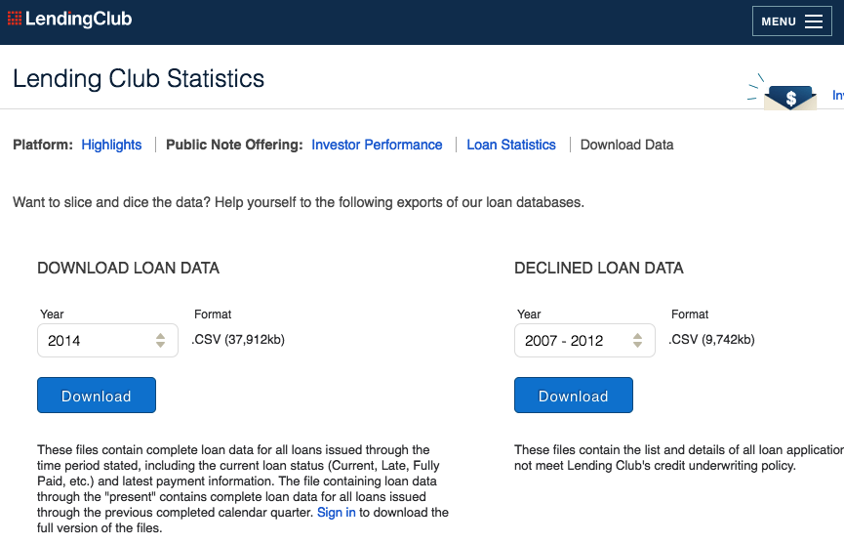
Lending Club Historic Data
Lending Club Data
Data Exploration
Feature Engineering
Model and Evaluation
Lending club loans’ length
36 months
60 months
Only use 36 months for this project, so use 2014 data as training data

Slide 8
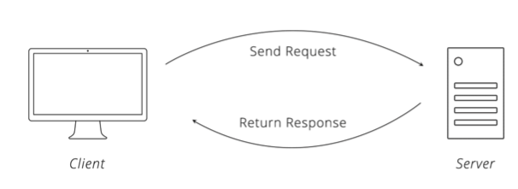
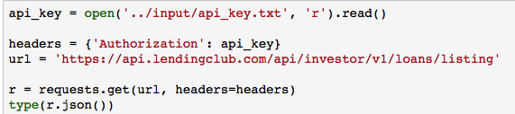
Lending Club Current Data
Lending Club Data
Data Exploration
Feature Engineering
Model and Evaluation
API
Python
code
Loans are listed on the Lending Club platform at 6AM, 10AM, 2PM, and 6PM every day.

Slide 9
Input Data
Lending Club Data
Data Exploration
Feature Engineering
Data size
Historic (2014) data: (235631, 145)
Current (02/24/2018 2-6pm) data: (4, 119)
Format conversion of feature names
Unify feature names
emp_title vs. empTitle
zipcode vs. addrZip
Keep only common features
Total 105 features after format conversion
56 numeric and 19 categorical
30 are all Nulls, another 30 have Nulls in historic data
Model and Evaluation

Slide 10
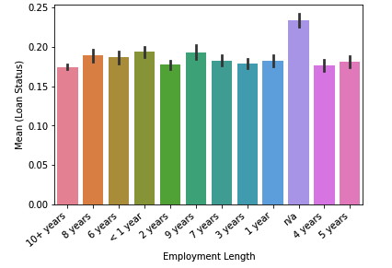
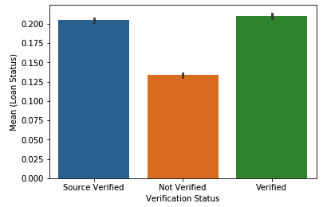
Feature Exploration
Lending Club Data
Data Exploration
Feature Engineering
Model and Evaluation
Employment length vs.
mean of loan status
Income source vs.
mean of loan status

Slide 11
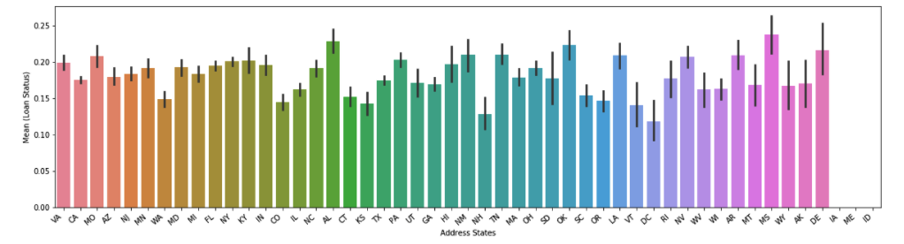
Feature Exploration
Lending Club Data
Data Exploration
Feature Engineering
Model and Evaluation
Address states vs. mean of loan status

Slide 12
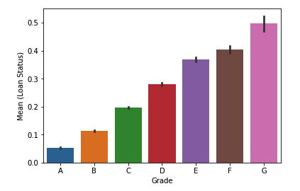
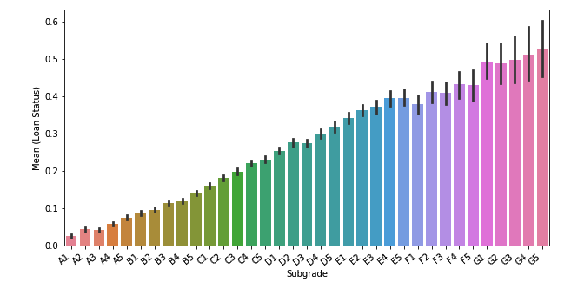
Feature Exploration
Lending Club Data
Data Exploration
Feature Engineering
Model and Evaluation
Grade vs.
mean of loan status
Subgrade vs.
mean of loan status

Slide 13
Input Data Selection
Lending Club Data
Data Exploration
Feature Engineering
Use only loans with term = 36 months
Label data (feature of loan status)
Fully paid → 0
Charged off → 1
Current
Late (301 - 120 days)
In Grace Period
Late (16 – 30 days)
Default
Historic data size after selection 161820
Fully paid 139703, ~86%
Charged off 22117, ~14%
Model and Evaluation

Slide 14
Feature Exploration
Lending Club Data
Data Exploration
Feature Engineering
Convert ‘emplength’ to numeric feature
Convert ‘earliestcrline’, which represents the beginning of credit line history, to number of months till Dec. 2014
Ordinal feature encoding
grade and subgrade
Frequency encoding
zipcode, emptitle, addrstate
One-hot encoding
homeownership, verificationstatus, purpose, initialliststatus
Model and Evaluation

Slide 15
Model: XGBoost
Lending Club Data
Data Exploration
Feature Engineering
Data splitting
Training Jan. – Sept. 2014 (112533, ~70%)
Testing Oct. – Dec. 2014 (49287, ~30%)
XGBoost model with parameters
Max_depth = 3
Min_child_weight = 100
Colsample_bytree = 0.5
Gamma = 1.5
Model trained on training dataset by cross validation and evaluate on testing dataset by AUC
Model and Evaluation

Slide 16
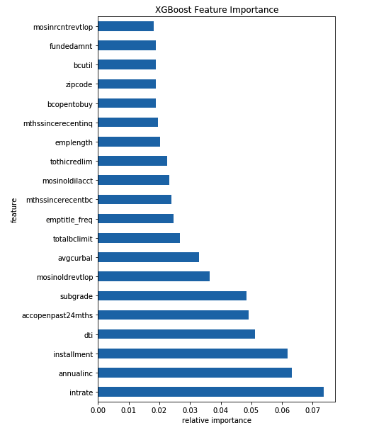
XGBoost Feature Importance
Lending Club Data
Data Exploration
Feature Engineering
Model and Evaluation

Slide 17
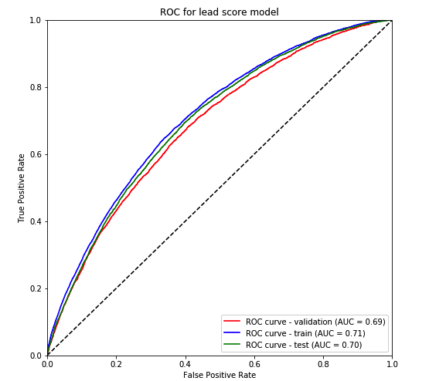
Model Evaluation: AUC
Lending Club Data
Data Exploration
Feature Engineering
Model and Evaluation

Slide 18
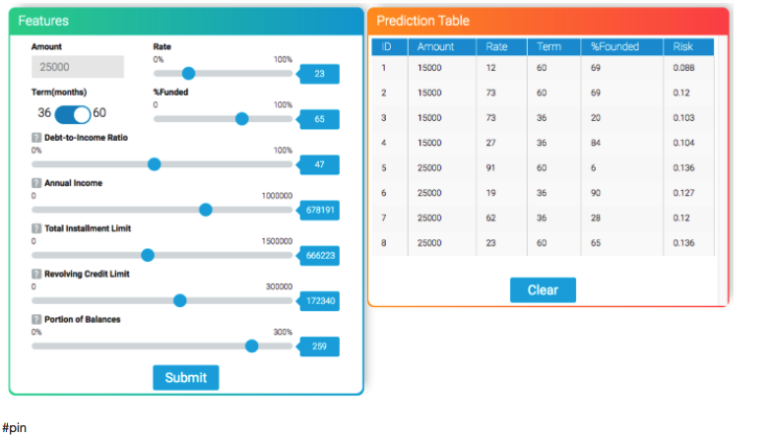
FinTech-Intelligence Personal Investment Consultant
Notes:
Provide a filter to end customer.

