Slide 1
Paraphrasing Arabic 11-731
Fatima Al-Raisi, Abdelwahab Bourai, Weijian Lin

Slide 2
Main Contributions
A tool for Arabic paraphrasing
A paraphrase database for Arabic
A large parallel (monolingual) corpus for Arabic
An automatic evaluation metric for paraphrasing

Slide 3
Problem
No tool for Arabic paraphrasing
Two main challenges:
Obtaining monolingual parallel data
Evaluating system output

Slide 4
Building a System for Paraphrasing
Using one language
Using two languages
Using three languages

Slide 5
Building a Model for Paraphrasing
Train a seq-to-seq model on monolingual parallel data (1)
Use another language as a pivot/bridge (2)
Use two (reliable) MT systems with different source languages and Arabic as the target. Train on the output as parallel data (3)

Slide 6
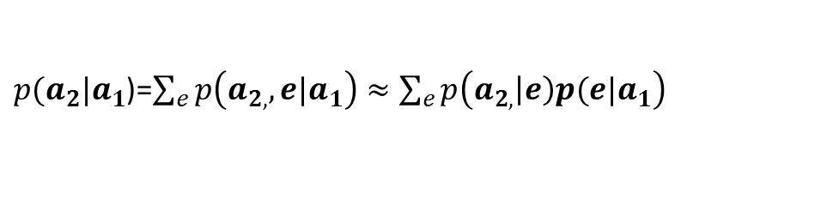
Bilingual Pivoting/Bridging
عشرون طالبا اجتاز اختبار الدخول
twenty students passed the entry test
The dean congratulated twenty students who ranked highest in the Putnam test
هنأ العميد 20 تلميذا أحرزوا أعلى المعدلات في امتحان البتنم
${\hat{a}}_{2}$= $\underset{a_{2}≠a_{1}}{argmax}{p\left({a_{2}|a}_{1}\right)}$
$p({a_{2}|a}_{1}$)=$\sum_{e}{p\left({a_{2,},e|a}_{1}\right)≈\sum_{e}{p\left({a_{2,}\left|e\right)p(e|a}_{1}\right)}}$

Slide 7
Bilingual Pivoting/Bridging
Coverage: over 1M phrase pairs
Use the paraphrase table to substitute phrases and produce new sentences
Judge paraphrase quality:
Correctness (semantic similarity)
Grammaticality

Slide 8
Novel Approach
Start with two parallel data from another language pair (europarl-v7.fr-en, 2M pairs)
Train on the output of 2 reliable MT systems: difference source languages and
Arabic as target
We used Google translate toolkit

Slide 9
Model 3
En
Fr
En → Ar
Ar ← Fr
Ar → Ar

Slide 10
Model 3
Use the output as training data for a seq-to-seq model: bi-LSTM
So far: over 400,000 sentence pairs (and counting → target O(1M))
Use dynet code from assignment1, tuning params, 6:3:1 train/valid/test
Sample output:

Slide 11
An Automatic Evaluation Metric
Two Competing Criteria
Semantic Similarity
Surface Diversity
Proposed functions
Averaging over word embeddings of input words
Hamming distance (words or character level)
Combining both
Harmonic mean
Note: depending on the paraphrastic task, one may consider other criteria
output complexity (text simplification)
output length (summarization)

Slide 12
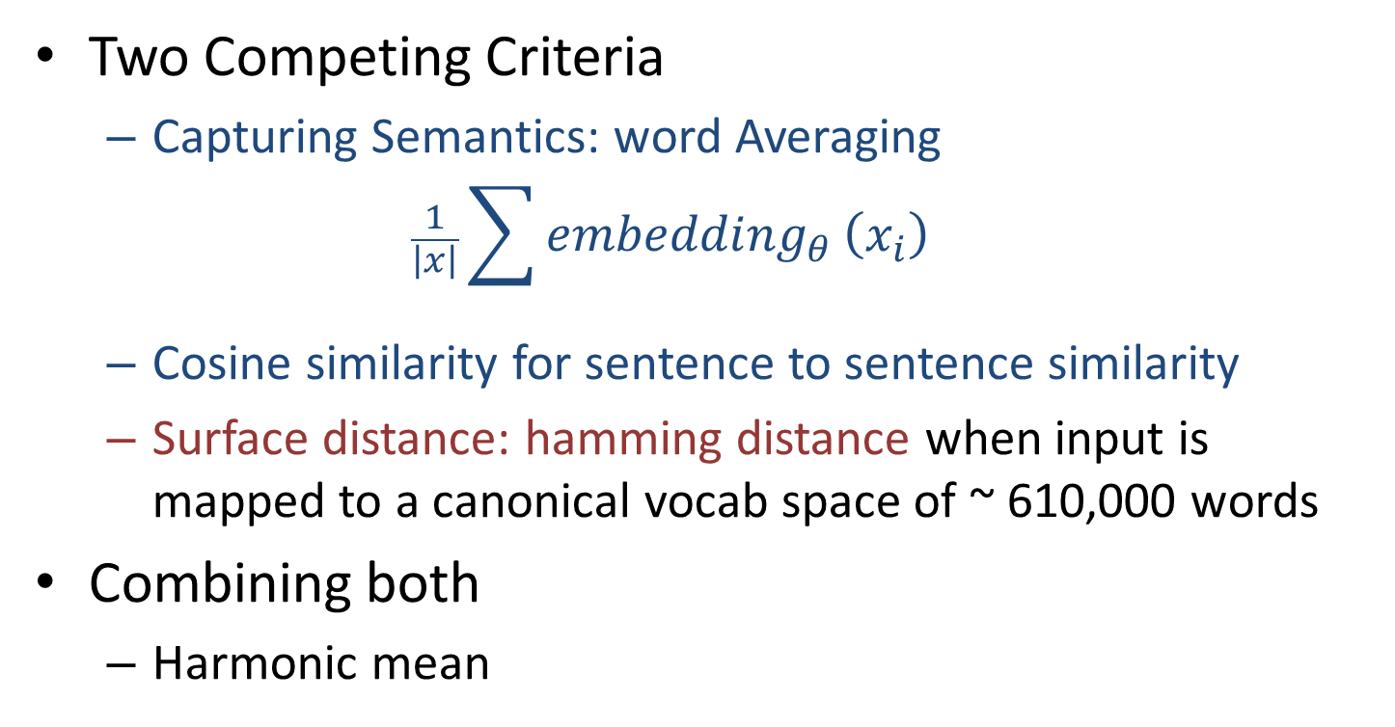
An Automatic Evaluation Metric
Two Competing Criteria
Capturing Semantics: word Averaging
$$\frac{1}{\left|x\right|}\sum{{embedding}_{θ}}\left(x_{i}\right)$$
Cosine similarity for sentence to sentence similarity
Surface distance: hamming distance when input is mapped to a canonical vocab space of ~ 610,000 words
Combining both
Harmonic mean

Slide 13
An Automatic Evaluation Metric
Results: on 198 sentence pairs:
“Very good” Inter-annotator agreement:
ICC = 0.77 (ICC ← 5-point scale for quality judgement)
Association with evaluation metric
Biserial Correlation = 0.8112

Slide 14
Next
Testing and improving grammaticality/fluency of the paraphrase output
Word order variants
Equivalent constructions
Morphology
Applying evaluation metric at the character level
Applying human and automatic evaluation on system output
Error analysis
Comparing output of different models

