Slide 1
Smart Retrofit Kit for Legacy Air Conditioners
MC555577
Wei JianNan
Notes:
“Welcome! Today I’ll present my project: Smart Retrofit Kit for Legacy Air Conditioners. This solution modernizes old AC units with smart control and connectivity.”

Slide 2


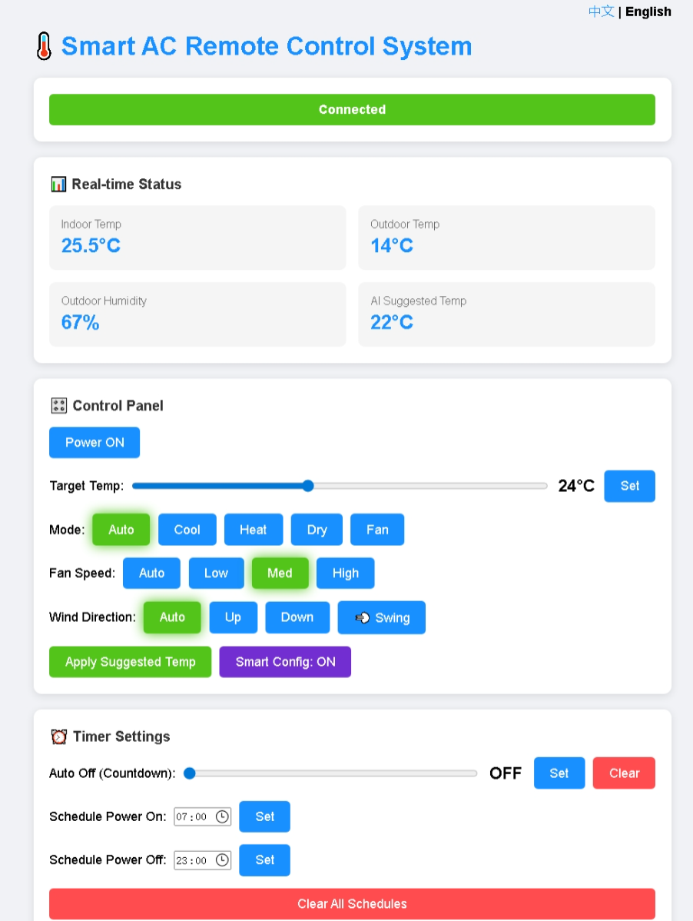
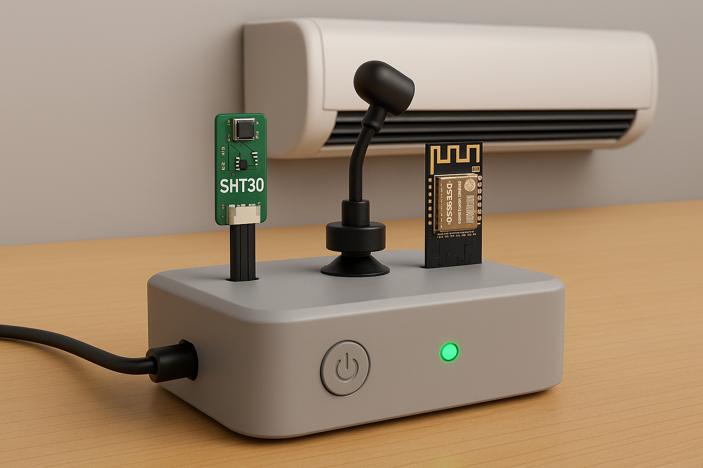

Motivation
Home Appliance Domain:Similarly
legacy AC lack networking capabilities.
By adding smart control gateway
  remote control&web
  intelligent adjustment
  extended lifespan—a cost-effective modernization.
Military Domain:Russia–Ukraine conflict
UMPK kits :
  upgraded Cold War-era FAB bombs
  enabling precision guidance at low cost
Su-34 fighter jets with UMPK(FAB-500M62)
Notes:
“Inspired by cost-effective upgrades in other domains, like UMPK kits for old bombs, we apply similar logic to home appliances. Legacy AC units lack networking and smart features. By adding a smart gateway, we enable remote control, intelligent adjustment, and extend lifespan.”

Slide 3
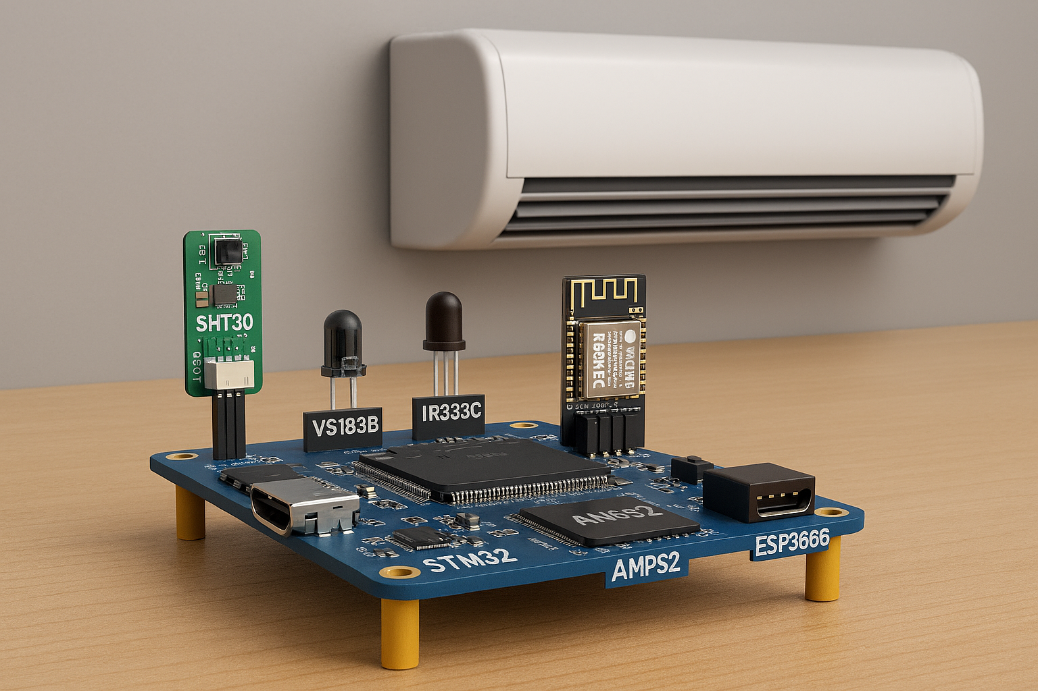
Hardware Modules/simulation
Project Objectives
  Intelligent AC Control Gateway with STM32F407 + FreeRTOS
  Real-time monitoring: temperature & humidity
  Infrared remote control for AC
  Wi-Fi connectivity + web interface (remote access)
  AI-powered temperature suggestions
  QEMU + Python simulation for testing & validation
Hardware
MPS2-AN386 Platform (STM32F407 MCU running FreeRTOS)
SHT30 Sensor – Temperature & humidity monitoring (I2C, 0x44, 400kHz)
VS1838B IR Receiver – NEC protocol signal reception (GPIO PA0, 38kHz)
IR333C IR Transmitter – Infrared control for AC (PWM PA1, 38kHz)
ESP8266 Wi-Fi Module – Wireless connectivity (UART1, 115200 baud)
Interfaces: I2C, UART, PWM, GPIO, HTTP, JSON
Notes:
My system runs on STM32F407 with FreeRTOS. Key modules:
SHT30 sensor for temperature/humidity
IR transmitter/receiver for AC control
ESP8266 for Wi-Fi
Interfaces include I2C, UART, PWM, GPIO.
Simulation uses QEMU plus Python bridge for testing.”

Slide 4
System Tasks
Aspect | Sensor Task | IR Task | Control Task | WiFi Task | Bridge Task
Main Role | Collect environment data | Infrared AC control | System logic & AI suggestion | Network connectivity | External communication
Key Operations | - Read SHT30 via I2C every 2s - Convert raw data - Push SensorData_t | - Receive commands - Encode NEC protocol - Transmit IR signals | - Merge sensor data & user input - Maintain system state - Auto Suggestion: • Spring/Autumn: Outdoor ±1°C • Summer: Outdoor −4°C • Winter: Outdoor +6°C | - Manage ESP8266 via UART - Send AT commands - Monitor link & LED | - Format status as JSON - Send to Python/QEMU - Receive remote commands
Notes:
I designed five tasks:
Sensor Task reads environment data
IR Task sends NEC protocol commands
Control Task merges data and applies AI suggestions
WiFi Task manages ESP8266
Bridge Task handles external communication

Slide 5
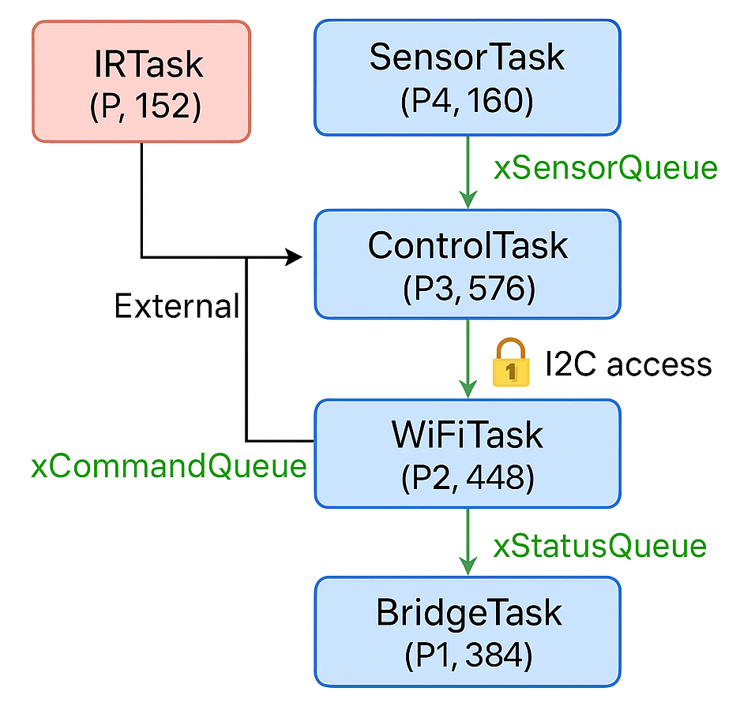
Inter-Task Communication and Synchronization
Communication Mechanisms
FreeRTOS Queues
  xSensorQueue: Sensor → Control / Bridge
  xCommandQueue: External → IR / Control
  xStatusQueue: Control → Bridge
Synchronization
Mutex (xSystemMutex)
  Protects shared resources (I2C bus, global structures)
  Timeout-based acquisition (100 ms) to prevent deadlocks
Communication Patterns:
  Producer-Consumer: Sensor → Control → Bridge
  Synchronous: Mutex + Queue-based messaging
  Asynchronous: Periodic sensor sampling, status broadcasting event-driven commands
Notes:
“Tasks communicate via FreeRTOS queues and mutex.Queues: Sensor → Control → Bridge; External → IRMutex protects I2C and shared resourcesPatterns include producer-consumer, synchronous messaging, and asynchronous updates.”

Slide 6
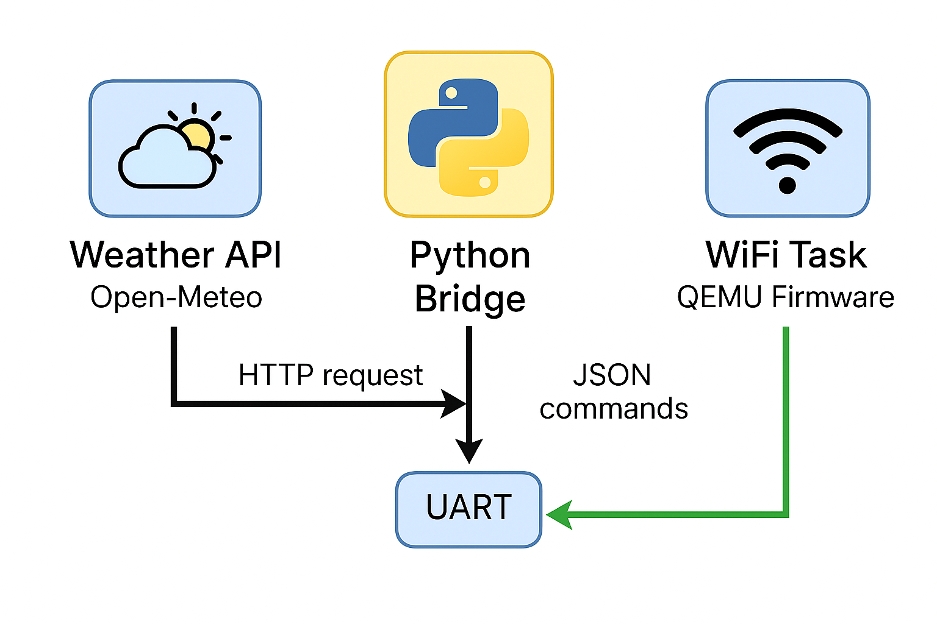
Weather API/WIFI/Web Integration in Simulation
Python Bridge Server acts as middleware between QEMU firmware and the internet
Sends HTTP requests to Open-Meteo API to fetch real-time weather data for Macau
Data Transmission Workflow:
API Call: Bridge Server → Weather API → JSON response
Command Packaging: Bridge Server converts weather suggestion into JSON commands
QEMU Simulation:
  WiFi Task simulates ESP8266 AT command interaction via UART1
  Receives JSON commands from Bridge Server
Notes:
“In simulation, the Python bridge fetches weather data from Open-Meteo API. It sends JSON commands to QEMU via UART. WiFi Task simulates ESP8266 AT commands. This enables AI-based temperature suggestions.”

Slide 7
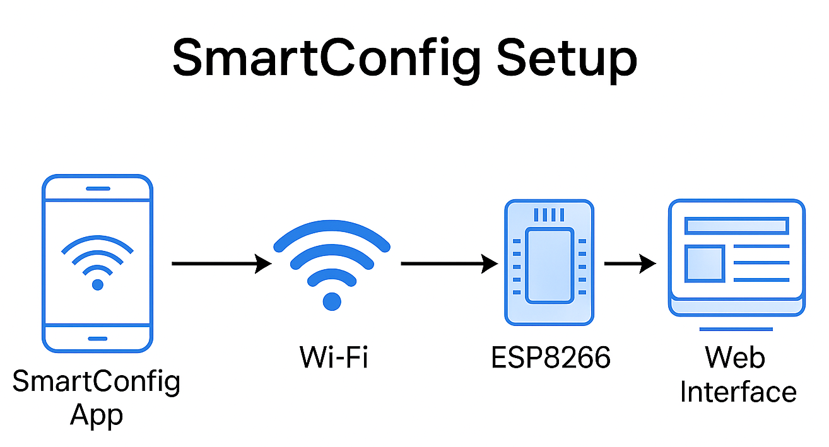
Smart Config Implementation
Connect device to WiFi without hardcoding SSID and password
Steps:
Mobile App: User enters WiFi info and starts SmartConfig.
Broadcast: App sends SSID and password via UDP packets.
ESP8266 Simulation: WiFi Task listens and decodes credentials.
Connect: Module joins WiFi and reports status.
Web Interface: Shows “Connected” and enables remote control.
Key Points:
Easy setup, no firmware changes.
Works in QEMU with AT command emulation.
Notes:
“SmartConfig lets users set Wi-Fi without hardcoding credentials.
Steps:
Mobile app broadcasts SSID and password
ESP8266 listens and connects
Web interface shows ‘Connected’.
This works even in QEMU simulation.”

Slide 8
Web control Panel /Show Demo
Live Status Display
Smart config
Indoor Temperature & Humidity
Outdoor Temperature
Auto Suggested Temperature
Bilingual Interface: Chinese / English
Continuous Updates: Data from QEMU firmware via Bridge Server (JSON over HTTP)
Timer & Scheduling:Auto-Off countdown
Schedule ON/OFF times
Notes:
“The web interface provides real-time status and control:
Power ON/OFF
Temperature and mode settings
Smart features like AI suggestions
Timer and scheduling options.
It’s bilingual and updates continuously.”

Slide 9
Thank You!
Avenida da Universidade, Taipa, Macau, China
Tel : (853) 8822 8833 Fax : (853) 8822 8822
Email : mc55557@um.edu.mo Website : www.um.edu.mo
Notes:
“Thank you for listening! I’m happy to take questions.”

