Slide 1
EE P 564: TinyML
Lab 9: Responsible AI in TinyML
Dept. of Electrical and Computer Engineering
University of Washington
Instructor: Dinuka Sahabandu (sdinuka@uw.edu)

Slide 2

Today’s Lab
Both Software and Hardware Lab!
Training models using TensorFlow-Privacy
Converting model to TensorFlow Lite format
Deploy the model to the Arduino board

Slide 3

Lab 9 – Software - Road Map
Data Processing
Model training using TensorFlow-Privacy
Model Evaluation
Covert the TensorFlow model to TensorFlow Lite Micro model
Compress the model

Slide 4
Lab 9 - Hardware - Road Map
Connect Arduino Boards to your computer
2. Implement converted ML model
3. Deploy the model on to board
4. Open Serial Monitor and test the model

Slide 5
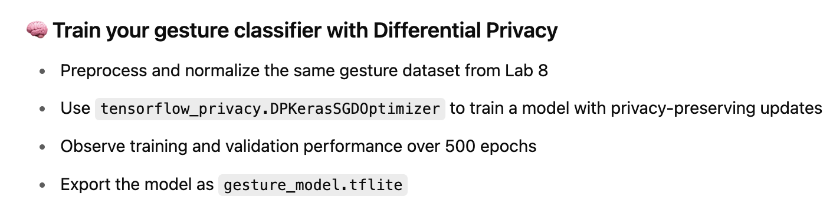
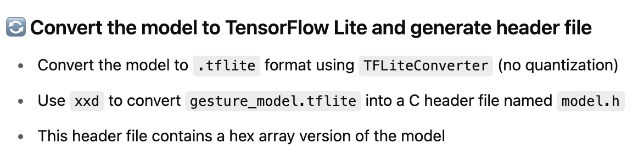
Training the Model with Differential Privacy
Open EEP564-TinyML-Lab9.ipynb in Google Colab to train the model with differential privacy and convert it into a hex array format for deployment.
Included in
EEP564-TinyML-Lab9.ipynb

Slide 6
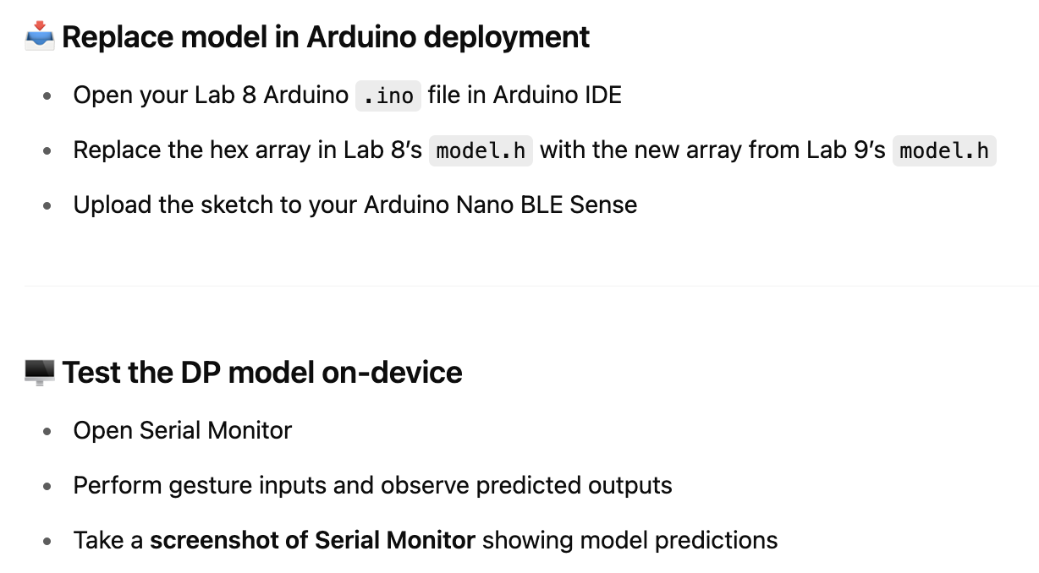
Deploying the Model with Differential Privacy

Slide 7
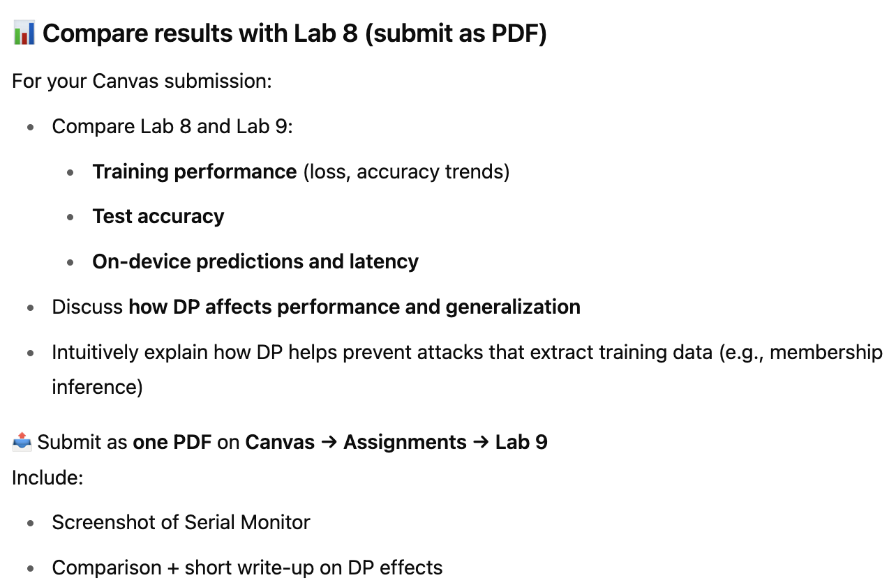
Lab 9 Canvas Submission Details

