Slide 1
EE 400: TinyML
Lab 6: Wizard Magic Wand
Summer 2025
Instructor: Dinuka Sahabandu (sdinuka@uw.edu)
Assistant Teaching Professor
Department of Electrical and Computer Engineering
University of Washington

Slide 2
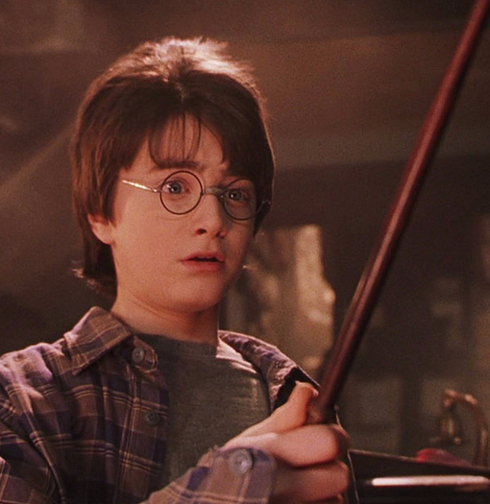
Today’s Lab
Both Software and Hardware Lab!
Gathering data
Training a model to recognize gesture
Finetuning your model using your data
Quantize the model for TinyML
Deploy the model to the Arduino board

Slide 3
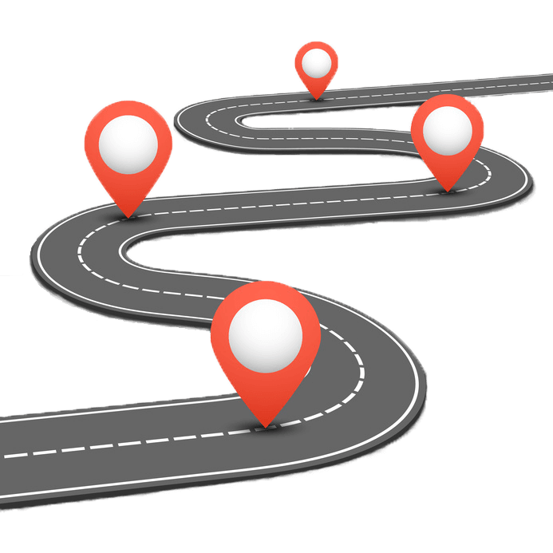
Lab 6 - Software - Road Map
Data Collection using Bluetooth
Labelled the data and Upload it to Google Drive
Rasterize the JSON files to Images
Train a CNN Model
Model Evaluation
Covert the TensorFlow model to TensorFlow Lite Micro model

Slide 4
What you need
Mac, Linux or Windows laptop
Arduino Nano BLE Sense 33
MicroUSB cable
Possibly a USB C to USB A converter, if you’re on a USB C laptop
[Optional] If you really really want to build magic wand …
A stick, about 12 inches (30 cm long)
Sticky tape

Slide 5
Recording Gestures
Connect the board to the webpage using Bluetooth and Chrome’s WebBLE API.
Moving the wand to collect the data.
The gestures are automatically split up by times when the wand is kept still.
Aim for at least 100 clean gestures of each type
Review and remove any sloppy or unrecognizable gestures using the trash can button
Label each gesture with its correct name (e.g., 0 or 1)
Download the reviewed and labeled data as a JSON text file for training purposes
Please refer to “Lab 6 Data Collection Instruction.docx”
provided for this lab in canvas under Files section

Slide 6
Training and Quantize the Model
Now Open EE400_TinyML_Lab6_(Magic_Dataset_Training).ipynb in Colab (in Canvas 🡪 Files 🡪 Labs 🡪 Lab6)
Let’s train our magic wand!

Slide 7
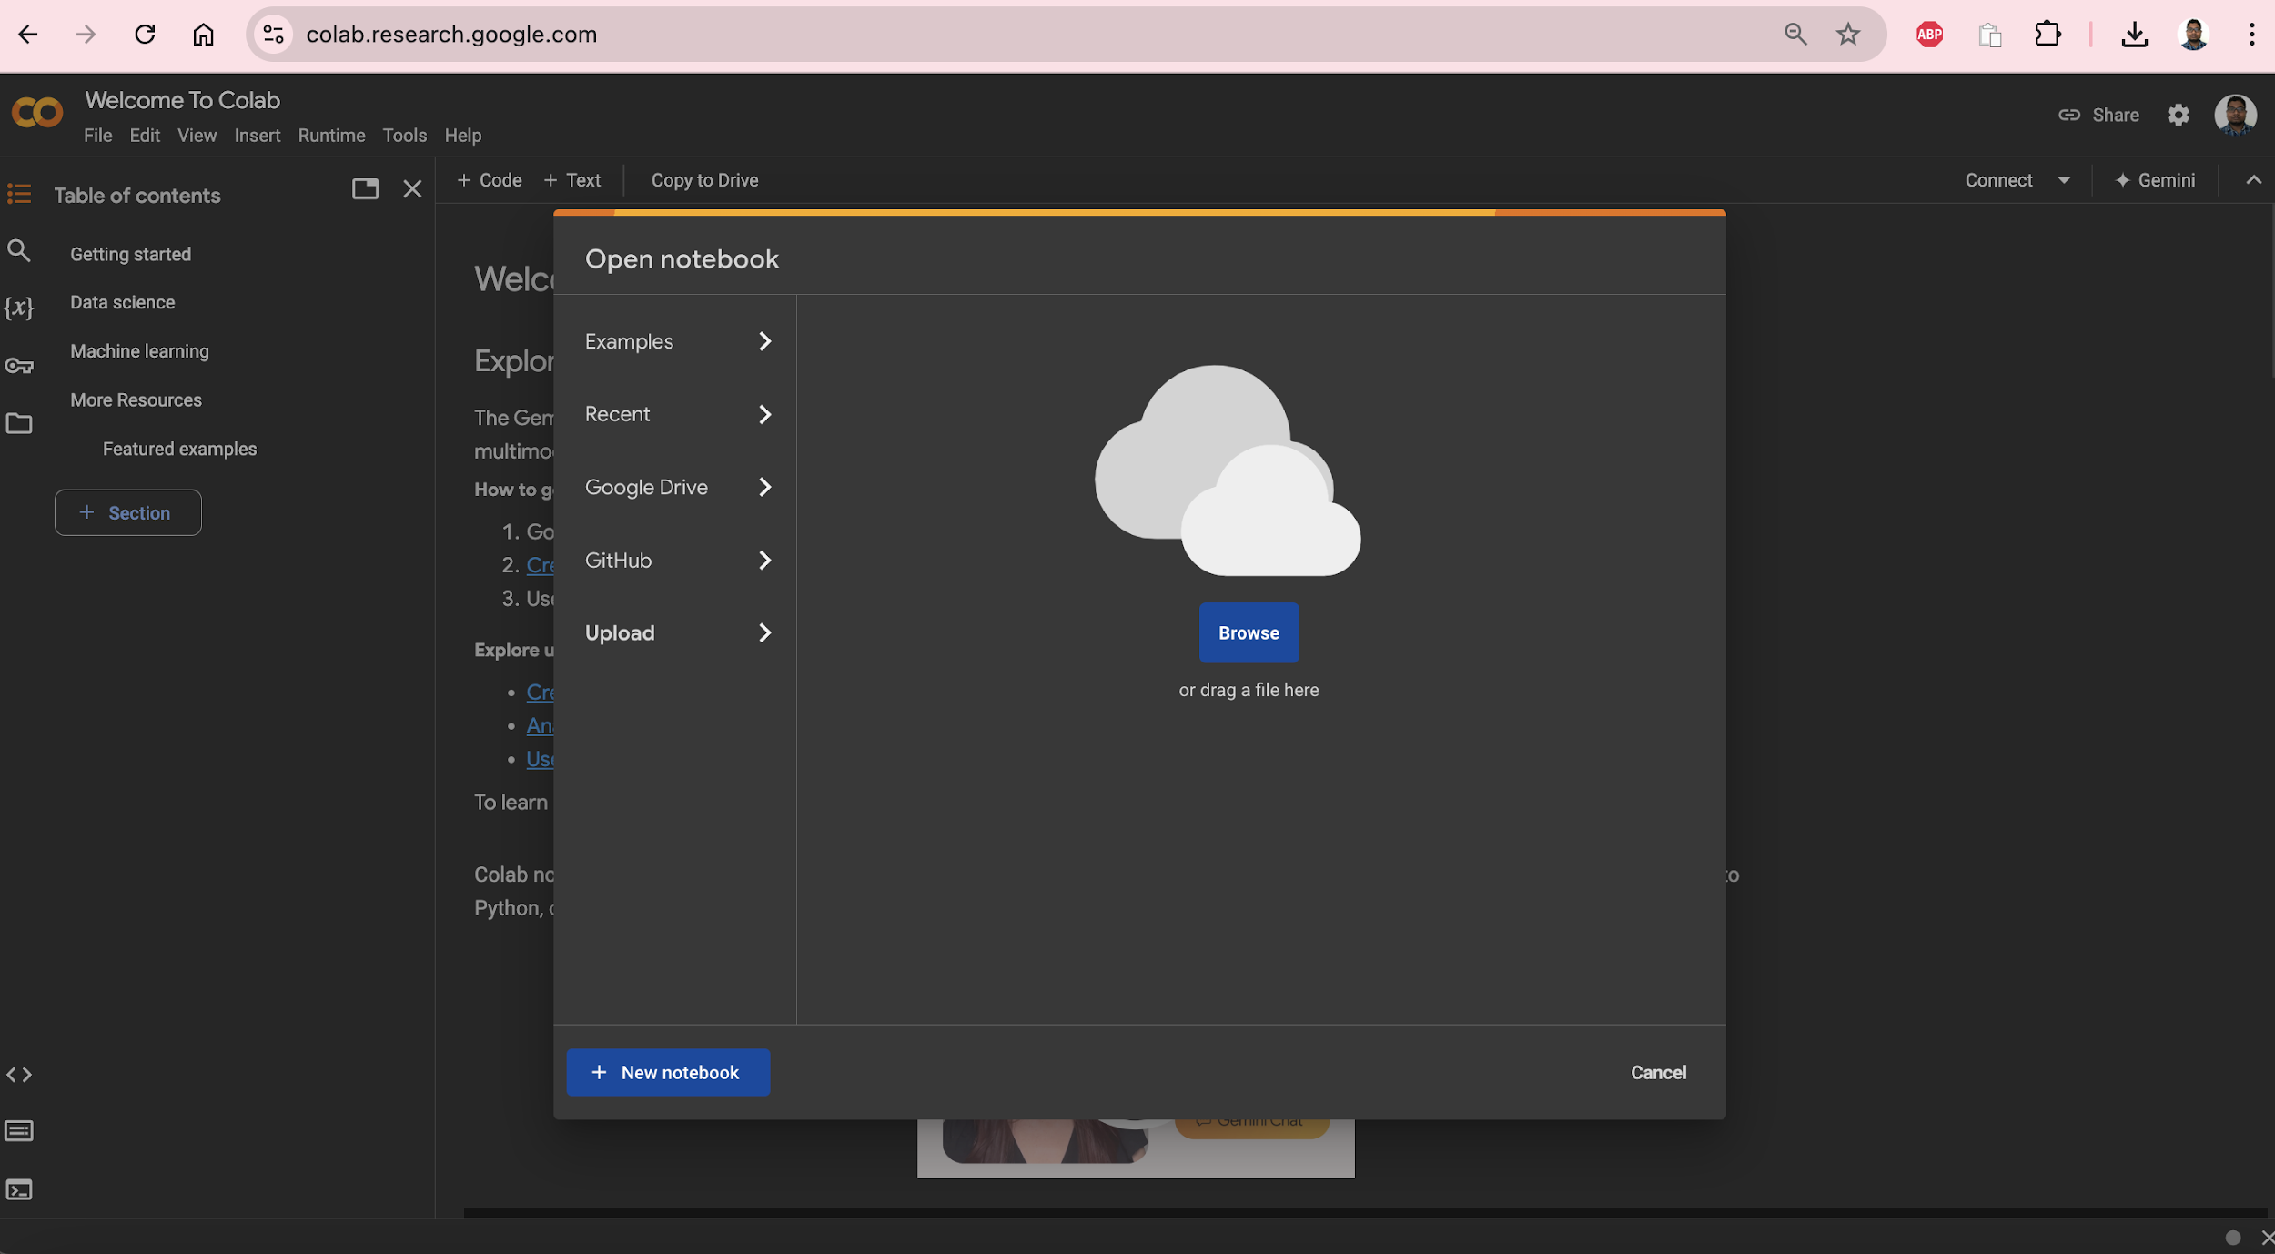
Step 1: Go to https://colab.research.google.com/ Step 2: Click on Upload. Then drag and drop “EE400_TinyML_Lab6_(Magic_Dataset_Training).ipynb”

Slide 8

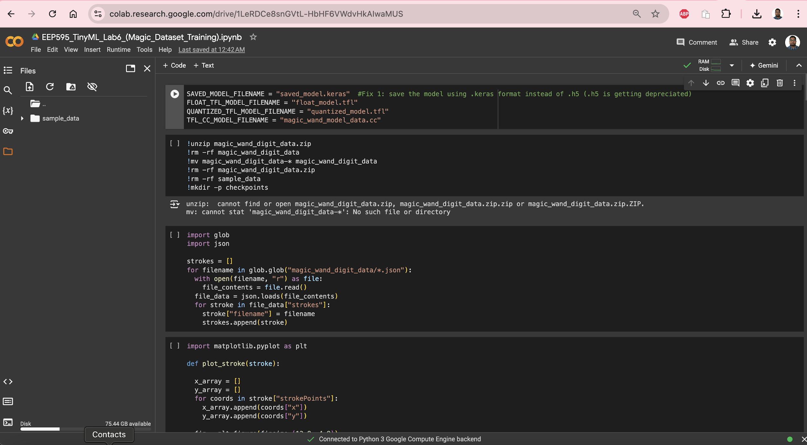
Step 3: Click on the Folder Icon. Then drag and drop “magic_wand_digit_data.zip” Step 4: Run All the Cells in the Notebook

Slide 9
Lab 6 - Hardware - Road Map
Connect Arduino Boards to your computer
2. Open magic wand example
3. Update the model in the example and deploy the model
4. Open Serial Monitor and test the model

Slide 10
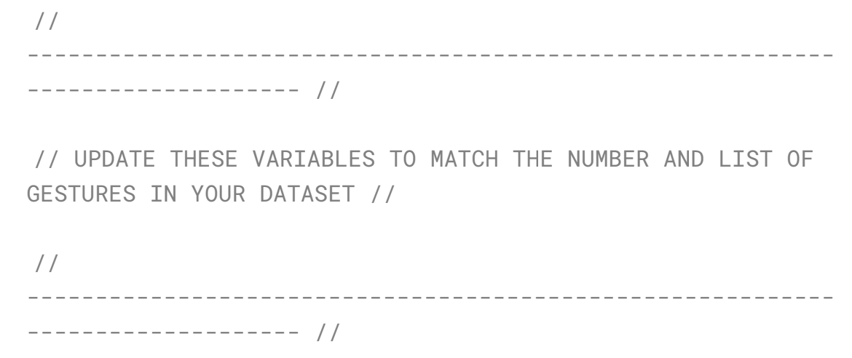
Deploy the Model
1. Use a USB cable to connect the Arduino Nano 33 BLE Sense to your machine. You should see the green LED power indicator come on when the board first receives power.
2. Open the magic_wand.ino sketch, which you can find in the Slack channel.
3. You’ll then need to make two changes to the magic_wand.ino file to alert it of
your number of gestures and gesture labels. These changes occur on lines
55-59, which currently read as:

Slide 11
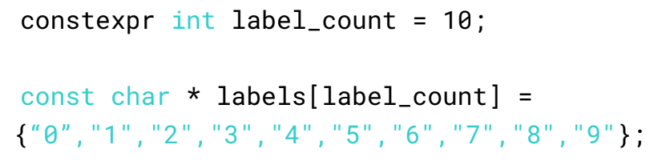
Deploy the Model
a. Update the label_count to reflect the number of gestures in your dataset.
b. Update the list of labels to reflect the gestures in your dataset. Note: the order matters! Make sure it matches the alphanumeric order as printed out in the training script!

Slide 12
Deploy the Model
4. You'll also need to update the model data as we've done with the previous examples. The model data can be found in the magic_wand_model_data.cpp file. As we've done in the past, make sure to only update the binary values and leave the cpp syntax constant.
5. When you save, just like with the KWS examples, you will be asked to save a copy. Again, we suggest that you make a folder called e.g., TinyML inside of your Arduino folder. You can find your main Arduino folder either inside of your Documents folder or in your Home folder, and save it in that folder with a descriptive name like magic_wand_custom. That said, you can save it wherever you like with whatever name you want!

Slide 13
Deploy the Model
6. As always, use the Tools drop-down menu to select the appropriate Port and
Board, and use the rightward arrow to upload / flash the code.
7. Now, open the serial monitor and test out your custom model. As a reminder, the serial monitor will output first ASCII art showing the gesture you just performed and below it will be the best match label as well as a confidence score between -128 and 127. The confidence score indicates how strongly the model believes you performed the gesture. Do note that every time you move the board and then stop, a new gesture will be processed, so don’t be surprised to get some odd results as you move the board to prepare for a gesture.

Slide 14
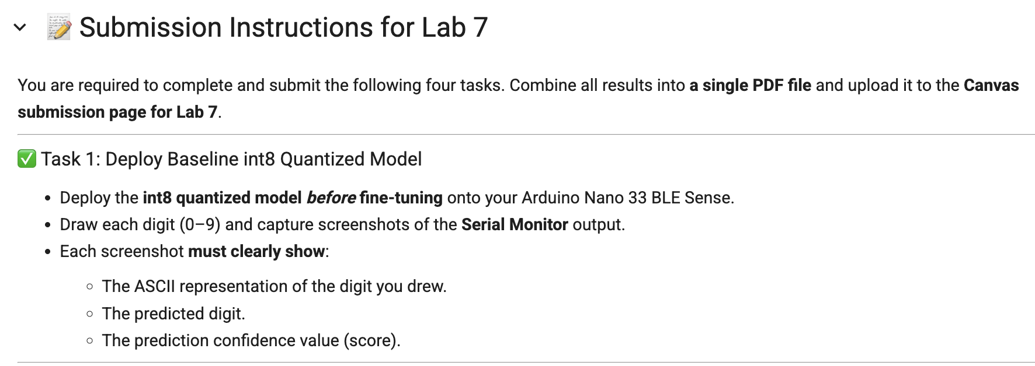
What you Should Submit

Slide 15
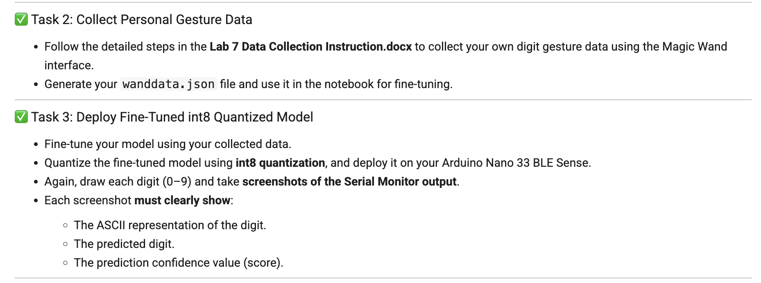
What you Should Submit

Slide 16
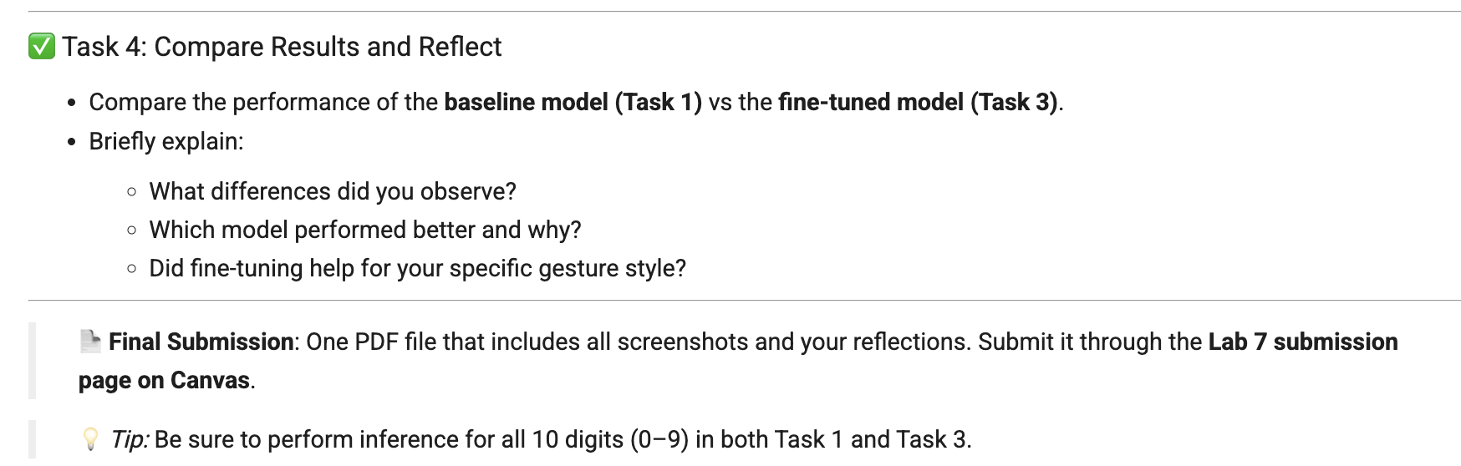
What you Should Submit

