Slide 1
Statistical Relational Learning
Pedro Domingos
Dept. of Computer Science & Eng.
University of Washington

Slide 2
Overview
Motivation
Foundational areas
  Probabilistic inference
  Statistical learning
  Logical inference
  Inductive logic programming
Putting the pieces together
Applications

Slide 3
Motivation
Most learners assume i.i.d. data
(independent and identically distributed)
  One type of object
  Objects have no relation to each other
Real applications:
dependent, variously distributed data
  Multiple types of objects
  Relations between objects

Slide 4
Examples
Web search
Information extraction
Natural language processing
Perception
Medical diagnosis
Computational biology
Social networks
Ubiquitous computing
Etc.

Slide 5
Costs and Benefits of SRL
Benefits
  Better predictive accuracy
  Better understanding of domains
  Growth path for machine learning
Costs
  Learning is much harder
  Inference becomes a crucial issue
  Greater complexity for user

Slide 6
Goal and Progress
Goal:
Learn from non-i.i.d. data as easily
as from i.i.d. data
Progress to date
  Burgeoning research area
  We’re “close enough” to goal
  Easy-to-use open-source software available
Lots of research questions (old and new)

Slide 7
Plan
We have the elements:
  Probability for handling uncertainty
  Logic for representing types, relations,
  and complex dependencies between them
  Learning and inference algorithms for each
Figure out how to put them together
Tremendous leverage on a wide range of applications

Slide 8
Disclaimers
Not a complete survey of statistical
relational learning
Or of foundational areas
Focus is practical, not theoretical
Assumes basic background in logic, probability and statistics, etc.
Please ask questions
Tutorial and examples available at
alchemy.cs.washington.edu

Slide 9
Overview
Motivation
Foundational areas
  Probabilistic inference
  Statistical learning
  Logical inference
  Inductive logic programming
Putting the pieces together
Applications

Slide 10
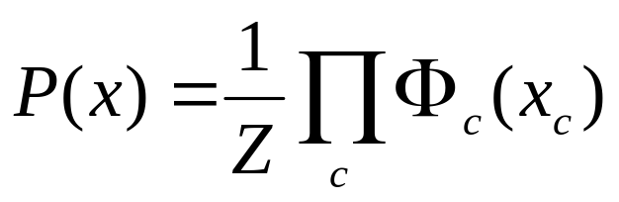
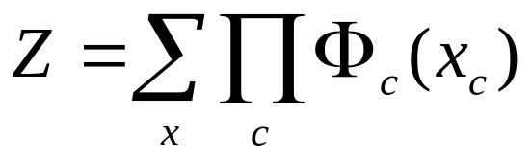
Markov Networks
Undirected graphical models
Smoking
Cancer
Asthma
Cough
Potential functions defined over cliques
Smoking | Cancer | Ф(S,C)
False | False | 4.5
False | True | 4.5
True | False | 2.7
True | True | 4.5

Slide 11
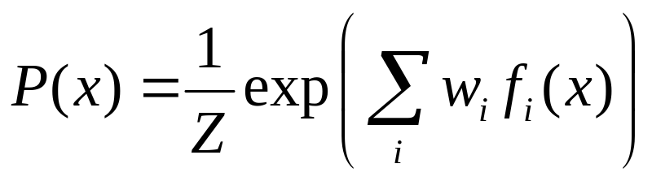
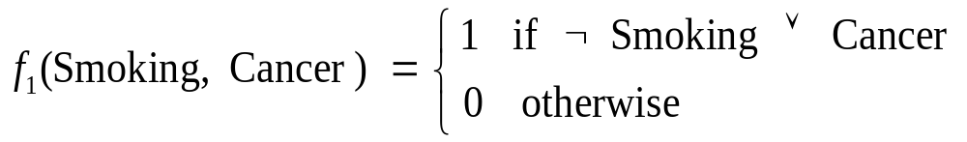

Markov Networks
Undirected graphical models
Smoking
Cancer
Asthma
Cough
Log-linear model:
Weight of Feature i
Feature i

Slide 12
Hammersley-Clifford Theorem
If Distribution is strictly positive (P(x) > 0)
And Graph encodes conditional independences
Then Distribution is product of potentials over cliques of graph
Inverse is also true.
(“Markov network = Gibbs distribution”)

Slide 13
Markov Nets vs. Bayes Nets
Property | Markov Nets | Bayes Nets
Form | Prod. potentials | Prod. potentials
Potentials | Arbitrary | Cond. probabilities
Cycles | Allowed | Forbidden
Partition func. | Z = ? | Z = 1
Indep. check | Graph separation | D-separation
Indep. props. | Some | Some
Inference | MCMC, BP, etc. | Convert to Markov

Slide 14
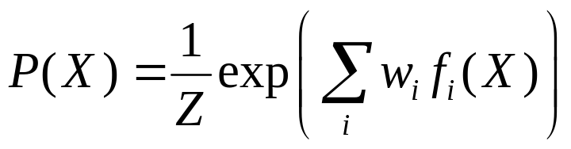
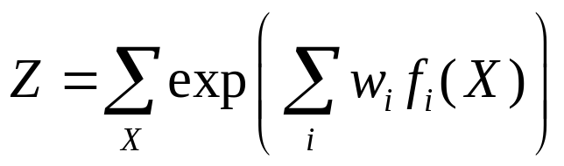
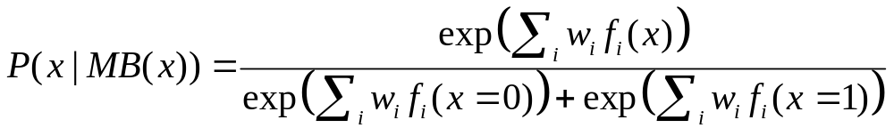
Inference in Markov Networks
Goal: Compute marginals & conditionals of
Exact inference is #P-complete
Conditioning on Markov blanket is easy:
Gibbs sampling exploits this

Slide 15
MCMC: Gibbs Sampling
state ← random truth assignment
for i ← 1 to num-samples do
for each variable x
sample x according to P(x|neighbors(x))
state ← state with new value of x
P(F) ← fraction of states in which F is true

Slide 16
Other Inference Methods
Many variations of MCMC
Belief propagation (sum-product)
Variational approximation
Exact methods

Slide 17
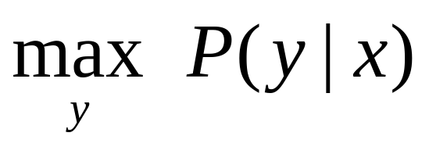
MAP/MPE Inference
Goal: Find most likely state of world given evidence
Query
Evidence

Slide 18
MAP Inference Algorithms
Iterated conditional modes
Simulated annealing
Graph cuts
Belief propagation (max-product)

Slide 19
Overview
Motivation
Foundational areas
  Probabilistic inference
  Statistical learning
  Logical inference
  Inductive logic programming
Putting the pieces together
Applications

Slide 20
Learning Markov Networks
Learning parameters (weights)
  Generatively
  Discriminatively
Learning structure (features)
In this tutorial: Assume complete data
(If not: EM versions of algorithms)

Slide 21
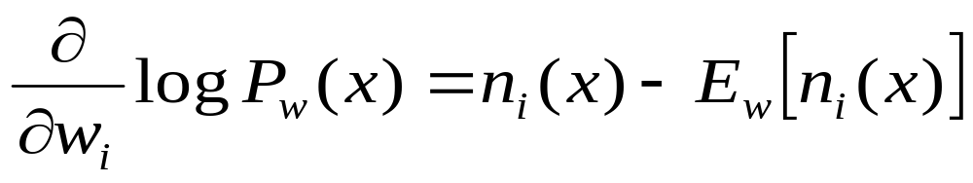
Generative Weight Learning
Maximize likelihood or posterior probability
Numerical optimization (gradient or 2nd order)
No local maxima
Requires inference at each step (slow!)
No. of times feature i is true in data
Expected no. times feature i is true according to model

Slide 22
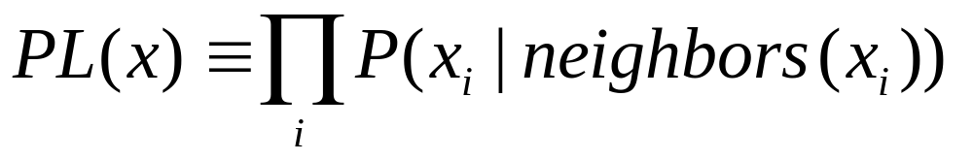
Pseudo-Likelihood
Likelihood of each variable given its neighbors in the data
Does not require inference at each step
Consistent estimator
Widely used in vision, spatial statistics, etc.
But PL parameters may not work well for
long inference chains

Slide 23
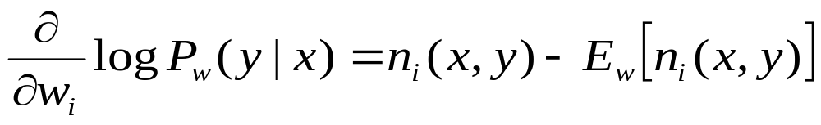
Discriminative Weight Learning
Maximize conditional likelihood of query (y) given evidence (x)
Approximate expected counts by counts in MAP state of y given x
No. of true groundings of clause i in data
Expected no. true groundings according to model

Slide 24
Other Weight Learning Approaches
Generative: Iterative scaling
Discriminative: Max margin

Slide 25
Structure Learning
Start with atomic features
Greedily conjoin features to improve score
Problem: Need to reestimate weights for each new candidate
Approximation: Keep weights of previous features constant

Slide 26
Overview
Motivation
Foundational areas
  Probabilistic inference
  Statistical learning
  Logical inference
  Inductive logic programming
Putting the pieces together
Applications

Slide 27
First-Order Logic
Constants, variables, functions, predicates
E.g.: Anna, x, MotherOf(x), Friends(x, y)
Literal: Predicate or its negation
Clause: Disjunction of literals
Grounding: Replace all variables by constants
E.g.: Friends (Anna, Bob)
World (model, interpretation):
Assignment of truth values to all ground predicates

Slide 28
Inference in First-Order Logic
Traditionally done by theorem proving
(e.g.: Prolog)
Propositionalization followed by model checking turns out to be faster (often a lot)
Propositionalization:
Create all ground atoms and clauses
Model checking: Satisfiability testing
Two main approaches:
  Backtracking (e.g.: DPLL)
  Stochastic local search (e.g.: WalkSAT)

Slide 29
Satisfiability
Input: Set of clauses
(Convert KB to conjunctive normal form (CNF))
Output: Truth assignment that satisfies all clauses, or failure
The paradigmatic NP-complete problem
Solution: Search
Key point:
Most SAT problems are actually easy
Hard region: Narrow range of
#Clauses / #Variables

Slide 30
Backtracking
Assign truth values by depth-first search
Assigning a variable deletes false literals
and satisfied clauses
Empty set of clauses: Success
Empty clause: Failure
Additional improvements:
  Unit propagation (unit clause forces truth value)
  Pure literals (same truth value everywhere)

Slide 31
The DPLL Algorithm
if CNF is empty then
return true
else if CNF contains an empty clause then
return false
else if CNF contains a pure literal x then
return DPLL(CNF(x))
else if CNF contains a unit clause {u} then
return DPLL(CNF(u))
else
choose a variable x that appears in CNF
if DPLL(CNF(x)) = true then return true
else return DPLL(CNF(¬x))

Slide 32
Stochastic Local Search
Uses complete assignments instead of partial
Start with random state
Flip variables in unsatisfied clauses
Hill-climbing: Minimize # unsatisfied clauses
Avoid local minima: Random flips
Multiple restarts

Slide 33
The WalkSAT Algorithm
for i ← 1 to max-tries do
solution = random truth assignment
for j ← 1 to max-flips do
if all clauses satisfied then
return solution
c ← random unsatisfied clause
with probability p
flip a random variable in c
else
flip variable in c that maximizes
number of satisfied clauses
return failure

Slide 34
Overview
Motivation
Foundational areas
  Probabilistic inference
  Statistical learning
  Logical inference
  Inductive logic programming
Putting the pieces together
Applications

Slide 35
Rule Induction
Given: Set of positive and negative examples of some concept
  Example: (x₁, x₂, … , x_{n}, y)
  y: concept (Boolean)
  x₁, x₂, … , x_{n}: attributes (assume Boolean)
Goal: Induce a set of rules that cover all positive examples and no negative ones
  Rule: x_{a} ^ x_{b} ^ … ⇒ y (x_{a}: Literal, i.e., x_{i} or its negation)
  Same as Horn clause: Body ⇒ Head
  Rule r covers example x iff x satisfies body of r
Eval(r): Accuracy, info. gain, coverage, support, etc.

Slide 36
Learning a Single Rule
head ← y
body ← Ø
repeat
for each literal x
r_{x} ← r with x added to body
Eval(r_{x})
body ← body ^ best x
until no x improves Eval(r)
return r

Slide 37
Learning a Set of Rules
R ← Ø
S ← examples
repeat
learn a single rule r
R ← R U { r }
S ← S − positive examples covered by r
until S contains no positive examples
return R

Slide 38
First-Order Rule Induction
y and x_{i} are now predicates with arguments
E.g.: y is Ancestor(x,y), x_{i} is Parent(x,y)
Literals to add are predicates or their negations
Literal to add must include at least one variable
already appearing in rule
Adding a literal changes # groundings of rule
E.g.: Ancestor(x,z) ^ Parent(z,y) ⇒ Ancestor(x,y)
Eval(r) must take this into account
E.g.: Multiply by # positive groundings of rule
still covered after adding literal

Slide 39
Overview
Motivation
Foundational areas
  Probabilistic inference
  Statistical learning
  Logical inference
  Inductive logic programming
Putting the pieces together
Applications

Slide 40
Plethora of Approaches
Knowledge-based model construction
[Wellman et al., 1992]
Stochastic logic programs [Muggleton, 1996]
Probabilistic relational models
[Friedman et al., 1999]
Relational Markov networks [Taskar et al., 2002]
Bayesian logic [Milch et al., 2005]
Markov logic [Richardson & Domingos, 2006]
And many others!

Slide 41
Key Dimensions
Logical language
First-order logic, Horn clauses, frame systems
Probabilistic language
Bayes nets, Markov nets, PCFGs
Type of learning
  Generative / Discriminative
  Structure / Parameters
  Knowledge-rich / Knowledge-poor
Type of inference
  MAP / Marginal
  Full grounding / Partial grounding / Lifted

Slide 42
Knowledge-Based
Model Construction
Logical language: Horn clauses
Probabilistic language: Bayes nets
  Ground atom → Node
  Head of clause → Child node
  Body of clause → Parent nodes
  >1 clause w/ same head → Combining function
Learning: ILP + EM
Inference: Partial grounding + Belief prop.

Slide 43
Stochastic Logic Programs
Logical language: Horn clauses
Probabilistic language:
Probabilistic context-free grammars
  Attach probabilities to clauses
  .Σ Probs. of clauses w/ same head = 1
Learning: ILP + “Failure-adjusted” EM
Inference: Do all proofs, add probs.

Slide 44
Probabilistic Relational Models
Logical language: Frame systems
Probabilistic language: Bayes nets
  Bayes net template for each class of objects
  Object’s attrs. can depend on attrs. of related objs.
  Only binary relations
  No dependencies of relations on relations
Learning:
  Parameters: Closed form (EM if missing data)
  Structure: “Tiered” Bayes net structure search
Inference: Full grounding + Belief propagation

Slide 45
Relational Markov Networks
Logical language: SQL queries
Probabilistic language: Markov nets
  SQL queries define cliques
  Potential function for each query
  No uncertainty over relations
Learning:
  Discriminative weight learning
  No structure learning
Inference: Full grounding + Belief prop.

Slide 46
Bayesian Logic
Logical language: First-order semantics
Probabilistic language: Bayes nets
  BLOG program specifies how to generate relational world
  Parameters defined separately in Java functions
  Allows unknown objects
  May create Bayes nets with directed cycles
Learning: None to date
Inference:
  MCMC with user-supplied proposal distribution
  Partial grounding

Slide 47
Markov Logic
Logical language: First-order logic
Probabilistic language: Markov networks
  Syntax: First-order formulas with weights
  Semantics: Templates for Markov net features
Learning:
  Parameters: Generative or discriminative
  Structure: ILP with arbitrary clauses and MAP score
Inference:
  MAP: Weighted satisfiability
  Marginal: MCMC with moves proposed by SAT solver
  Partial grounding + Lazy inference

Slide 48
Markov Logic
Most developed approach to date
Many other approaches can be viewed as special cases
Main focus of rest of this tutorial

Slide 49
Markov Logic: Intuition
A logical KB is a set of hard constraints
on the set of possible worlds
Let’s make them soft constraints:
When a world violates a formula,
It becomes less probable, not impossible
Give each formula a weight
(Higher weight ⇒ Stronger constraint)

Slide 50
Markov Logic: Definition
A Markov Logic Network (MLN) is a set of pairs (F, w) where
  F is a formula in first-order logic
  w is a real number
Together with a set of constants,
it defines a Markov network with
  One node for each grounding of each predicate in the MLN
  One feature for each grounding of each formula F in the MLN, with the corresponding weight w

Slide 51
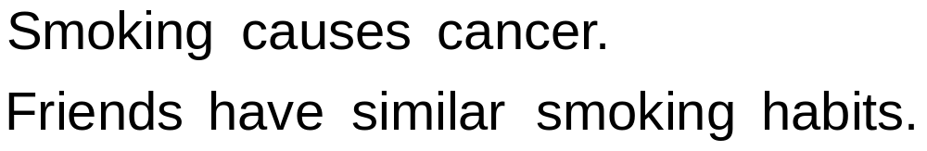
Example: Friends & Smokers

Slide 52
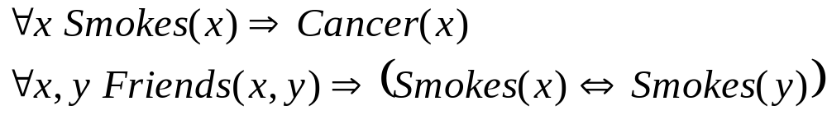
Example: Friends & Smokers

Slide 53

Example: Friends & Smokers

Slide 54
Example: Friends & Smokers
Two constants: Anna (A) and Bob (B)

Slide 55
Example: Friends & Smokers
Two constants: Anna (A) and Bob (B)
Smokes(A)
Smokes(B)
Cancer(A)
Cancer(B)

Slide 56
Example: Friends & Smokers
Two constants: Anna (A) and Bob (B)
Friends(A,B)
Friends(A,A)
Smokes(A)
Smokes(B)
Friends(B,B)
Cancer(A)
Cancer(B)
Friends(B,A)

Slide 57
Example: Friends & Smokers
Two constants: Anna (A) and Bob (B)
Friends(A,B)
Friends(A,A)
Smokes(A)
Smokes(B)
Friends(B,B)
Cancer(A)
Cancer(B)
Friends(B,A)

Slide 58
Example: Friends & Smokers
Two constants: Anna (A) and Bob (B)
Friends(A,B)
Friends(A,A)
Smokes(A)
Smokes(B)
Friends(B,B)
Cancer(A)
Cancer(B)
Friends(B,A)

Slide 59
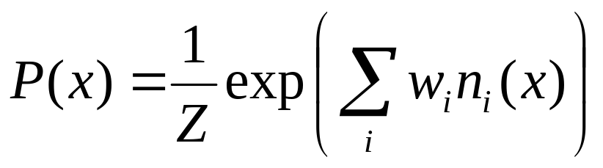
Markov Logic Networks
MLN is template for ground Markov nets
Probability of a world x:
Typed variables and constants greatly reduce size of ground Markov net
Functions, existential quantifiers, etc.
Infinite and continuous domains
Weight of formula i
No. of true groundings of formula i in x

Slide 60
Relation to Statistical Models
Special cases:
  Markov networks
  Markov random fields
  Bayesian networks
  Log-linear models
  Exponential models
  Max. entropy models
  Gibbs distributions
  Boltzmann machines
  Logistic regression
  Hidden Markov models
  Conditional random fields
Obtained by making all predicates zero-arity
Markov logic allows objects to be interdependent
(non-i.i.d.)

Slide 61
Relation to First-Order Logic
Infinite weights ⇒ First-order logic
Satisfiable KB, positive weights ⇒
Satisfying assignments = Modes of distribution
Markov logic allows contradictions between formulas

Slide 62
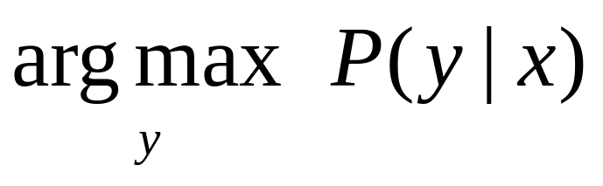
MAP/MPE Inference
Problem: Find most likely state of world given evidence
Query
Evidence

Slide 63
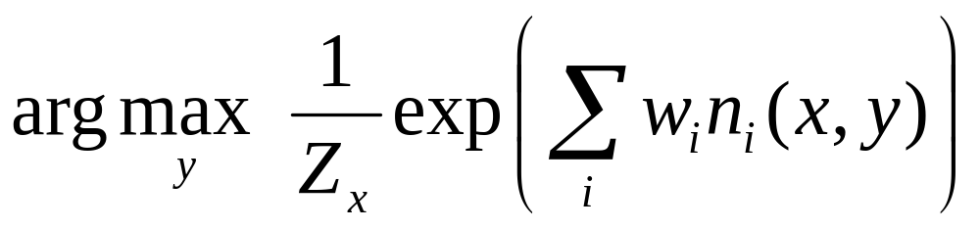
MAP/MPE Inference
Problem: Find most likely state of world given evidence

Slide 64
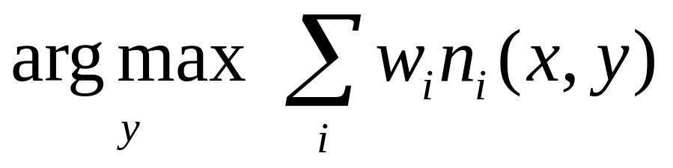
MAP/MPE Inference
Problem: Find most likely state of world given evidence

Slide 65
MAP/MPE Inference
Problem: Find most likely state of world given evidence
This is just the weighted MaxSAT problem
Use weighted SAT solver
(e.g., MaxWalkSAT [Kautz et al., 1997] )
Potentially faster than logical inference (!)

Slide 66
The MaxWalkSAT Algorithm
for i ← 1 to max-tries do
solution = random truth assignment
for j ← 1 to max-flips do
if ∑ weights(sat. clauses) > threshold then
return solution
c ← random unsatisfied clause
with probability p
flip a random variable in c
else
flip variable in c that maximizes
∑ weights(sat. clauses)
return failure, best solution found

Slide 67
But … Memory Explosion
Problem:
If there are n constants
and the highest clause arity is c,
the ground network requires O(n ) memory
Solution:
Exploit sparseness; ground clauses lazily
→ LazySAT algorithm [Singla & Domingos, 2006]
c

Slide 68
Computing Probabilities
P(Formula|MLN,C) = ?
MCMC: Sample worlds, check formula holds
P(Formula1|Formula2,MLN,C) = ?
If Formula2 = Conjunction of ground atoms
  First construct min subset of network necessary to answer query (generalization of KBMC)
  Then apply MCMC (or other)
Can also do lifted inference [Braz et al, 2005]

Slide 69
Ground Network Construction
network ← Ø
queue ← query nodes
repeat
node ← front(queue)
remove node from queue
add node to network
if node not in evidence then
add neighbors(node) to queue
until queue = Ø

Slide 70
But … Insufficient for Logic
Problem:
Deterministic dependencies break MCMC
Near-deterministic ones make it very slow
Solution:
Combine MCMC and WalkSAT
→ MC-SAT algorithm [Poon & Domingos, 2006]

Slide 71
Learning
Data is a relational database
Closed world assumption (if not: EM)
Learning parameters (weights)
Learning structure (formulas)

Slide 72
Weight Learning
Parameter tying: Groundings of same clause
Generative learning: Pseudo-likelihood
Discriminative learning: Cond. likelihood,
use MC-SAT or MaxWalkSAT for inference
No. of times clause i is true in data
Expected no. times clause i is true according to MLN

Slide 73
Structure Learning
Generalizes feature induction in Markov nets
Any inductive logic programming approach can be used, but . . .
Goal is to induce any clauses, not just Horn
Evaluation function should be likelihood
Requires learning weights for each candidate
Turns out not to be bottleneck
Bottleneck is counting clause groundings
Solution: Subsampling

Slide 74
Structure Learning
Initial state: Unit clauses or hand-coded KB
Operators: Add/remove literal, flip sign
Evaluation function:
Pseudo-likelihood + Structure prior
Search: Beam, shortest-first, bottom-up
[Kok & Domingos, 2005; Mihalkova & Mooney, 2007]

Slide 75
Alchemy
Open-source software including:
Full first-order logic syntax
Generative & discriminative weight learning
Structure learning
Weighted satisfiability and MCMC
Programming language features
alchemy.cs.washington.edu

Slide 76
 | Alchemy | Prolog | BUGS
Represent-ation | F.O. Logic + Markov nets | Horn clauses | Bayes nets
Inference | Model check- ing, MC-SAT | Theorem proving | Gibbs sampling
Learning | Parameters & structure | No | Params.
Uncertainty | Yes | No | Yes
Relational | Yes | Yes | No

Slide 77
Overview
Motivation
Foundational areas
  Probabilistic inference
  Statistical learning
  Logical inference
  Inductive logic programming
Putting the pieces together
Applications

Slide 78
Applications
Basics
Logistic regression
Hypertext classification
Information retrieval
Entity resolution
Hidden Markov models
Information extraction
Statistical parsing
Semantic processing
Bayesian networks
Relational models
Robot mapping
Planning and MDPs
Practical tips

Slide 79
Running Alchemy
Programs
  Infer
  Learnwts
  Learnstruct
Options
MLN file
  Types (optional)
  Predicates
  Formulas
Database files

Slide 80
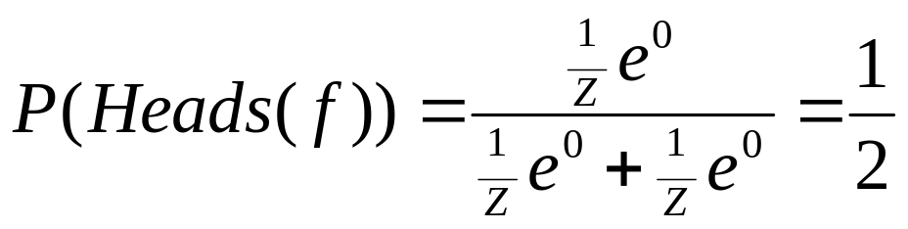
Uniform Distribn.: Empty MLN
Example: Unbiased coin flips
Type: flip = { 1, … , 20 }
Predicate: Heads(flip)

Slide 81
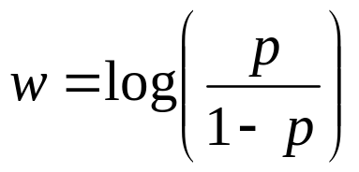
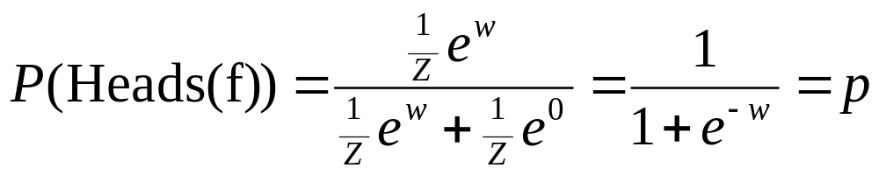
Binomial Distribn.: Unit Clause
Example: Biased coin flips
Type: flip = { 1, … , 20 }
Predicate: Heads(flip)
Formula: Heads(f)
Weight: Log odds of heads:
By default, MLN includes unit clauses for all predicates
(captures marginal distributions, etc.)

Slide 82
Multinomial Distribution
Example: Throwing die
Types: throw = { 1, … , 20 }
face = { 1, … , 6 }
Predicate: Outcome(throw,face)
Formulas: Outcome(t,f) ^ f != f’ => !Outcome(t,f’).
Exist f Outcome(t,f).
Too cumbersome!

Slide 83
Multinomial Distrib.: ! Notation
Example: Throwing die
Types: throw = { 1, … , 20 }
face = { 1, … , 6 }
Predicate: Outcome(throw,face!)
Formulas:
Semantics: Arguments without “!” determine arguments with “!”.
Also makes inference more efficient (triggers blocking).

Slide 84
Multinomial Distrib.: + Notation
Example: Throwing biased die
Types: throw = { 1, … , 20 }
face = { 1, … , 6 }
Predicate: Outcome(throw,face!)
Formulas: Outcome(t,+f)
Semantics: Learn weight for each grounding of args with “+”.

Slide 85
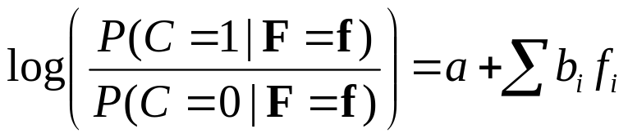
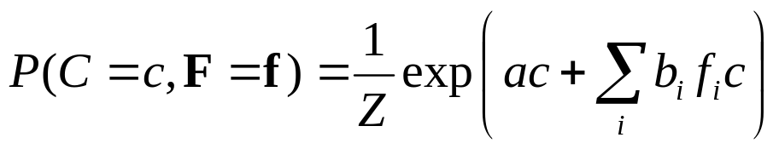
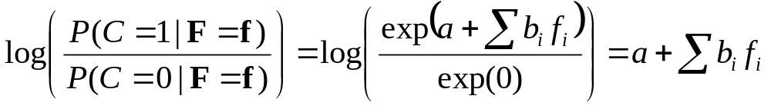
Logistic Regression
Logistic regression:
Type: obj = { 1, ... , n }
Query predicate: C(obj)
Evidence predicates: F_{i}(obj)
Formulas: a C(x)
b_{i} F_{i}(x) ^ C(x)
Resulting distribution:
Therefore:
Alternative form: F_{i}(x) => C(x)

Slide 86
Text Classification
page = { 1, … , n }
word = { … }
topic = { … }
Topic(page,topic!)
HasWord(page,word)
!Topic(p,t)
HasWord(p,+w) => Topic(p,+t)

Slide 87
Text Classification
Topic(page,topic!)
HasWord(page,word)
HasWord(p,+w) => Topic(p,+t)

Slide 88
Hypertext Classification
Topic(page,topic!)
HasWord(page,word)
Links(page,page)
HasWord(p,+w) => Topic(p,+t)
Topic(p,t) ^ Links(p,p') => Topic(p',t)
Cf. S. Chakrabarti, B. Dom & P. Indyk, “Hypertext Classification
Using Hyperlinks,” in Proc. SIGMOD-1998.

Slide 89
Information Retrieval
InQuery(word)
HasWord(page,word)
Relevant(page)
InQuery(w+) ^ HasWord(p,+w) => Relevant(p)
Relevant(p) ^ Links(p,p’) => Relevant(p’)
Cf. L. Page, S. Brin, R. Motwani & T. Winograd, “The PageRank Citation
Ranking: Bringing Order to the Web,” Tech. Rept., Stanford University, 1998.

Slide 90
Entity Resolution
Problem: Given database, find duplicate records
HasToken(token,field,record)
SameField(field,record,record)
SameRecord(record,record)
HasToken(+t,+f,r) ^ HasToken(+t,+f,r’)
=> SameField(f,r,r’)
SameField(f,r,r’) => SameRecord(r,r’)
SameRecord(r,r’) ^ SameRecord(r’,r”)
=> SameRecord(r,r”)
Cf. A. McCallum & B. Wellner, “Conditional Models of Identity Uncertainty
with Application to Noun Coreference,” in Adv. NIPS 17, 2005.

Slide 91
Entity Resolution
Can also resolve fields:
HasToken(token,field,record)
SameField(field,record,record)
SameRecord(record,record)
HasToken(+t,+f,r) ^ HasToken(+t,+f,r’)
=> SameField(f,r,r’)
SameField(f,r,r’) <=> SameRecord(r,r’)
SameRecord(r,r’) ^ SameRecord(r’,r”)
=> SameRecord(r,r”)
SameField(f,r,r’) ^ SameField(f,r’,r”)
=> SameField(f,r,r”)
More: P. Singla & P. Domingos, “Entity Resolution with
Markov Logic”, in Proc. ICDM-2006.

Slide 92
Hidden Markov Models
obs = { Obs1, … , ObsN }
state = { St1, … , StM }
time = { 0, … , T }
State(state!,time)
Obs(obs!,time)
State(+s,0)
State(+s,t) => State(+s',t+1)
Obs(+o,t) => State(+s,t)

Slide 93
Information Extraction
Problem: Extract database from text or
semi-structured sources
Example: Extract database of publications from citation list(s) (the “CiteSeer problem”)
Two steps:
  Segmentation:
  Use HMM to assign tokens to fields
  Entity resolution:
  Use logistic regression and transitivity

Slide 94
Information Extraction
Token(token, position, citation)
InField(position, field, citation)
SameField(field, citation, citation)
SameCit(citation, citation)
Token(+t,i,c) => InField(i,+f,c)
InField(i,+f,c) <=> InField(i+1,+f,c)
f != f’ => (!InField(i,+f,c) v !InField(i,+f’,c))
Token(+t,i,c) ^ InField(i,+f,c) ^ Token(+t,i’,c’)
^ InField(i’,+f,c’) => SameField(+f,c,c’)
SameField(+f,c,c’) <=> SameCit(c,c’)
SameField(f,c,c’) ^ SameField(f,c’,c”) => SameField(f,c,c”)
SameCit(c,c’) ^ SameCit(c’,c”) => SameCit(c,c”)

Slide 95
Information Extraction
Token(token, position, citation)
InField(position, field, citation)
SameField(field, citation, citation)
SameCit(citation, citation)
Token(+t,i,c) => InField(i,+f,c)
InField(i,+f,c) ^ !Token(“.”,i,c) <=> InField(i+1,+f,c)
f != f’ => (!InField(i,+f,c) v !InField(i,+f’,c))
Token(+t,i,c) ^ InField(i,+f,c) ^ Token(+t,i’,c’)
^ InField(i’,+f,c’) => SameField(+f,c,c’)
SameField(+f,c,c’) <=> SameCit(c,c’)
SameField(f,c,c’) ^ SameField(f,c’,c”) => SameField(f,c,c”)
SameCit(c,c’) ^ SameCit(c’,c”) => SameCit(c,c”)
More: H. Poon & P. Domingos, “Joint Inference in Information
Extraction”, in Proc. AAAI-2007.

Slide 96
Statistical Parsing
Input: Sentence
Output: Most probable parse
PCFG: Production rules
with probabilities
  E.g.: 0.7 NP → N
  0.3 NP → Det N
WCFG: Production rules
with weights (equivalent)
Chomsky normal form:
A → B C or A → a
S
VP
NP
NP
V
N
Det
N
John ate the pizza

Slide 97
Statistical Parsing
Evidence predicate: Token(token,position)
  E.g.: Token(“pizza”, 3)
Query predicates: Constituent(position,position)
  E.g.: NP(2,4)
For each rule of the form A → B C:
Clause of the form B(i,j) ^ C(j,k) => A(i,k)
  E.g.: NP(i,j) ^ VP(j,k) => S(i,k)
For each rule of the form A → a:
Clause of the form Token(a,i) => A(i,i+1)
  E.g.: Token(“pizza”, i) => N(i,i+1)
For each nonterminal:
Hard formula stating that exactly one production holds
MAP inference yields most probable parse

Slide 98
Semantic Processing
Weighted definite clause grammars:
Straightforward extension
Combine with entity resolution:
NP(i,j) => Entity(+e,i,j)
Word sense disambiguation:
Use logistic regression
Semantic role labeling:
Use rules involving phrase predicates
Building meaning representation:
Via weighted DCG with lambda calculus
(cf. Zettlemoyer & Collins, UAI-2005)
Another option:
Rules of the form Token(a,i) => Meaning
and MeaningB ^ MeaningC ^ … => MeaningA
Facilitates injecting world knowledge into parsing

Slide 99
Semantic Processing
Example: John ate pizza.
Grammar: S → NP VP VP → V NP V → ate
NP → John NP → pizza
Token(“John”,0) => Participant(John,E,0,1)
Token(“ate”,1) => Event(Eating,E,1,2)
Token(“pizza”,2) => Participant(pizza,E,2,3)
Event(Eating,e,i,j) ^ Participant(p,e,j,k)
^ VP(i,k) ^ V(i,j) ^ NP(j,k) => Eaten(p,e)
Event(Eating,e,j,k) ^ Participant(p,e,i,j)
^ S(i,k) ^ NP(i,j) ^ VP(j,k) => Eater(p,e)
Event(t,e,i,k) => Isa(e,t)
Result: Isa(E,Eating), Eater(John,E), Eaten(pizza,E)

Slide 100
Bayesian Networks
Use all binary predicates with same first argument (the object x).
One predicate for each variable A: A(x,v!)
One clause for each line in the CPT and
value of the variable
Context-specific independence:
One Horn clause for each path in the decision tree
Logistic regression: As before
Noisy OR: Deterministic OR + Pairwise clauses

Slide 101
Relational Models
Knowledge-based model construction
  Allow only Horn clauses
  Same as Bayes nets, except arbitrary relations
  Combin. function: Logistic regression, noisy-OR or external
Stochastic logic programs
  Allow only Horn clauses
  Weight of clause = log(p)
  Add formulas: Head holds => Exactly one body holds
Probabilistic relational models
  Allow only binary relations
  Same as Bayes nets, except first argument can vary

Slide 102
Relational Models
Relational Markov networks
  SQL → Datalog → First-order logic
  One clause for each state of a clique
  * syntax in Alchemy facilitates this
Bayesian logic
  Object = Cluster of similar/related observations
  Observation constants + Object constants
  Predicate InstanceOf(Obs,Obj) and clauses using it
Unknown relations: Second-order Markov logic
S. Kok & P. Domingos, “Statistical Predicate Invention”, in
Proc. ICML-2007. (Tomorrow at 3:15pm in Austin Auditorium)

Slide 103
Robot Mapping
Input:
Laser range finder segments (x_{i}, y_{i}, x_{f}, y_{f})
Outputs:
  Segment labels (Wall, Door, Other)
  Assignment of wall segments to walls
  Position of walls (x_{i}, y_{i}, x_{f}, y_{f})

Slide 104
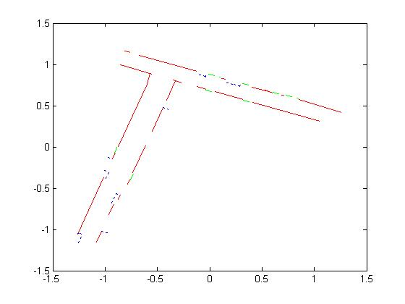
Robot Mapping

Slide 105
MLNs for Hybrid Domains
Allow numeric properties of objects as nodes
  E.g.: Length(x), Distance(x,y)
Allow numeric terms as features
  E.g.: –(Length(x) – 5.0)²
  (Gaussian distr. w/ mean = 5.0 and variance = 1/(2w))
Allow α = β as shorthand for –(α – β)²
  E.g.: Length(x) = 5.0
Etc.

Slide 106
Robot Mapping
SegmentType(s,+t) => Length(s) = Length(+t)
SegmentType(s,+t) => Depth(s) = Depth(+t)
Neighbors(s,s’) ^ Aligned(s,s’) =>
(SegType(s,+t) <=> SegType(s’,+t))
!PreviousAligned(s) ^ PartOf(s,l) => StartLine(s,l)
StartLine(s,l) => Xi(s) = Xi(l) ^ Yi(s) = Yi(l)
PartOf(s,l) => =
Etc.
Cf. B. Limketkai, L. Liao & D. Fox, “Relational Object Maps for
Mobile Robots”, in Proc. IJCAI-2005.
Yf(s)-Yi(s) Yi(s)-Yi(l)
Xf(s)-Xi(s) Xi(s)-Xi(l)

Slide 107
Planning and MDPs
Classical planning
Formulate as satisfiability in the usual way
Actions with uncertain effects
Give finite weights to action axioms
Sensing actions
Add clauses relating sensor readings to world states
Relational Markov Decision Processes
  Assign utility weights to clauses (coming soon!)
  Maximize expected sum of weights of satisfied utility clauses
  Classical planning is special case:
  Exist t GoalState(t)

Slide 108
Practical Tips
Add all unit clauses (the default)
Implications vs. conjunctions
Open/closed world assumptions
How to handle uncertain data:
R(x,y) => R’(x,y) (the “HMM trick”)
Controlling complexity
  Low clause arities
  Low numbers of constants
  Short inference chains
Use the simplest MLN that works
Cycle: Add/delete formulas, learn and test

Slide 109
Summary
Most domains are non-i.i.d.
Much progress in recent years
SRL mature enough to be practical tool
Many old and new research issues
Check out the Alchemy Web site:
alchemy.cs.washington.edu

