Slide 1

Data For Good 2025

Slide 2
Executive Summary
Check in on each student-mentor pair within 50 days of starting the mentorship
Offer study support to each mentee over the Christmas period, even if the mentee only requires “professional” help
Recommend that mentees meet their mentors at least once a week
Provide extra support to students studying: Political Science, Art & Design, and International Relations

Slide 3
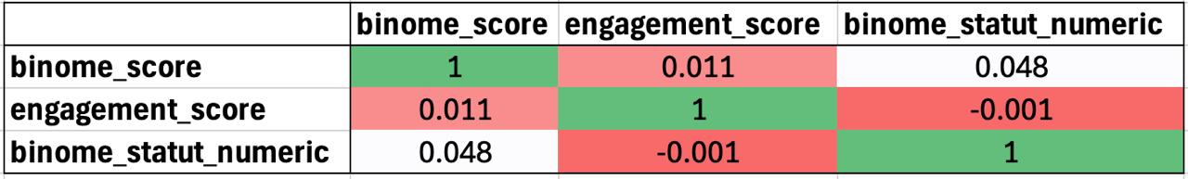
Challenge 1: How to monitor and act on mentee falloff?
Why are mentees disengaging?
Insight 1: Pairing score and Mentee engagement are not indicative of whether individuals in the mentorship programme will last.
So what is making them disengage?

Slide 4
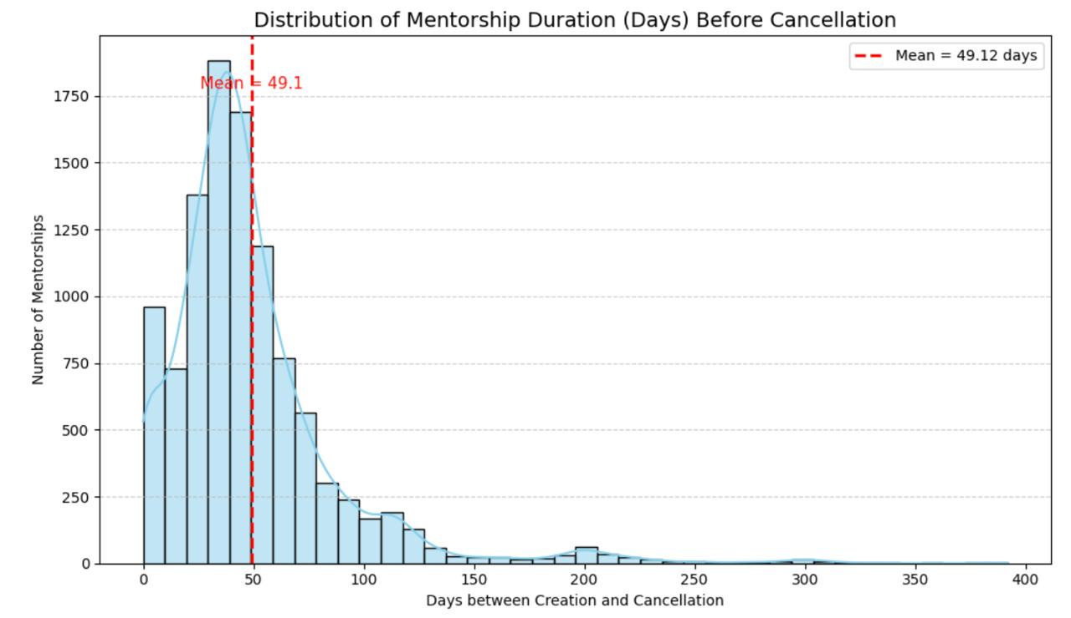
Challenge 1: How to monitor and act on mentee falloff?
Reccomendation: Check in on each student-mentor pair within 50 days of starting the mentorship

Slide 5
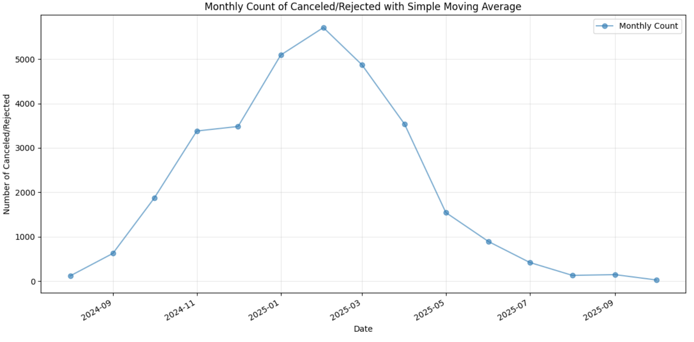
Challenge 1: How to monitor and act on mentee falloff?
Recommendation: Offer study support to each mentee over the Christmas period, even if the mentee only requires “professional” help
Notes:
French uni exams in Jan. 53% pro help only

Slide 6
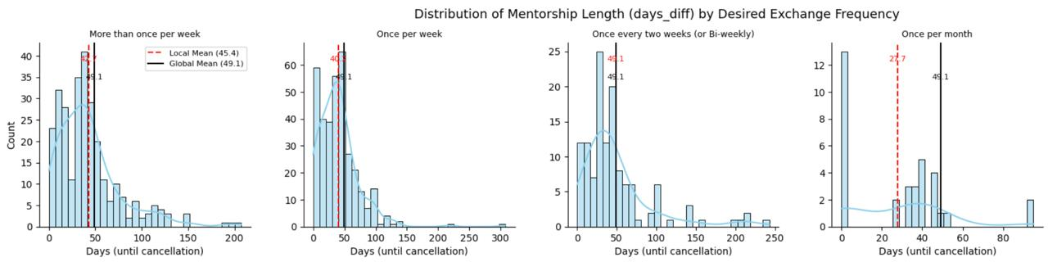
Challenge 1: How to monitor and act on mentee falloff?
Recommendation: Recommend that mentees meet their mentors at least once a week
Notes:
French uni exams in Jan

Slide 7
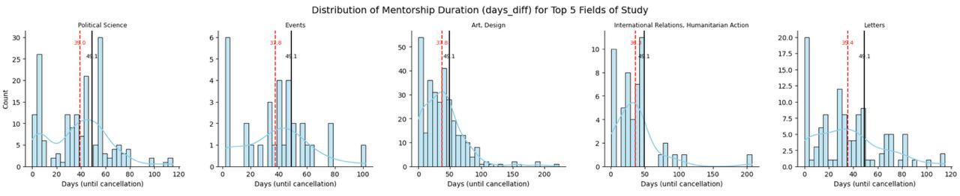
Challenge 1: How to monitor and act on mentee falloff?
Recommendation: Provide extra support to students studying: Political Science, Art & Design, and International Relations
Notes:
French uni exams in Jan

Slide 8
Challenge 2: An effective matching algorithm
Our main design philosophy:
INTERPRETABILITY

Slide 9
Challenge 2
DEMO

Slide 10
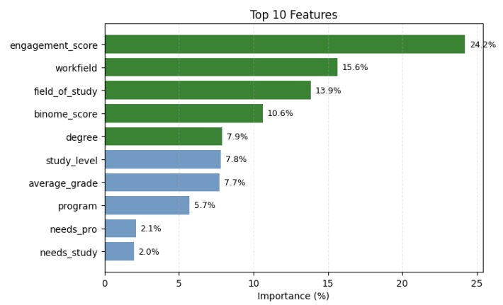
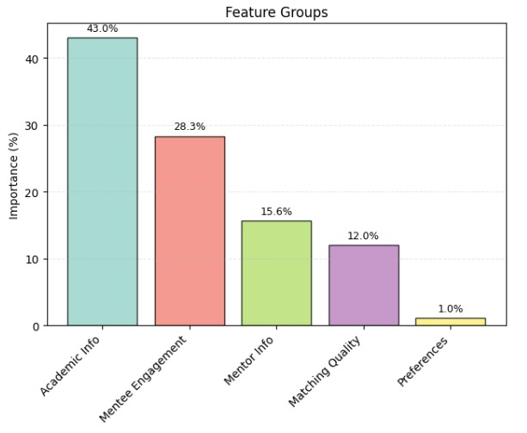
Challenge 2: An effective matching algorithm
Model Performance (Random Forest): 75%

Slide 11
Next Steps
Improved data collection
Meetings remote or in person
Age
Location
In-between distance
Updated form
Reward mechanisms for mentors
Notes:
Meetings remote or in person
Age
Location
In-between distance
Upgraded form
Reward mechanisms for mentors

Slide 12
Questions?

