Slide 1
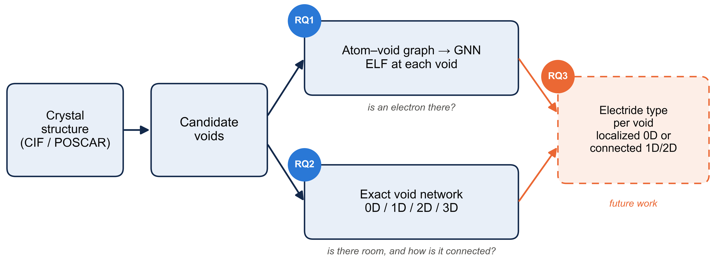
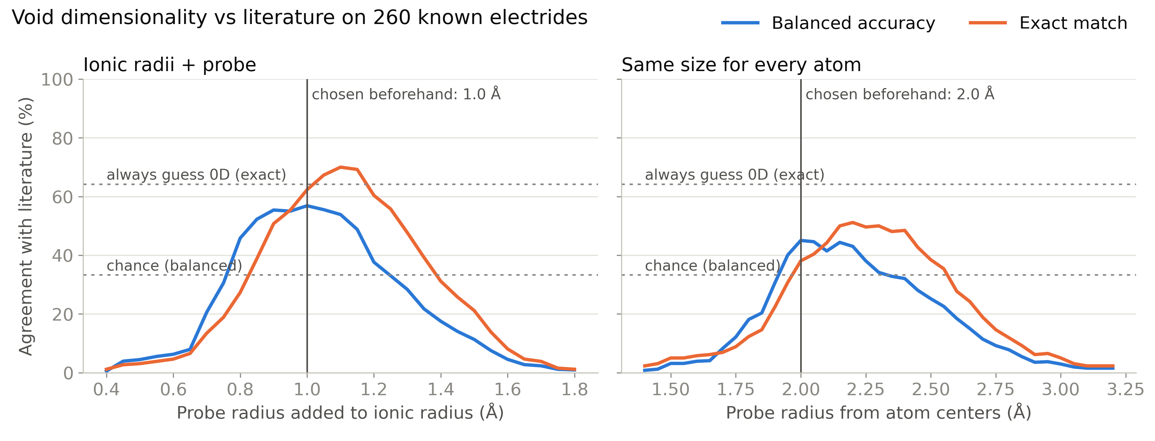
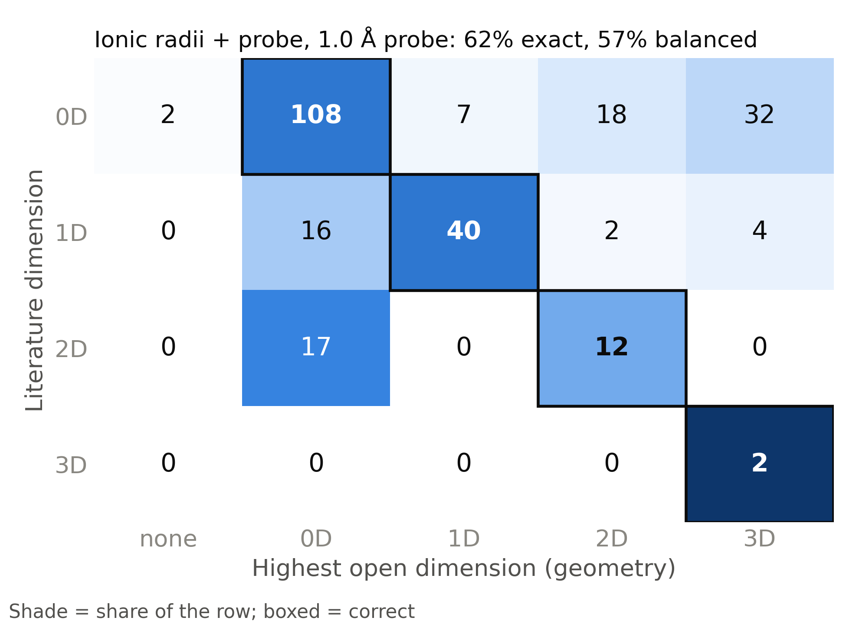
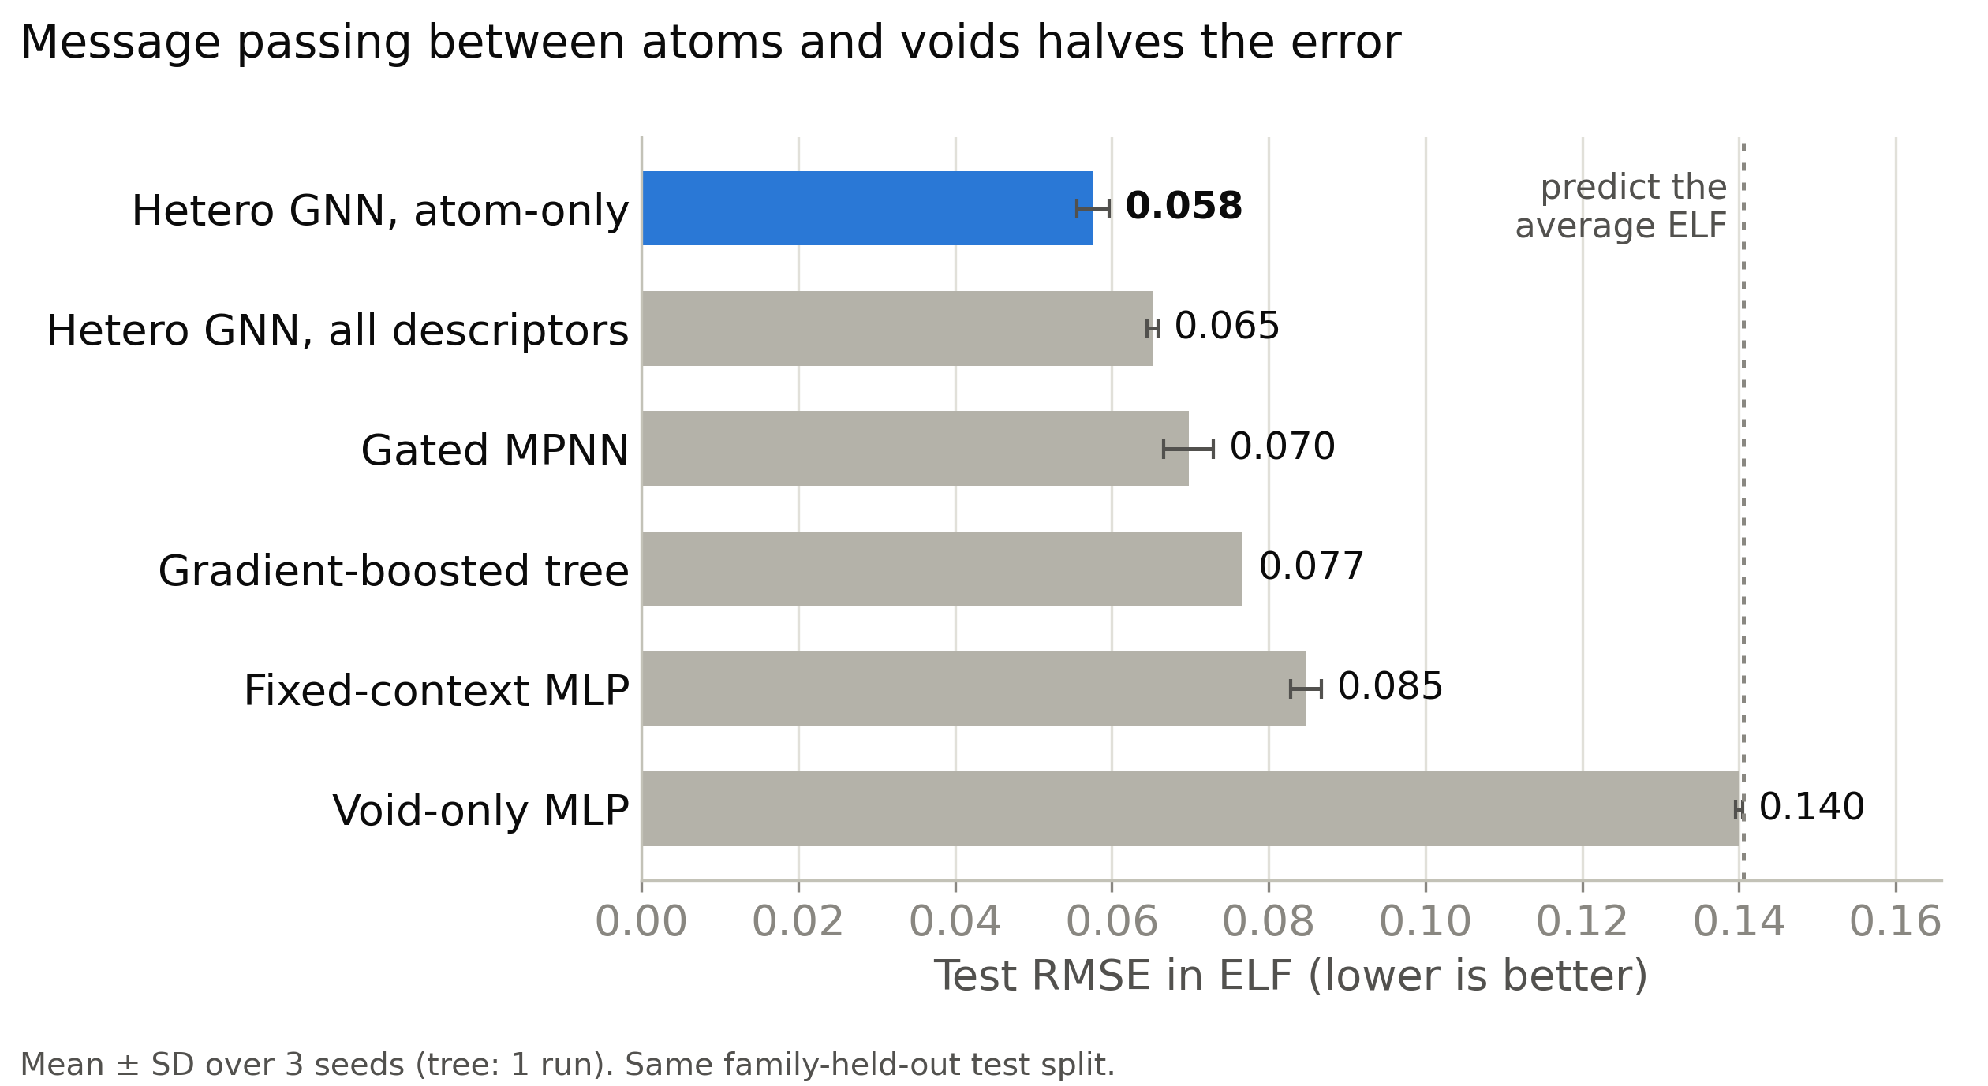
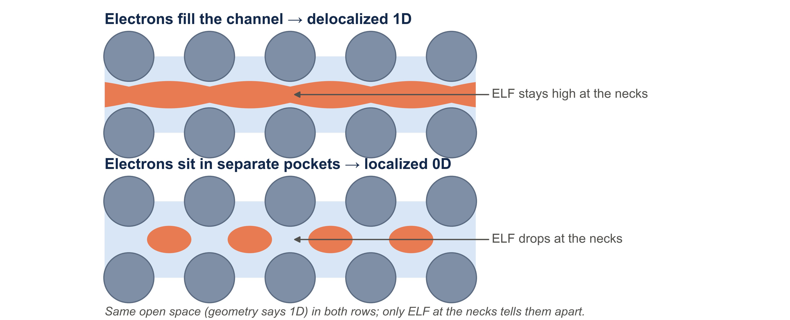
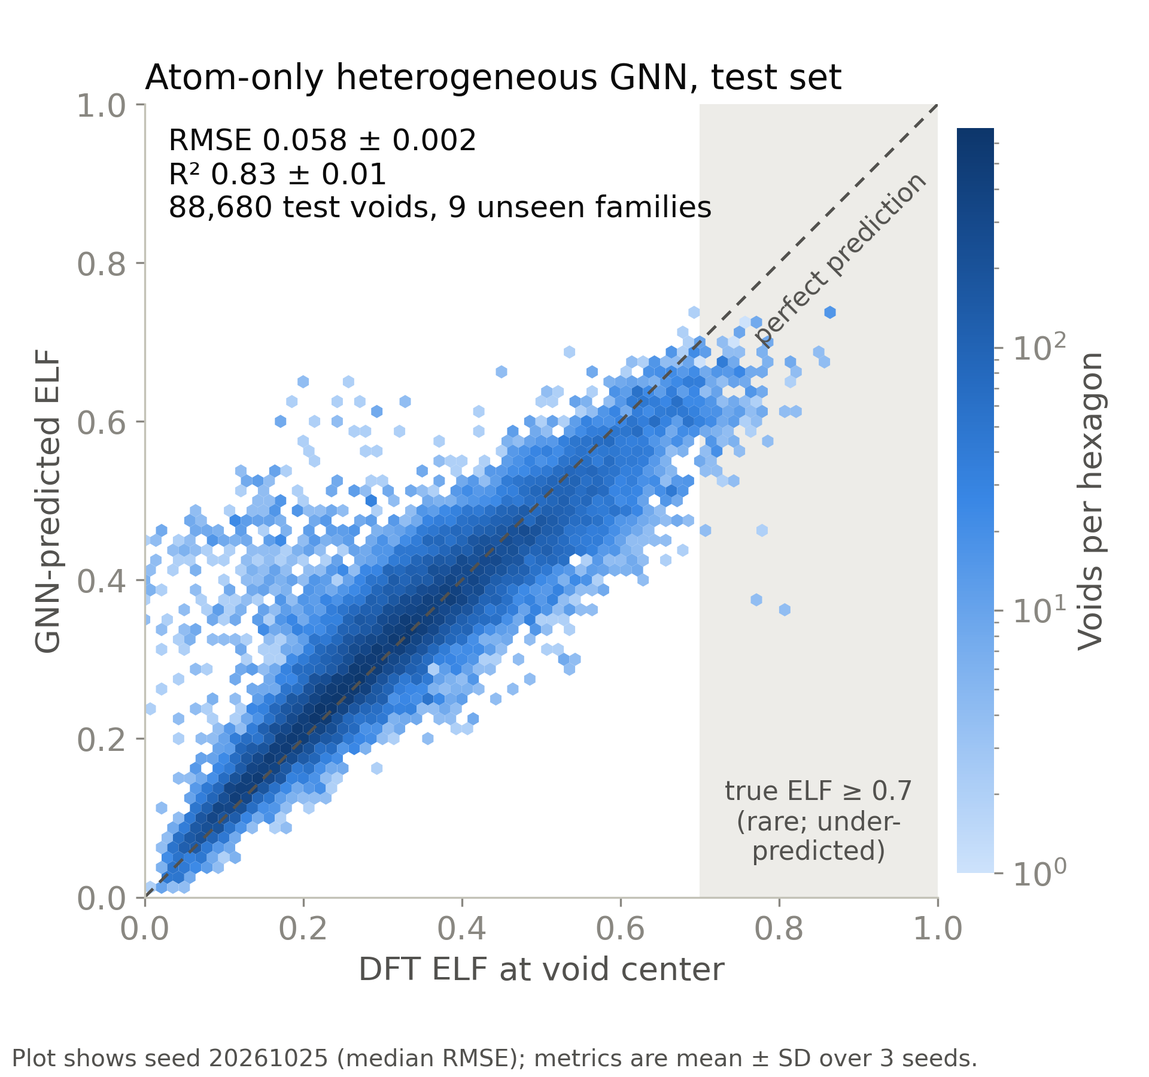
Where Do the Extra Electrons Go?
TO DO: logo
TO DO: QR code (repo or contact)
Predicting interstitial electron localization and void dimensionality for electride screening
Andrew Weiland · [Advisor name] · [Department], Purdue University · [email]
Background
Approach
RQ2
Can geometry alone find dimensionality?
Electrides are crystals whose extra electrons sit in the empty space between atoms and act as anions.
How those electrons connect sets their properties: isolated 0D cages, 1D channels, or 2D layers.
ELF (electron localization function, 0–1): a high value in a void marks a trapped electron, the electride fingerprint.
Finding them needs a DFT calculation per crystal: too slow to screen large databases.
On 260 known electrides: 57% balanced accuracy (chance 33%)
Cations (+) with electrons (e⁻) in the empty space between them.
Voids: Voronoi interstitials plus points farthest from atoms, expanded by symmetry.
GNN: atoms and candidate voids are both nodes joined by distance edges; message passing predicts ELF at each void.
Void network: each atom blocks a sphere (ionic radius + 1.0 Å probe); an exact power-diagram network counts how many directions the open space repeats through the crystal.
"Atom-only" means the explicit void descriptors are zeroed; the void nodes and atom–void message passing remain.
Ionic radii beat one size for all atoms (57% vs 45%).
The right dimension appears at some probe for 99%: one probe can't fit every material.
Main miss: 50 of 167 0D electrides look 2D/3D. The space connects; the electrons don't.
TO DO: VESTA render: 0D cages (mayenite), open space at isosurface 0.5
TO DO: VESTA render: 1D channels (Y5Si3), open space at isosurface 0.5
TO DO: VESTA render: 2D layers (Ca2N), open space at isosurface 0.5
RQ1
Can a GNN predict ELF at voids?
Learning from the surrounding atoms predicts void ELF: RMSE ≈ 0.06, R² ≈ 0.82 in the confirmation study
Literature labels come from computational screens (JACS 2023, Matter 2019, Chem. Mater. 2018), compiled with AI-assisted search; not fully hand-checked.
Research questions
RQ1
Can a GNN predict ELF at candidate voids from crystal structure and atomic environment?
RQ3
Putting them together (proposed)
RQ2
Can geometry alone recover the dimensionality associated with known electrides?
RQ3
How do the two combine into an electride screen?
Data
A void alone predicts nearly nothing: RMSE 0.140.
Atom–void message passing beats fixed atom summaries (0.065 vs 0.077–0.085).
Best features: atomic descriptors plus graph geometry; explicit void descriptors did not help.
Limitation: rare very-high-ELF voids (≥ 0.7) are under-predicted.
50,000 DFT structures with ELF (ELFNet): metal frameworks from high-pressure hydrides.
Split by family: 40,031 train · 4,969 validation · 5,000 test from 9 unseen families.
260 known electrides with literature dimensionality for testing RQ2.
Conclusions and next steps
References
Void ELF can be predicted from crystal structure and atomic environment (R² ≈ 0.82).
Geometry recovers the dimensionality associated with known electrides above balanced chance; its errors show where ELF is needed.
Together, these components establish a screening foundation, not yet a validated crystal-level classifier.
Run DFT on known electrides to test the GNN on real ones.
Predict ELF at void necks → electronic dimensionality.
Crystal-level electride score; test on unseen compositions.
TO DO: final reference list: ELF (Becke & Edgecombe 1990), ELFNet dataset, electride screens (Burton 2018, Zhu 2019, JACS 2023 magnetic electrides), Zeo++ (Willems 2012); acknowledgements (advisor, funding, Purdue RCAC Negishi)

Slide 2
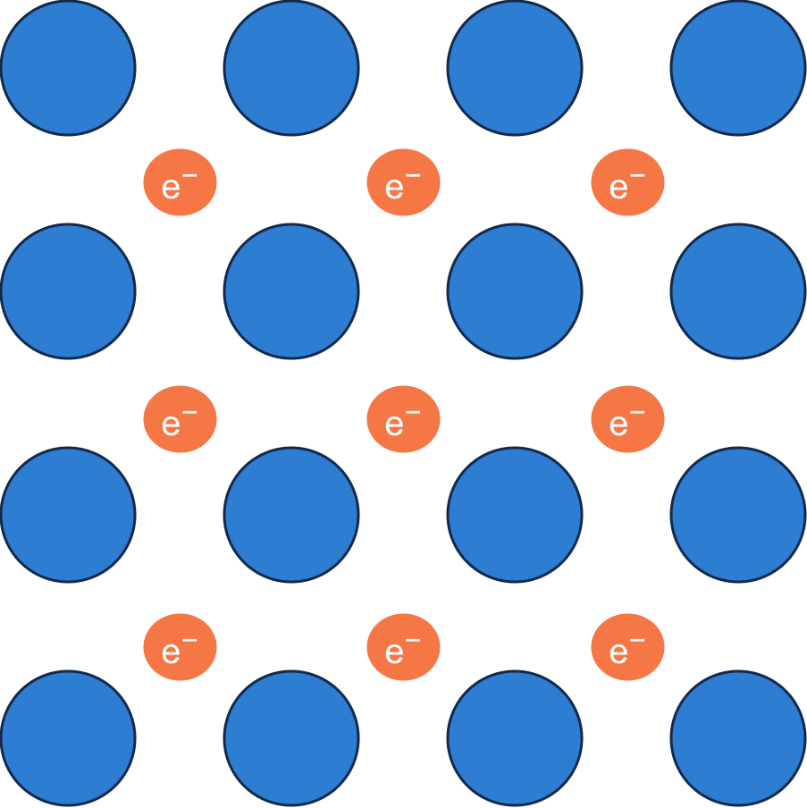
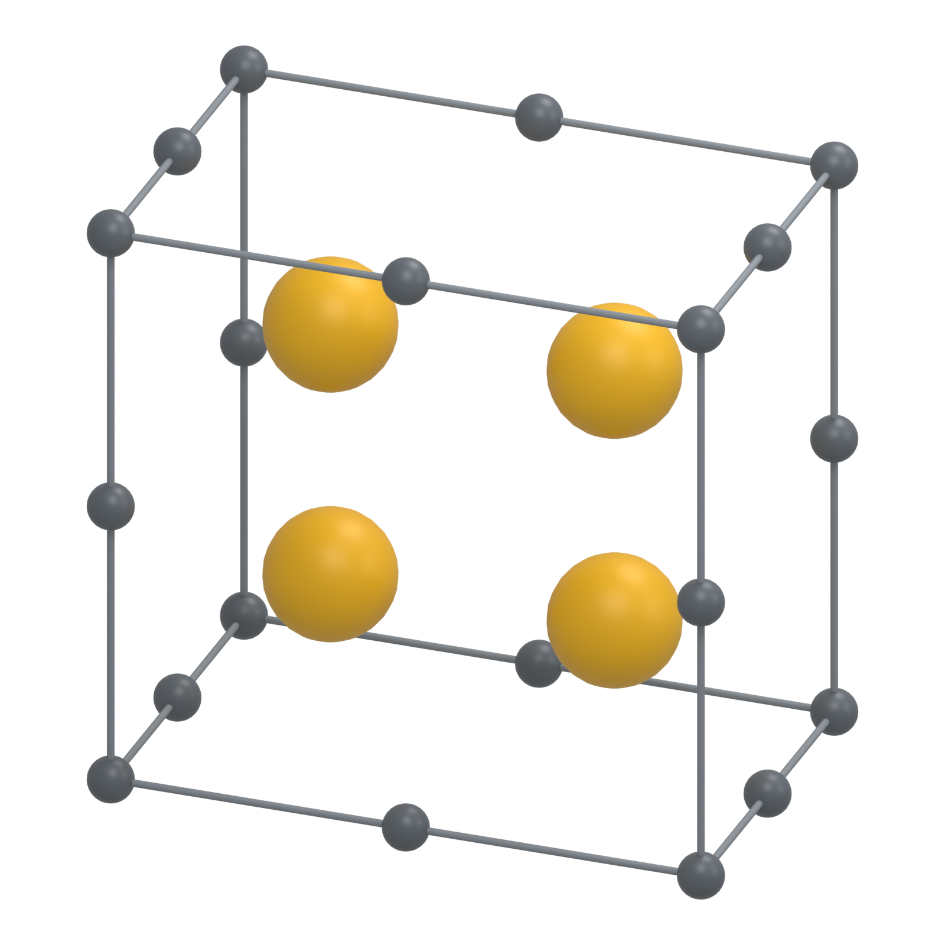
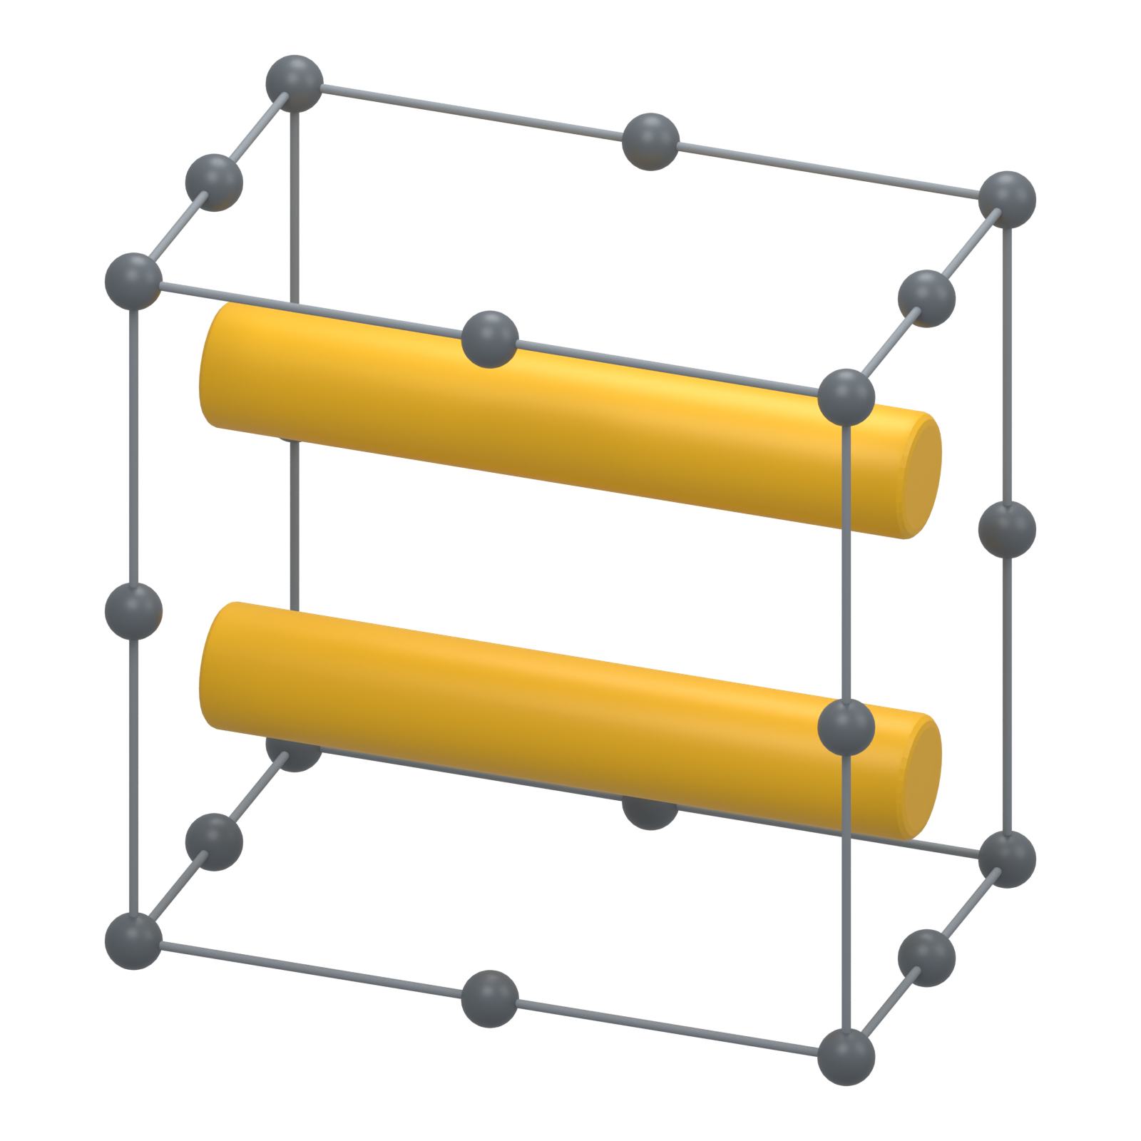
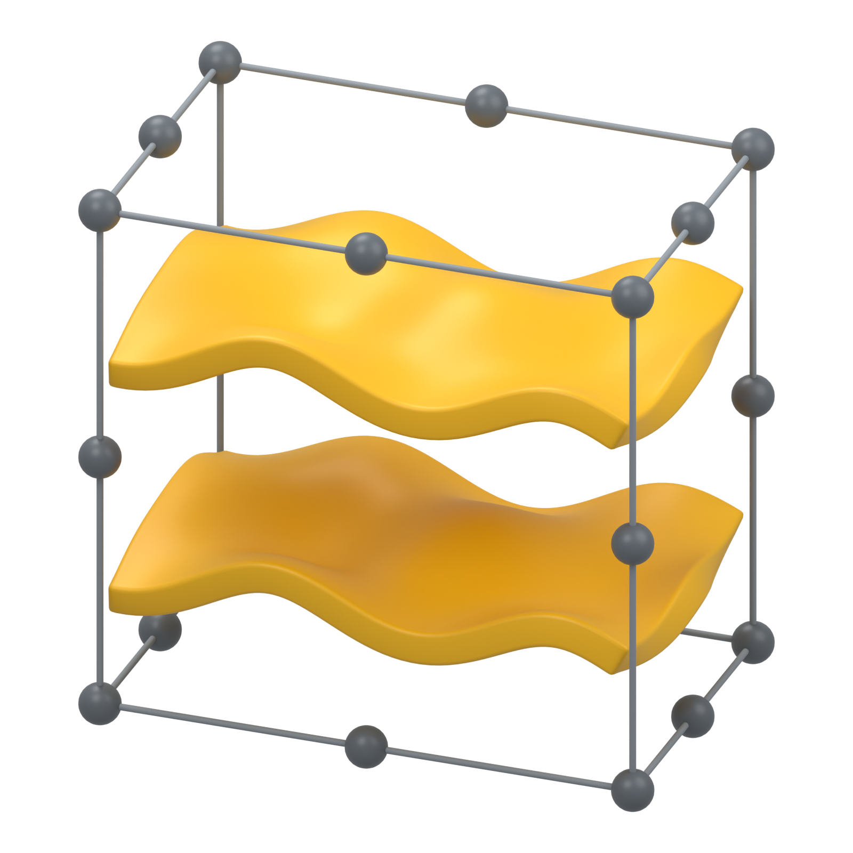
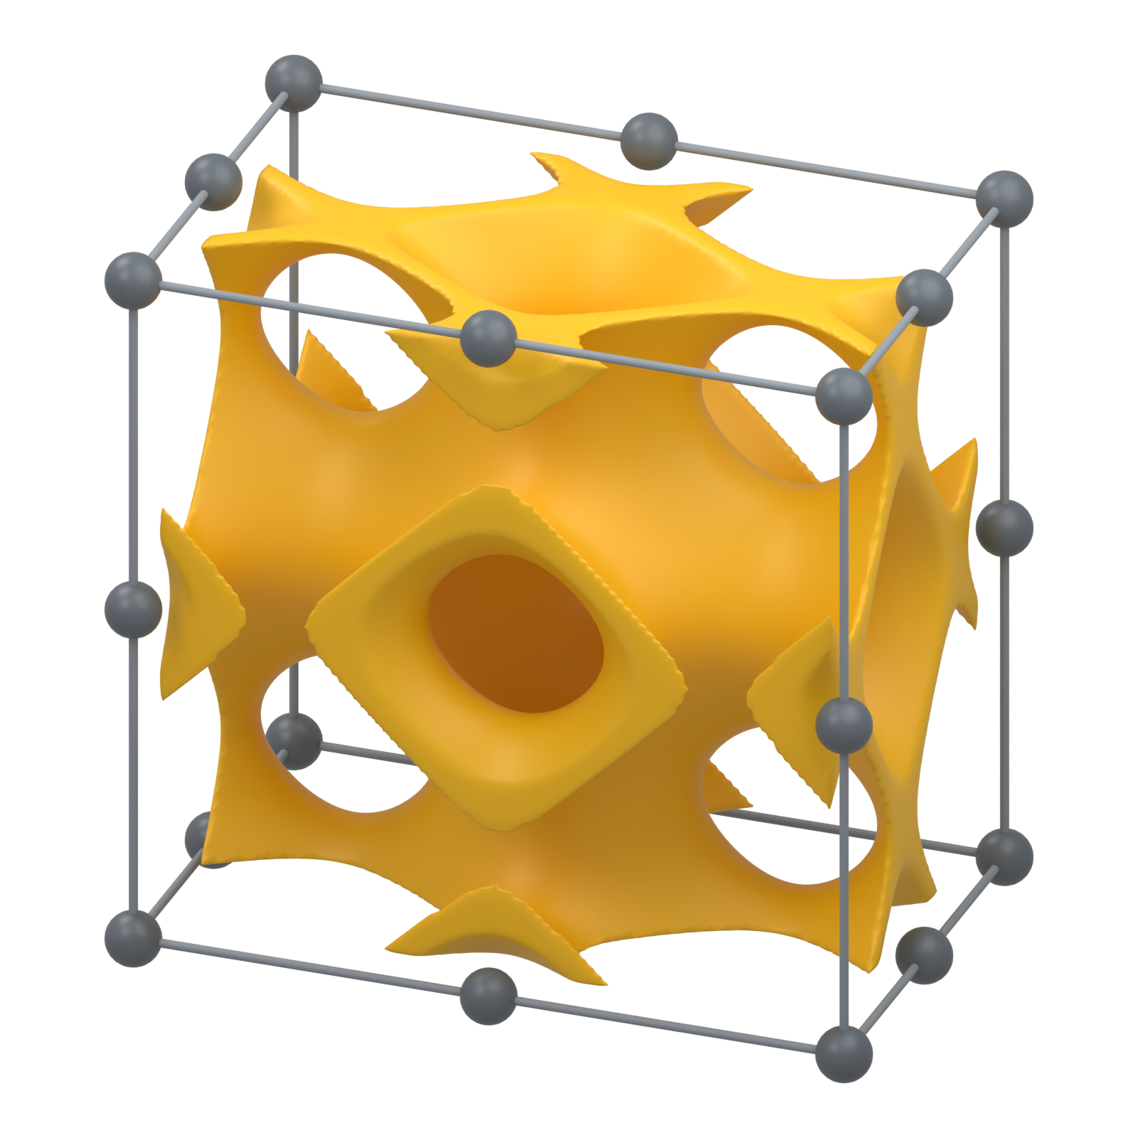
Predicting Interstitial Electron Localization and Void Connectivity
A void-centered machine-learning and geometric framework for characterizing 0D, 1D, and 2D electrides
LOGO
QR CODE
Andrew Weiland · [Advisor name] · [Department], Purdue University · [email]
Why voids matter
One workflow, two evidence streams
Electrides host electrons in crystal voids,
where they act as anions.
Where do electrons localize, and how do they connect?
Electron connectivity defines dimensionality
0D Isolated pockets
1D Channels
2D Sheets
3D Network
The machine-learning branch predicts ELF at each void. The geometric branch determines whether the void network forms isolated pockets, channels, or layers. The proposed final screen combines both signals.
Gold: electron-rich regions Gray: host atoms
Per-void ELF prediction
Void connectivity screening
Atom–void message passing predicts ELF at individual crystal voids
Geometric screening recovers electride-associated dimensionality above balanced chance
RMSE ≈ 0.06
R² ≈ 0.82
The heterogeneous model treats atoms and candidate voids as different node types. The model predicts a local ELF value for every target void instead of assigning one value to the whole crystal.
Rare very-high-ELF voids remain the hardest cases.
260 known electrides
57% balanced accuracy
33% chance
The exact void network uses crystal geometry to distinguish isolated pockets, 1D channels, and 2D sheets. Ionic radii outperform a single uniform probe size.
Caveat: connected open space does not guarantee connected electron density.
What the two outputs mean together
The geometric screen asks whether a path exists through open space. The ELF model asks whether electron density actually occupies that path. A channel in the void network may therefore be electronically empty, while a localized electron pocket may remain disconnected.
Main contributions
1 A local prediction target at specific crystal voids.
2 A heterogeneous atom–void graph that preserves both chemical and geometric context.
3 An exact connectivity screen for 0D, 1D, and 2D void networks.
4 A path toward combining geometry with electronic evidence.
Take-home message
Predicting ELF at voids and mapping void connectivity creates a crystal-screening framework that can separate structural dimensionality from electronic dimensionality.
Next: predict ELF at bottlenecks, test known electrides, and build a crystal-level electride score.
References: Becke & Edgecombe (1990); Burton et al. (2018); Zhu et al. (2019); Zeo++ (2012).

