Slide 1
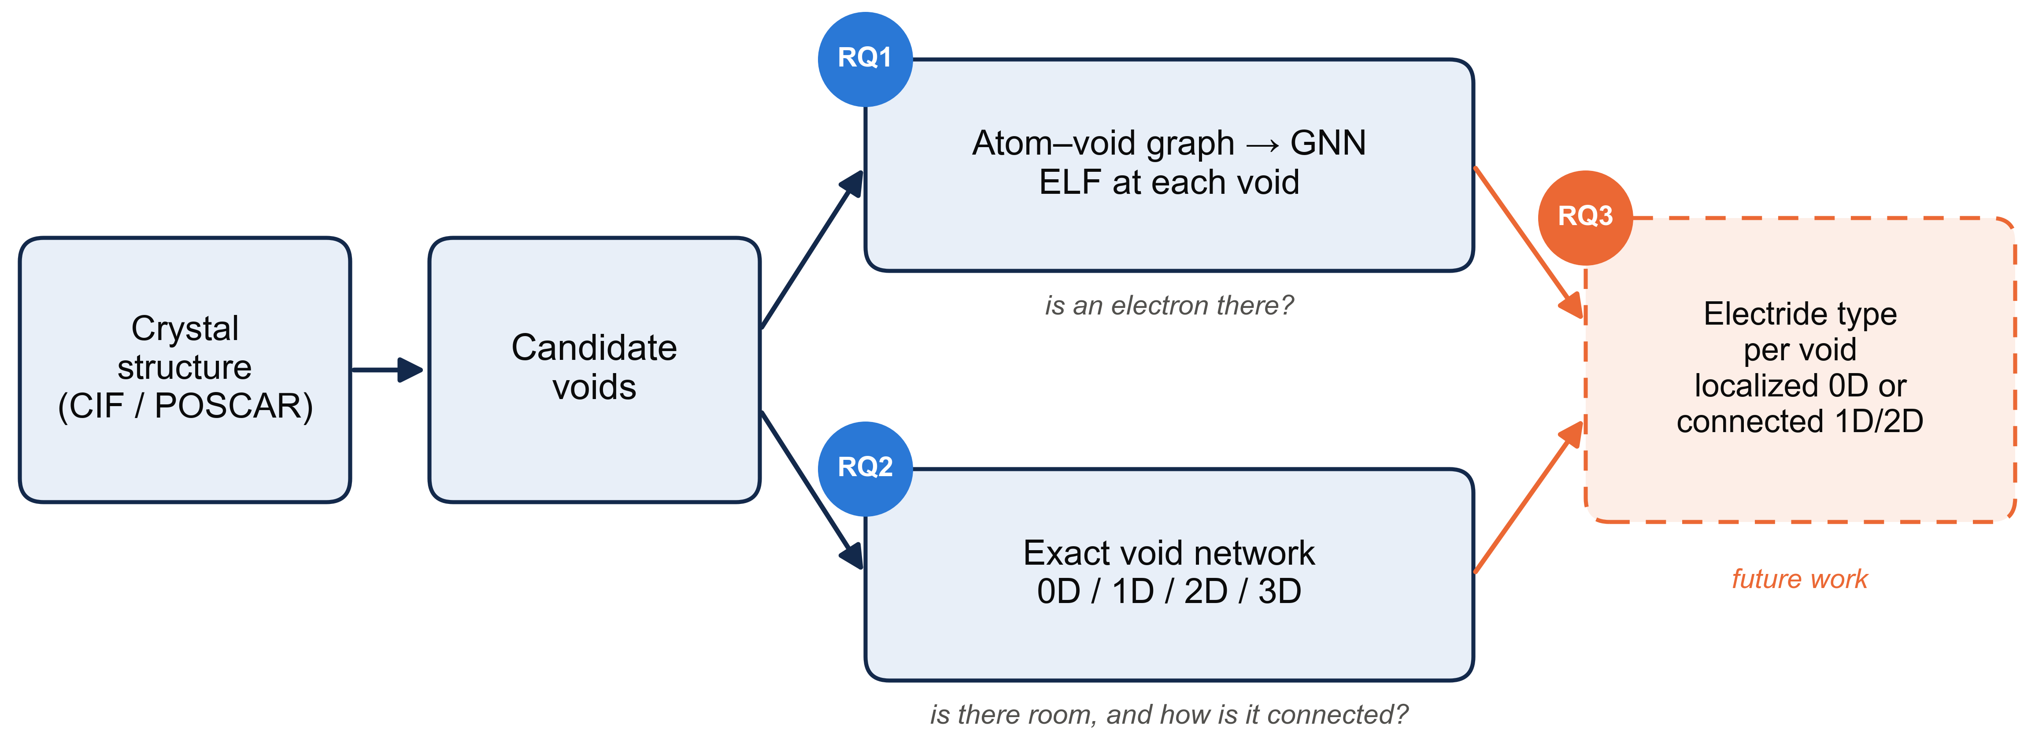
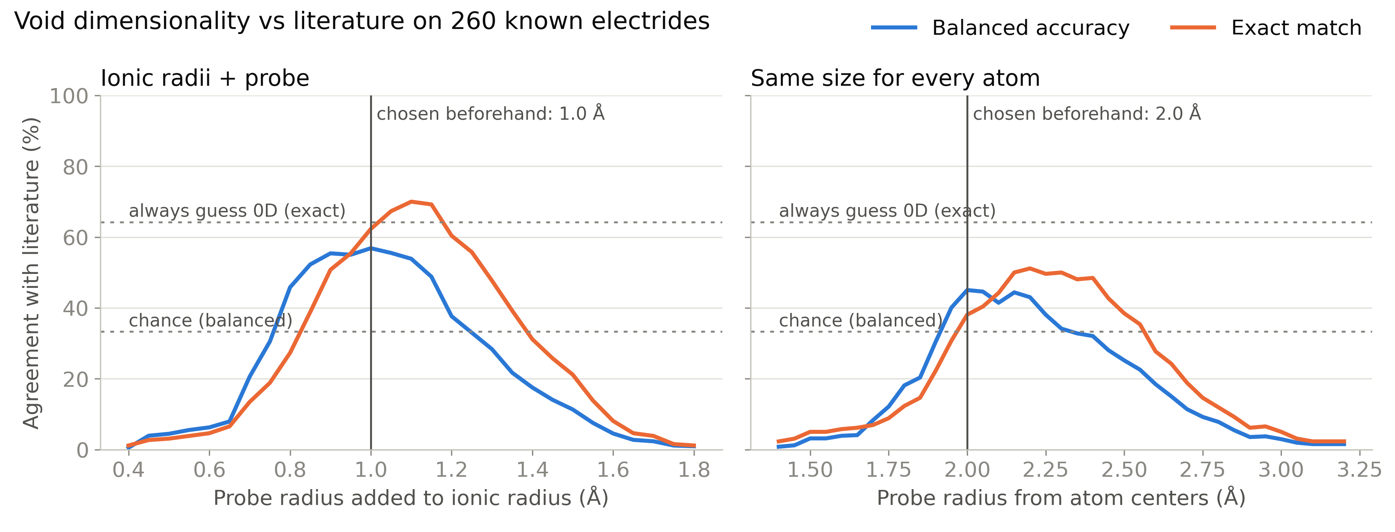
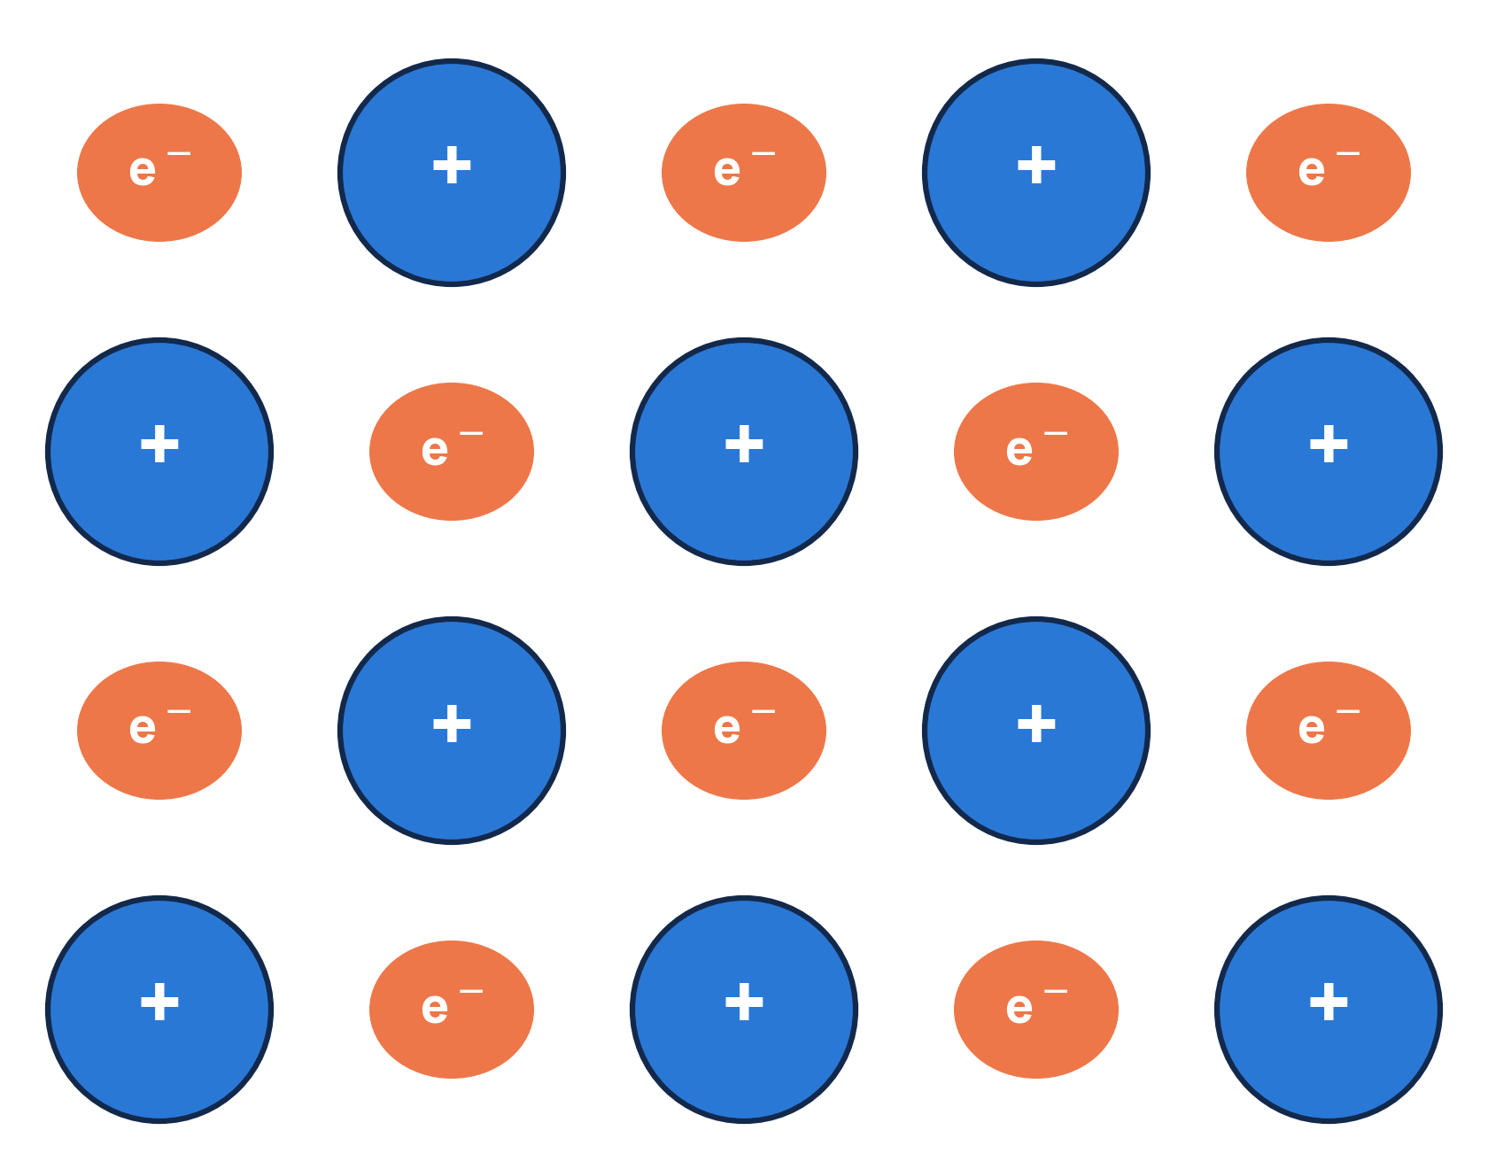
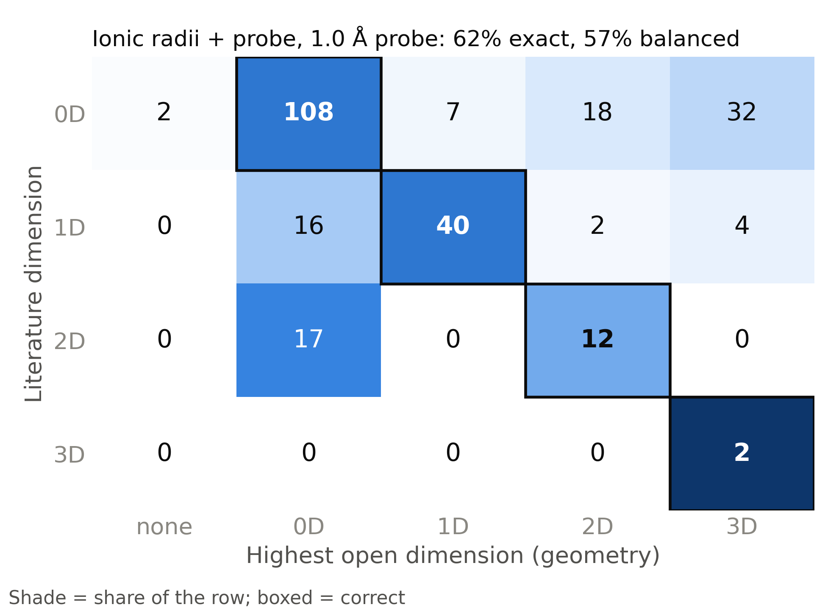
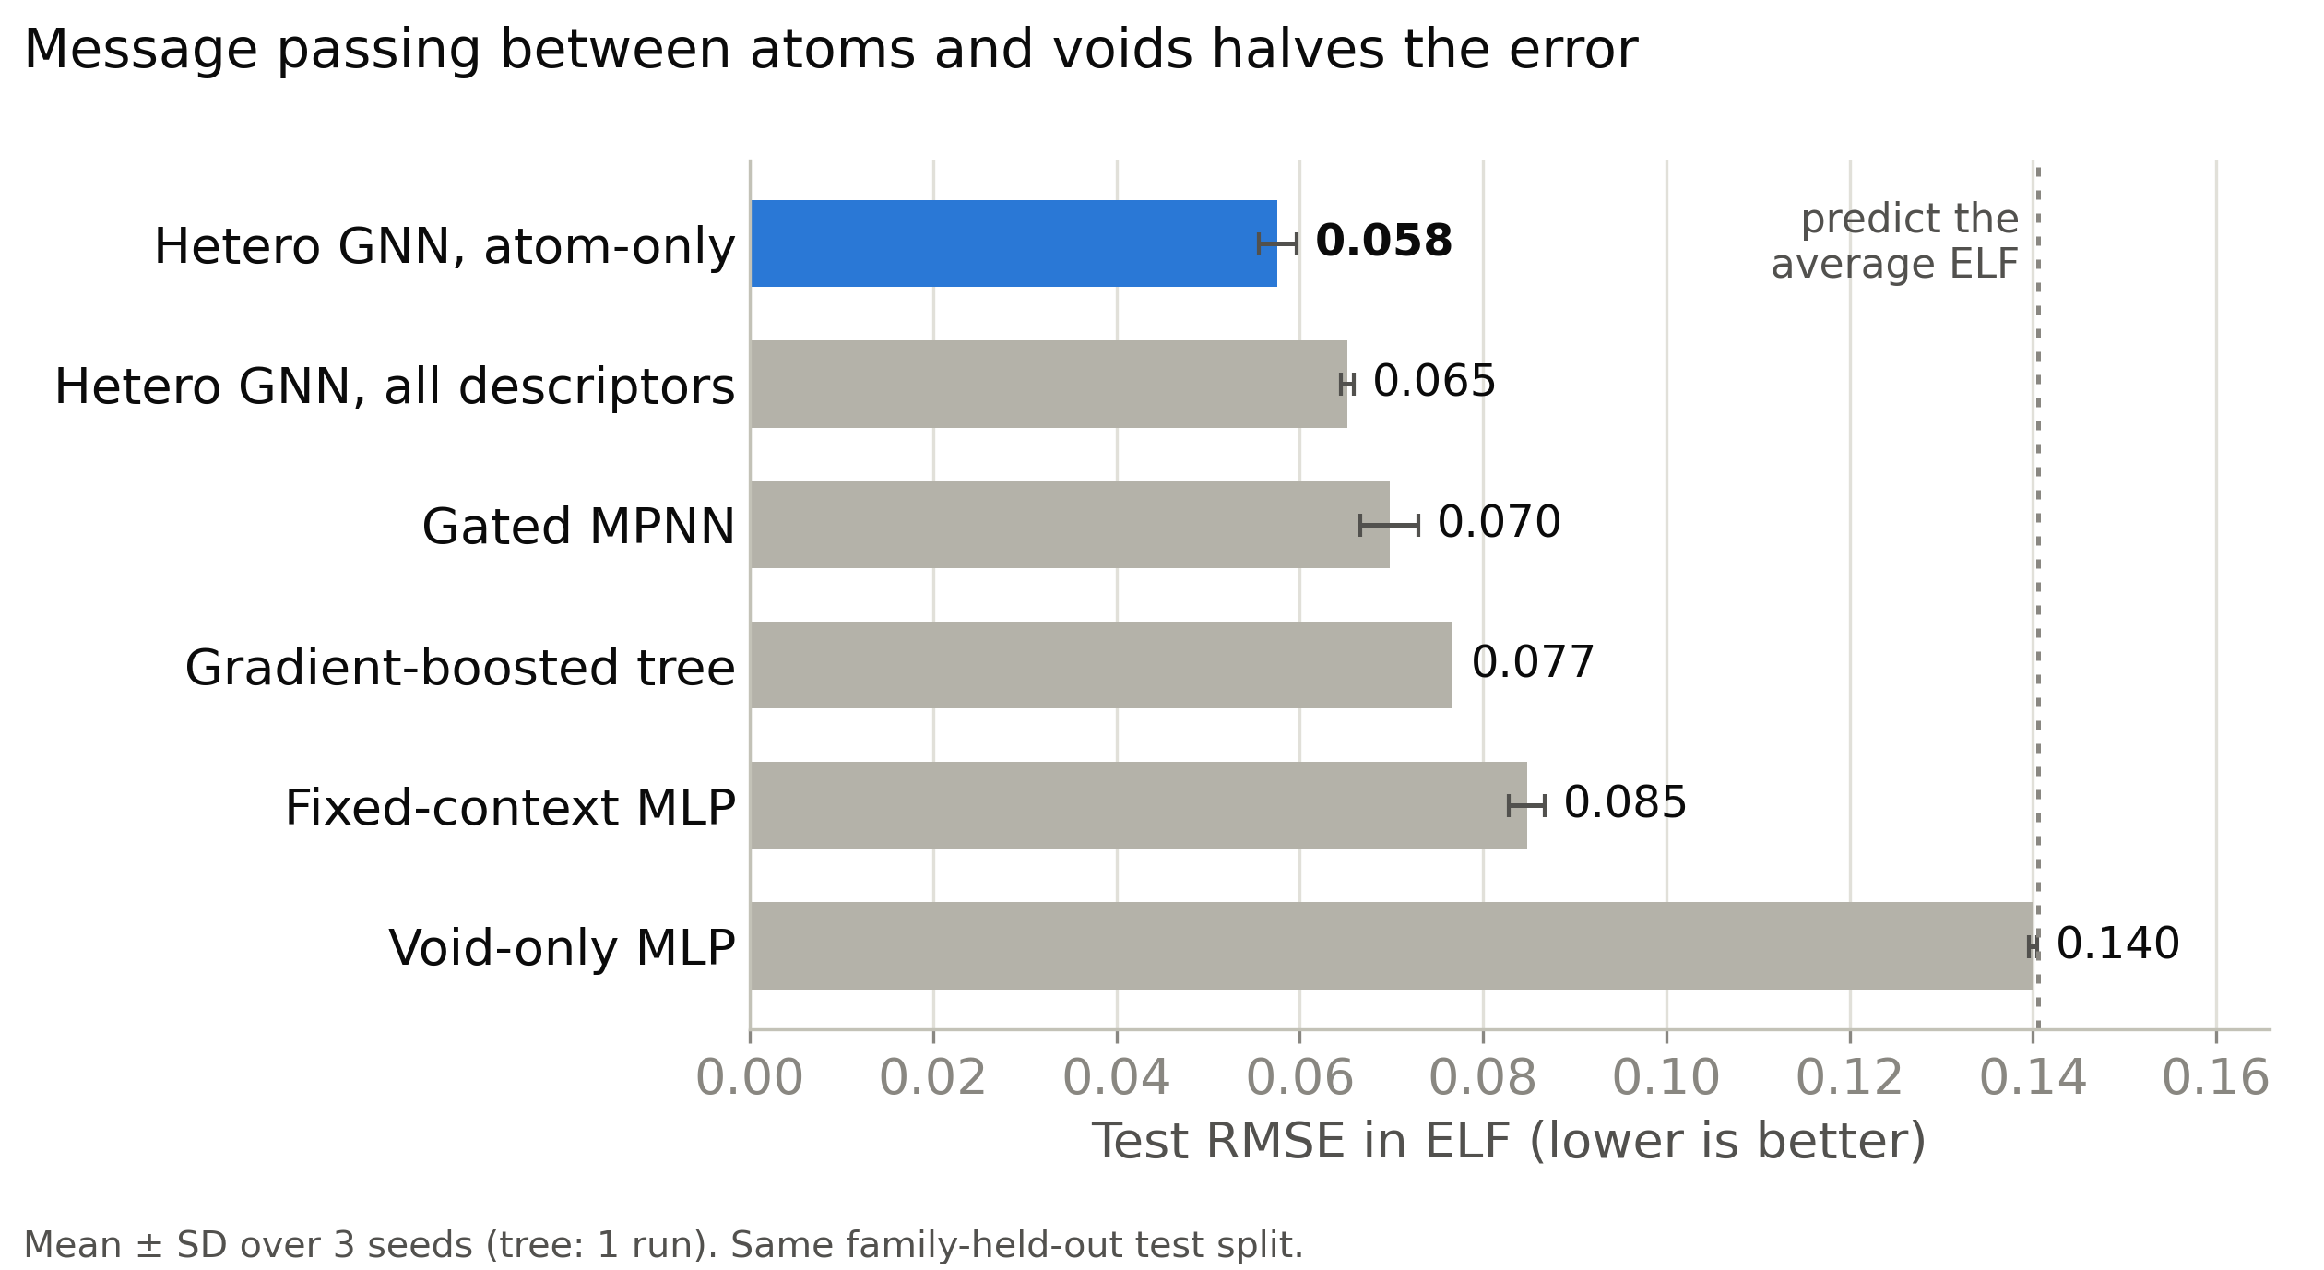
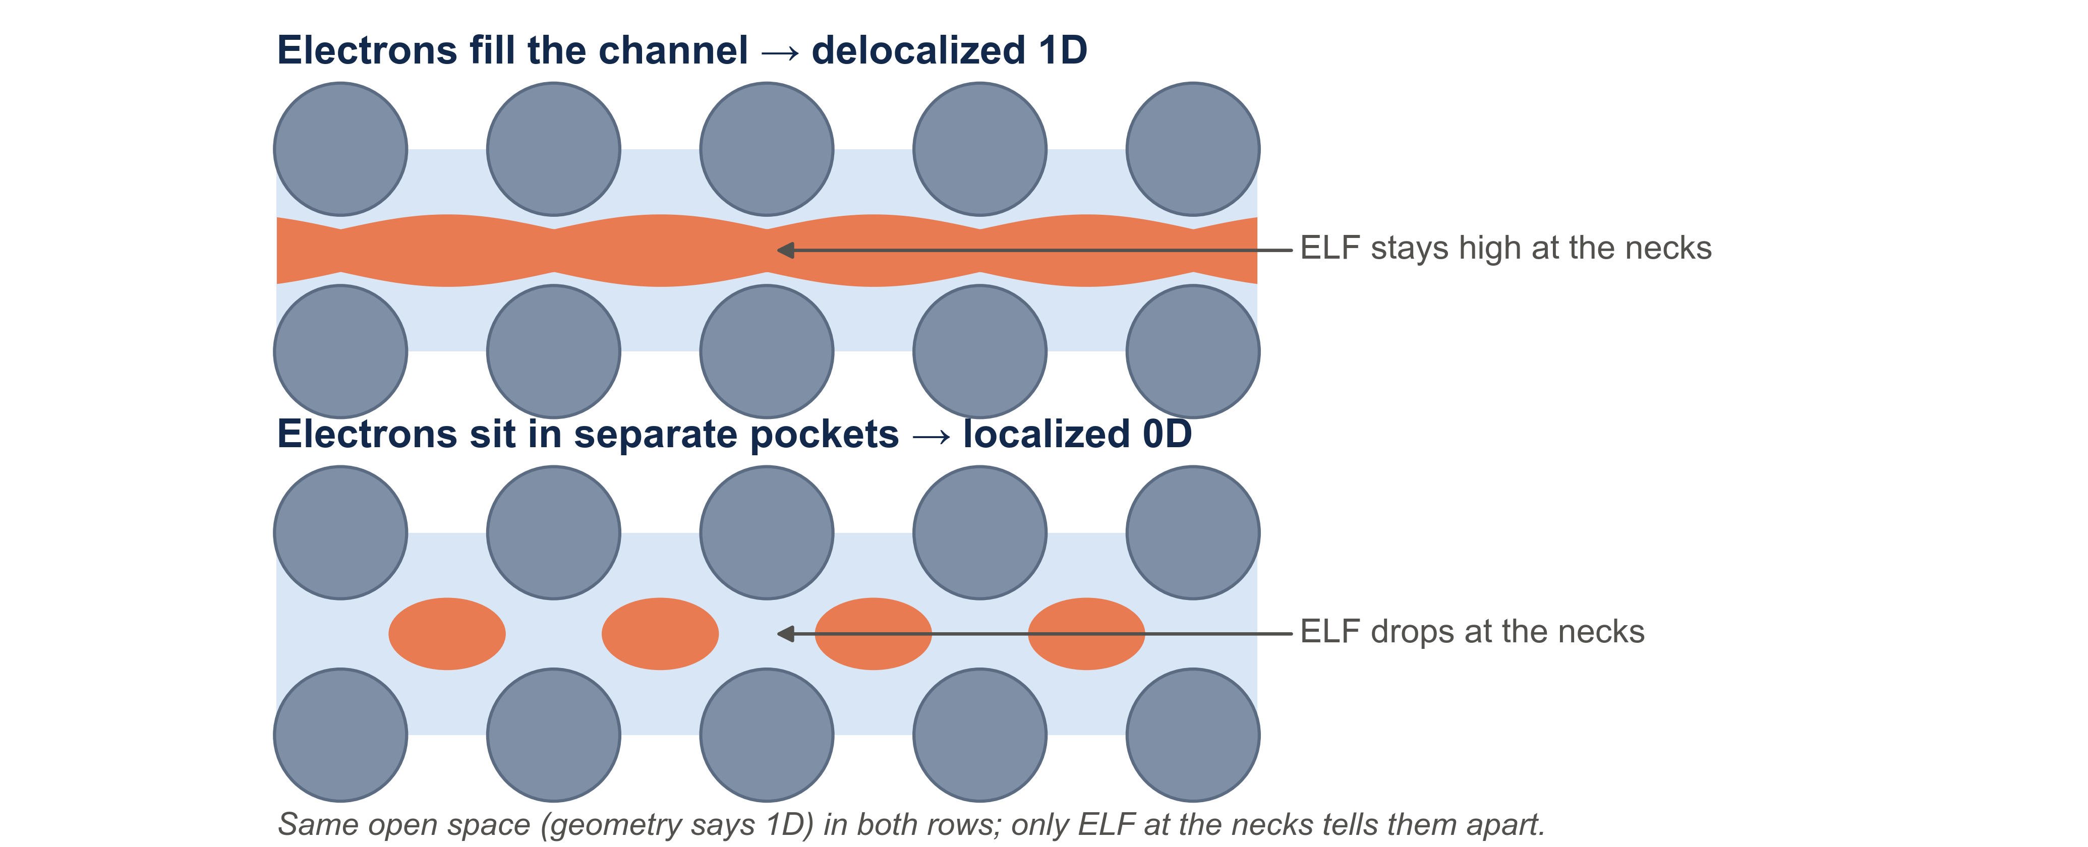
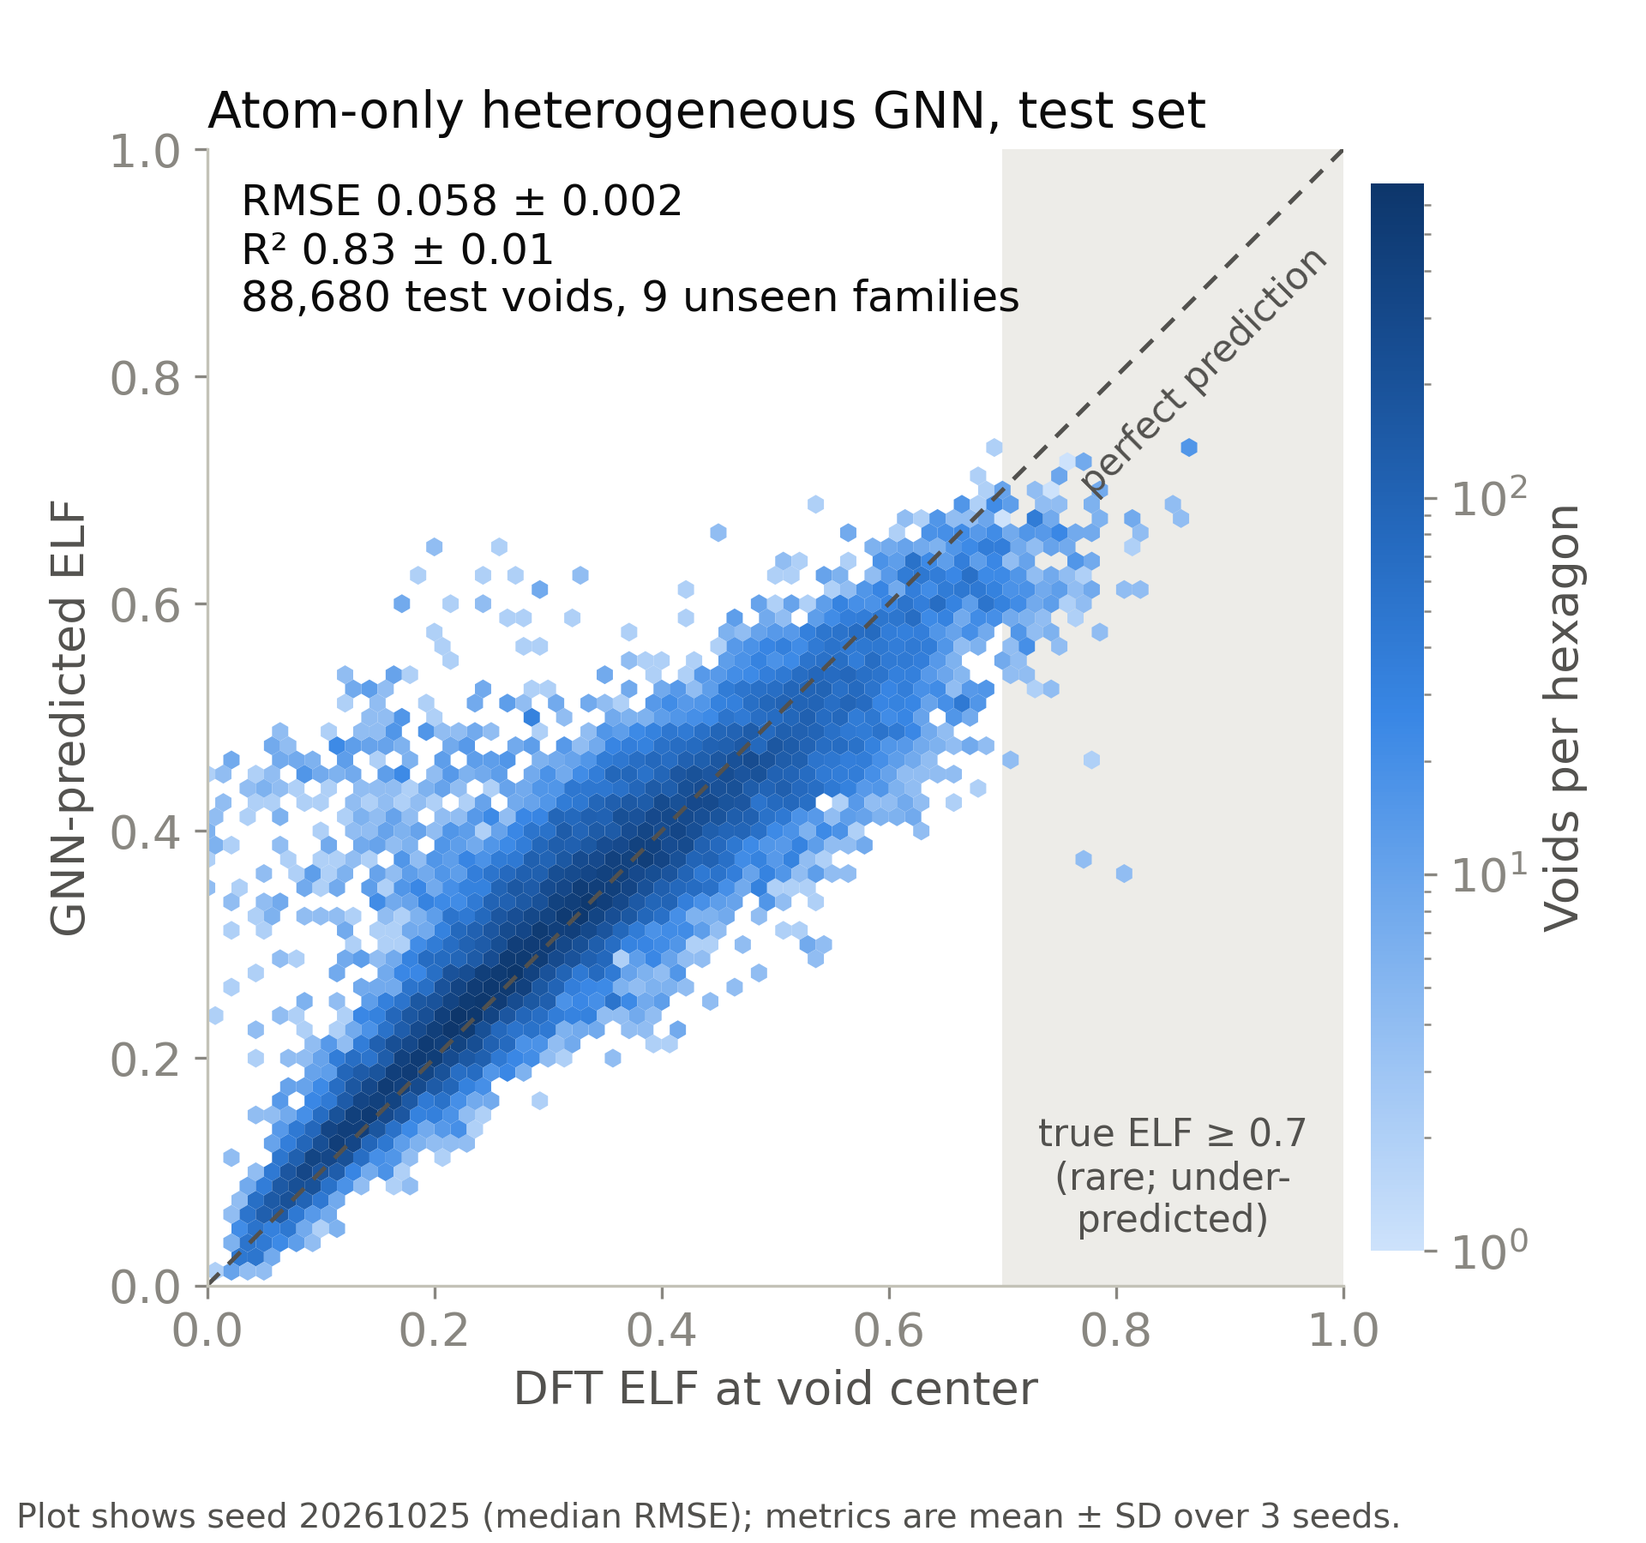
Where Do the Extra Electrons Go?
TO DO: logo
TO DO: QR code (repo or contact)
Predicting interstitial electron localization and void dimensionality for electride screening
Andrew Weiland · [Advisor name] · [Department], Purdue University · [email]
Background
Approach
RQ2
Can geometry alone find dimensionality?
Electrides are crystals whose extra electrons sit in the empty space between atoms and act as anions.
How those electrons connect sets their properties: isolated 0D cages, 1D channels, or 2D layers.
ELF (electron localization function, 0–1): a high value in a void marks a trapped electron, the electride fingerprint.
Finding them needs a DFT calculation per crystal: too slow to screen large databases.
On 260 known electrides: 57% balanced accuracy (chance 33%)
Cations (+) with electrons (e⁻) in the empty space between them.
Voids: Voronoi interstitials plus points farthest from atoms, expanded by symmetry.
GNN: atoms and voids are nodes joined by distance edges; message passing predicts ELF at each void.
Void network: each atom blocks a sphere (ionic radius + 1.0 Å probe); an exact power-diagram network counts how many directions the open space repeats through the crystal.
Ionic radii beat one size for all atoms (57% vs 45%).
The right dimension appears at some probe for 99%: one probe can't fit every material.
Main miss: 50 of 167 0D electrides look 2D/3D. The space connects; the electrons don't.
TO DO: VESTA render: 0D cages (mayenite), open space at isosurface 0.5
TO DO: VESTA render: 1D channels (Y5Si3), open space at isosurface 0.5
TO DO: VESTA render: 2D layers (Ca2N), open space at isosurface 0.5
RQ1
Can a GNN predict ELF at voids?
Learning from the surrounding atoms predicts void ELF: test RMSE 0.058, R² 0.83
Literature labels come from computational screens (JACS 2023, Matter 2019, Chem. Mater. 2018), compiled with AI-assisted search; not fully hand-checked.
Research questions
RQ1
Can a GNN predict ELF at candidate voids from the crystal structure alone?
RQ3
Putting them together (next step)
RQ2
Can geometry alone recover an electride's dimensionality (0D/1D/2D)?
RQ3
How do the two combine into an electride screen?
Data
A void alone predicts nothing: 0.140, the same as guessing the average.
Message passing beats fixed atom summaries (0.065 vs 0.077–0.085).
Hand-made void descriptors hurt; atoms alone work best.
Limitation: rare very-high-ELF voids (≥ 0.7) are under-predicted.
50,000 DFT structures with ELF (ELFNet): metal frameworks from high-pressure hydrides.
Split by family: 40,031 train · 4,969 validation · 5,000 test from 9 unseen families.
260 known electrides with literature dimensionality for testing RQ2.
Conclusions and next steps
Void ELF can be predicted from structure alone (R² 0.83).
Geometry finds electride dimensionality well above chance; its errors show where ELF is needed.
Run DFT on known electrides to test the GNN on real ones.
Predict ELF at void necks → electronic dimensionality.
Crystal-level electride score; test on unseen compositions.
References
TO DO: final reference list: ELF (Becke & Edgecombe 1990), ELFNet dataset, electride screens (Burton 2018, Zhu 2019, JACS 2023 magnetic electrides), Zeo++ (Willems 2012); acknowledgements (advisor, funding, Purdue RCAC Negishi)

