Slide 1

Hello Aderant Application
--Slot Machine

Slide 2
Agenda
About Me
Hello Aderant Slot Machine
Other things about slot machine

Slide 3
About Me
Full stack Web developer in Connex World 2017-2018
Senior Database Engineer in IGT 2012-2017
Senior Database Engineer in Beijing Run Technology 2008-2012

Slide 4
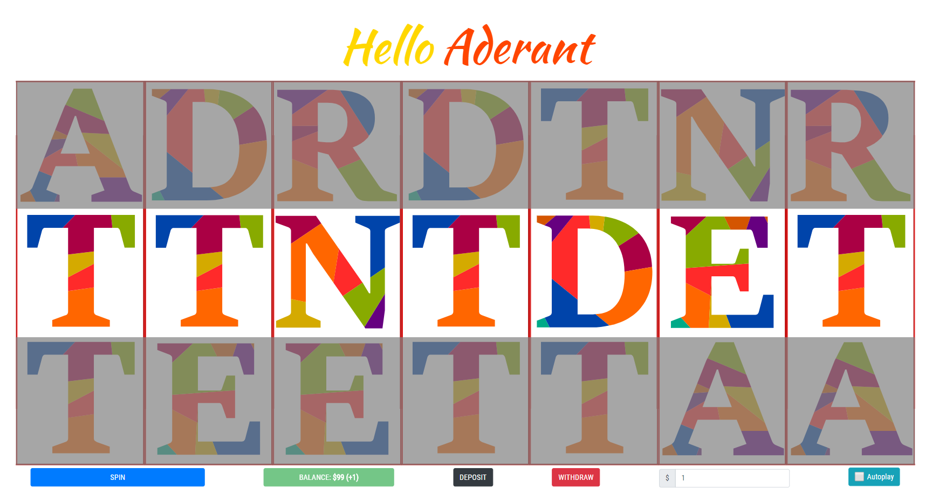
Hello Aderant Slot Machine
URL
https://weilingxie.github.io/helloaderantslotmachine/
Code
https://github.com/weilingxie/helloaderantslotmachine

Slide 5
Hello Aderant Slot Machine
Technology List
Frontend | HTML5
 | CSS3
 | Boostrap (4.0.0)
 | Javascript | ES6
 |  | Babel (7.3)
 |  | Jquery (3.2.1)
 |  | Webpack (4.29.5)
Version Control | Github
Web Hosting | Github Page

Slide 6
Hello Aderant Slot Machine
Features
Spin
Show the balance
Choose the bet amount
Deposit (Mock)
Withdraw (Mock)
Autoplay
Sound effect
Cheating

Slide 7
Hello Aderant Slot Machine
Reward Mechanism
Based on the continuous repeated character
Based on the same position of character as ADERANT
Formula: 2^{(repeatedChar-2)}*betAmount
E.g. Bet for $10, result is AADDDNN
=> Maximum number of repeated characters is 3
=> Reward will be 2⁽³⁻²⁾*10 = 20

Slide 8
Other things about Slot Machine
Random Number Generator – RNG
Theme
Reward mechanism based on player classification

Slide 9
Q&A

Slide 10
Thank you

