Slide 1

Hello Aderant Application
--Slot Machine

Slide 2
Agenda
About Me
Hello Aderant Slot Machine
Other things about slot machine

Slide 3
About Me
Full stack Web developer in Connex World 2017-2018
Senior Database Engineer in IGT 2012-2017
Senior Database Engineer in Beijing Run Technology 2008-2012

Slide 4
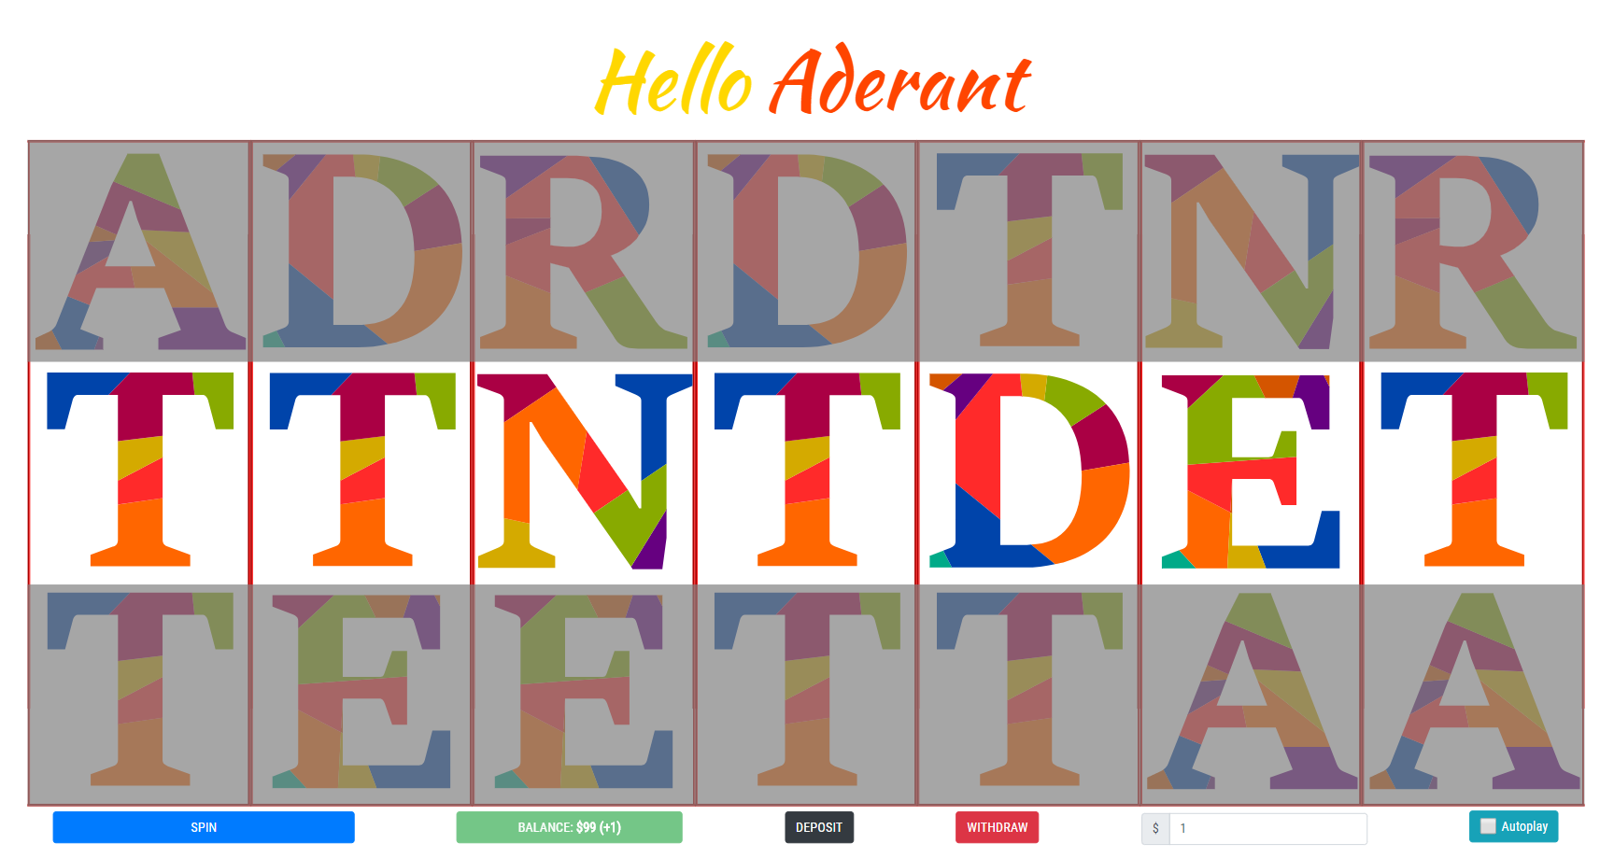
Hello Aderant Slot Machine
Inspiration
URL
https://weilingxie.github.io/helloaderantslotmachine/
Code
https://github.com/weilingxie/helloaderantslotmachine

Slide 5
Hello Aderant Slot Machine
Technology List
Frontend | HTML5
 | CSS3
 | Boostrap (4.0.0)
 | Javascript | ES6
 |  | Babel (7.3)
 |  | Jquery (3.2.1)
 |  | Webpack (4.29.5)
Version Control | Github
Web Hosting | Github Page

Slide 6
Hello Aderant Slot Machine
Features
Spin
Show the balance
Choose the bet amount
Deposit (Mock)
Withdraw (Mock)
Autoplay
Sound effect
Cheating

Slide 7
Hello Aderant Slot Machine
Reward Mechanism (Formula: 2^{(repeatedChar-2)}*betAmount)
A. Based on the continuous repeated character
E.g. Bet for $10, result is AADDDNN
=> Maximum number of repeated characters is 3
=> Reward will be 2⁽³⁻²⁾*10 = 20
B. Based on the same position of character as ADERANT
E.g. Bet for $10, result is AAEDDNN
=> Maximum number of repeated characters is 3
=> Reward will be 2⁽³⁻²⁾*10 = 20
Choose the maximum from either A or B

Slide 8
Other things about Slot Machine
Random Number Generator – RNG
Slot machines are typically programmed to pay out as winnings 82% to 98% of the money that is wagered by players. This is known as the "theoretical payout percentage" or RTP, "return to player". The minimum theoretical payout percentage varies among jurisdictions and is typically established by law or regulation.
Theme
Monopoly
Jewel
IP – Star war, Transformers
Reward mechanism based on player classification
Normal player - Small pay, small gain
Gambler – High risk, high reward
Professional Game Player – Auto play based on ” theoretical payout percentage”

Slide 9
Q&A

Slide 10
Thank you

