Slide 1
Diagnostic classification of autism using particle swarm optimization for fMRI feature selection
Colleen P. Chen^{1, 2}, Christopher L. Keown^{1,2}, Ralph-Axel Müller^{2,3}
¹Computational Science Research Center, SDSU
²Brain Development Imaging Lab, Dept. of Psychology, SDSU ³Joint Doctoral Program in Clinical Psychology, SDSU/UCSD

Slide 2
Background: Autism Spectrum Disorders (ASD)
Array of neurodevelopmental disorders characterized by sociocommunicative, cognitive, and sensory motor impairments.
Current diagnostic methods rely on autism-specific behavioral criteria
Convergent evidence implicates abnormal connectivity in autism

Slide 3
Can ASD be detected using fMRI data?
Machine-learning (ML) application in classifying autism data from typically developing functional imaging data
Classification studies in autism: Anderson et al. (2011)
Experimental method: implement ML algorithms to maximize classification accuracy while selecting for features that were most informative
Try to understand patterns underlying autism by using a data-driven approach to classify ASD fcMRI
ADHD 200 Competition: 21 teams competed in classifying fMRI data collected from various sites.
Highest prediction accuracy: 60.5%; sensitivity: 52%, specificity: 94%

Slide 4
Toward diagnostic classification of autism
Motivation: Identification of complex biomarkers
Current classification efforts
Anderson et al. (2011): 71 – 79% overall from data collected from one site
Objective: to find functional connections that are informative in classifying autism from typically developing imaging data, for identifying possible biomarkers
Challenge: classifying data collected across various sites
Anderson et al., Functional connectivity magnetic resonance imaging classification of autism, Brain, 2011, 134(12):3739-3751

Slide 5
Methods
Autism Brain Imaging Data Exchange (ABIDE)
To maximize data quality:
fcMRI sensitive to even small amounts of motion
Relatively conservative motion cutoff >0.25mm for censoring (“scrubbing”)
Large sample size + low motion
Resting state (rs-fMRI) data from 252 low-motion participants
Training set: N=202
Validation set: N=50 (randomly selected)
In each set, equal numbers of ASD and TD participants, matched for age and head motion

Slide 6
Data preprocessing
AFNI and FSL
Slice-time, motion (3dvolreg), and field-map correction
Second-order band-pass using Butterworth filter (.008<f<.08)
Minimize the ripple effect of motion from high-motion time points that are later censored
17 nuisance regressors
6 rigid-body, white matter, ventricles, and derivatives
Global signal
Notes:
Butterworth filter: temporal blurring across time points using a very small window. Minimize the effects of high motion

Slide 7
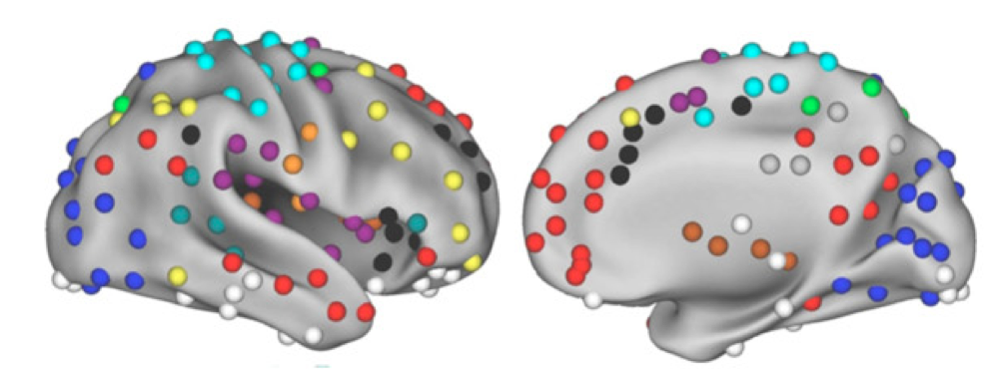
ROI selection
264 ROIs defined from meta-analysis by Power et al. (2011)
Almost all assigned to known functional networks
Power et al., Functional Network Organization of the Human Brain, Neuron, 2011, 72:665-678

Slide 8
Functional connectivity
Pearson’s correlation matrix computed to quantify connectivity between ROIs
Correlation coefficients were normalized
Regressed out site and age
Notes:
Normalization consists of subtracting the mean over all training values and dividing by the corresponding standard deviation

Slide 9
Particle Swarm Optimization (PSO) for feature selection
Evolutionary Algorithm (EA) utilizing stochastic (random) search optimization
Models social behavior of swarming particles
Computationally efficient for high dimensional feature space such as fMRI data
Implemented a PSO based approach for feature selection of the Support Vector Machine (SVM), termed PSO-SVM
Demonstrated efficacy in breast cancer diagnostics: 99.28% (Chen 2012 J Med Syst)

Slide 10
PSO-SVM Results:
Classification performance for ABIDE* dataset:
Classification performance for SDSU dataset:
Leave-One-Out Cross Validation method
N = 48 (24 ASD, 24 TD)
Total no. of runs = 100
Training N=202 (101 ASD, 101 TD)
Validation N=50 (25 ASD, 25 TD)
Leave-One-Out CV | Best performing run
Sensitivity | 96% (23/24)
Specificity | 92% (22/24)
Overall | 94% (45/48)
Independent validation set | Best performing run
Training | 81% (164/202)
Validation | 58% (29/50)
Sensitivity | 44% (11/25)
Specificity | 72% (18/25)
*Di Martino et al., Mol Psychiatry (in press)

Slide 11
PSO
PSO is finding noise
Randomness in the data is driving the decisions as opposed to repeatable characteristics.
Large degrees of freedom (provided into the model) but not enough sample data
model does not generalize well, it is specific for the data it was trained on

Slide 12
Alternative approach: Recursive Feature Elimination (RFE) for feature ranking
Implemented Support Vector Machine (SVM) method based on Recursive Feature Elimination (RFE) (Guyon, 2002)
Variable parameter: number of features
Ranks all features using SVM-RFE algorithm to obtain a list of ranked connections
Then selects a minimal subset of top ranked features that consistently achieves 100% classification accuracy on training dataset
Apply those features to an independent validation set
Guyon et al., Gene Selection for Cancer Classification using Support Vector Machines, Machine Learning, 2002, 46:389-422

Slide 13
SVM-RFE feature subset selection

Slide 14
SVM-RFE Classification Performance
SVM classification accuracy using the top ranked 40 features:
Data set | Accuracy overall | Sensitivity | Specificity
Training (N=202) | 100%
Validation (N=50) | 66% (33/50) | 60% (15/25) | 72% (18/25)

Slide 15
Most informative features (connections)
Almost even mix of under- and overconnectivity
52% underconnected
48% overconnected
Long- and short-distance connections:
25% >100mm
20% <40mm

Slide 16
Network distribution of most informative ROIs
Functional network | % informative ROIs per network | % informative ROIs / total ROIs per network
Somatosensory/motor Hand | 16% | 62%
Somatosensory/motor Face | 6% | 100%
Cingulo-opercular task control | 5% | 36%
Auditory | 5% | 31%
Default mode | 20% | 35%
Memory retrieval | 1% | 20%
Visual | 8% | 19%
Fronto-parietal task control | 14% | 44%
Salience | 10% | 44%
Subcortical | 0% | 0%
Ventral attention | 4% | 38%
Cerebellar | 0% | 0%
Dorsal attention | 0% | 0%
uncertain | 11% | 82%
Notes:
TRIED TO FORMAT PIE CHART, BUT IT’S REALLY FLAKEY AND KEEPS COLLAPSING

Slide 17
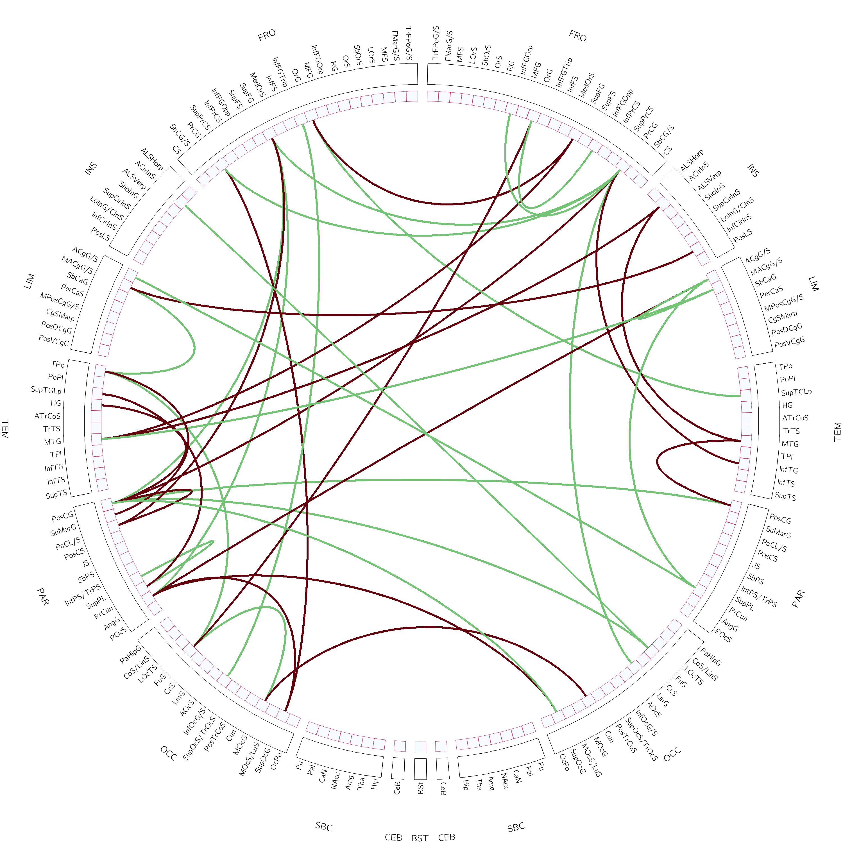
No obvious regional pattern of informative connections
Notes:
These are the over- (red) and under-connected (green) features
there is no obvious pattern or clustering
* These are the over and underconnected features, there is no obvious pattern and it’s not clustered in just a few regions or so

Slide 18
Brain regions represented in ≥ 2 features
Left hemisphere | Right hemisphere
Superior frontal gyrus | Precentral gyrus
Precentral gyrus | Anterior cingulate gyrus
Postcentral gyrus | Middle cingulate gyrus
Fusiform gyrus
Middle temporal gyrus
Temporal pole
Angular gyrus
Precuneus
Superior & middle occipital gyrus
Intrahemispheric: 57.5%
Left: 37.5% Right: 20%
Interhemispheric: 42.5%

Slide 19
Conclusion
While particle swarm optimization has been found useful for other types of data, it did not perform well in fcMRI data combined from multiple different sites
Using a subset of low-motion rs-fMRI data from ABIDE, SVM performed perfectly on a training data set and moderately well (66% accuracy) on a validation data set
Issue: Small validation sample included data from multiple sites
Informative features (connections) widely distributed, but:
25% long-distance
Majority (80%) in left hemisphere or interhemispheric
Disproportionately strong contribution from somatosensory and motor regions (especially face)

Slide 20
Discussion
Are behavior-based diagnostic criteria (generally taken for granted in ASD research) fully adequate for identifying a brain-based (set of) disorder(s)?
Rather than being solely attributed to limitations of ML approaches, modest classification performance may reflect inadequacies of diagnostic procedures
Poster #1064 on display until Tuesday 6/18

Slide 21
Acknowledgements
Omar Maximo, Yuli Cabrera, Mark Mulvey, and my mentor Chris Keown!
Supported by NIH (R01-MH081023), grant CDMRP AR093335 (PI: J. Pineda)

Slide 22
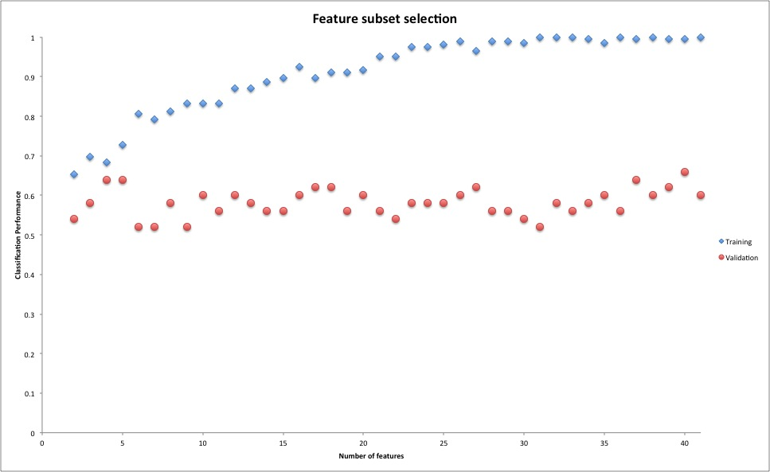

Slide 23
Correlation between ADOS_repetitive behavior scores and distance from the (SVM) hyperplane for all participants
r=0.19
one-tailed p=0.04
Notes:
A Support Vector Machine (SVM) is a discriminative classifier formally defined by a separating hyperplane. In other words, given labeled training data (supervised learning), the algorithm outputs an optimal hyperplane which categorizes new examples.
Optimal hyperplane and maximum margin
** the optimal separating hyperplane maximizes the margin of the training data.
The idea in SVMs indeed is that the further a test vector is from the hyperplane the more it belongs to a certain class (except when it's on the wrong side of course). In that sense, support vectors do not belong to the class with high probability because they either are the ones closest to or on the wrong side of the hyperplane. The α value that you get from libsvm has nothing to do with the α in the decision function. It is rather the output of the decision function ∑i∈SVαik(x,xi)+b (and should therefore be properly called y). Since y=∑i∈SVαik(x,xi)+b=⟨w,ϕ(x)⟩+b where w lives in the reproducing kernel Hilbert space, y is proportional to the signed distance to the hyperplane. It would be if you divide by the norm of w, which in kernel terms is ∥w∥H=∑i,j∈SVαiαjk(xi,xj)‾‾‾‾‾‾‾‾‾‾‾‾‾‾‾‾‾‾√.

Slide 24
Introduction: ML data-driven approach
ML is programming computers to optimize a performance criterion using data or past experience
Exploratory data analysis looks at experimental results and attempts to make sense of them
ML finds pattern in complex data, but requires a priori knowledge to determine whether pattern is meaningful or relevant

Slide 25
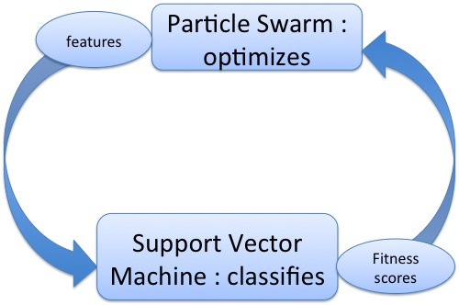
PSO-SVM
PSO utilized as feature selection tool to obtain a discriminative feature subset to improve accuracy and robustness of classifier

Slide 26
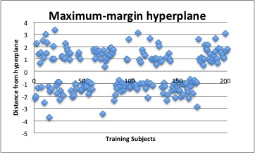
Distribution of sample vectors from the hyperplane

Slide 27
left Precuneous, left &right Precentral gyrus, left Postcentral gyrus, left Temporal pole, left Middle temporal gyrus, left Superior frontal gyrus, left Superior Occipital gyrus, left Middle occipital gyrus, left Fusiform gyrus, left Angular gyrus , right Middle-anterior cingulate gyrus , right Anterior cingulate gyrus

Slide 28
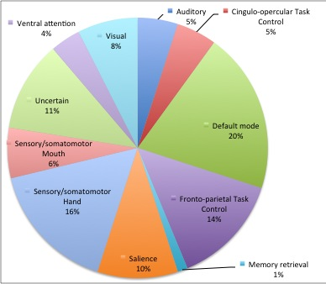
Network distribution of selected ROIs
Functional network | % of all 264 ROIs | % of informative ROIs
Sensory/somatomotor Hand | 9.5%
Sensory/somatomotor Mouth | 2.2%
Cingulo-opercular task control | 5%
Auditory | 5.9%
Default mode | 20.5%
Memory retrieval | 2.2%
Visual | 14%
Fronto-parietal task control | 11%
Salience | 8.2%
Subcortical | 5.9%
Ventral attention | 3.6%
Cerebellar | 1.4%
Dorsal attention | 5%
uncertain | 5%
Pie chart showing selection ratio of
functional networks
Notes:
*** MOVE UNCERTAIN TO THE BOTTOM & CAPITALIZE EACH FUNCTIONAL NETWORK

