Slide 1


Intro to Angular Building Dynamic Web Applications
Presented by Josh Weil Joshua.weil@lexisnexis.com

Slide 2
Who am I and Why am I here?
Josh Weil – Florida Tech Graduate 2010
Now Living in Raleigh, North Carolina
Professional Software Engineering for last 15 years
“Manager of Software Engineering” for LexisNexis – large company over 10k employees
Working in Angular since 2015
Now mostly strategic in my role but still can get my hands dirty
Asked to talk about Angular, its value, uses, and share some code
Notes:
Introduction
Briefly introduce yourself.
Mention the topic: Angular.
State the purpose and outline of the presentation.
Begin by introducing yourself.
Mention that you will be discussing Angular.
State the purpose of the presentation and briefly outline the topics.

Slide 3
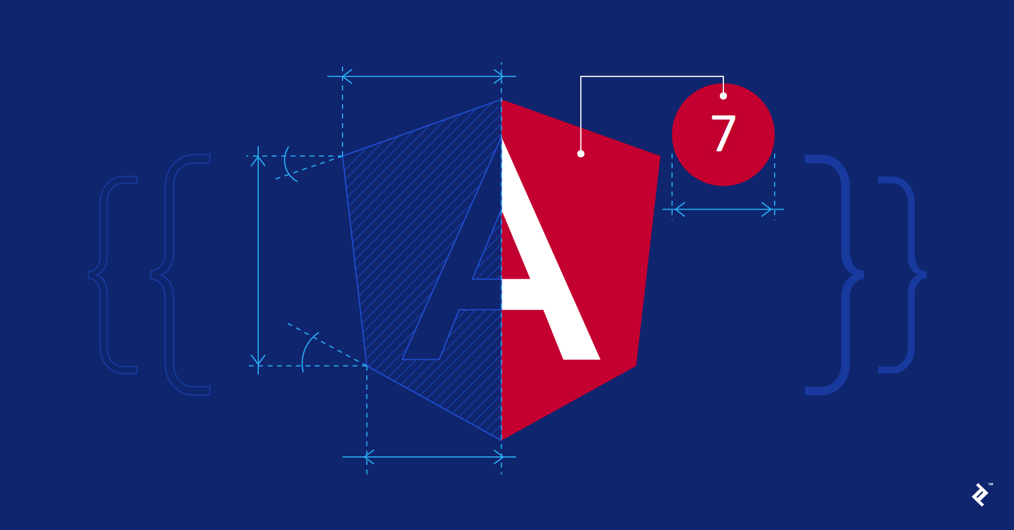
Agenda
What is Angular?
Why use Angular?
Angular Features
Angular Demo
Q&A
Notes:
Agenda
Provide an overview of what you'll cover:
What is Angular?
Why use Angular?
Angular Features
Angular Demo
Q&A

Slide 4



What is Angular?
Popular open-source web framework for building dynamic and interactive web apps.
It’s built on Typescript which is a super script of JavaScript
It’s Developed by Google so it is well supported and continually evolving
https://github.com/angular/angular
“In a nutshell, Angular is a comprehensive tool that simplifies web development by providing a structured and efficient way to create dynamic, data-driven web applications. It's especially valuable for creating modern, interactive web apps that require real-time updates and a smooth user experience. If you're studying computer science, getting familiar with Angular can be a valuable addition to your skill set, as it's widely used in the industry for web application development.”
Chat GPT Explain what Angular is for someone who is a Student in Computer Science that has never used it before
Notes:
What is Angular?
Explain what Angular is.
Mention it's a JavaScript framework for building web applications.
Emphasize that it's maintained by Google.
Framework, not just a Library: Angular is more than just a library or a collection of tools; it's a complete framework. It provides a set of rules, practices, and tools to help you build robust, feature-rich web applications.
Helps You Organize: It helps you organize your code and design your application in a structured way, making it easier to manage and scale as your project grows.
Two-Way Data Binding: One of the cool features of Angular is its two-way data binding. This means that changes in your application's user interface (UI) are automatically reflected in your application's data, and vice versa. It reduces the need for manual updates, making your code more efficient.
Modular: Angular encourages you to break your application into smaller, reusable pieces called components. This modularity makes it easier to develop and maintain complex applications.
Dependency Injection: Angular uses a technique called dependency injection, which makes it easy to manage and share application dependencies, like data services, across your components.
Rich User Interfaces: With Angular, you can create rich and responsive user interfaces. It provides a powerful templating system that allows you to define your application's UI declaratively.
Supports Building Single-Page Applications (SPAs): Angular is great for building single-page applications (SPAs) where you can load all the necessary code and data when the application starts, and then dynamically update the content as users interact with it. This can lead to a smoother and more seamless user experience.
Developed by Google: Angular is developed and maintained by Google, so it's well-supported and constantly evolving.

Slide 5
Why use Angular?
Think of Angular as a “Toolbox for building web applications”
Framework Not Just a Library – set of rules, practices, and tools to help build robust, feature rich, web applications
Helps you stay organized – organizes your code in a structured way allowing your project to scale and grow
Two-Way Data Binding – keeps UI and code in sync, reducing manual effort and making code more efficient
Modular – encourages smaller Reuseable pieces called components
Dependency Injection – makes it easy dependencies such as data services across components
Rich User Interface – Allows for rich interactive interfaces with a templating system making code quicker and easier to maintain
Supports Single Page Applications – allows loading the whole app when the app starts and changing pages or views dynamically resulting in a seamless user experience
Developed by Google – well supported and constantly evolving
Notes:
Why Angular?
Discuss the value of using Angular.
Benefits: Two-way data binding, dependency injection, modular structure.
Highlight its popularity in the industry.
Discuss the benefits of using Angular, such as two-way data binding, dependency injection, and modular structure.
Highlight Angular's popularity in the industry.

Slide 6
Angular Features
Angular is comprised of many key features
Components - building blocks of an Angular application. They represent specific parts of the user interface and encapsulate their functionality.
Modules - containers for organizing related components, services, and other application features. They define the application's structure and dependencies.
Templates - used to define the HTML structure of a component and how it should render data.
Services - used for building functionality that can be shared across components. They often handle data, business logic, or communication with external resources.
Directives - markers on the DOM elements that tell Angular to do something with the element or change its behavior. Angular has built in directives like (ngIf, ngFor, ngStyle, and more) or you can define and build your own
Pipes - feature in Angular that takes in a value as input, applies a transformation or formatting operation to it, and then returns the transformed value.
Many more Features exist but these are the most used
Notes:
Components:
What is it? Components are the building blocks of an Angular application. They represent specific parts of the user interface (UI) and encapsulate their functionality and data.
How it works: Each component consists of a TypeScript class, an HTML template, and CSS styles. These elements work together to define the behavior and appearance of a portion of your web application.
Why it's important: Components promote modularity and reusability, making it easier to manage complex UIs and separate concerns.
Modules:
What is it? Angular Modules are containers for organizing related components, services, and other application features. They define the application's structure and dependencies.
How it works: You create modules by defining a class with the @NgModule decorator. Modules can be used to group components and services that work together.
Why it's important: Modules help keep your application organized and maintainable. They allow you to manage different parts of your application separately.
Templates:
What is it? Templates are used to define the HTML structure of a component and how it should render data.
How it works: Templates use Angular's templating syntax, which allows you to bind data from your components to the HTML. This data binding can be one-way (from component to view) or two-way.
Why it's important: Templates enable you to create dynamic and data-driven user interfaces. They help keep the UI in sync with your application's data.
Services:
What is it? Services are used for building functionality that can be shared across components. They often handle data, business logic, or communication with external resources.
How it works: Services are TypeScript classes decorated with @Injectable. They can be injected into components, allowing components to use the service's functionality.
Why it's important: Services promote the separation of concerns and reusability. They help avoid code duplication and make it easier to manage application logic.
Directives:
What is it? Directives are markers on the DOM elements that tell Angular to do something with the element or change its behavior.
How it works: Angular provides built-in directives like ngIf, ngFor, and ngStyle. You can also create custom directives.
Why it's important: Directives allow you to add behavior to HTML elements, manipulate the DOM, or apply conditional rendering based on your application's data.
Dependency Injection:
What is it? Dependency injection is a design pattern used in Angular to manage dependencies and share instances of services across components.
How it works: Angular's dependency injection framework provides instances of services to components when they are requested. Components can declare their dependencies in their constructors.
Why it's important: Dependency injection promotes loose coupling and helps manage dependencies and services effectively. It's a core part of Angular's architecture that makes your application modular and testable.
Understanding and effectively using these key features of Angular is essential for developing scalable and maintainable web applications. These features help you create well-structured and efficient code, making Angular a powerful framework for web development.

Slide 7
Angular Architecture
Modules – basic angular applications have a single module called the app module, but as applications get larger you often discover you need similar things in more than 1 application examples include logging or authentication modules.
Components –continuing down the idea of multiple modules you may want to expose one or more components in an Authentication module think about Login Component, Reset Password Component, Log Out Components etc. These components can be built once and shared across many applications as modules
Templates – each component likely needs its own template, although in some cases a single template can be shared with multiple components. Think about this like inheritance maybe you have a vehicle template and it could be used for both a Boar component and a Car Component. Templates lay out the screen via HTML and template syntax including bindings and directives
Services – services are the last key concept in the architecture of a simple Angular app. Services are a singleton that are injected into modules and components and should provide most of your logic to the system that is not dependent on the view.
Notes:
Angular Architecture
Explain Angular's architecture:
Modules
Components
Templates
Services
Show how they work together.
Explain Angular's architecture with modules, components, templates, and services.
Show how they work together to create a dynamic web application.

Slide 8
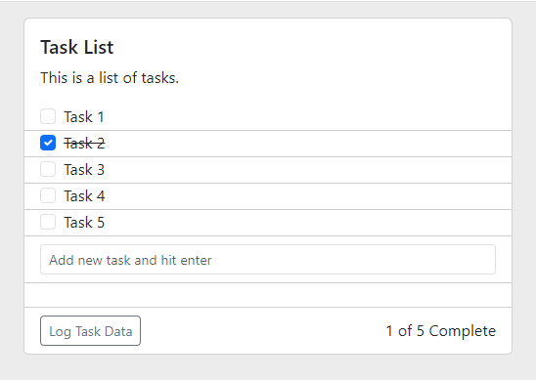
Demo Introduction
Simple Angular Application
Setting Up Angular
Components – Task and Task List
Directives – Built In and Custom onEnter
Services – Task Service
Templates – HTML Templates for Components
Routing – Simple Route Examples
Notes:
Demo Introduction
Simple Angular Application
Setting Up Angular
Components – Task and Task List
Directives – Built In and Custom onEnter
Services – Task Service
Templates – HTML Templates for Components
Routing – Simple Route Examples

Slide 9
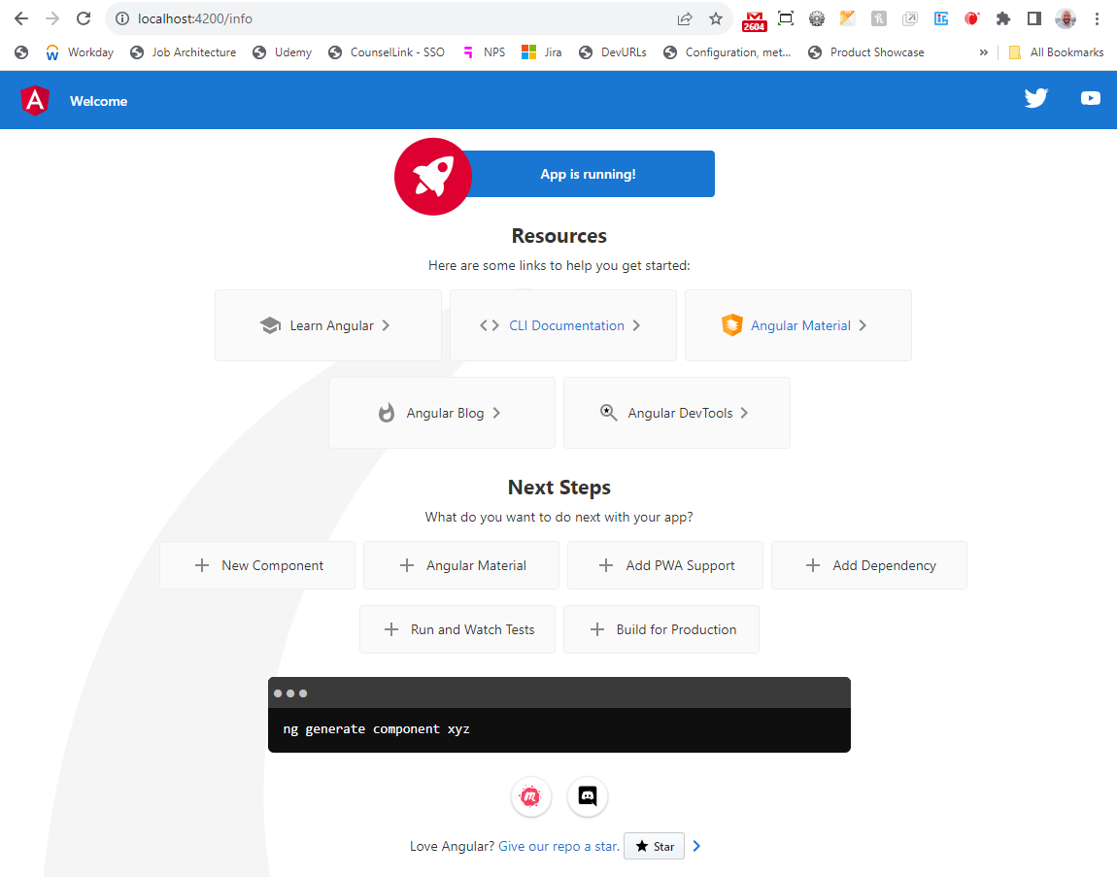
Setting Up Angular
Dependencies: Node.js and Angular CLI
Create an Angular Project with the CLI ng new project-name
Use Angular CLI to generate the code
Service: ng generate service service-name
Component: ng generate component component-name
Directive: ng generate directive directive-name
Run the Application Locally npm run start
https://angular.io/cli
Notes:
Setting Up Angular
Briefly describe the tools needed (Node.js, Angular CLI).
Provide step-by-step instructions for setting up a new Angular project.
Discuss the tools needed to set up Angular development (Node.js, Angular CLI).
Provide step-by-step instructions for setting up a new Angular project.

Slide 10
Questions?
Presented by Josh Weil Joshua.weil@lexisnexis.com
Notes:
Slide 16: Q&A
Open the floor for questions.
Open the floor for questions and engage with the audience.

Slide 11
Thank You!
Presented by Josh Weil Joshua.weil@lexisnexis.com
Notes:
Slide 17: Thank You
Thank your audience for their attention.
Provide contact information for further queries.
Thank your audience for their time and attention.
Provide your contact information for any further questions or assistance.

