Slide 1

NotebookLM-Style Consistency Test
Testing Unified Design System
February 2026

Slide 2

Typography Consistency
• All titles: 54pt Segoe UI Bold
• All content: 28pt Segoe UI Regular
• Line spacing: 1.5x for readability

Slide 3

Layout Precision
• Title: 0.6" from top, 0.8" from left
• Content: 2.2" from top, 0.8" from left
• Pixel-perfect positioning

Slide 4
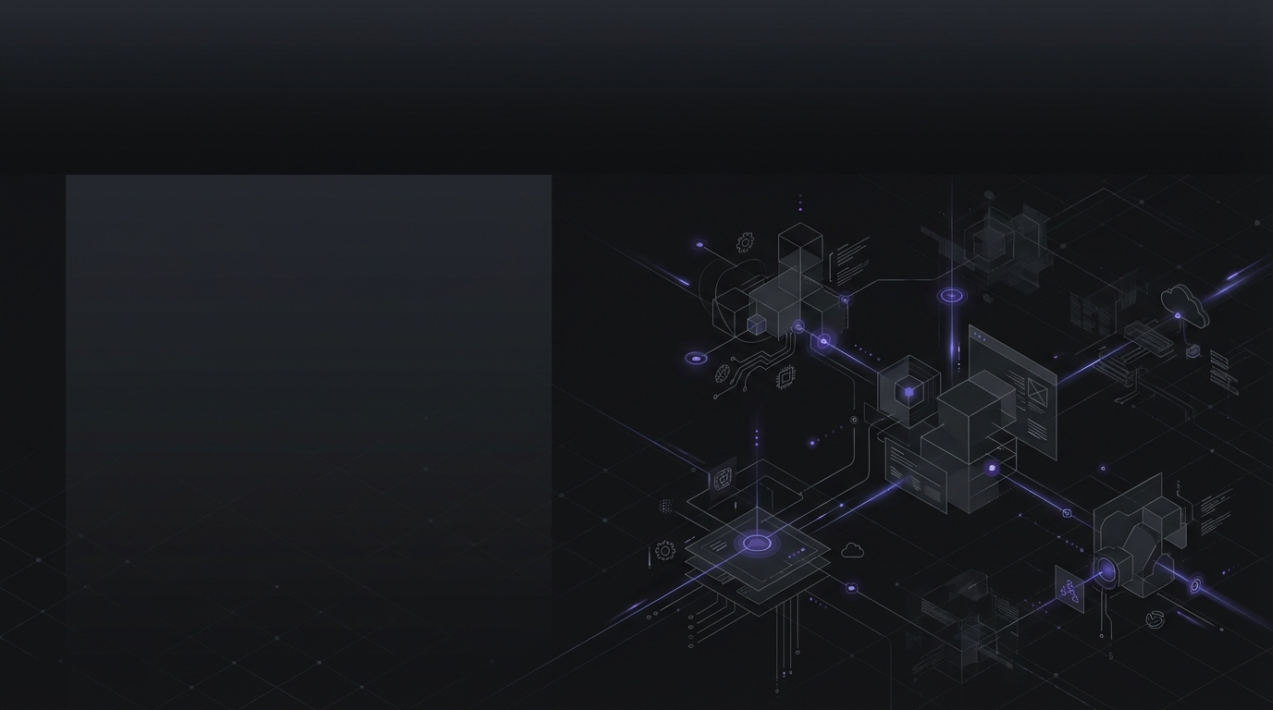
Visual Background Only
• AI generates backgrounds
• Text added programmatically
• No text in generated images

Slide 5
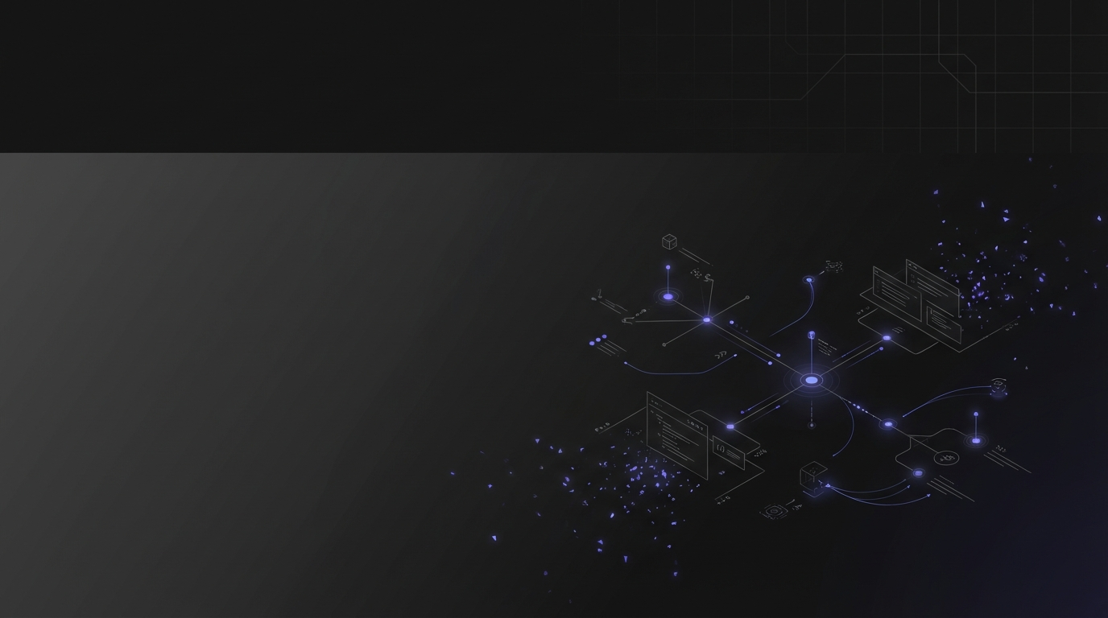
Thank You
Consistent Design System
NotebookLM Quality

