Slide 1
Batter Constrained UAV Motion Planning
I-Chen JWO(ijwo), Tzu-Chieh Tai(tzuchiet), Lung Jan(Ljan), Kyungzun Rim(krim)

Slide 2
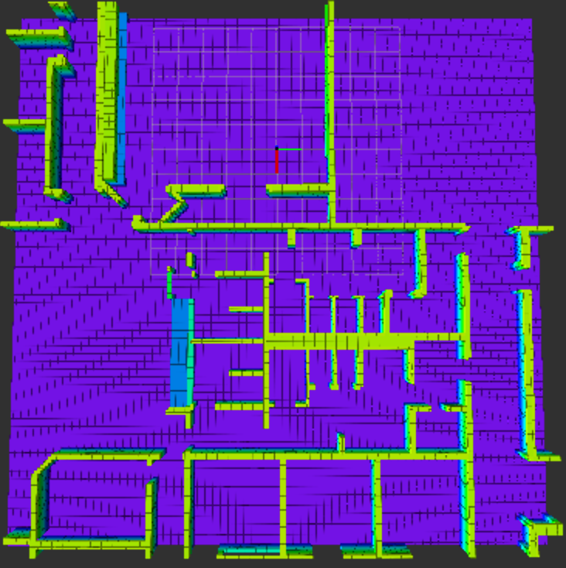
Problem Definition
Stage1 : Find path Stage2 : Optimal path (distance)
Stage3 : Battery Constraint Stage4 : Battery State Uncertainty

Slide 3
Math definition of the problem
Goal : To traverse through all given waypoints
in any order with minimum cost
2. Cost function : f = w_{t} * time + w2 *Charge Used

Slide 4
How to solve the problem
Waypoints

Slide 5
Video
Waypoints

Slide 6
Problem Definition
Waypoints

Slide 7
Problem Definition
Waypoints

