Slide 1
Discussion Speaker : Wei Meng Lin

Slide 2
Work List
Axiom APMRA analysis All Reevaluated
Colorectal cancer
Lung
Breast
Liver
Oral
Prostate
Ovarian
CVD, hypertension, stroke, asthma
Mendelian

Slide 3
Work List
Mendelian analysis workflow
Neonatal genetic disease list
Find Associated disease from OMIM, omim_phen, clinvar_traits, nhgri_traits
Reevaluate

Slide 4
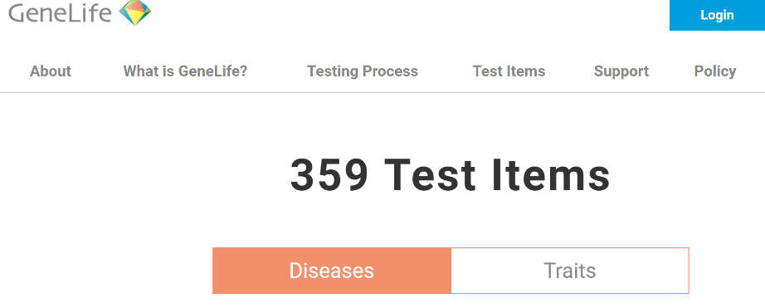
Work List
Refer to GeneLife Test Items 359 items
Diseases 148 items
Traits 211 items

Slide 5
Work List
Disease Category
Digestive System 19 items
Cardiovascular System, Circulatory System, Neurological System 30 items
Respiratory System 13 items
Reproductive System, Urinary System 25 items
Endocrine Glands, Blood, Metabolism 21 items
Bone, Joint (Articulation) 13 items
Skin 9 items
Eye, Ear, Nose 12 items
Others 6 items

Slide 6
Work List
Traits Category
Blood, Metabolism 76 items
Bｏｄｙ Structure, Growth 32 items
Nutrients System 12 items
Dietary behavior 12 items
Skin, Hair 8 items
Circulatory System 9 items
Eye 11 items
Inflammation 9 items
Body traits 14 items
Infections 5 items
Others 23 items

Slide 7
Work List
Axiom APMRA analysis Diseases + Traits = 359 + 4 = 363 items
Colorectal cancer → merged to Digestive System
Lung → added to Others of Disease
Breast → merged to Reproductive System, Urinary System
Liver → merged to Digestive System
Oral → added to Others of Disease
Prostate → merged to Reproductive System, Urinary System
Ovarian → merged to Reproductive System, Urinary System
CVD, hypertension, stroke, asthma → added to Others of Disease
Mendelian → added to Others of Disease

Slide 8
Work List
1000 genome and APMRA analysis
2504 people in 1000 genome database
711237 SNPs found in the 1000 genome database while APMRA has 831425 SNPs (ref. rate 85.54%)
Set variation type
Ignore ClinVar By ClinVar
Average: 553876.76 Average: 350.4
Type | Weights
1|1 | 4 (added)
1|0 0|1 | 2
0|0 | 0
Type | Weights
1|1 7.35% | 1.2 (multiplied)
1|0 0|1 13.49% | 1.1
0|0 79.16% | 0

Slide 9
Future Work
Complete Axiom APMRA disease dictionary
Complete reevaluation of other diseases
First demo of new website and app before Chinese New Year

Slide 10
Thank you for this opportunity

