Slide 1
Experiment procedure (Part 01)
Fixation
Sample
Delay
Response
ITI
500 ms
200 ms
1300 ms
Until Response
1000 -1500 ms
Orientation (12 types) : 15°, 45°, 75°, 105°, 135°, 165°, 195°, 225°, 255°, 285°, 315°, 345°;
Color (3 types) : Red, Blue, Green;
Duration per trial ~= 5 s
Trial number = 360(5 Blocks)
Total duration ~= 35 min

Slide 2
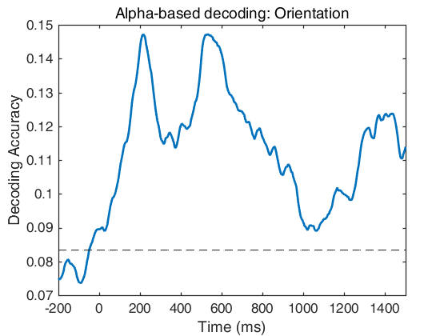
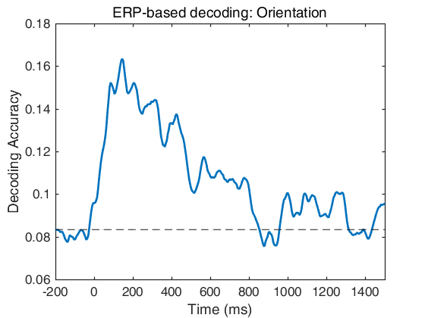
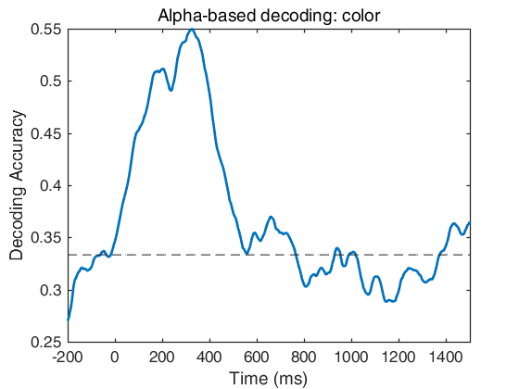
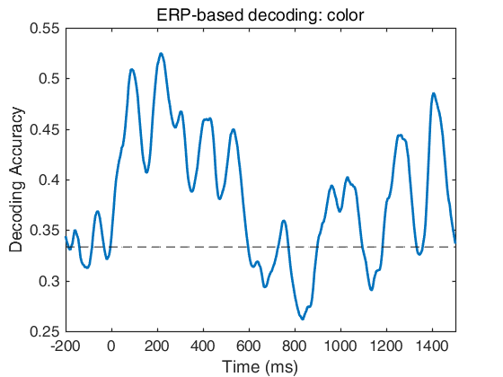
Decoding results in part 01

Slide 3
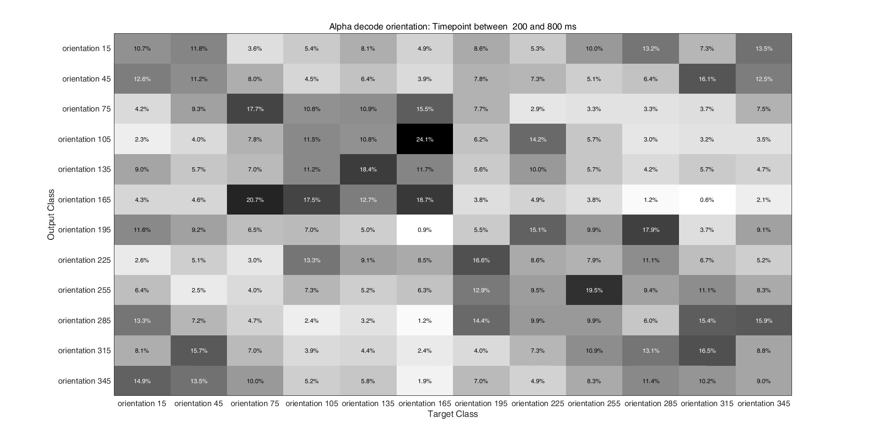

Slide 4
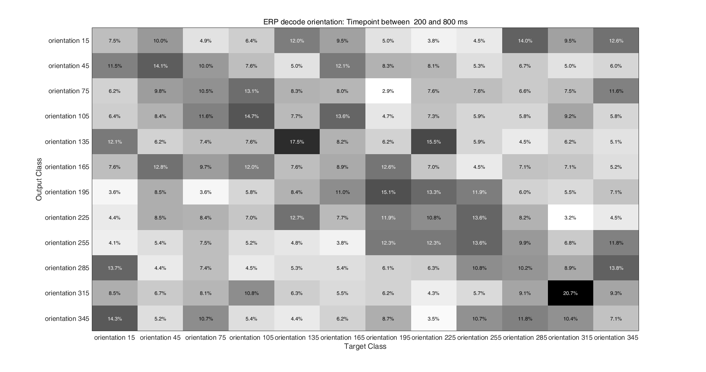

Slide 5
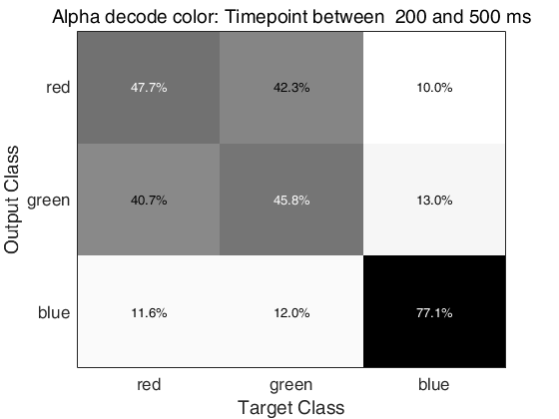
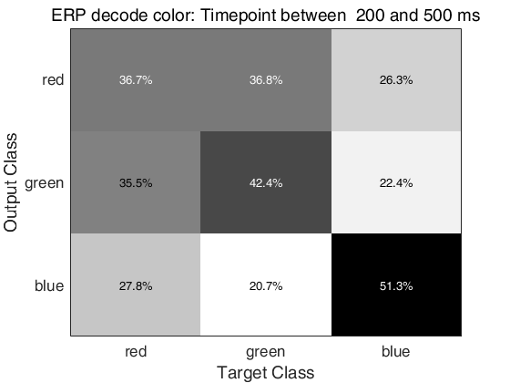

Slide 6
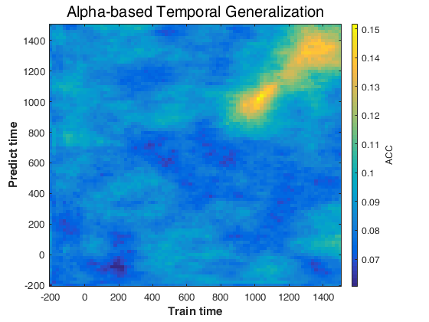
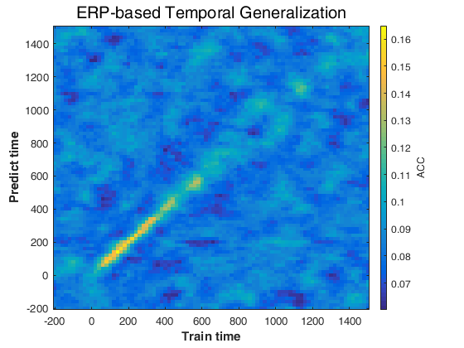
Temporal generalization in part 01：Orientation

Slide 7
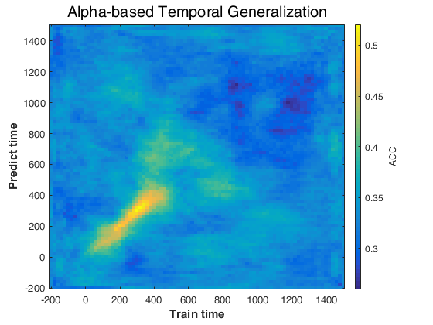
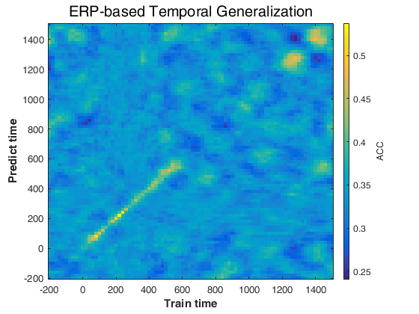
Temporal generalization in part 01：Color

Slide 8
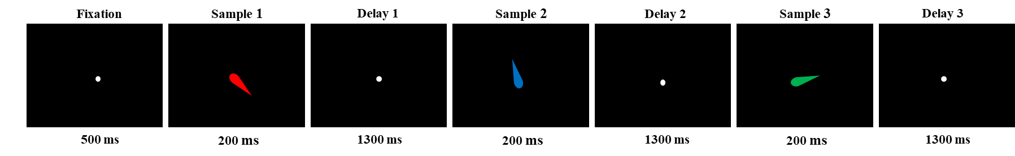
Experiment procedure (Part 2):
Orientation (12 types) : 15°, 45°, 75°, 105°, 135°, 165°, 195°, 225°, 255°, 285°, 315°, 345°;
Color (3 types) : Red, Blue, Green;
Duration per trial ~= 5 s
Trial number = 144(3 Blocks)

Slide 9
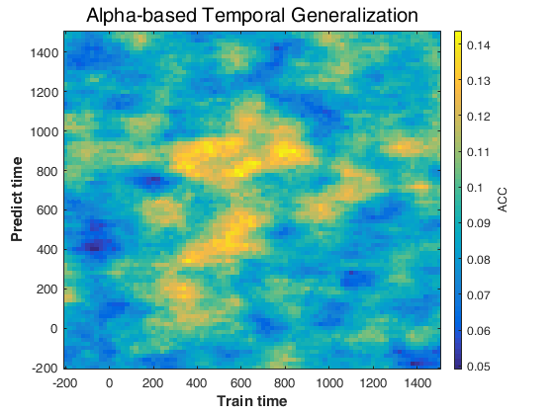
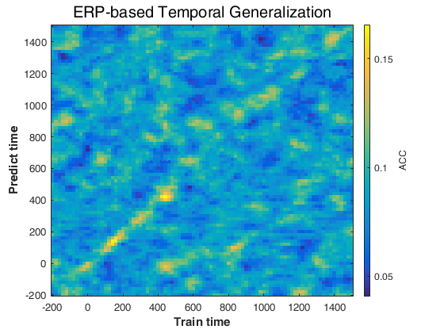
Temporal generalization in delay 01 (part 02)
Use decoder trained in part 01 to predict presentation of item 01 in delay 01 (part 02)

Slide 10
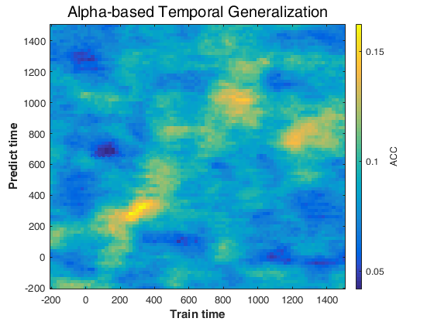
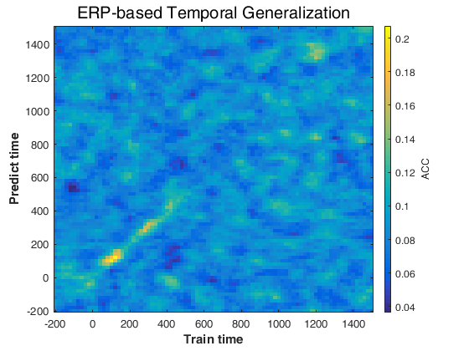
Temporal generalization in delay 02 (part 02)
Use decoder trained in part 01 to predict presentation of item 02 in delay 02 (part 02)

Slide 11
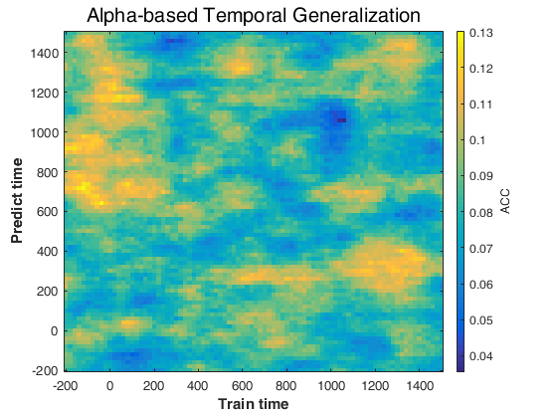
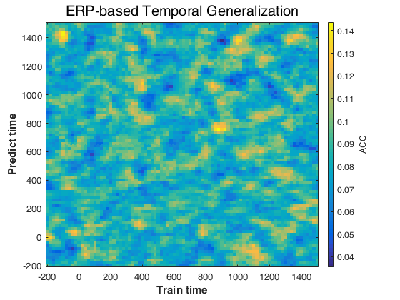
Temporal generalization in delay 02 (part 02)
Use decoder trained in part 01 to predict presentation of item 01 in delay 02 (part 02)

Slide 12
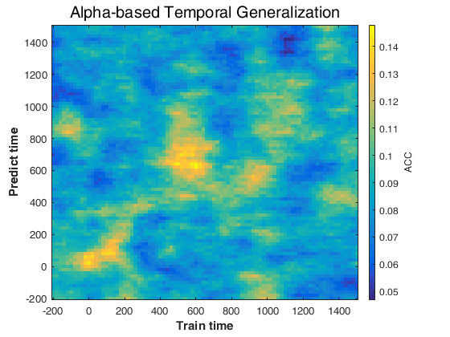
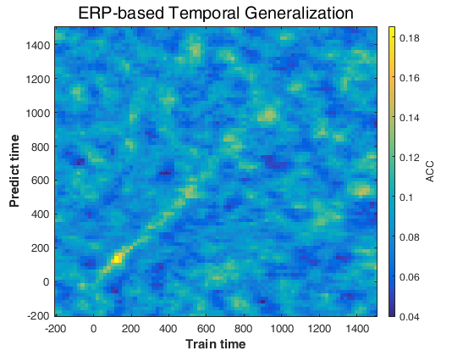
Temporal generalization in delay 03 (part 02)
Use decoder trained in part 01 to predict presentation of item 03 in delay 03 (part 02)

Slide 13
Behavior: Modeling Response Error Distributions
Response error: the difference of orientation between the reported and presented orientations, which could range from -180° to 180°.
The response error distribution for each participant was modeled as the mixture of a von Mises distribution and a uniform distribution, corresponding to trials in which the sample stimulus was successfully or unsuccessfully stored, respectively.
Maximum likelihood estimates were obtained for three parameters:
The mean of the von Mises component (μ), corresponding to response bias;
The dispersion of the von Mises distribution (s.d.), corresponding to mnemonic precision;
The height of the uniform distribution (P_{f}), corresponding to the probability of forgetting the sample stimulus

Slide 14
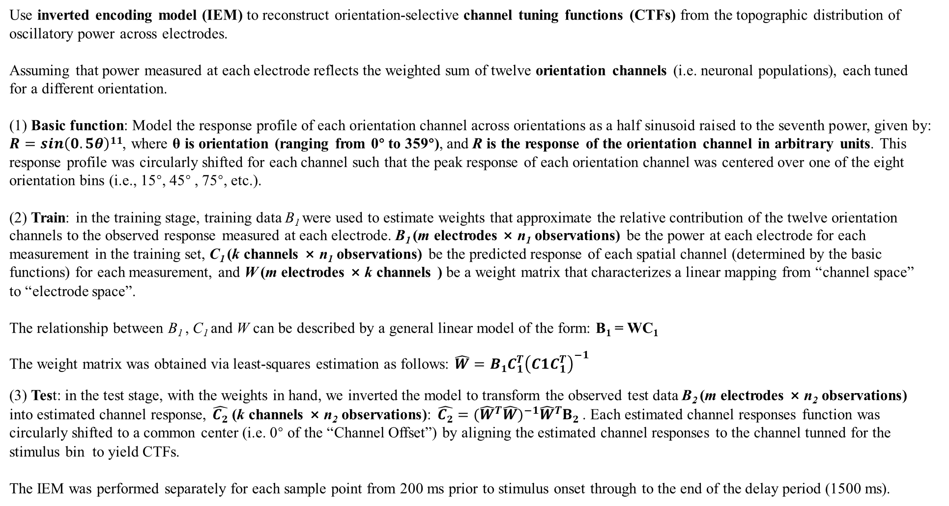
Inverted encoding model (IEM)
Use inverted encoding model (IEM) to reconstruct orientation-selective channel tuning functions (CTFs) from the topographic distribution of oscillatory power across electrodes.
Assuming that power measured at each electrode reflects the weighted sum of twelve orientation channels (i.e. neuronal populations), each tuned for a different orientation.
(1) Basic function: Model the response profile of each orientation channel across orientations as a half sinusoid raised to the seventh power, given by: $R=sin\left(0.5θ\right)11$, where θ is orientation (ranging from 0° to 359°), and R is the response of the orientation channel in arbitrary units. This response profile was circularly shifted for each channel such that the peak response of each orientation channel was centered over one of the eight orientation bins (i.e., 15°, 45° , 75°, etc.).
(2) Train: in the training stage, training data B₁ were used to estimate weights that approximate the relative contribution of the twelve orientation channels to the observed response measured at each electrode. B₁ (m electrodes × n₁ observations) be the power at each electrode for each measurement in the training set, C₁ (k channels × n₁ observations) be the predicted response of each spatial channel (determined by the basic functions) for each measurement, and W (m electrodes × k channels ) be a weight matrix that characterizes a linear mapping from “channel space” to “electrode space”.
The relationship between B₁ , C₁ and W can be described by a general linear model of the form: B₁ = WC₁
The weight matrix was obtained via least-squares estimation as follows: $\hat{W}=B1C_{1}^{T}{（C1C_{1}^{T}）}^{−1}$
(3) Test: in the test stage, with the weights in hand, we inverted the model to transform the observed test data B₂ (m electrodes × n₂ observations) into estimated channel response, $\hat{C2}$ (k channels × n₂ observations): $\hat{C2}={({\hat{W}}^{T}\hat{W})}^{−1}{\hat{W}}^{T}B2$ . Each estimated channel responses function was circularly shifted to a common center (i.e. 0° of the “Channel Offset”) by aligning the estimated channel responses to the channel tunned for the stimulus bin to yield CTFs.
The IEM was performed separately for each sample point from 200 ms prior to stimulus onset through to the end of the delay period (1500 ms).

Slide 15
Statistics of CTFs
To quantify the orientation selectivity of CTFs, linear regression was used to estimate CTF slope, where higher CTF slope indicates greater orientation selectivity.
To test whether CTF selectivity was reliably above chance, we tested whether CTF slope was greater than zero using a one-sample t-test. Because mean CTF slope may not be normally distributed under the null hypothesis, a Monte Carlo randomization procedure was employed to empirically approximate the null distribution of the t-statistic.
CTF selectivity was deemed reliably above chance if the probability of a Type I Error (the probability of obtaining a t-statistic from the surrogate null distribution greater than or equal to the observed t-statistic) was less than 0.01.
This permutation procedure was applied to each time point and each frequency band independently.

Slide 16
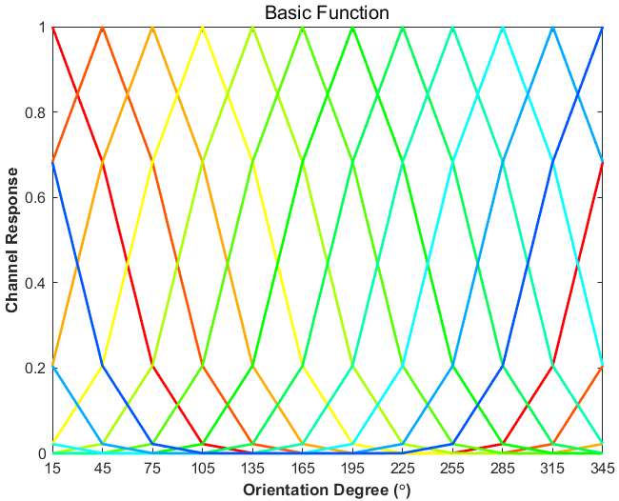

Slide 17
Experiment procedure (Part 01)
Fixation
Sample
Delay
Response
ITI
500 ms
200 ms
1300 ms
Until Response
1000 -1500 ms
Orientation (12 types) : 15°, 45°, 75°, 105°, 135°, 165°, 195°, 225°, 255°, 285°, 315°, 345°;
Color (3 types) : Red, Blue, Green;
Duration per trial ~= 5 s
Trial number = 360(5 Blocks)
Total duration ~= 35 min

Slide 18
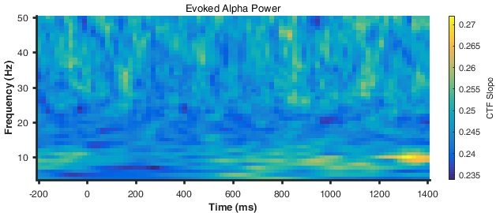
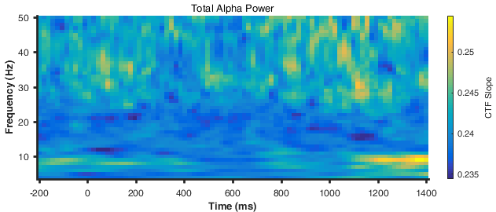
Identify the frequency bands that track orientation in part 01
An IEM was used to reconstruct orientation-selective channel tuning functions (CTFs) from the topographic distribution of evoked power across a broad range of frequency (4-50 Hz, in increments of 1 Hz) and time.
An IEM was used to reconstruct orientation-selective channel tuning functions (CTFs) from the topographic distribution of total power across a broad range of frequency (4-50 Hz, in increments of 1 Hz) and time.

Slide 19
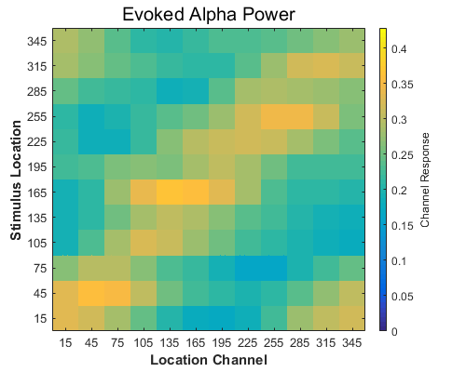
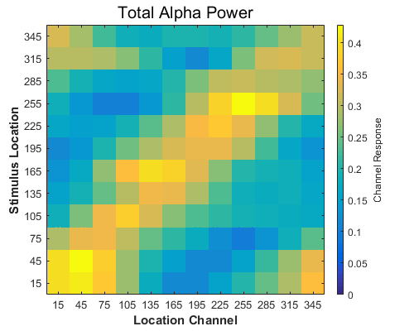
Channel response for each orientation bin in part 01
Channel responses reconstructed from evoked alpha power after stimulus onset (averaged from 0 – 1500 ms) shown for each of the twelve stimulus orientation bins
Channel responses reconstructed from total alpha power after stimulus onset (averaged from 0 – 1500 ms) shown for each of the twelve stimulus orientation bins

Slide 20
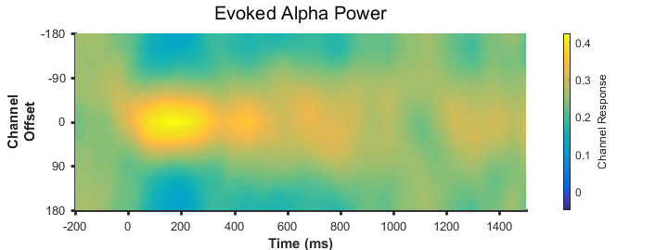
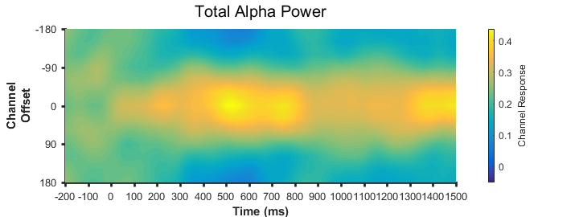
Average alpha-band channel response across time for all twelve orientations in part 01
Orientation-selective CTFs reconstructed from evoked alpha (8-12 Hz) activity during -200 ms to 1500ms relative stimulus onset
Orientation-selective CTFs reconstructed from total alpha (8-12 Hz) activity during -200 ms to 1500ms relative stimulus onset

Slide 21
