Slide 1
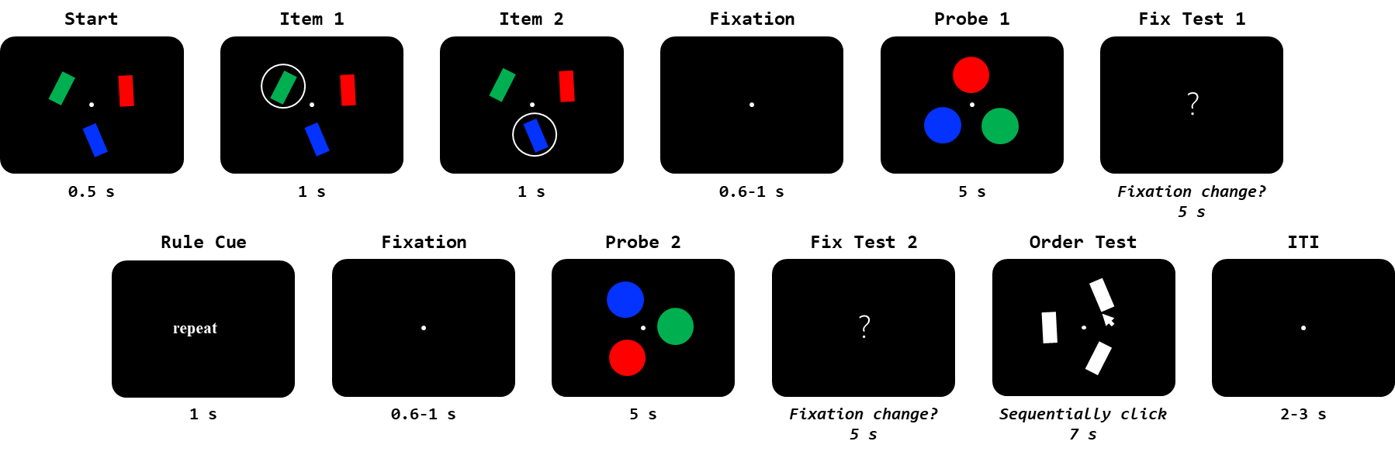
Experiment procedure
Number of trials = 80 trials × 2 rule
Number of participants = 20

Slide 2
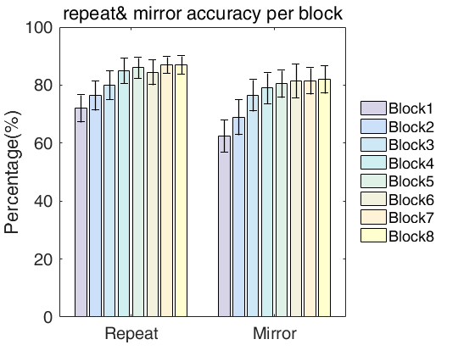
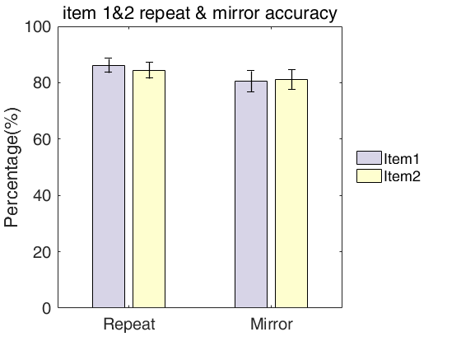
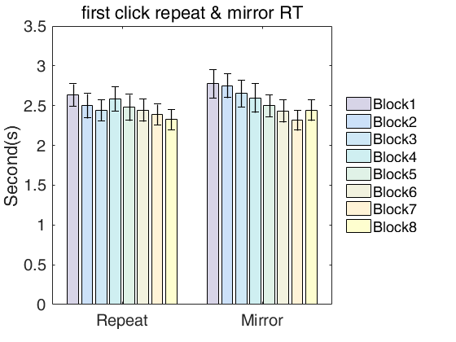
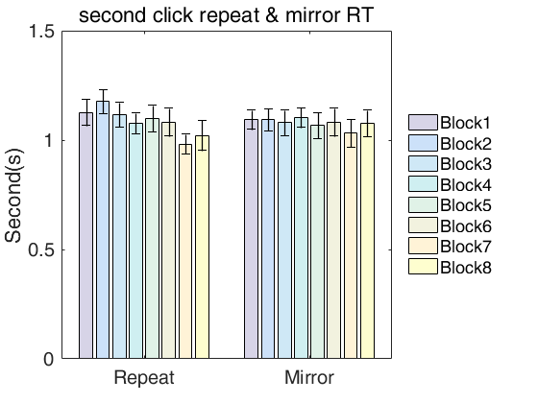
Behavior results

Slide 3
Temporal Response Function (TRF)
Method (1):
Calculate TRF in each trial manner (4s)
Average TRF for each subject
Calculate time-frequency representation for averaged TRF
Group average
Method (2):
Calculate TRF in each trial manner (4s)
Calculate time-frequency representation for each TRF
Average time-frequency power spectrum across trials for each subject
Group average
Method (3):
Merge/Concatenate luminance sequence together across trials, same as EEG signal (>120s)
Calculate the TRF for each subject
Calculate time-frequency representation for each TRF
Group average

Slide 4
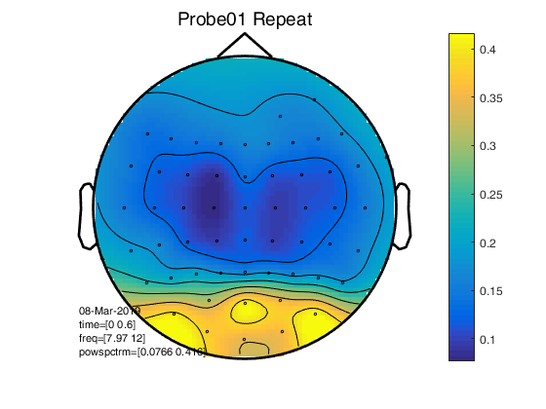
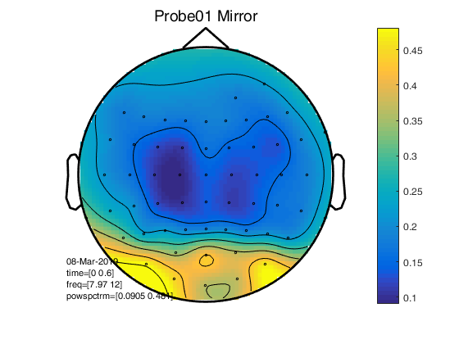
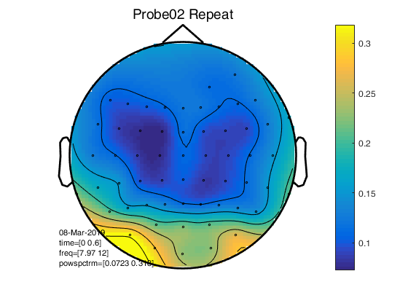
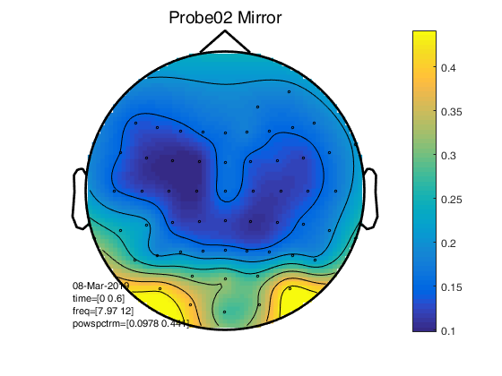
Topography for (WM+NWM) alpha-band TRF responses
Channal of Interest: Pz; P1,P3,P5,P7; P2,P4,P6,P8; Poz; PO3,PO7; PO4,PO8; Oz; O1,O2
(Significant larger (WM+NWM) alpha-band TRF responses compared to average of all channels)

Slide 5
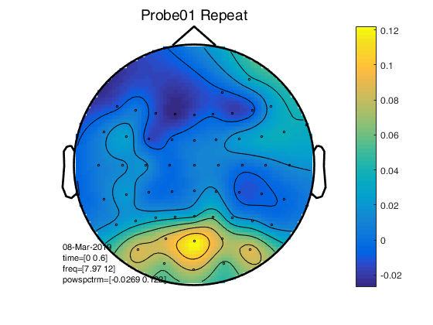
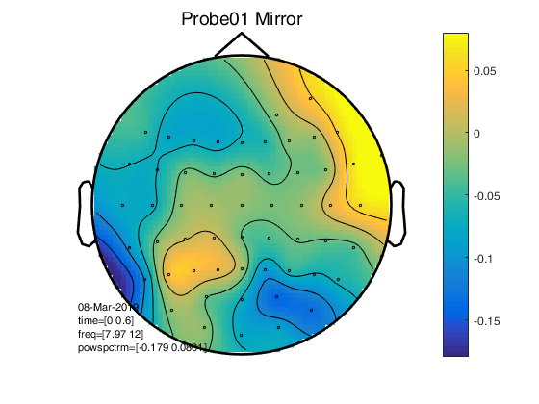
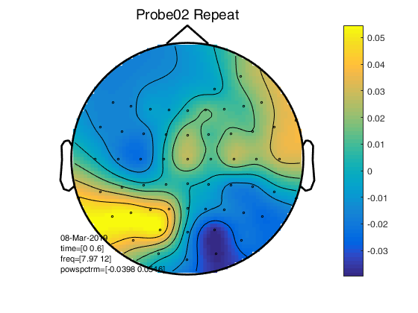
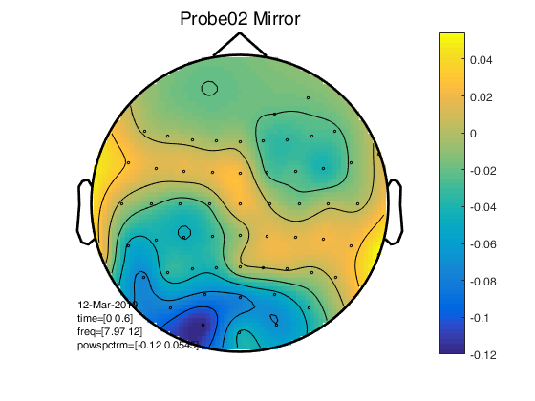
Topography for (WM-NWM) alpha-band TRF responses

Slide 6
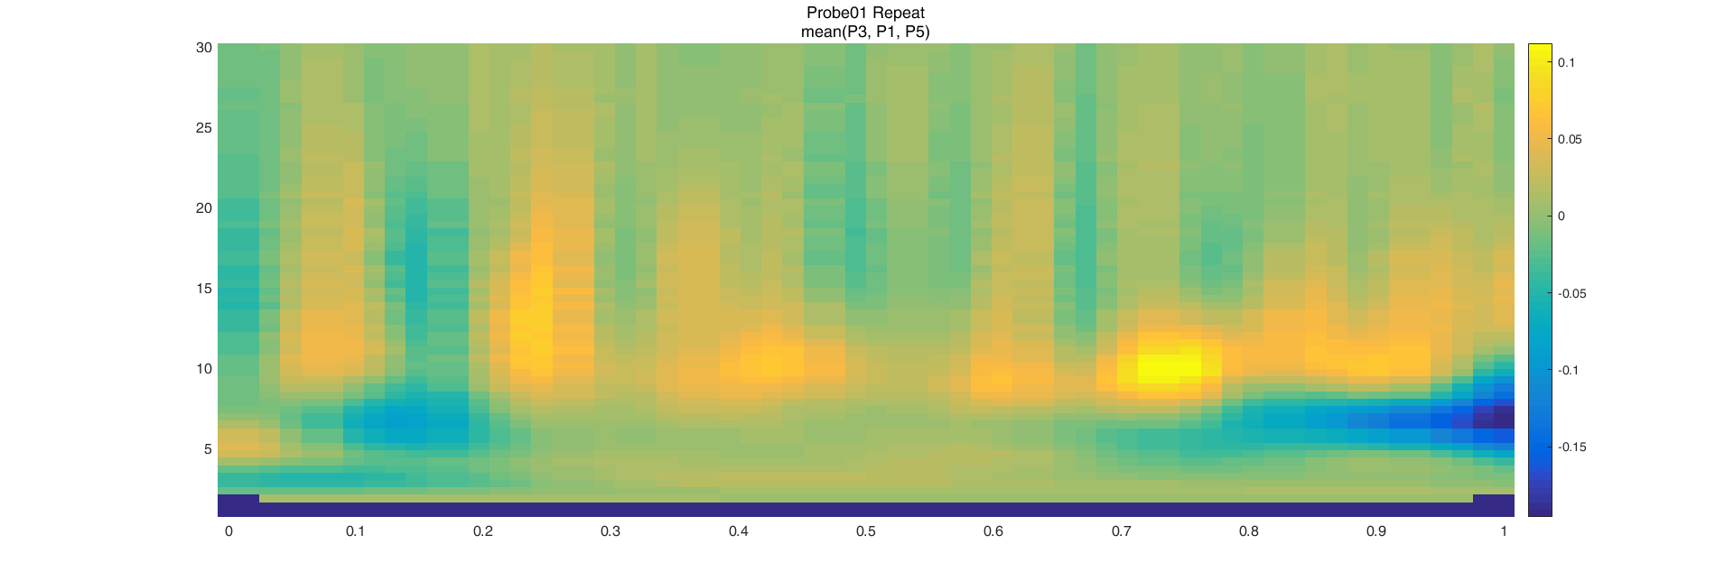
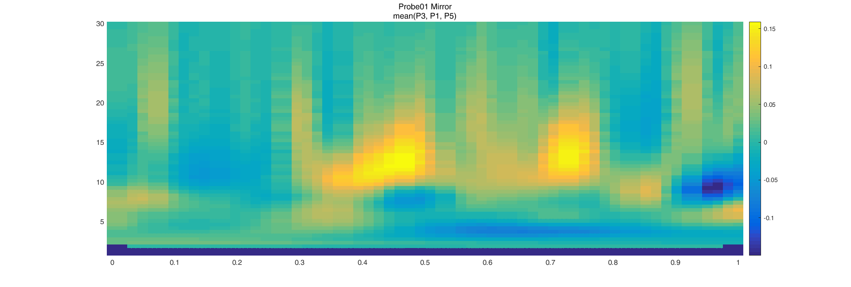
(WM-NWM) alpha-band TRF responses in ROI

Slide 7
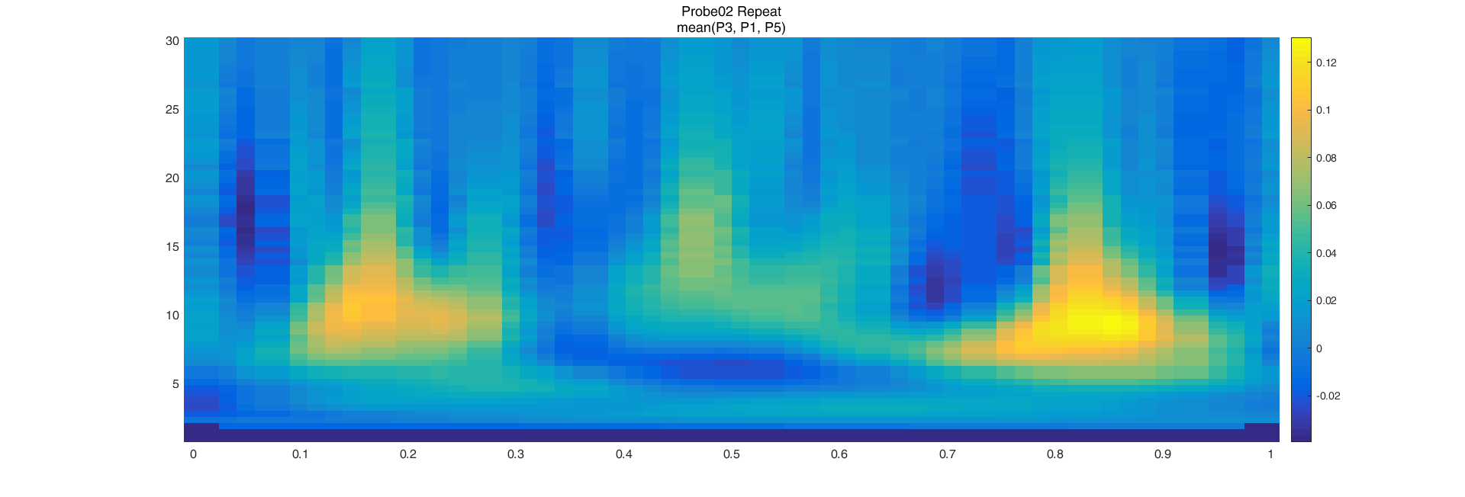
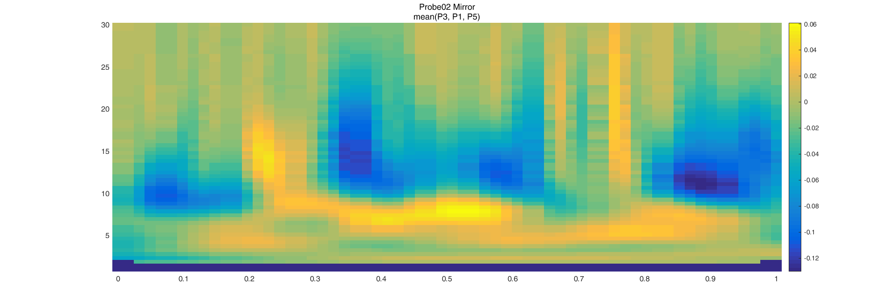
(WM-NWM) alpha-band TRF responses in ROI

Slide 8
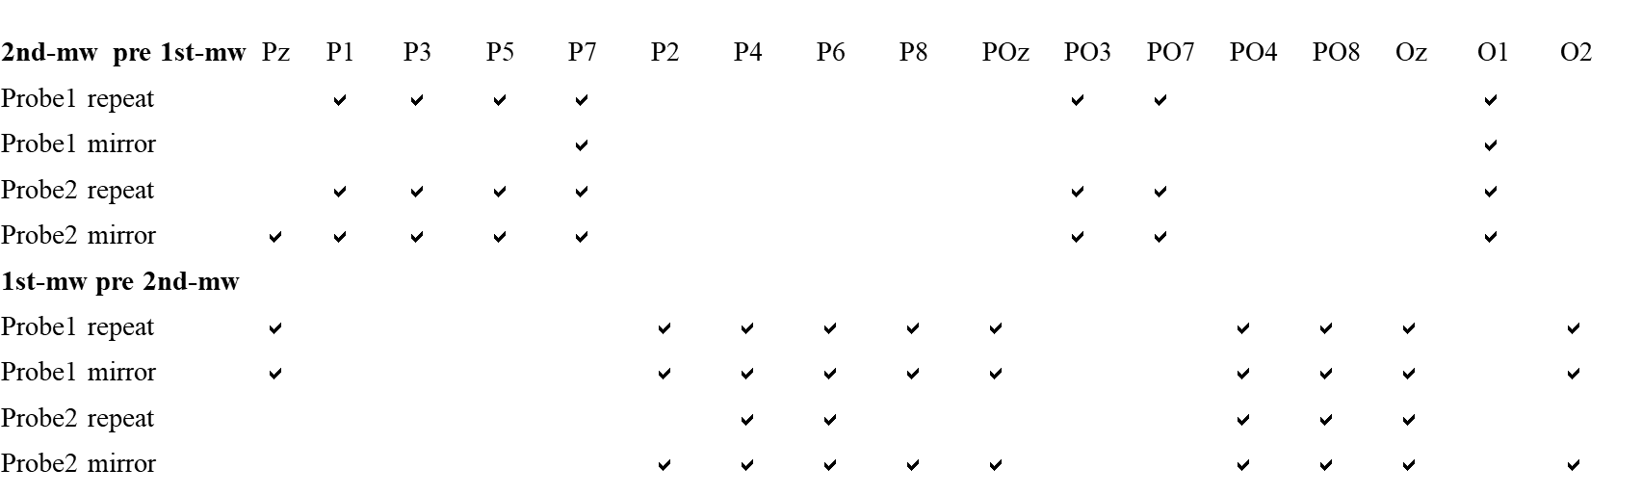
Normalized alpha power time courses (subtract the average of three items)

Slide 9
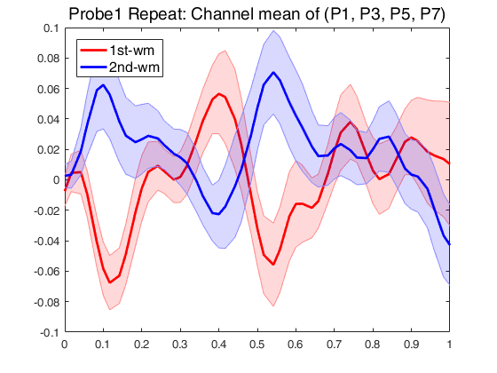
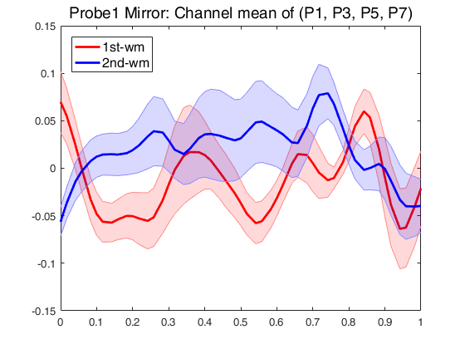
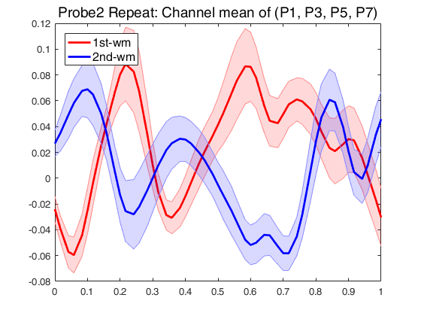
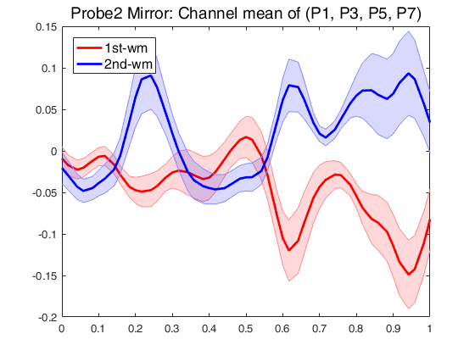
Normalized alpha power time courses (average of P1, P3, P5, P7)

Slide 10
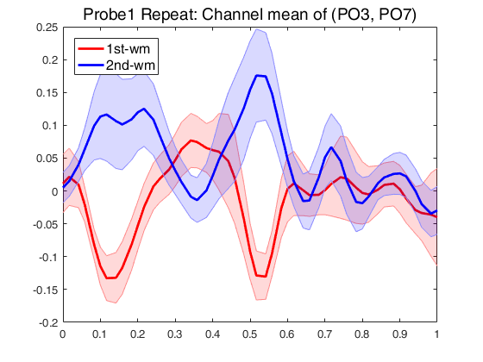
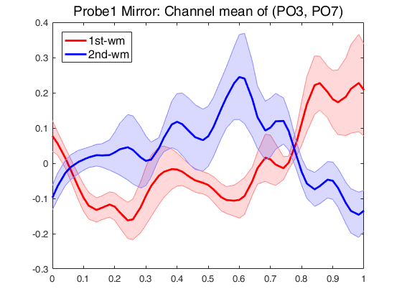
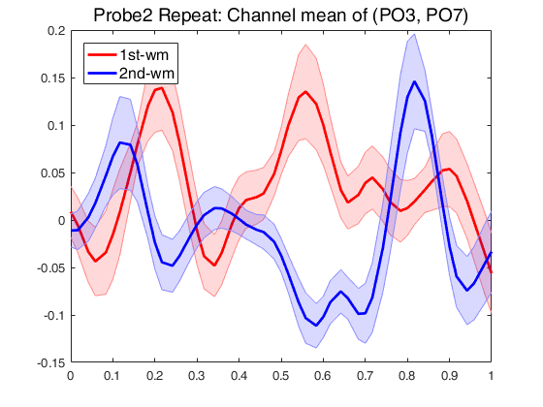
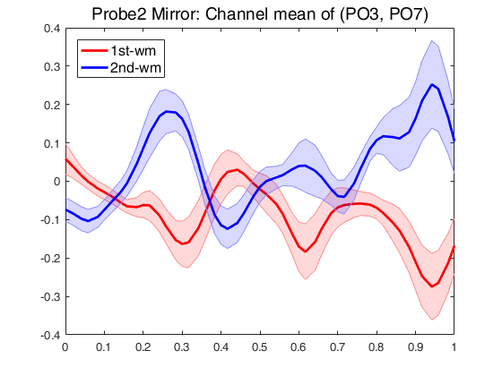
Normalized alpha power time courses (average of PO3, PO7)

Slide 11
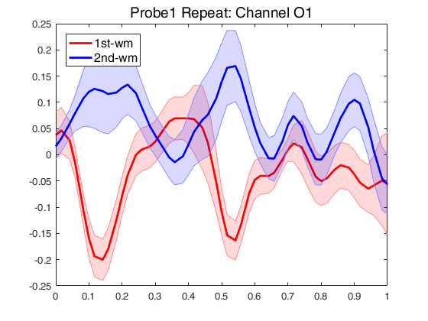
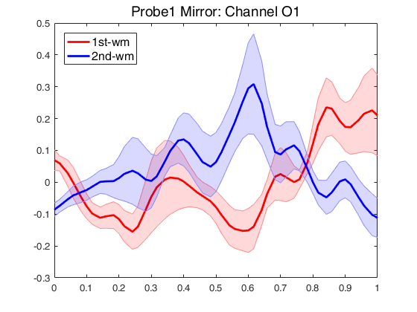
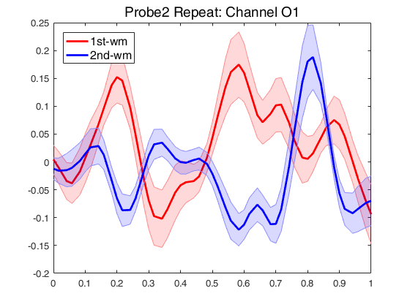
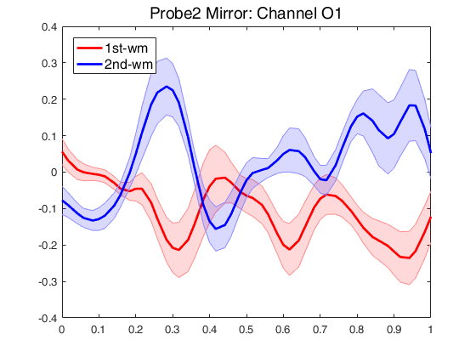
Normalized alpha power time courses (average of O1)

Slide 12
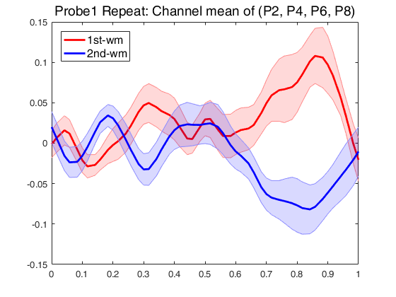
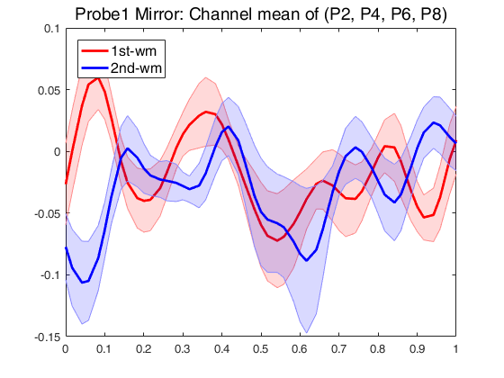
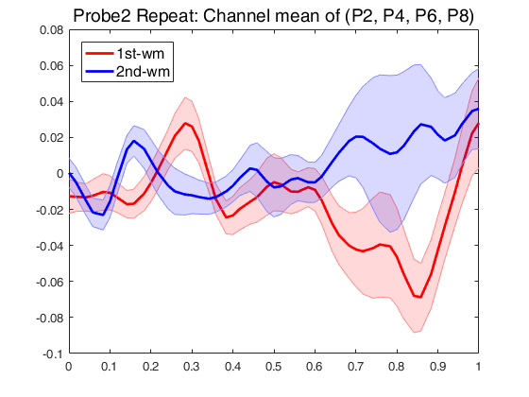
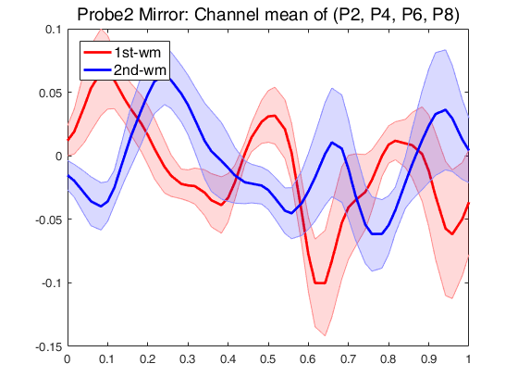
Normalized alpha power time courses (average of P2, P4, P6, P8)

Slide 13
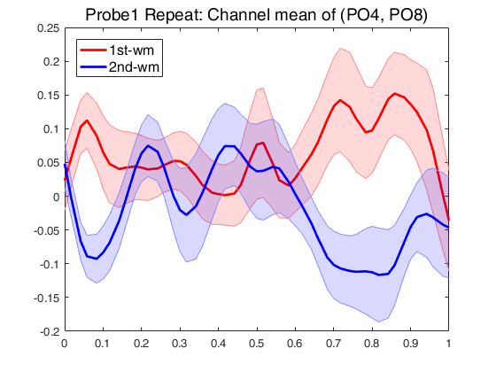
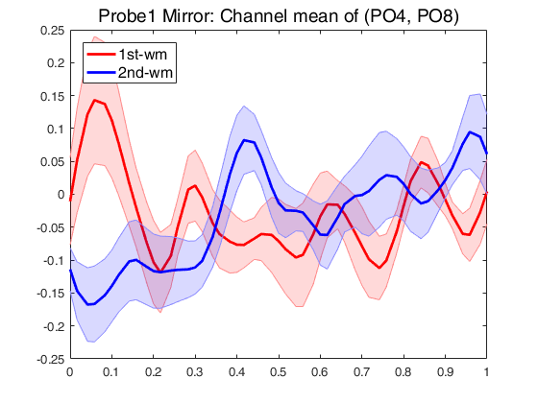
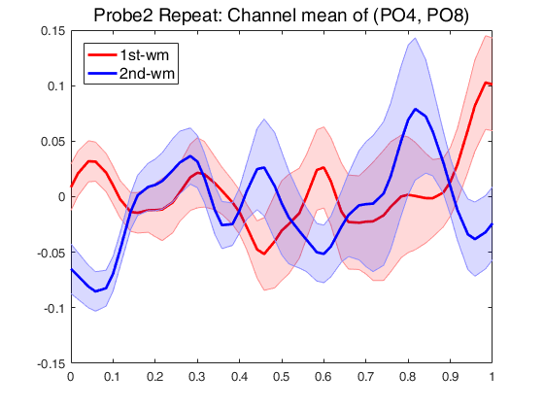
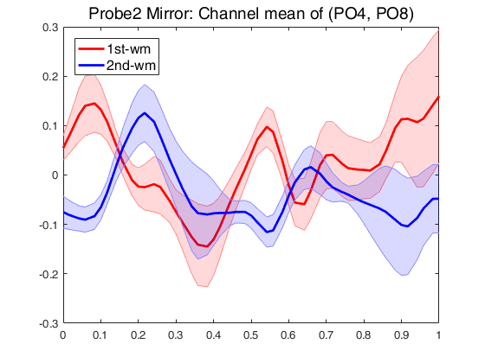
Normalized alpha power time courses (average of PO4, PO8)

Slide 14
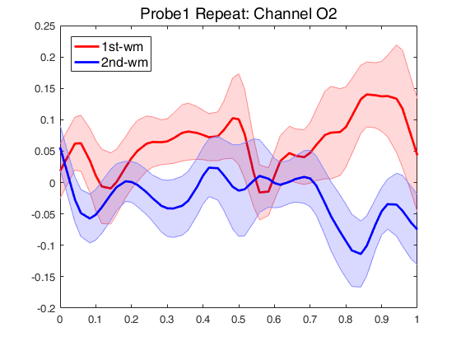
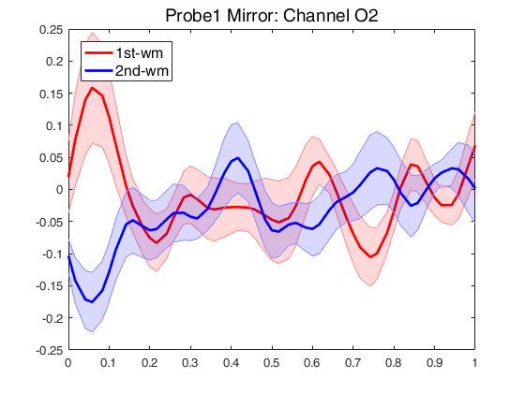
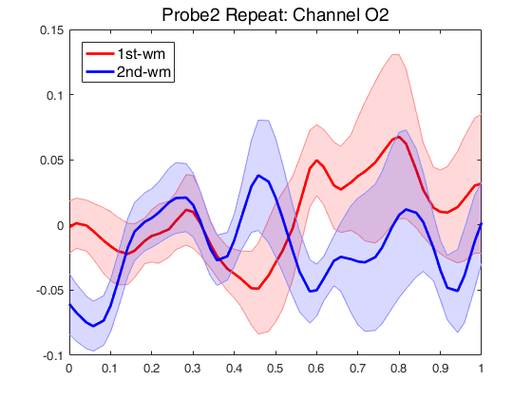
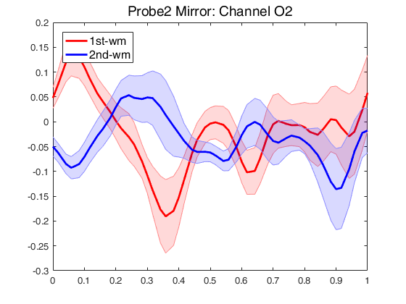
Normalized alpha power time courses (average of O2)

Slide 15
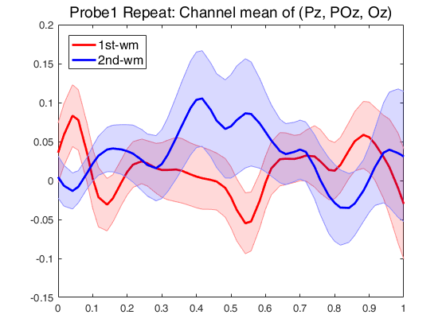
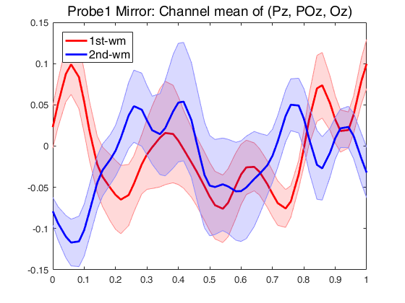
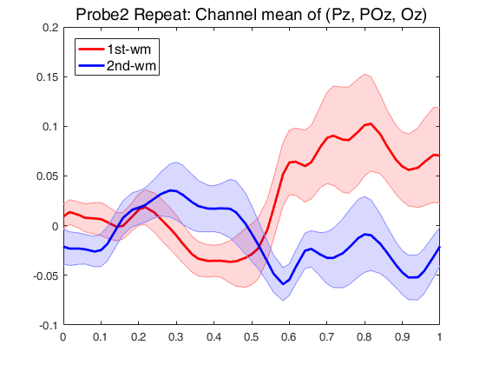
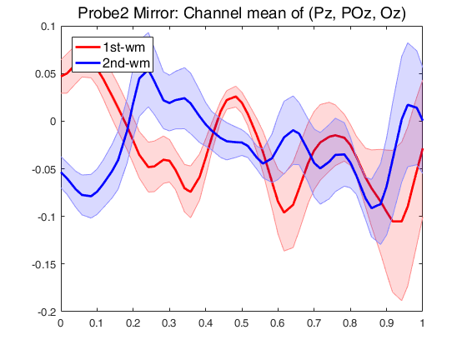
Normalized alpha power time courses (average of Pz, POz , Oz)

