Slide 1
PV is conserved is our strongest statement to explain weather But then where does PV come from?
ATM 405/561
Brian Mapes, Univ of Miami

Slide 2
Outline
Read this brief review of our journey from not-at-all-conserved momentum, to sorta-conserved relative vorticity, to more- conserved absolute vorticity, to most-conserved potential vorticity.
https://www.notion.so/miamimapes/Horizontal-vorticity-and-PV-as-explanations-for-cyclones-anticyclones-2e6d2c075dba44699dc822ca5748e2e8

Slide 3
Questions about it: write answers
1. Using the concepts from the reading, and earlier homework, explain how patches or elements of relative vorticity advect other patches of relative vorticity, under the assumption that relative vorticity is sorta almost conserved.
2. Using the concepts from the reading, and earlier homework, explain how planetary vorticity is converted to relative vorticity, so that their sum, the absolute vorticity, is almost conserved. Consider a loop of air moving in latitude, and explain how the different Coriolis force felt by its northern and southern edges acts as a torque on the fluid loop.
3. Using the concepts from the reading, and the reading, explain how static stability is converted to absolute vorticity, so that potential vorticity, their product, arguably the truest essence of vortices (cyclones and anticyclones) is really really almost conserved.
4. Based on the end of the reading, what you will look for in vertically resolved data about diabatic heating rate in the atmosphere to explain the ultimate source of PV?

Slide 4
PV is conserved -- almost
APPROXIMATE term that generates PV on the Earth
Mostly, you are looking for WHERE THE DIABATIC OR PHYSICAL HEATING RATE INCREASES OR DECREASES WITH HEIGHT, weighted by (f+𝜁). In both hemispheres… so be careful with ”cyclonic”.

Slide 5
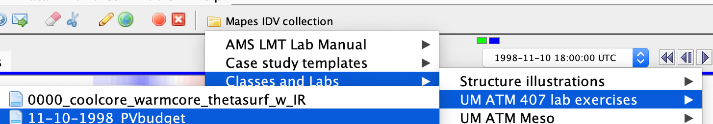
Assignment part 1: global view
Open the bundle 11-10-98 PV budget
Orient yourself to its displays, in both windows
a pole-to-pole transect of the zonal mean heating rates (averaged around the whole Earth)
A map view with many displays (including movable cross sections).

Slide 6
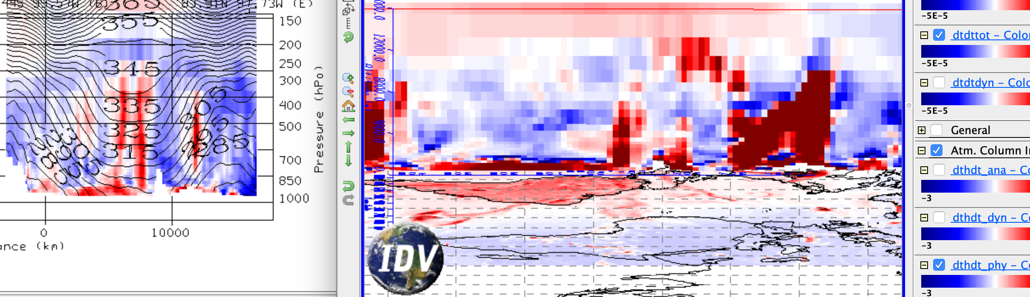
transect of zonal mean diab. heating, cross section of total diab. heating, map of column integral diab. heating

Slide 7
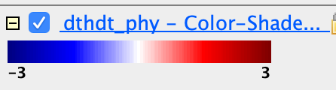
Assignment part 1: global view
What time of year is it? How can you see that in the column-integrated heating rate map dthdt_phy, or other radiative heating rates?

Slide 8
Assignment part 1: global view
Now turn to the Transect View window, showing average cross sections all around the Earth. Create a slide showing the transect of total diabatic heating. Label it: where is the south pole, the north pole? Hint: Antarctica is mountainous.
The units of all heating rates are are K/s. What is the color range in K/day?

Slide 9
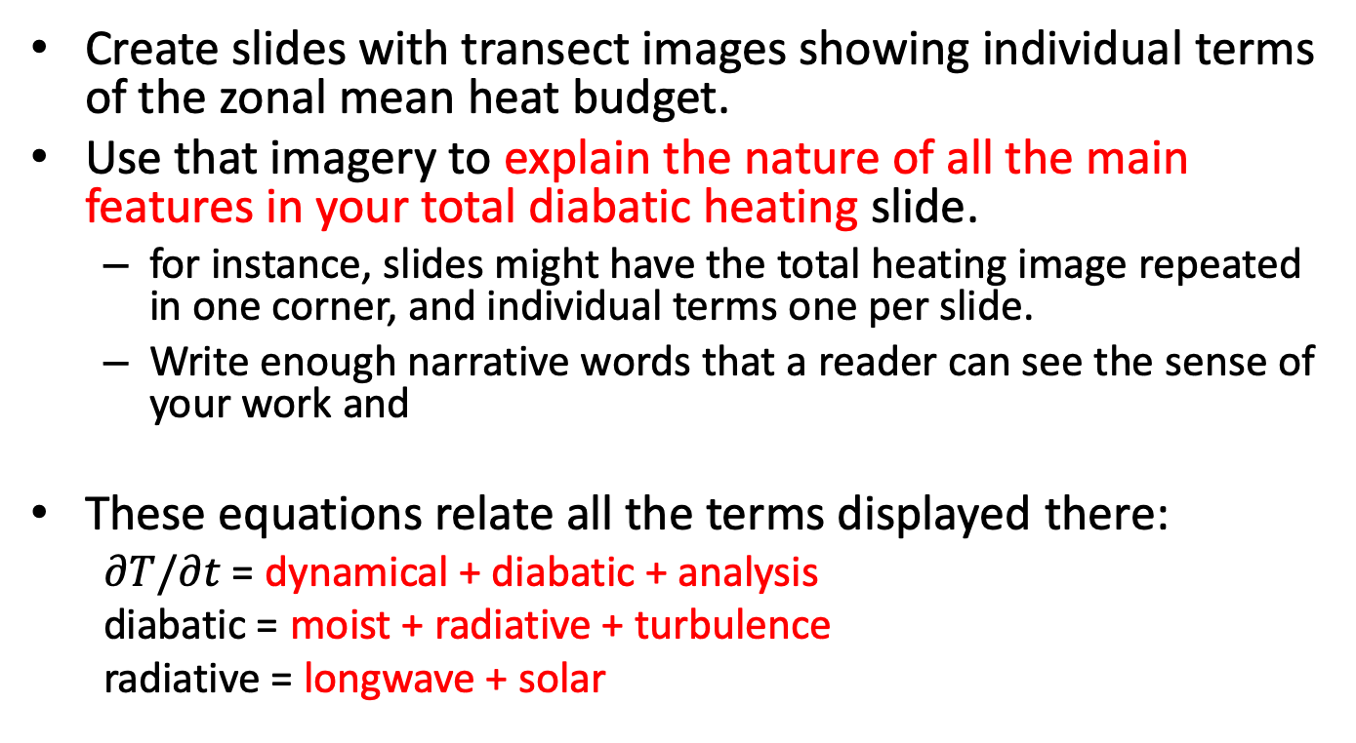
Assignment part 1: global view
Create slides with transect images showing individual terms of the zonal mean heat budget.
Use that imagery to explain the nature of all the main features in your total diabatic heating slide.
for instance, slides might have the total heating image repeated in one corner, and individual terms one per slide.
Write enough narrative words that a reader can see the sense of your work and
These equations relate all the terms displayed there:
$∂T/∂t$ = dynamical + diabatic + analysis
diabatic = moist + radiative + turbulence
radiative = longwave + solar

Slide 10
Assignment part 1: global view
Radiation and clouds:
Toggle the cloud fraction display with the radiative heating rate displays. Can you see any features that clearly indicate how clouds affect radiation?
clouds scatter solar photons, which are absorbed by vapor, especially at low levels.
clouds cool by emitting longwave from their tops
clouds absorb upwelling longwave from the surface at their bases (hard to see in the zonal mean, clearer in individual cross sections in Part 2)

Slide 11
Assignment part 1: global view
From your total diabatic heating, indicate areas where PV tendency is positive and negative. Also label these areas as cyclonic or anticyclonic tendencies.
Does the zonal mean PV transect resemble areas where your PV tendency is strong? It’s not so simple: PV has a long lifetime in the stratosphere, so a large source is not required to explain a large value.
How does this zonal-mean PV show the imprint of both its vorticity factor and its static stability factor? Label an image to explain your answer.

Slide 12
Assignment part 2: Local sections
Now explore the cross section displays in the Map View window.
You can drag the cross section around to storms or other features. Drag them to north-south positions that slice through tropical and higher latitude weather features that interest you (perhaps guided by other displays).

Slide 13
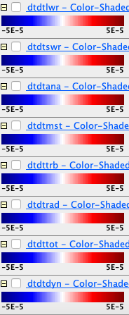
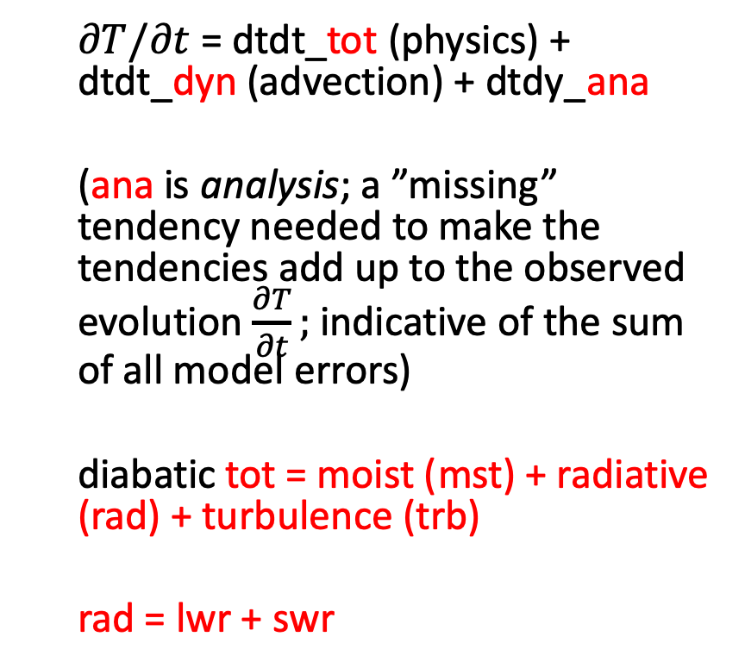
Legend explanation for cross sections
longwave
shortwave
$∂T/∂t$ = dtdt_tot (physics) + dtdt_dyn (advection) + dtdy_ana
(ana is analysis; a ”missing” tendency needed to make the tendencies add up to the observed evolution $\frac{∂T}{∂t};$ indicative of the sum of all model errors)
diabatic tot = moist (mst) + radiative (rad) + turbulence (trb)
rad = lwr + swr
analysis
(0 for perfect model)
moist mst
(convection & cloud cond. )
turbulence
(PBL)
SW+LW radiation
total physics (”diabatic”)
dynamic (advective)

Slide 14
Assignment part 2: Local view
Make comparison slides juxtaposing the zonal-mean transects and your local cross-sections, like in slide 6 above.
Toggle the various terms making up the total diabatic heating, in order to explain
Which is more variable (more spatially concentrated): radiative or moist heating? Illustrate your answer with images.

Slide 15
Assignment part 2: Local view
Revisit cloud-radiative interactions
LW radiation can be understood as water vapor cooling, cloud top cooling, and cloud base warming. Toggle the layers to find a good example, then juxtapose cloud fraction and radiative heating cross-section images to show an example of a place where cloud effects are dominant

Slide 16
Assignment part 2: Local view
Consider the PV source term motivating this exploration.
Where does the vertical gradient of heating imply large PV sources? Use arrows to annotate a couple positive and negative source regions.
Can you find a weather situation where this source term is a positive feedback on PV?

Slide 17
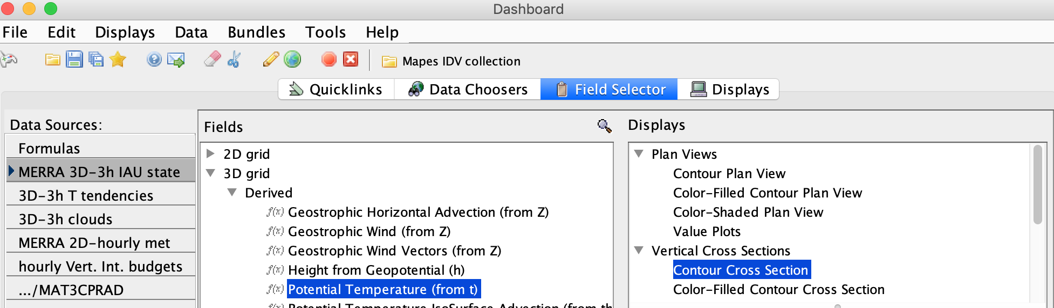
Create a new cross section of potential temperature contours

Slide 18
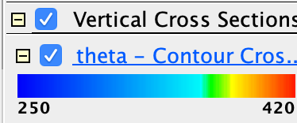

Create a new cross section of potential temperature contours
Now click its Legend entry to pop up its Display Controls.
Change the contour interval to 5K. Change the Color to Black. Change their label size to 20.

Slide 19
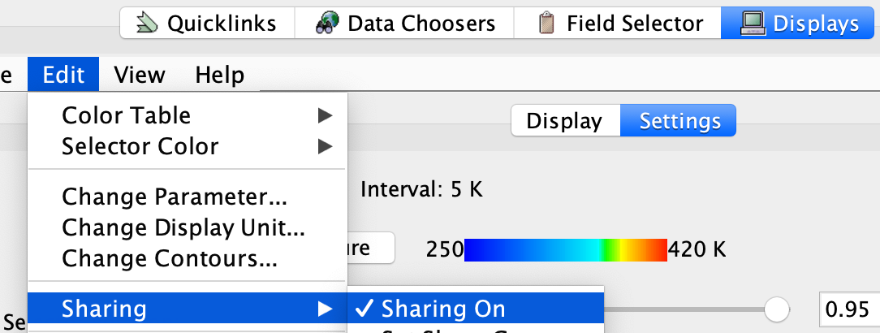
Create a new cross section of potential temperature contours
Again click the Legend entry to pop up the Display Controls.
Under the Edit menu, turn on Sharing
Move the main north-south cross section slightly. This will make your new theta contour section snap into place with it.

Slide 20
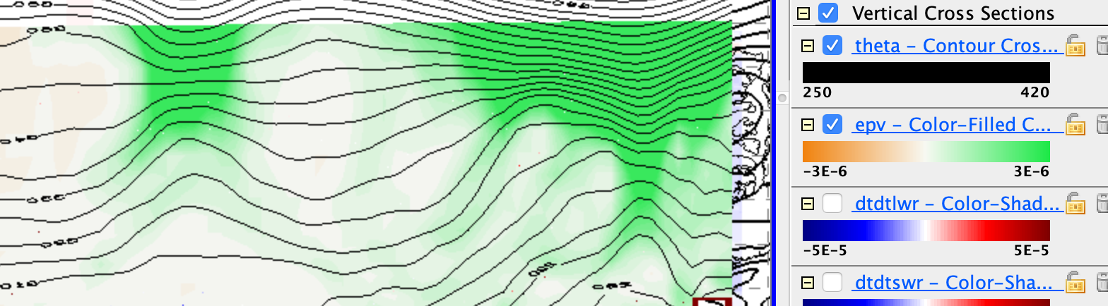
Create a new cross section of potential temperature contours
You should see our familiar relation between theta surfaces and (most clearly) upper-level cool core cyclones:

Slide 21
Warm and cool cores & condensation heating
Use the cross section with theta contours and the moist-processes heating rate (dtdtmst) to find an example
with the condensation heating in a warm core storm, like the one halfway to Ireland
how does the PV source term from latent heating feed back on such a warm core storm?

Slide 22
Warm and cool cores & condensation heating
Use the cross section with theta contours and the moist-processes heating rate (dtdtmst) to find an example
where a cool core cyclone (lifted isentropes, cyclonic PV aloft; a tentacle of the polar vortex) may be gently lifting air to its condensation level, releasing some latent heating
how does the PV source term from latent heating feed back on such a cool core storm?

Slide 24
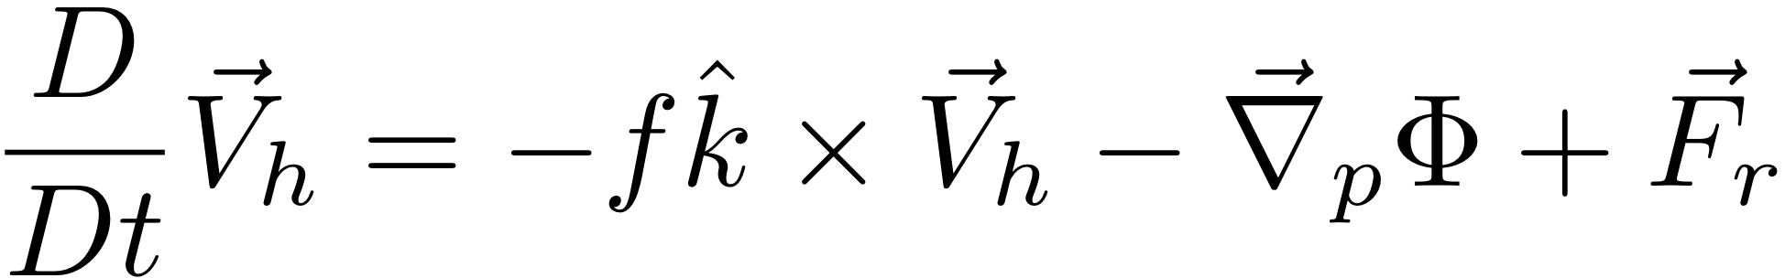
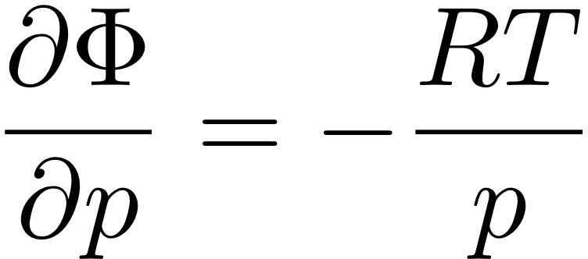


“The Primitive Equations”
(meaning elemental, fundamental)
F=MA in the HORIZONTAL
HYDROSTATIC (w/ ideal gas law to eliminate ρ)
MASS CONSERVATION
FIRST LAW OF THERMO
Notes:
\frac{D}{Dt} \vec V_h = -f \hat k \times \vec V_h - \vec \nabla_p \phi +\vec F_r
\frac {\partial \Phi}{\partial p} = - \alpha \equiv -\frac{1}{\rho}
\alpha = \frac{RT}{p}
\frac {\partial u}{\partial x} + \frac {\partial v}{\partial y} + \frac {\partial \omega}{\partial p} = 0
\frac {D_hT}{Dt} + S_p \omega = J/C_p

Slide 25
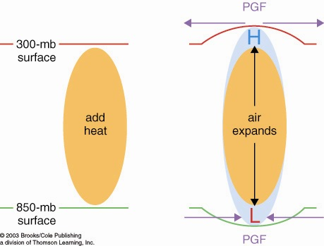
How heated air rises and a warm core vortex develops: the Primitive Equation view. 7 logical steps
1. Warmed column of air gets thicker
2. Air accelerates
due to PGF
2. Air accelerates
due to PGF
1. 200 mb
surface
bulges
upward
0. Heating (maybe latent heating by condensation in a patch
of convection over warm water someplace)

Slide 26
How heated air rises and a warm core vortex develops: the Primitive Equation view. 7 logical steps
3. Mass removal and 4. surface pressure drop
3. Mass removed
from column
3. Mass removed
from column
4. less mass of air in column
= lower surface pressure
L

Slide 27
How heated air rises and a warm core vortex develops: the Primitive Equation view. 7 logical steps
5. Low level inflow accelerates, 6. heated air rises
6. warm
air
rises!
5. Air accelerates
due to PGF
5. Air accelerates
due to PGF

Slide 28
How heated air rises and a warm core vortex develops: the Primitive Equation view. 7 logical steps
ANTI
CYCLONIC
Warm
Core
Vortex
CYCLONIC
FLOW
7. Coriolis turns flow to right

Slide 29
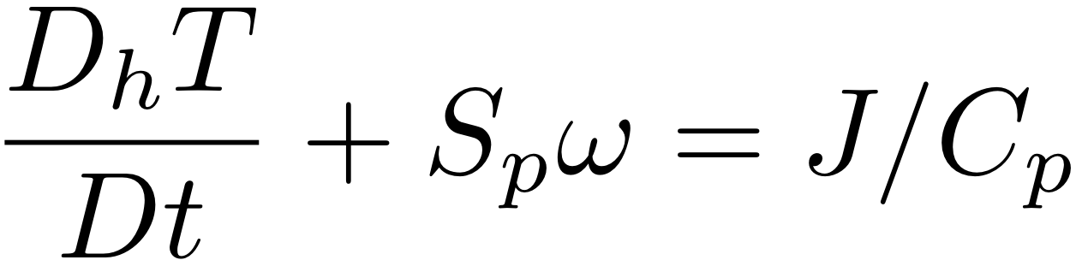
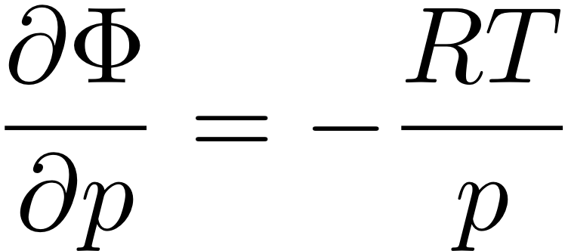
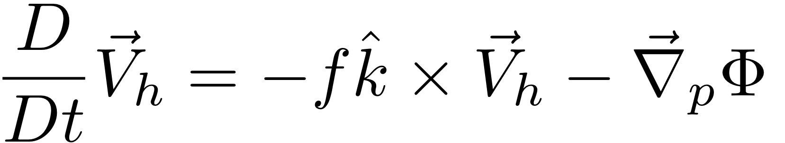
HW: use The Primitive Equations to compute how a local heating J drives flow in an initially motionless atmosphere
J causes T to increase
net change of T =
amount of heat added/Cp
2. Warmer T causes increased thickness of the heated column
3. High Φ over hot column pushes wind outward
4. Surface pressure drops (remember, omega = Dp/Dt; Holton eq. 3.44)
Notes:
Homework 5, MSC 405. Due Thursday, April 13
This problem set walks through the heated-air-rising process above, for a 100 km patch of latent heating in an initially motionless atmosphere.
ALL ANSWERS MUST HAVE UNITS, BUT NUMBERS CAN BE SIMPLE ROUGH ESTIMATES.
Suppose the heating J corresponds to the latent heat released during 1cm of rain over a 100km x 100km area. Let’s figure out how much ΔT that causes.
What is the volume of water condensed (m³)?
What is the mass of water condensed (kg)?
How much latent heat is released (Joules)? (L = 2.5 x 10⁶ J per kg of water).
How many kg of air are in a 1 square meter column of atmosphere, if surface pressure p is 1000mb? M=p/g
How many kg of air are therefore in a 100km x 100km column?
If Cp = 1000 J/(kg K), by how many K can the heat from c. warm the air mass from e.?

Slide 30
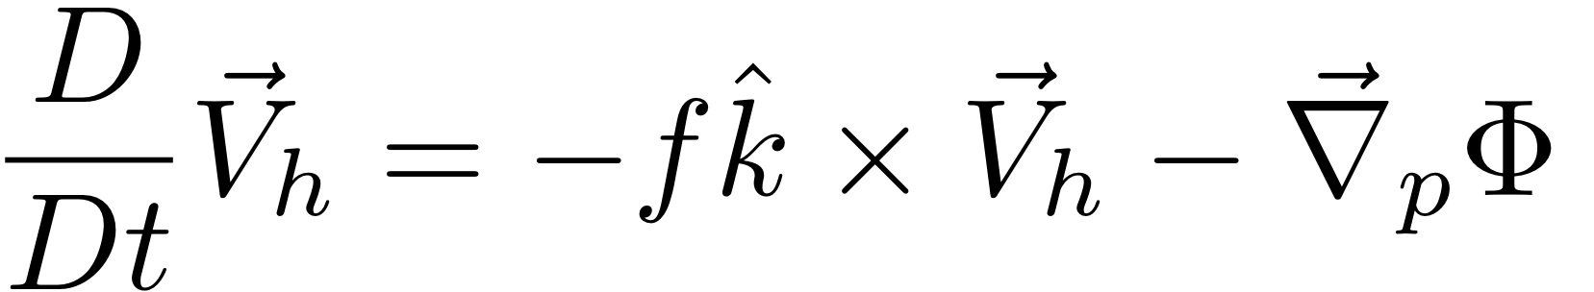
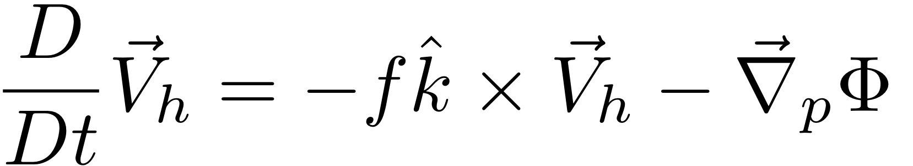
HW: use The Primitive Equations to compute how a local heating J drives flow in an initially motionless atmosphere
5. Low Φ under hot column pulls wind inward
6. Hot air rises (finally!)
ω =~ ρgw
7. Coriolis force turns inflowing and outflowing air to make round-and-round flow
Notes:
Homework 5, MSC 405. Due Thursday, April 12
This problem set walks through the sequential process above, for a 100 km patch of latent heating in an initially motionless atmosphere.
ALL ANSWERS MUST HAVE UNITS, BUT NUMBERS SHOULD BE ROUGH: 1-2 SIGNIFICANT DIGITS.
Suppose the heating J corresponds to the latent heat released during 1cm of rain over a 100km x 100km area. Let’s figure out how much ΔT that causes.
What is the volume of water condensed (m³)? (1 point)
What is the mass of water condensed (kg)? (1 point)
How much latent heat is released (Joules)? (1pt) (L = 2.5 x 10⁶ J per kg of water).
How many kg of air are in a 1 square meter column of atmosphere, if surface pressure p is 1000mb? M=p/g (1)
How many kg of air are therefore in a 100km x 100km column? (1)
If Cp = 1000 J/(kg K), by how many K can the heat from c. warm the air mass from e.? (1)

Slide 31
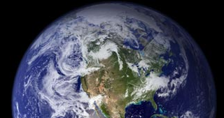
How cooled air sinks and a cool core vortex develops:
the Primitive Equation view. 7 logical steps
1. Cooled column of air gets thinner
2. Air accelerates
due to PGF
2. Air accelerates
due to PGF
200 mb
surface
IR cooling
cold
air
1. 200 mb
surface
bulges
downward

Slide 32
How cooled air sinks and a cool core vortex develops:
the Primitive Equation view. 7 logical steps
3. Mass drawn in
to column
3. Mass drawn in
to column
L
4. more mass of air in column
= higher surface pressure
H

Slide 33
How cooled air sinks and a cool core vortex develops:
the Primitive Equation view. 7 logical steps
L
6. Cold air sinks
5. Air accelerates
due to PGF
5. Air accelerates
due to PGF
H

Slide 34
How cooled air sinks and a cool core vortex develops:
7. Coriolis force turns the winds
L
CYCLONIC
FLOW
Cool
core
Vortex
ANTI
H
CYCLONIC

Slide 35
The geostrophically balanced polar vortex:
The Coriolis force on the westerly jet stream
prevents cold pool of Arctic air from sinking down
and covering the whole Northern Hemisphere
L
Cor.
PGF
PGF
Cor
Heavy cold air
would like to sink
if it could
H

Slide 36
Polar and stratospheric "Reservoirs" of ζ_{a} or PV
Potential vorticity: PV = -g ζ_{a} (∂θ/∂p)
The polar latitudes, where f is large, are a "reservoir" of high PV even when there is no wind!
The stratosphere where (∂θ/∂p) is large is a "reservoir" of PV even when there is no wind!
When tentacles or pieces of the polar & stratospheric PIZZA or OCTOPUS of PV stretch or break off into the midlatitudes, they become our upper-tropospheric synoptic cyclones.

Slide 38
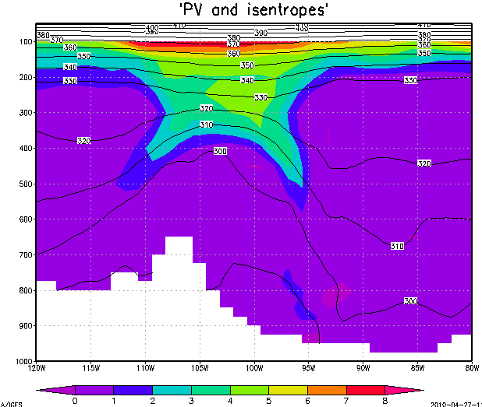
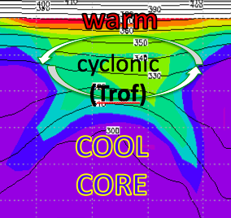
Unsheared advection of T, u, v, vort, PV:
no breaking of balance
warm
cyclonic
(Trof)
COOL
CORE

Slide 39
Sheared advection breaks thermal wind balance
Coriolis force
COOL
CORE
Z Trof

Slide 40
Sheared advection breaks thermal wind balance
imbalanced force = acceleration
COOL
CORE
Z Trof
L

Slide 41
Sheared advection breaks thermal wind balance
imbalanced force = acceleration
COOL
CORE
Z Trof
L

Slide 42
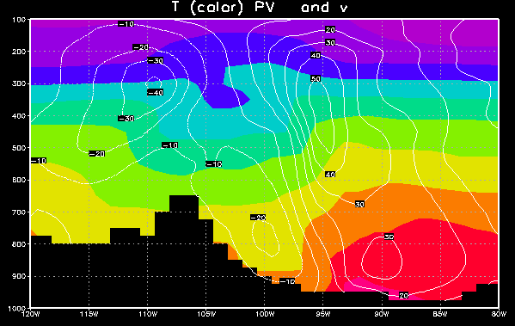
But there is some T advection too
cool air flowing south
warm air flowing north
L

Slide 43
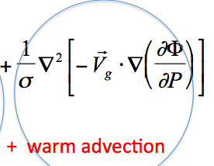
But there is some T advection too
Upward motion ~
cool air flowing south
warm air flowing north
L

Slide 44
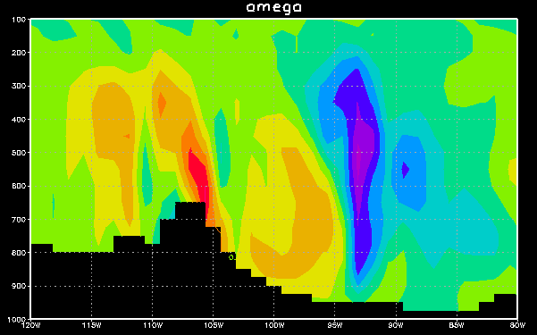
East-west section: omega

