Slide 1
Bicycle-sharing Prediction
Ruining Zhang, Weiming Long
12.5.2019

Slide 2
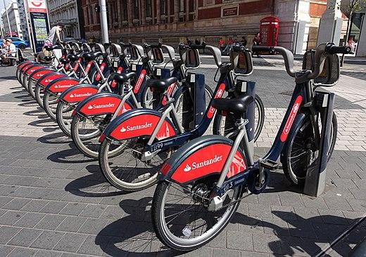
Introduction and motivation
The bicycle-sharing service has been growing rapidly in modern city as the Internet connection develops rapidly.
Our motivation is build a model to find some relation between environmental data and the total amount of bicycle-sharing services used.
Would contribute to help sharing bike company to adjust the distribution of the bicycles according to location and time.

Slide 3
Problem statement
Goal: Build a model to predict amount of shared bicycles used at a certain time.
Prediction model should be constructed with input features like weather, weekday, humidity, temperature, time, etc.

Slide 4
Summary of Contributions
Implemented a neural network by ourselves to make prediction.
Implemented a dropout layer between hidden layers to prevent overfitting and improve generalization.
Implemented Backpropagation Algorithm(BP) with Mini-batch Gradient Descent(MBGD) and Momentum to updated weights and bias of each layers.

Slide 5
Related Work
Neural Network model with sigmoid activation^{[1]}
Artificial immune system prediction framework^{[2]}
Combined with back-propagation neural networks to achieve numerical prediction
Define cells, antibodies and antigens
A set of ANN sub-models generated by partial features with samples of training data are forming a set of cells
[1] T., Chandra Segar & K., Ravisankar. (2017). Bike Sharing Prediction using Deep Neural Networks. JOIV : International Journal on Informatics Visualization. 1. 83. 10.30630/joiv.1.3.30.
[2] Chang, PC., Wu, JL., Xu, Y. et al. Soft Comput (2019) 23: 613. https://doi.org/10.1007/s00500-017-2909-8

Slide 6
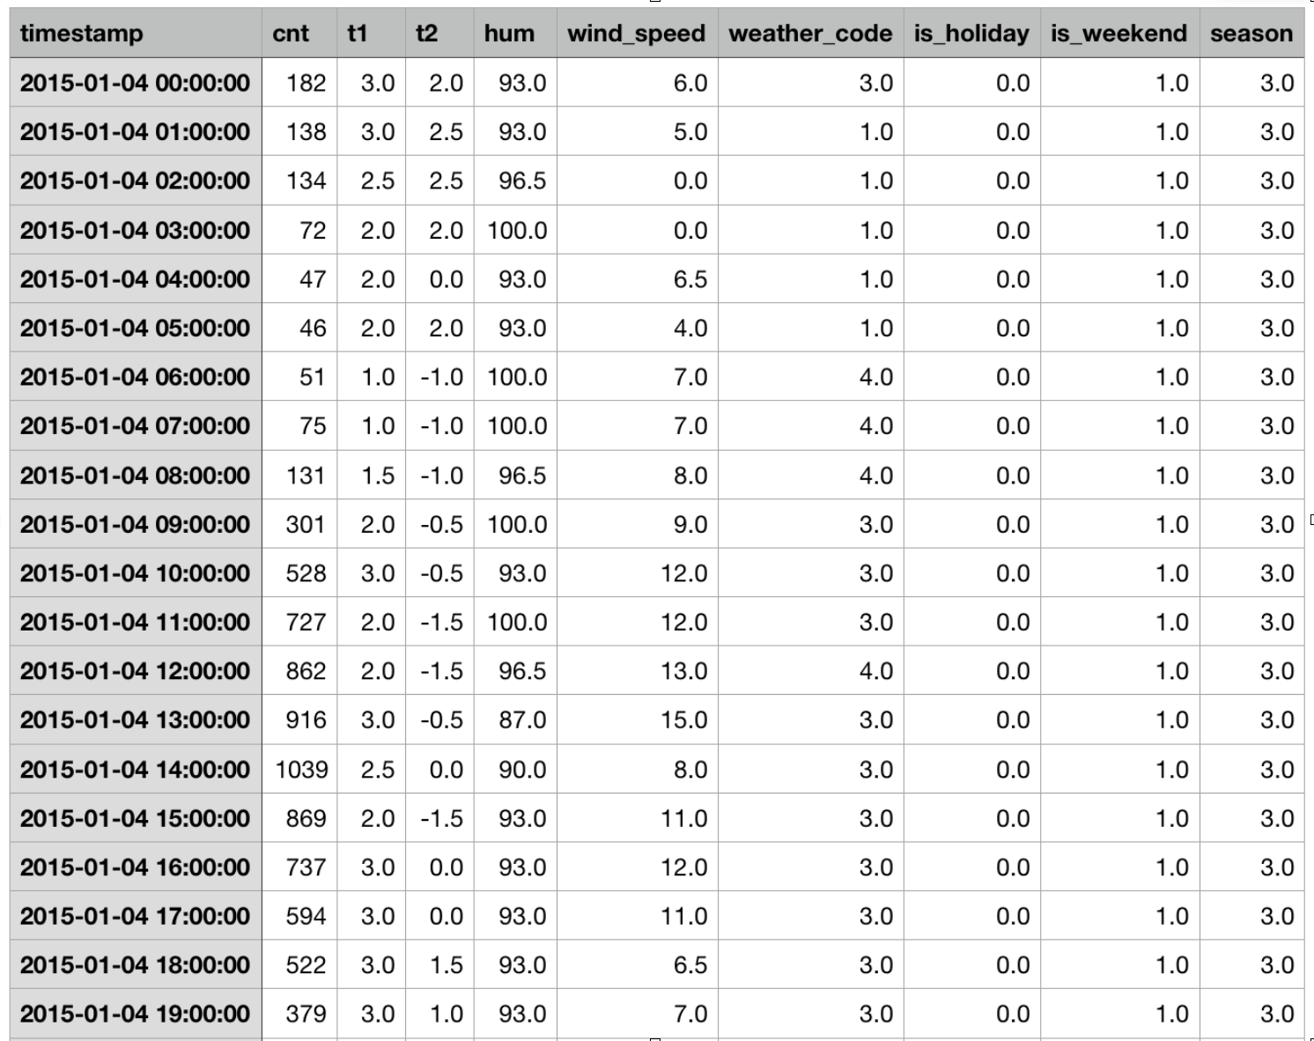
Dataset
Bicycle-sharing data in London*
Basic Features:
Timestamp, Counts,
Actual temperature(t1),
“Feel like” temperature(t2),
humidity, wind_speed,
weather_code , is_holiday, season
* Hristo Mavrodiev (2019,10) London bike sharing dataset-Historical data for bike sharing in London 'Powered by TfL Open Data’ https://www.kaggle.com/hmavrodiev/london-bike-sharing-dataset

Slide 7
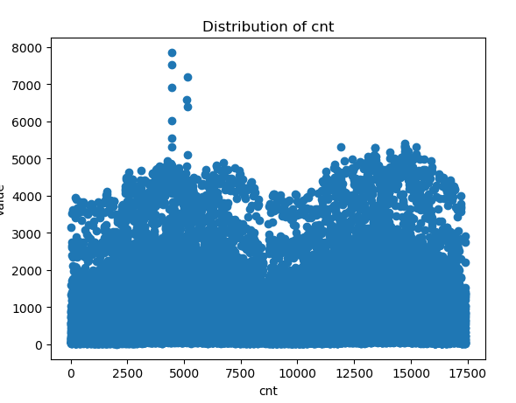
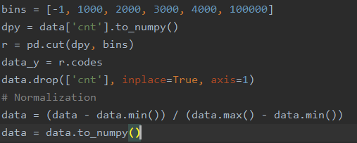
Data Preprocessing
Drop Features “Timestamp”
Feature normalization.
Discretization on share count
Class: 5
Class: 3
Class: 3
Class: 2
Class: 1

Slide 8
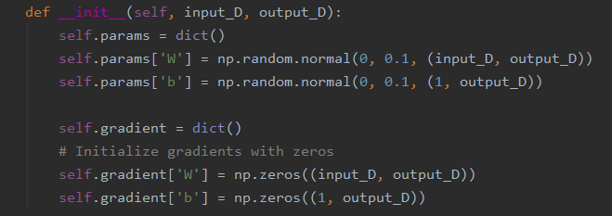
Approach and Algorithm Implementation
Neural Network Layer
Linear Layer
Fully-connected Module
Store Weight Bias and gradient
Activation Layer
ReLU Activation
Tanh Activation

Slide 9
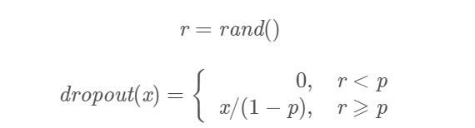
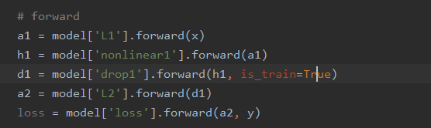
Approach and Algorithm Implementation
Neural Network Layer
Dropout Layer
p: dropout rate
For each layer, define forward and backward function
eg: training forward pass in one epoch

Slide 10
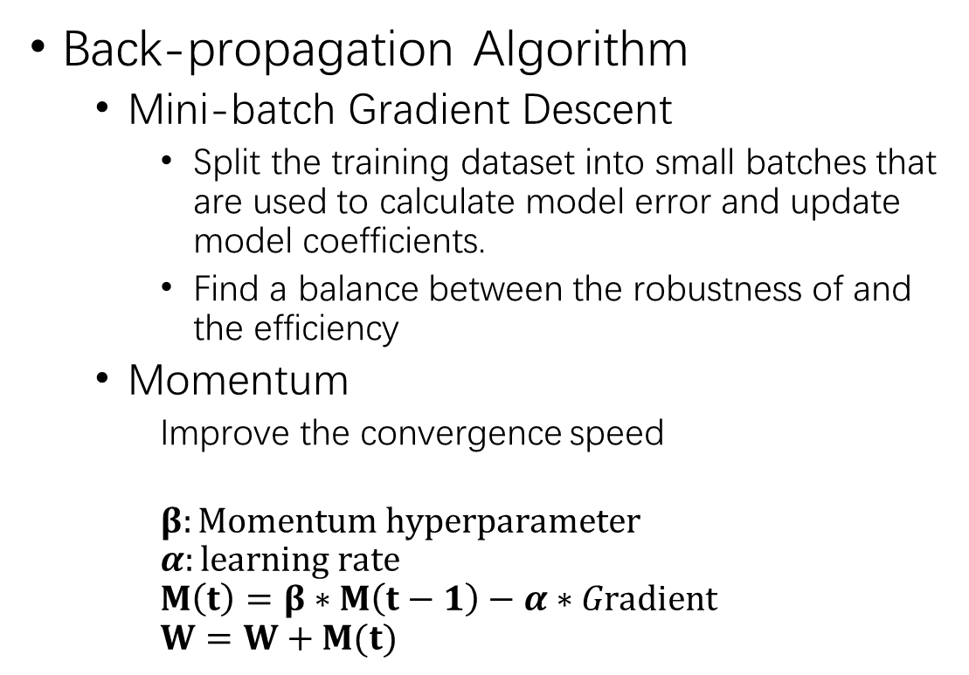
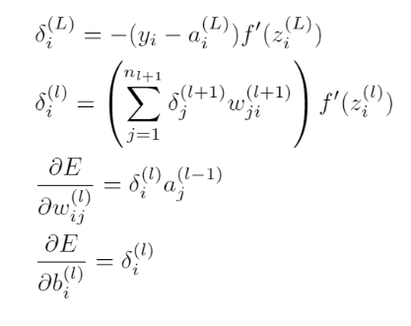
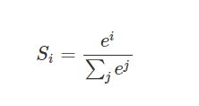
Approach and Algorithm Implementation
Weight Update:
Softmax：

Slide 11
Approach and Algorithm Implementation
Model Schema 1:
Input
Linear Layer
(hidden layer 1)
Activation layer
Dropout layer
Output layer

Slide 12
Approach and Algorithm Implementation
Model Schema 2:
Input
Linear Layer
(hidden layer 1)
Activation layer
Dropout layer
Linear Layer
(hidden layer 2)
Activation layer
Output layer

Slide 13
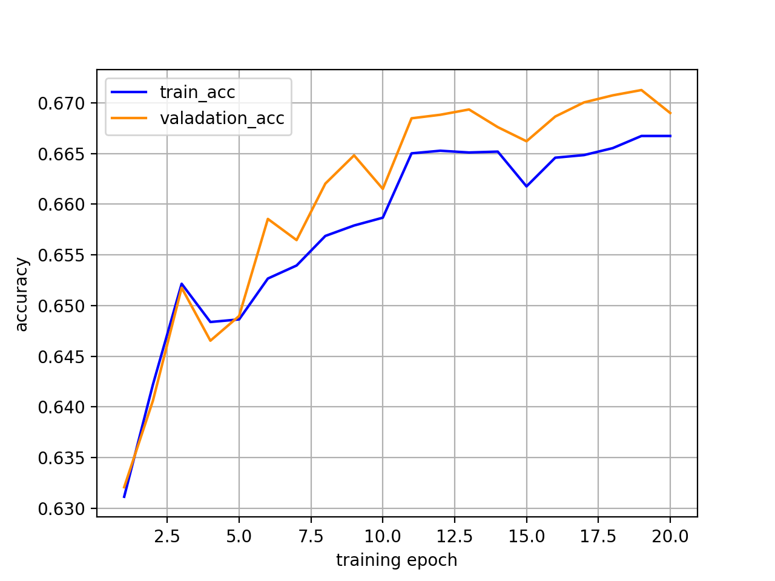
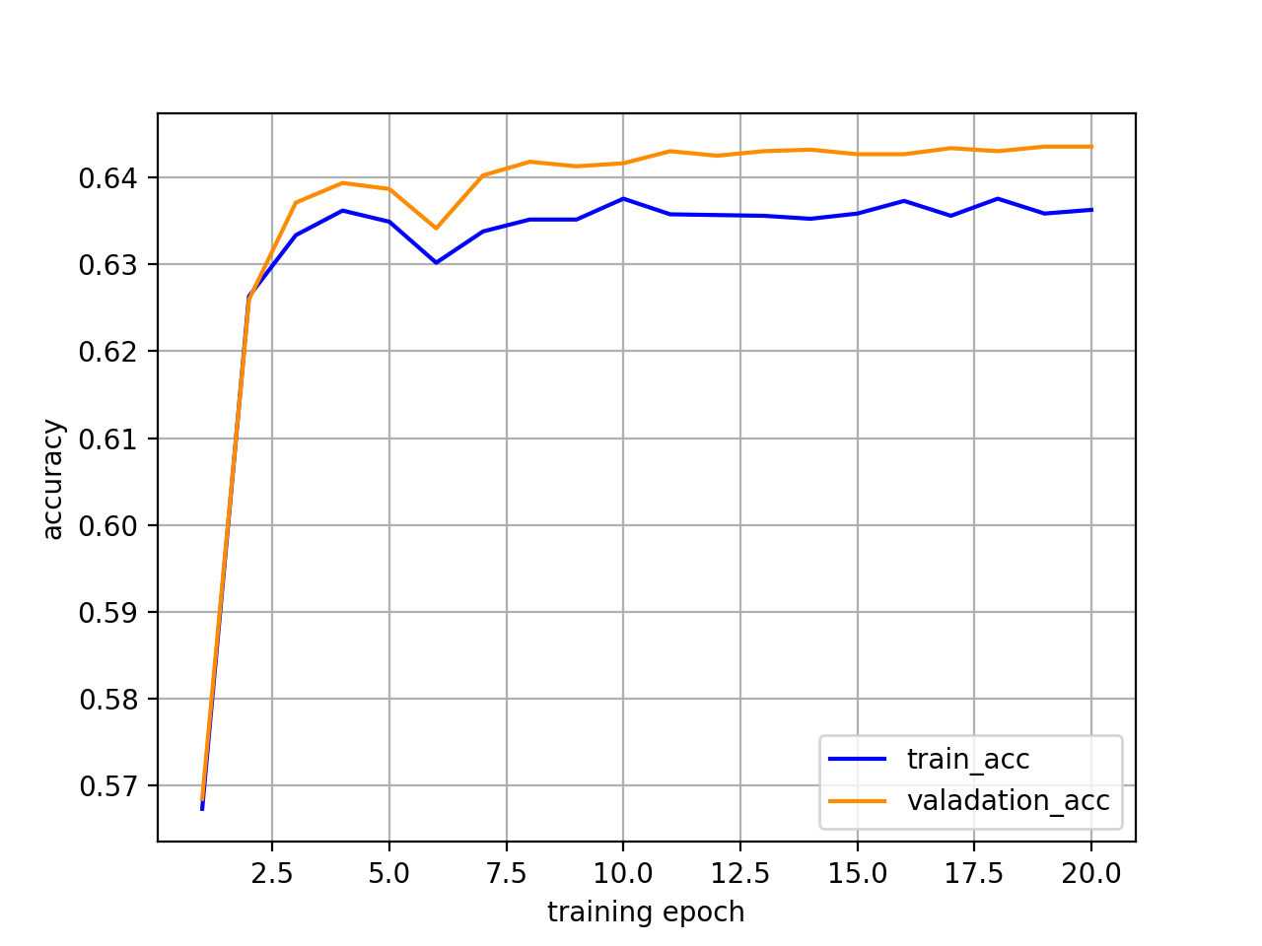
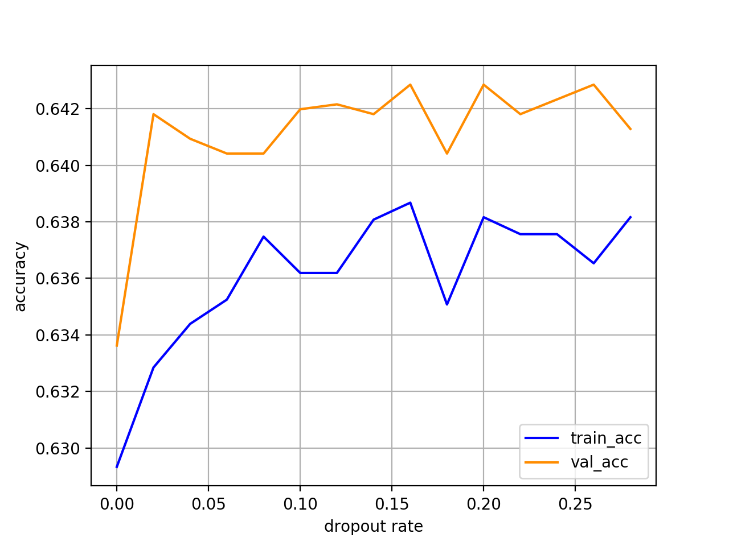
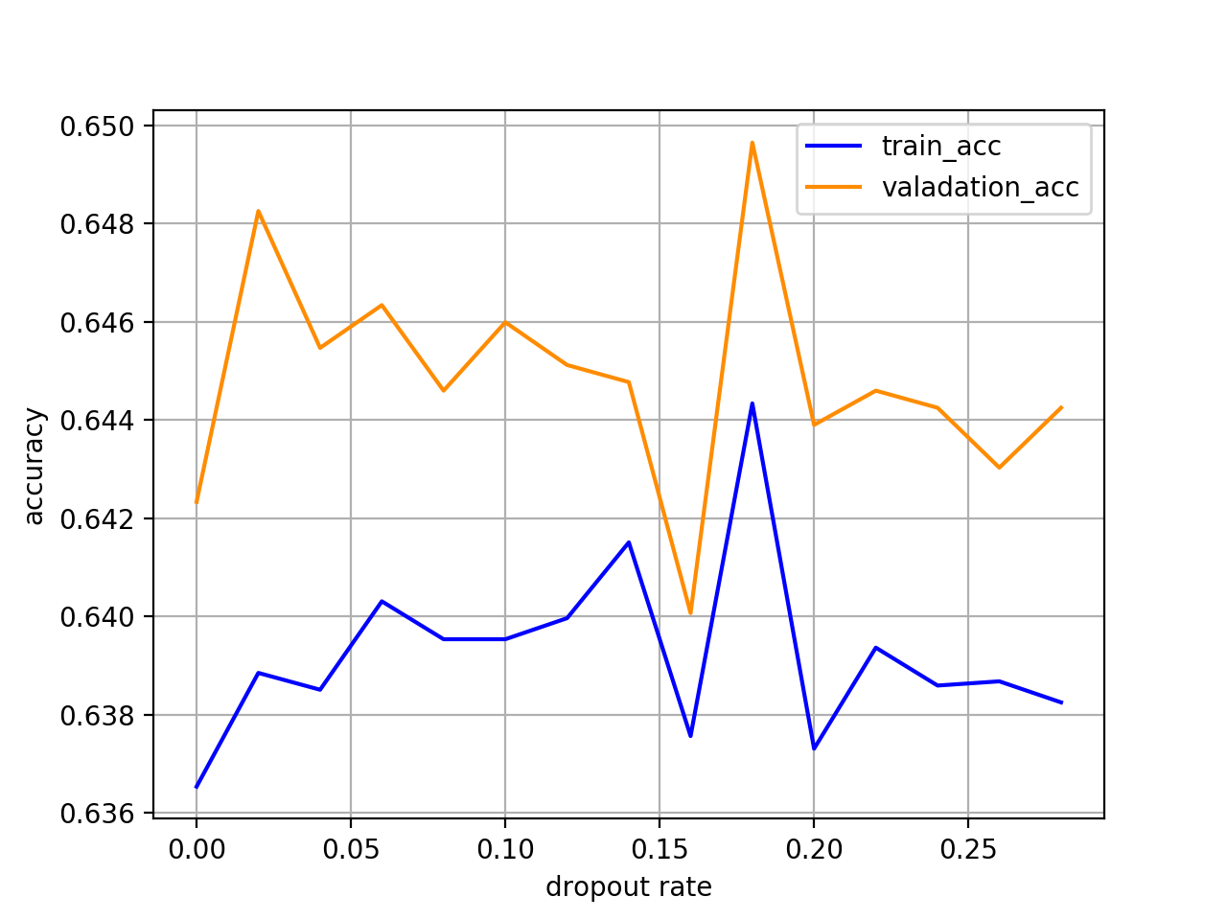
Results
1 2

Slide 14

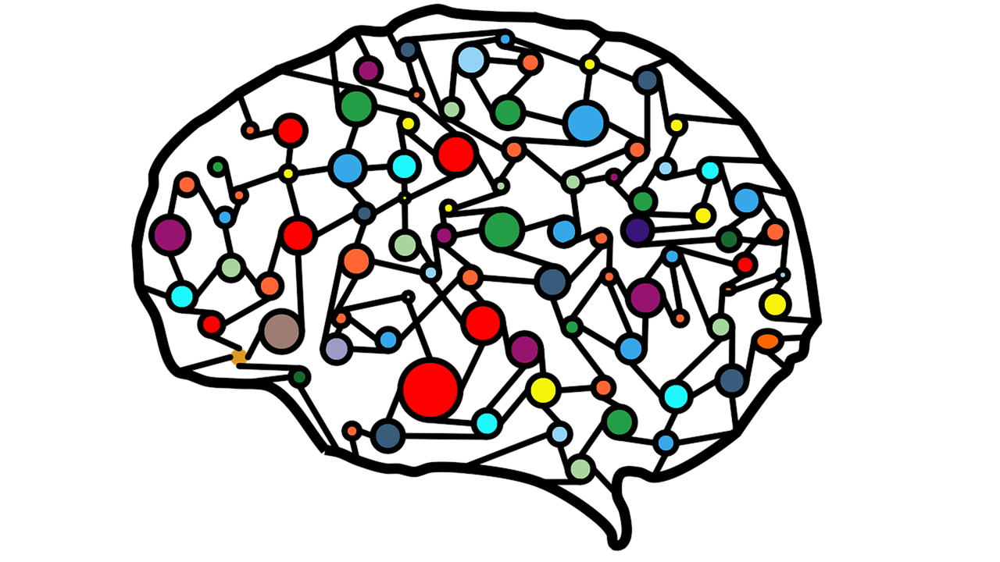
Discussion & Conclusion
Better dataset
Attributes
Sample size
Better model
More layers
Different activation functions

Slide 15
References
[1] T., Chandra Segar & K., Ravisankar. (2017). Bike Sharing Prediction using Deep Neural Networks. JOIV : International Journal on Informatics Visualization. 1. 83. 10.30630/joiv.1.3.30.
[2] Chang, PC., Wu, JL., Xu, Y. et al. Soft Comput (2019) 23: 613. https://doi.org/10.1007/s00500-017-2909-8
[3] M. H. Almannaa, M. Elhenawy, F. Guo and H. A. Rakha, "Incremental Learning Models of Bike Counts at Bike Sharing Systems," 2018 21st International Conference on Intelligent Transportation Systems (ITSC), Maui, HI, 2018, pp. 3712-3717.

