Slide 1
ChIP-seq pipeline
Xiaozhuan Dai
2017-3-22

Slide 2
Raw reads
mapping
bowtie
bam
Call peaks
SICER,MACS2 etc.
Peak files
ChIPseeker,
ChIPpeakAnno，hommer
Peak annotation
Assign nearest genes
Metaseq, deeptools,
fluff,
ngsplot
Visualization
Plots

Slide 3
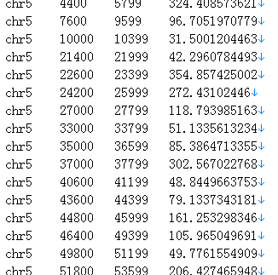
1. Mapping
Bowtie, BWA, STAR
sam bam call peak

Slide 4
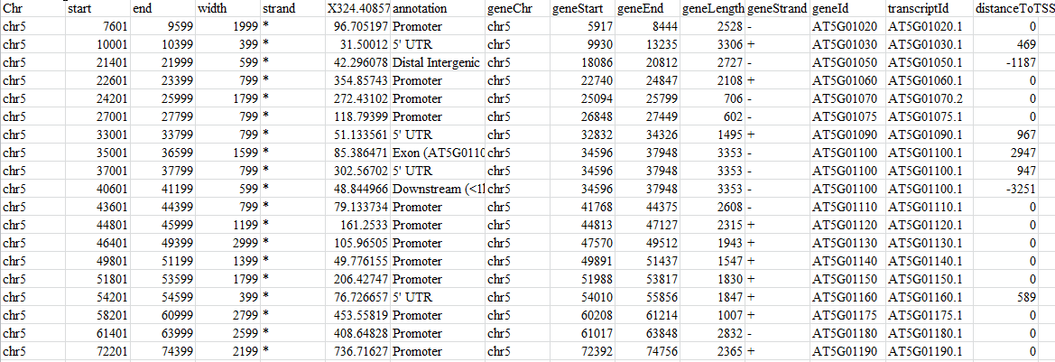
Peak annotation

Slide 5
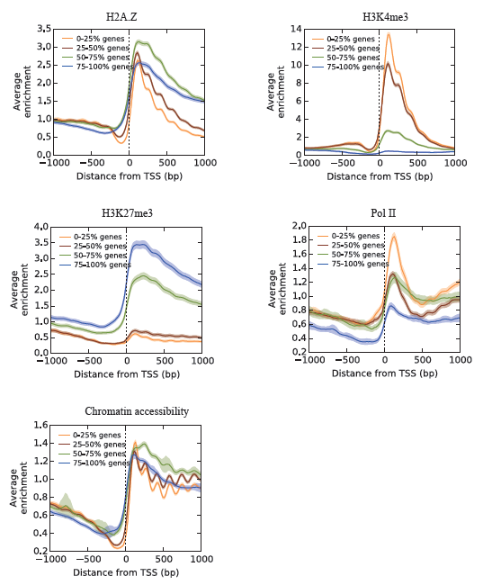

Slide 6
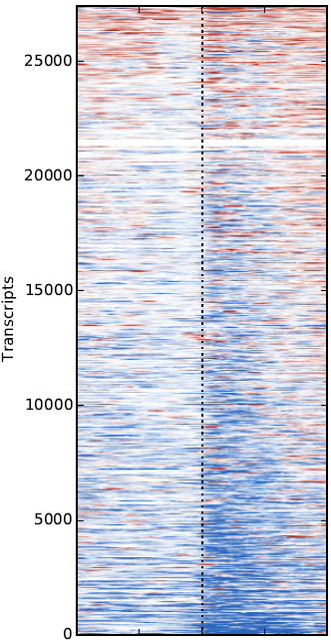
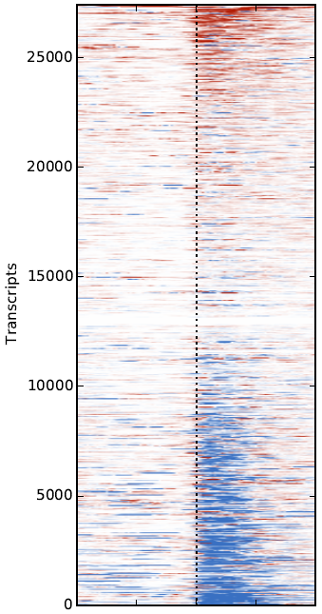
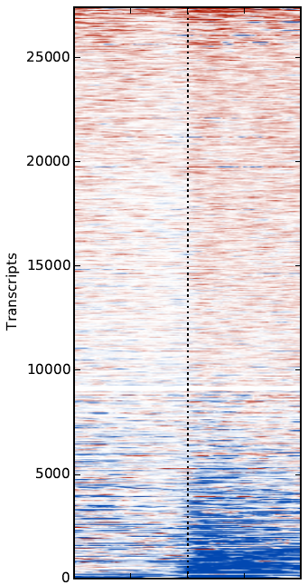
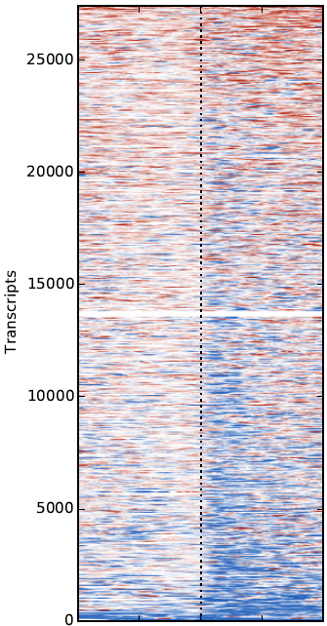
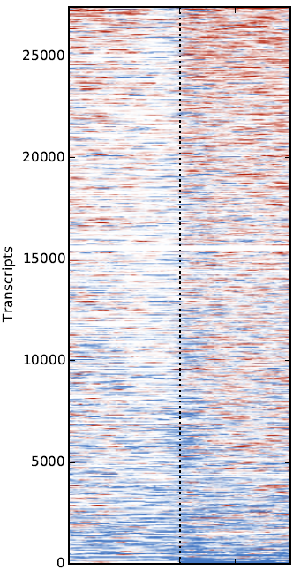
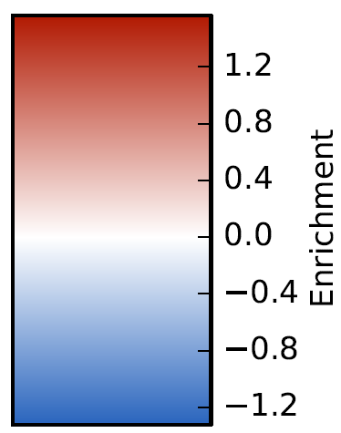
H2A.Z
H3K4me3
H3K27me3
MNase
Pol II

