Slide 1
How to write a scientific manuscript?
Dr. Ravi Palanivelu
School of Plant Sciences
University of Arizona
Tucson, Arizona, USA

Slide 2
1. Preparation

Slide 3
Step 1-Conceptualizing your study
Plan (timeline) and prioritize your experiments
Know the question you are trying to answer
Your experiment must be necessary and answer the question
Your experiment must include controls that help you distinguish between two or more possibilities
Think through the experiment; anticipate results

Slide 4
Localize LORELEI protein in plant cells
pLRE:LRE-YFP
ATG
TGA
ω
YFP

Slide 5
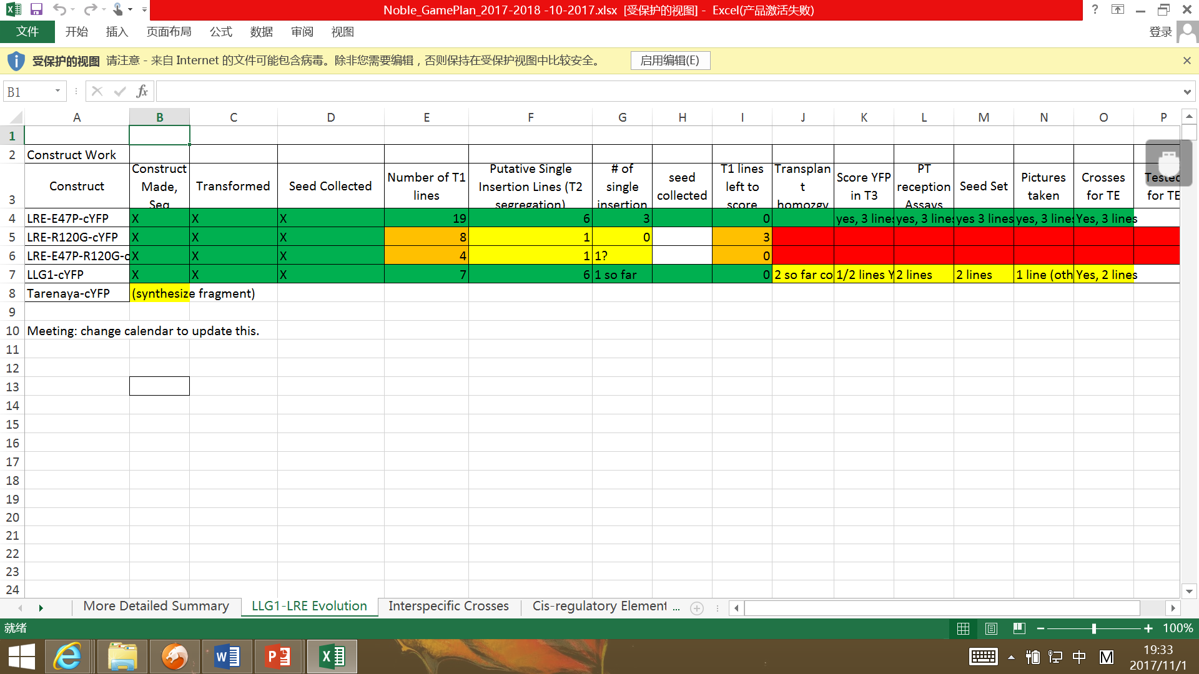
Step 1 – Experimental Planning Gant Chart of tasks
Break up a big task into smaller tasks
and follow the progress

Slide 6
Step 2 - Data collection
Be efficient in performing your experiments
Perform similar experiments together
Complete the experiment:
do you have enough replicates?
finished statistical analysis?
high quality images?
appropriate controls?
Know what is and isn’t in your control?

Slide 7
Localize LORELEI protein in plant cells
pLRE:LRE-YFP
ATG
TGA
ω
YFP
In your control
lre-7/lre-7 null mutant
Identify 3 single insertion stable transformants
Analyze homozygous plants in each line in T2/T3
Not in your
control
Where is it localized?

Slide 8
Step 2 - Data collection
Get to the point of collecting data – in your control; so sooner the better
Getting to the point of data collection efficiently will give extra time to do follow up experiments
Outcomes of your experiment – not in your control

Slide 9
Step 2 - Data collection
Be efficient in performing your experiments
Perform similar experiments together
Complete the experiment: do you have enough replicates, finished statistical analysis, high quality images, appropriate controls?
Know what is and isn’t in your control?
Complete your experiments
Assemble figures as you go
OK data with PI before moving on

Slide 10
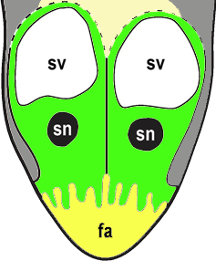
Polarized localization of LRE-YFP in the synerid cell periphery - Filiform Apparatus
d
ROI 2
ROI 1
ROI 1
ROI 1 + ROI 2
R =
26.7 µm
ROI 2
R = 0.56 ± 0.14
ROI 1
35.9 µm
(n = 18)

Slide 11
Step 3 - Transition to writing
What is the story?
What are the major conclusions?
What journal do you want to publish?
Are the data sufficient and appropriate for that journal?
Long/short format journal?

Slide 12
2. Writing the manuscript

Slide 13
Stage 1 – Prepare Figures
List key points you want to convey using your figure
Determine order, rationale, main/supplemental figure?
Confer with colleagues and get approval from PI during lab meetings
Easy to do this if you did it along the way – ground data ready, can combine figures etc

Slide 14
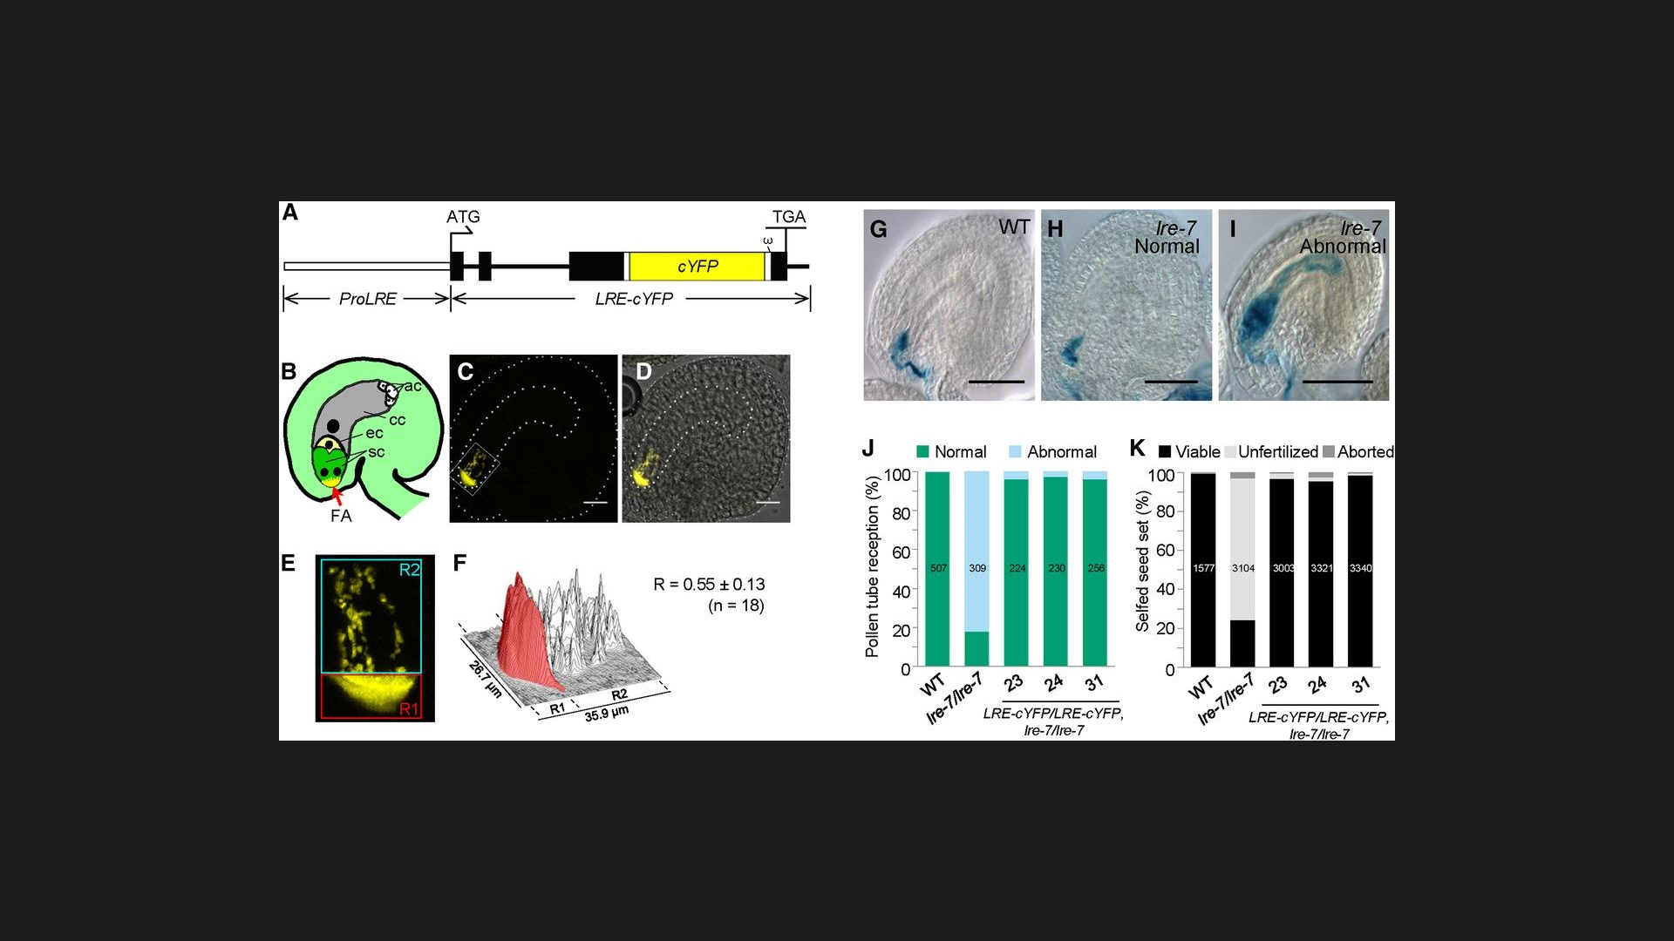
Step 2 - Data collection

Slide 15
Stage 2. Make an Outline of your manuscript
Paper title
List sections and section titles
Theme sentences (bullet points) in each section
Don’t write the sections until outline is OK’d by PI
Outline exercise

Slide 16
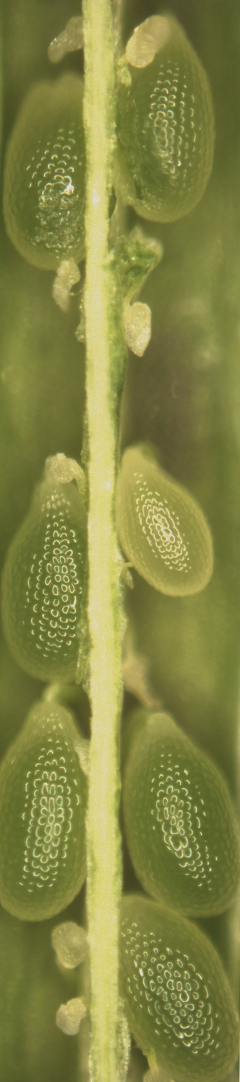
Experiment completed:
phenotypic characterization of a mutant
Viable
Viable
Unfertilized
seed set
Viable
Unfertilized
Unfertilized
Aborted
WT
lre-7
#23
#24
#31
pLRE:LRE-YFP
[lre-7]

Slide 17
Stage 2. Make an Outline of your manuscript
Paper title
List sections and section titles
Theme sentences (bullet points) in each section
Don’t write the sections until outline is OK’d by PI
Outline results section in this order :
Why did you do the experiment?
How you did the experiment?
What did you learn from the experiment?

Slide 18
Stage 2. Make an Outline of your manuscript
Results section: don’t forget transitions between sections
Results section: don’t overstate or understate the findings. Write conclusions based on what you are presenting in the paper not what you wished you could show
Introduction section: Include all information that a reader should know to critically evaluate and completely understand your paper

Slide 19
Stage 2. Make an Outline of your manuscript
Methods section: Write in a way some one can read and reproduce it.
Introduction section: Include all information that a reader should know to critically evaluate and completely understand your paper

Slide 20
Stage 2. Make an Outline of your manuscript
Discussion section: Don’t repeat results; instead
perspective
big picture thoughts
connecting the dots to present a model
take home messages
Acknowledgements: Make sure you thank all appropriate people and funding agency; can be a sore point if you leave out any one
“take home message”是学术写作常常出现的用语，就是你希望传达的要点，换句话说就是你希望读者在读完你的论文后能记得的一项重点。评审给出这条意见表示楼主应该在论文结尾明确传达你的要点。建议你在结论章节进行修改，让你的研究影响更清楚凸显，所以读者知道你研究的重点是什么，这个研究对领域的价值是什么。

Slide 21
Stage 3. Meeting with PI - Discuss technical issues
Figures
Content (outline)
Order
Story
Spin

Slide 22
Stage 3. Discuss Management issues
Journal choice
Date to get a full draft ready
Agreement of date for a response from PI
Submission date
Authorship-List
Determine authors’ order in the paper based on authors’ contribution

Slide 23
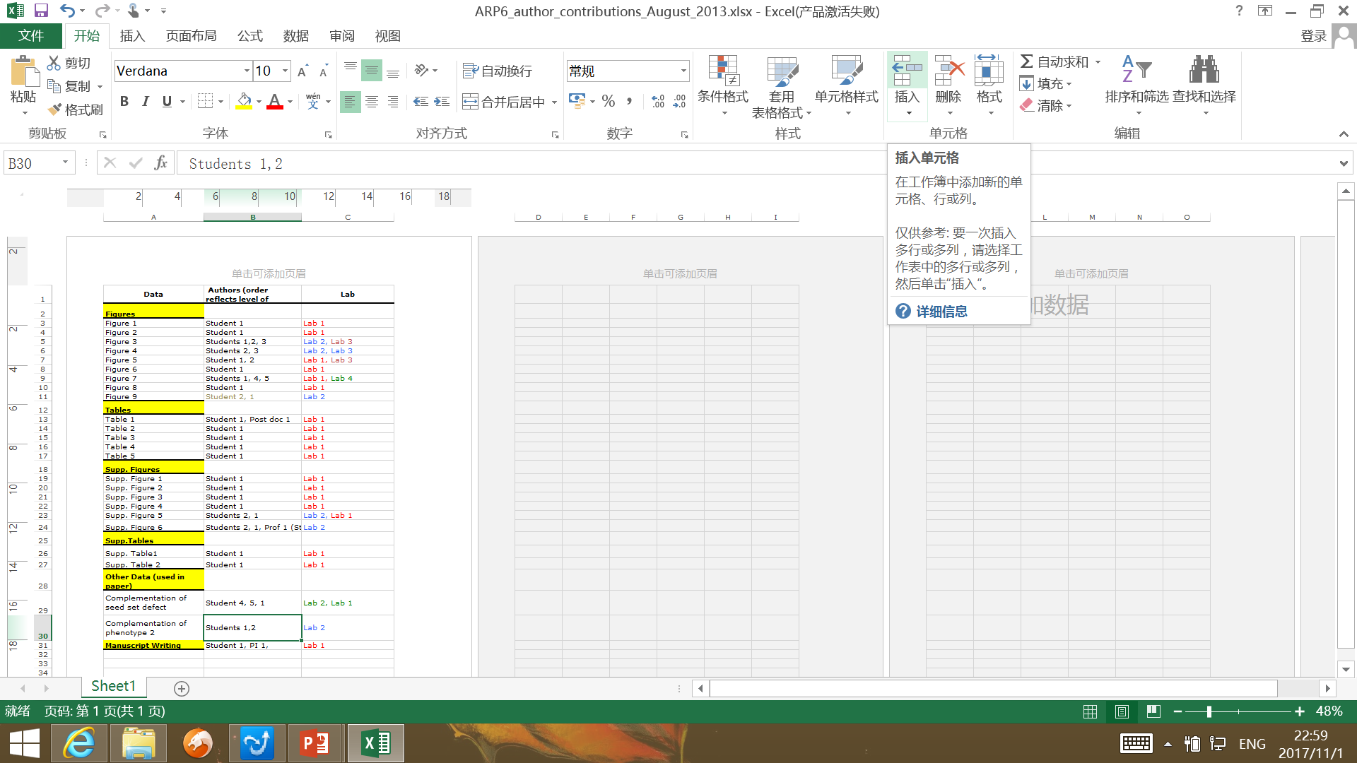

Slide 24
Stage 4. Writing the manuscript
Take Control of writing
Write in this order: Results, Methods, Discussion, Introduction, and Abstract
Don’t expect to get the perfect sentence the first time
Separate scientific content and grammar - Write what you want to say first and then work on tightening the text
If you hit a wall, take a break before resuming
It is normal that momentum in writing may ebb and rise
Get it read by other authors and colleagues

Slide 25
Stage 5. Submit to PI
Should be a full draft (refs, # of words)
While waiting, familiarize with online submission procedures and requirements
Assemble list of potential reviewers
Begin writing the cover letter
First summarize the major results
Indicate why these are important and state the significance of your findings and what gaps do they bridge in the field
Why your work will be appealing to people beyond your field
Could use professional writers’ help at this stage

Slide 26
3. Post submission

Slide 27
Stage 6. Under review
Perform experiments you anticipate reviewers may demand
Alternative plans in case of rejection
Resubmit in the same journal
Submit elsewhere
If so, try journals with similar style/length
New experiments? Time and opportunities-dependent

Slide 28
Stage 7. Revision
If accepted and revising….
Create a new MS word file and track ALL changes
Must include a summary of changes to the editor
Be prepared for rapid response at galley stages
Always try to submit a cover image! (10% success rate for me)

Slide 29
Archive your work
Make back up of your work all along the way
Make back up in an external drive, distinct from the computer you are working
Accessible over the internet is the best back up

Slide 30
Closing Thoughts
Don’t plagiarize and don’t cut corners; conduct yourself ethically
Think independently
Be persistent and hardworking
Learn to ask questions, at every step of the way, so that you can:
Learn
Self-teach
Become efficient
Become creative
Become scholarly

Slide 31
Acknowledgements
Dr. Richard Meagher, my graduate advisor
Dr. Daphne Preuss, my post doc advisor
Dr. Yuan Qin
Lihua Zhao
Center for Genomics and Biotechnology, FAFU

Slide 32
Acknowledgements
Thank you for your interest, time, and attention.

