Slide 1
Project Presentation
SMU-X OOP
| Amanda Choo
| Baratharam S/O Manogaran
| Po Qi Lin
| Wei Minn
Notes:
BARATHARAM S/O MANOGARAN

Slide 2
Client-Server Architecture
1
Model-View-Controller

Slide 3
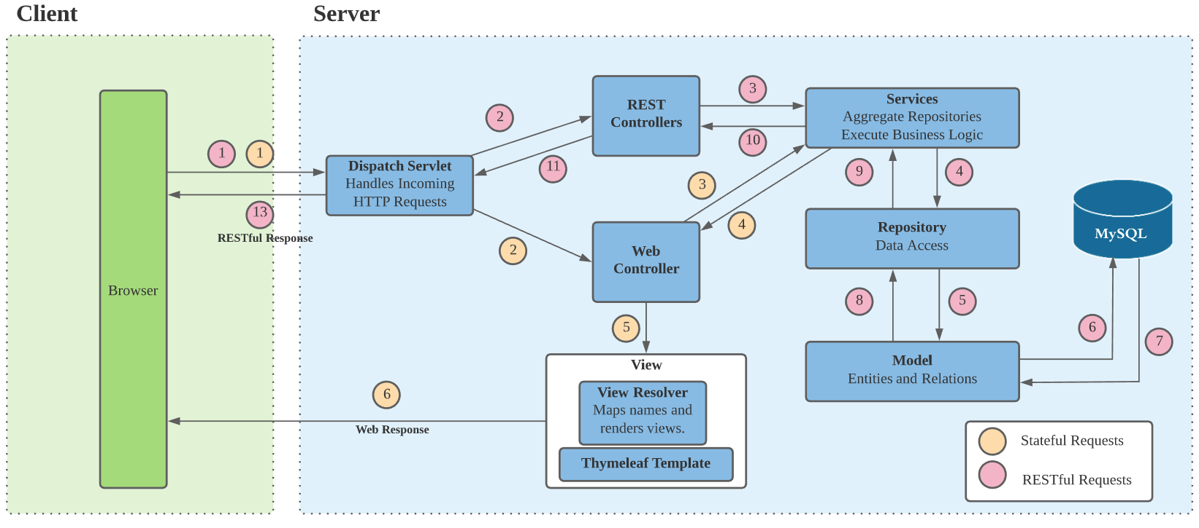
Spring MVC Architecture
Notes:
For our web application, we follow the MVC Architecture on Spring Framework.
We have client which is the browser on the left, and the server on the right.
At the forefront, Dispatch Servlet component which receives all the HTTP requests and map the requests to their respective endpoints in the controllers.
We have two types of controllers here, for Web and REST.
Web Controller, will render the views with the data retrieved from the services using the templates that we built on top of Thymeleaf, and send the response back to the browser.
Alternatively, for stateless REST API, the REST controllers will also use the same business logic defined in the services to return raw JSON data to the browser through the Dispatch Servlet.
The services are aggregators for the data retrieved via different repositories.
And the repositories are data access object provided by Spring framework according to the model. They allow us to execute crud functionality without worrying about SQL syntax.
Models are referred to by the JPA to create entities in the database for persistency.

Slide 4
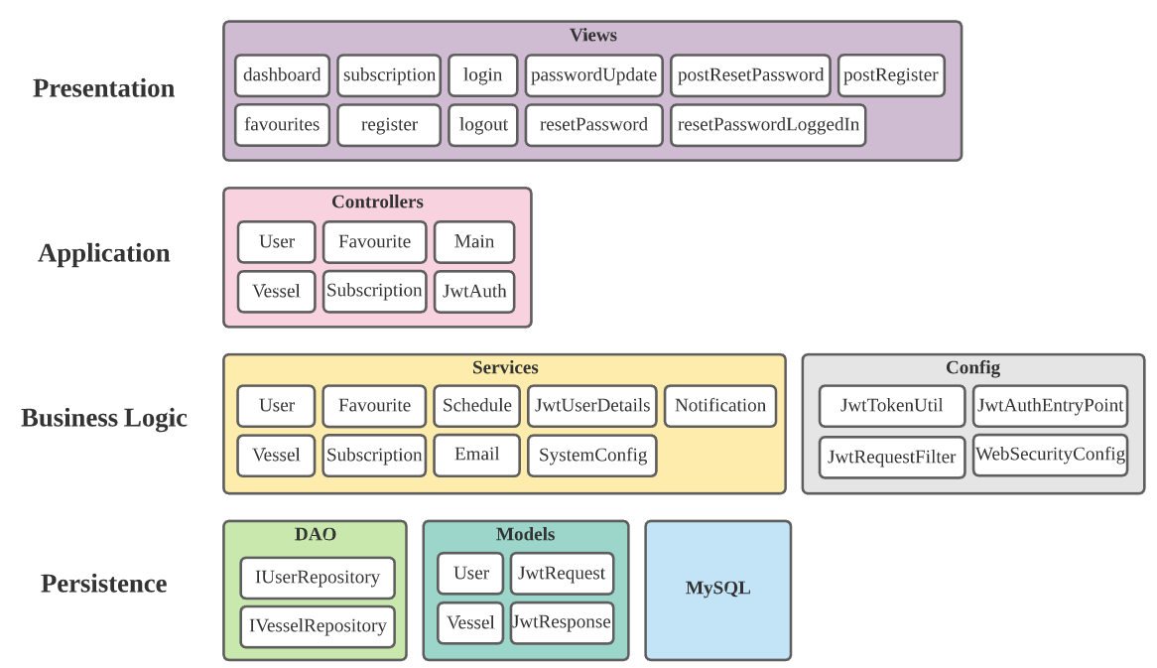
n-Layer Architecture
Notes:
We are also inspired by MultiTier architecture that decouples different tiers of application into different applications themselves for scalability.
However, in this project we only have 1 application, but we structured our application very much akin to the multitier,
And throughout the development process it was extremely helpful to our team in terms of code maintainability and readibility.
For example, in Application layer, we have the API endpoints from the controllers and they are only supposed to do controller related stuffs like exposing the endpoint and formatting the data.
The business logic is left to the classes in the component layer which in ony bothers with the business logic but have no concerns at all about what’s happening inside the database.

Slide 5
Frameworks and Libraries
2

Slide 6
Open Source Frameworks/Libraries
Spring framework
Javax (Management for persistence and object/relational mapping, mail, servlet)
JsonWebToken (Validate token)
JbCrypt (Password hashing)
Jackson-databind (Object Mapper)
Bootstrap 4
Datatables
Notes:
We used a few open source frameworks and libraries.
First is Spring framework which help provide us a comprehensive programming and configuration
model
, javax for the management for persistence and object/relational mapping, mail and servlet
JsonWebToken to generate and validate token
JbCyrpt is for password hashing for our registration and login
Jackson-databind to convert JSON to and from Java Maps, Lists and many more
For our front end : we used bootstrap 4 for mobile responsiveness and datatables to display the vessels

Slide 7
Design Considerations
Separation of Concerns
Classes in their respective layers of the N-Layer Architecture
Inversion of Control
Annotation-driven DI supported by
Spring Framework
Hybrid Rendering
Render some pages in the server, and other in client browser for efficiency
Facade Pattern
Aggregates the invocation and return data from other objects and provides a single interface for a business process
Notes:
Separation of Concern(N-tier layer)
We have separated application into different layers → makes it easier to manage the code because we know exactly where to go and what to look for when finding a specific functionality . For example the business logic of the application is a concern and the user interface is another concern. Changing the user interface should not require changes to classes that deal with business logic and vice versa.
Basically SpringBoot's @Autowired automatically enables Dependency Injection to achieve inversion-of-control.
This allows for much more flexible modification and extensions of the code by parameterizing their dependencies.
Hybrid Rendering
From our MVC architecture diagram, you can see that we expose APIs for both Web response and REST response for both server side and client side rendering. For example, in situation where there’s not a lot of changes in the View (user interface) like the dashboard, and only in the data to be shown, we want to render it in the client and let the server be busy with something else. In other situations like login, registration where there’s frequenty changes of the View, you the server might want to render instead for faster downloading of the page.

Slide 8
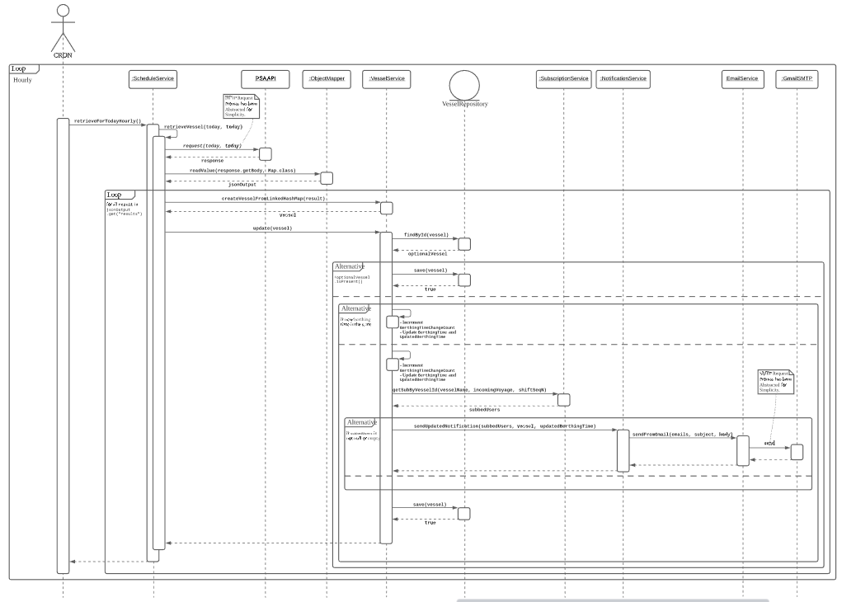
Notes:
Instead of putting all the logics inside the VesselService class, it is calling the other methods from other services and acts as the aggregator.

Slide 9
Demonstration
3

Slide 10
Thank You !
Q&A
Notes:
Features to show :
Dashboard :
fav
subscribe
Filter
Favourites :
show the count change
Add Subscription
remove favourites
Refresh button
Subscription: (not sure can show email )
remove subscription

Slide 11
Supplementary Slides
4

Slide 12
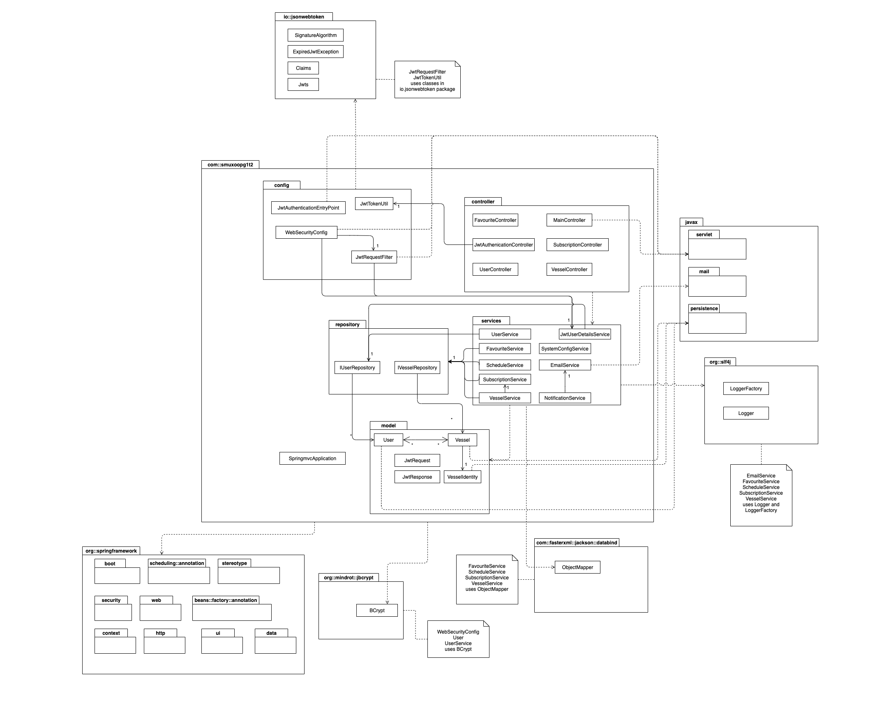
Notes:
This is the uml diagram of our application

