Slide 1

Web Application Development
Building Dynamic Webpages using PHP
Knowing is not enough; we must apply. Willing is not enough we must do.
- Goethe

Slide 2
Part III: Miscellaneous

Slide 3

Overview
Objective: Understand more complex cases and concepts of PHP and form handling
Content
Variable scoping, Array assignment
Checking associative array keys
Key-value pairs sent for various form components
Self-calling PHP pages
Complex/curly syntax of double quote print
Built-in functions often used in form processing
After this module, you should be able to be
Able to understand and/or use the above

Slide 4
I. Variable Scope
Variables can be declared anywhere.
The scope of a variable is the part of the script where the variable can be referenced/used.
PHP has three different variable scopes:
global
local
static

Slide 5
I. Variable Scope: Global and Local
A variable declared outside a function has a global scope
It can only be accessed outside a function
A variable declared within a function has a local scope
It can only be accessed within that function

Slide 6
I. Variable Scope: Global and Local
- scope.php –
<?php
$val = 5;
try_to_modify_val();
echo $val;
function try_to_modify_val() {
$val = 10;
}
?>
Global scope
Local scope
Any variable used inside a function is limited to the local function scope

Slide 7
I. Variable Scope: Difference with Python
val = 5
def try_to_modify_val():
print (val)
try_to_modify_val()
Global scope
val can be accessed, but changes made to it won’t affect the outer val
<?php
$val = 5;
function try_to_modify_val() {
echo $val;
}
try_to_modify_val();
?>
Global scope
$val can’t be accessed

Slide 8
I. Variable Scope: global keyword
Use global keyword to make a global-scope variable available to the function
<?php
$val = 5;
try_to_modify_val();
echo $val;
function try_to_modify_val() {
global $val;
$val = 10;
}
?>
Declare $val as global
Notes:
A scope-unrelated difference:
This works in PHP:
<?php
modify_val();
function modify_val() {
echo "hello";
}
?>
But this does not work in Python (modify_val needs to be defined first before used):
modify_val()
def modify_val():
print ("hello")
Error message: NameError: name 'modify_val' is not defined

Slide 9
I. Variable Scope: Loops
Loops do not act like functions
Variables declared and modified inside the loop will be available and will have effect outside the loop
Variable declared in the loop
<?php
$val = 5;
for ($i=0; $i<5; $i++) {
$j=1;
$val = $val + $j;
}
echo “Val: $val” . “i: $i” . “j: $j”;
?>
Variable modified in the loop

Slide 10
I. Variable Scope: Superglobals
Superglobals are available anywhere in the script
E.g. $_GET, $_POST
<?php
echo $_GET["val"];
print_val();
function print_val() {
echo $_GET["val"];
}
?>
$_GET is a superglobal that can be accessed from anywhere

Slide 11
II. Array Assignment
Array assignment involves value copying
<?php
$arr1 = array(2, 3); $arr2 = $arr1; $arr2[] = 4; // $arr2 is changed, // $arr1 still array(2, 3)
?>
In PHP
In Python
arr1 = [2,3]
arr2 = arr1
arr2.append(4) # arr1, arr2 refers to the # same array [2,3,4]

Slide 12
II. Array Assignment
<?php
$arr1 = array(2, 3); process($arr1);
function process($arr1){
$arr1[] = 5; // $arr1 (local) changed
// $arr1 (global) unchanged
}
?>

Slide 13
III. Checking Associative Array Keys
arrays_key_exists("a",$dict);
isset($dict["a"]);
!empty($dict["a"]);
$dict=[];
$dict=["a"=>null];
$dict=["a"=>""];
A
B
C

Slide 14








IV. K-V Pairs for Various Form Components
Text Field
Submit Button
Reset Button
Checkbox
Radio Button
Password Field
Hidden Field
Dropdown List
Text Area
Label | 123
Only named components with (default/explicitly entered) values will be sent
More information: https://bit.ly/2S6S1VG

Slide 15

IV. K-V Pairs for Various Form Components
<!DOCTYPE html>
<html>
<body>
<form method="get" action="process_form.php" >
Enter your name:
<input type="text"/>
<input type="submit" value="send"/>
</form>
</body>
</html>
form.html
Ex1

Slide 16
IV. K-V Pairs for Various Form Components
<!DOCTYPE html>
<html>
<body>
<form method="get" action="process_form.php" >
Enter your name:
<input type="text" name="fullname"/>
<input type="submit" value="send"/>
</form>
</body>
</html>
form.html
Ex2

Slide 17


IV. K-V Pairs for Various Form Components
<!DOCTYPE html>
<html>
<body>
<form method="get" action="process_form.php">
<input type="checkbox" name="food[]" value="burger"/>
Burger
<input type="checkbox" name="food[]" value="sushi"/>
Sushi
<input type="submit"/>
</form>
</body>
</html>
form.html
Ex3

Slide 18
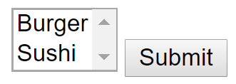
IV. K-V Pairs for Various Form Components
<!DOCTYPE html>
<html>
<body>
<form method="get" action="process_form.php">
<select name="food[]" multiple size="2">
<option value="burger">Burger</option>
<option value="sushi">Sushi</option>
</select>
<input type="submit"/>
</form>
</body>
</html>
form.html
Ex4

Slide 19

IV. K-V Pairs for Various Form Components
<!DOCTYPE html>
<html>
<body>
<form method="get" action="process_form.php">
<input type="checkbox" name="food[]"/>
Burger
<input type="checkbox" name="food[]"/>
Sushi
<input type="submit"/>
</form>
</body>
</html>
form.html
Ex5

Slide 20
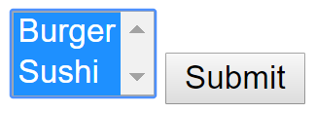
IV. K-V Pairs for Various Form Components
<!DOCTYPE html>
<html>
<body>
<form method="get" action="process_form.php">
<select name="food[]" multiple size="2">
<option>Burger</option>
<option>Sushi</option>
</select>
<input type="submit"/>
</form>
</body>
</html>
form.html
Ex6

Slide 21
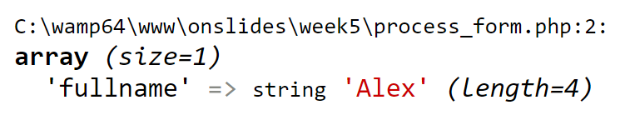
IV. K-V Pairs for Various Form Components
What are the data types of K-V pairs sent?
form.html
<?php
var_dump($_GET);
?>
process_form.php

Slide 22

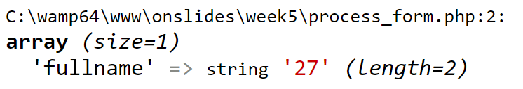
IV. K-V Pairs for Various Form Components
What are the data types of K-V pairs sent?
form.html
<?php
var_dump($_GET);
?>
process_form.php

Slide 23
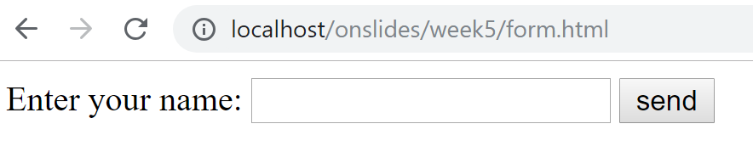
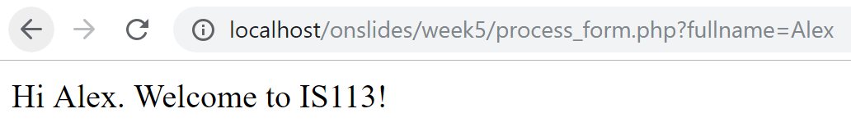
V. Self-Calling PHP Pages
form.html
process_form.php

Slide 24
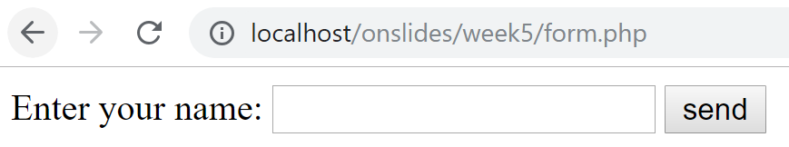
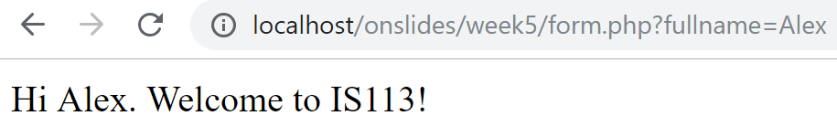
V. Self-Calling PHP Pages
1
form.php
2
form.php

Slide 25
<!DOCTYPE html>
<html>
<head><title>A simple form</title></head>
<body>
<?php
if(!isset($_GET["fullname"])){
echo " <form method='get'>
Enter your name:
<input type='text' name='fullname' />
<input type='submit' value='send' />
</form>";
} else{
$username = $_GET["fullname"] ;
echo "Hi $username. Welcome to IS113!<br />";
}
?>
</body>
</html>
1
2
form.php

Slide 26
VI. Complex/Curly Syntax
How to include array element in double quote print?
$username = $_GET["fullname"] ;
echo "Hi $username.";
Option 1
echo "Hi {$_GET['fullname']}.";
Option 2
More information: https://bit.ly/2Soh1ay

Slide 27
VII. Built-in Functions for Form Processing
filter_var
FILTER_VALIDATE_INT
FILTER_VALIDATE_URL
FILTER_VALIDATE_FLOAT
FILTER_VALIDATE_EMAIL
…
is_numeric, ctype_digit, ctype_lower, ctype_upper
trim, ltrim, rtrim
More are introduced through the exercises

Slide 28

Key Points
Variable scoping
global vs. local
global keyword
Array assignment
Checking associative array keys
K-V pairs sent for various form components
Self-calling PHP pages
Complex/curly syntax
More built-in functions

