Slide 1

Web Application Development
Database Interaction
If people are not making mistakes, they are not trying new things.
- Walter C Wright Jr
Notes:
Image from: https://openclipart.org/detail/94723/database-symbol

Slide 2

Overview
Objective
Learn how to store and manipulate data in MySQL using PHP Data Objects (PDO)
Content
Use of PDO to perform CRUD operations
Best practices:
Data Access Object (DAO)
ConnectionManager
PHP initialization file
After this module, you should be able to
Use PDO to perform CRUD operations

Slide 3
Part I
Basic Syntax

Slide 4

Use of PDO
It allows a PHP code to send SQL queries to the database and receive the results
select * from book
PDO
application
database
title | isbn13 | price
Modern PHP | 1234567890123 | 88
PHP Cookbook | 3214567890456 | 99

Slide 5
Step 1: Connect to database
Data source name (DSN)
Database type
Host
Database name
Port
Create a PDO object
Specify DSN, username, and password
$dsn = "mysql:host=localhost;dbname=week11;port=3306";
$pdo = new PDO($dsn, "root", "");

Slide 6
Step 2: Prepare a SQL statement
A PDOStatement object allows you to communicate with a database
$isbn13 = '1234567890123'; // simulates a user input $sql = 'select * from book where isbn13 = :isbn13';
$stmt = $pdo->prepare($sql);
$stmt->bindParam(':isbn13', $isbn13, PDO::PARAM_STR);
$stmt->execute();
$stmt->setFetchMode(PDO::FETCH_ASSOC);
if($row = $stmt->fetch()) {
echo $row['title'] . '|' . $row['isbn13']
. '|' . $row['price'];
}

Slide 7
Step 2: Prepare a SQL statement
Each :XX specified in the SQL string is a value that you have to fill in using the bindParam method
$isbn13 = '1234567890123'; // simulates a user input $sql = 'select * from book where isbn13 = :isbn13';
$stmt = $pdo->prepare($sql);
$stmt->bindParam(':isbn13', $isbn13, PDO::PARAM_STR);
$stmt->execute();
$stmt->setFetchMode(PDO::FETCH_ASSOC);
if($row = $stmt->fetch()) {
echo $row['title'] . '|' . $row['isbn13']
. '|' . $row['price'];
}

Slide 8
Some PDO class constants
Constants | Description
PDO::PARAM_BOOL | Represents the SQL BOOLEAN data type
PDO::PARAM_INT | Represents the SQL INT data type
PDO::PARAM_STR | Represents the SQL CHAR, VARCHAR, or other string data type. Use this for SQL FLOAT, DOUBLE, DECIMAL, and other data types that do not fit any other PDO constants too.
PDO::PARAM_NULL | Represents the SQL NULL data type
PDO::PARAM_LOB | Represents the SQL large object data type

Slide 9
Step 3: Run the SQL statement
$isbn13 = '1234567890123'; // simulates a user input $sql = 'select * from book where isbn13 = :isbn13';
$stmt = $pdo->prepare($sql);
$stmt->bindParam(':isbn13', $isbn13, PDO::PARAM_STR);
$stmt->execute();
$stmt->setFetchMode(PDO::FETCH_ASSOC);
if($row = $stmt->fetch()) {
echo $row['title'] . '|' . $row['isbn13']
. '|' . $row['price'];
}

Slide 10
Step 4: Retrieve results row-by-row
PDO::FETCH_ASSOC:
Each matching DB record is retrieved as an associative array with column names as keys
$isbn13 = '1234567890123'; // simulates a user input $sql = 'select * from book where isbn13=:isbn13';
$stmt = $pdo->prepare($sql);
$stmt->bindParam(':isbn13', $isbn13, PDO::PARAM_STR);
$stmt->execute();
$stmt->setFetchMode(PDO::FETCH_ASSOC);
if($row = $stmt->fetch()) {
echo $row['title'] . '|' . $row['isbn13']
. '|' . $row['price'];
}

Slide 11
Step 4: Retrieve results row-by-row
Fetch each matching row as an associative array
Retrieve the value using the column name
$stmt->setFetchMode(PDO::FETCH_ASSOC);
if($row = $stmt->fetch()) {
echo $row['title'] . '|' . $row['isbn13'] . '|' . $row['price'];
}
Key | Value
title | Modern PHP
isbn13 | 1234567890123
price | 88
$stmt.fetch()

Slide 12
Step 5: Free up resources
Close the connection to the database and SQL statement.
$stmt = null;
$pdo = null;

Slide 13
Issuing Insert/Delete/Update queries
$sql = 'insert into book (title, isbn13, price) values (:title, :isbn13, :price)';
$title = "Java"; // simulates a user input
$isbn13 = "9999999999999"; // simulates a user input
$price = 105; // simulates a user input
$stmt = $pdo->prepare($sql);
$stmt->bindParam(':title', $title, PDO::PARAM_STR);
$stmt->bindParam(':isbn13', $isbn13, PDO::PARAM_STR);
$stmt->bindParam(':price', $price, PDO::PARAM_INT);
// $isAddOK stores true or false
$isAddOK = $stmt->execute();
$stmt = null;
$pdo = null;

Slide 14
Exercise 1: Simple try
Given (in ex1 folder):
week11.sql
display.php
To do:
(1) Import week11.sql using phpMyAdmin.
It will import all tables needed for this exercise and the following ones.
(2) Put code given in previous slides corresponding to steps 1-6 into display.php. Delete any pptx special symbols.

Slide 15
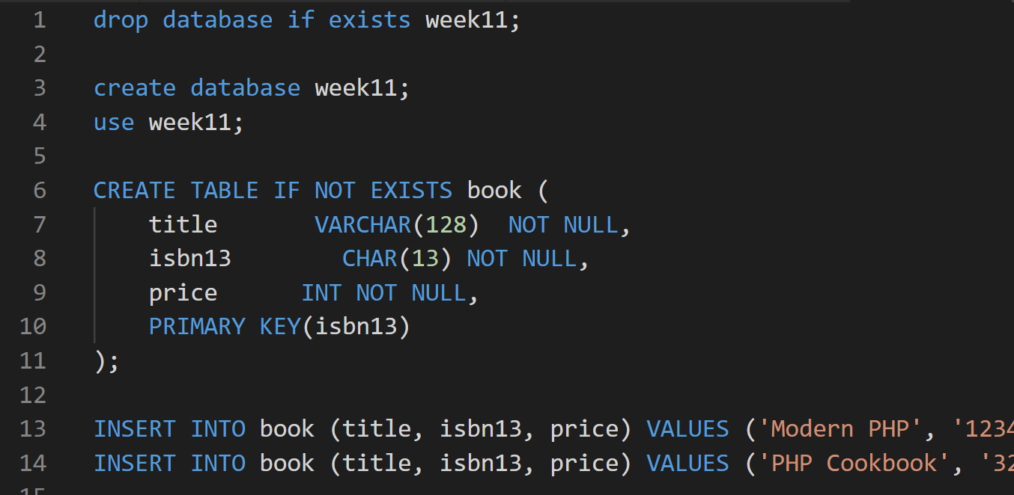
Exercise 1: Simple try
week11.sql

Slide 16
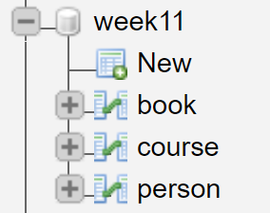
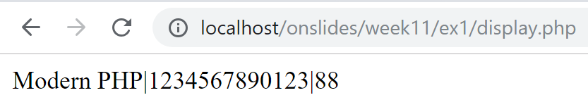
Exercise 1: Simple try

Slide 17
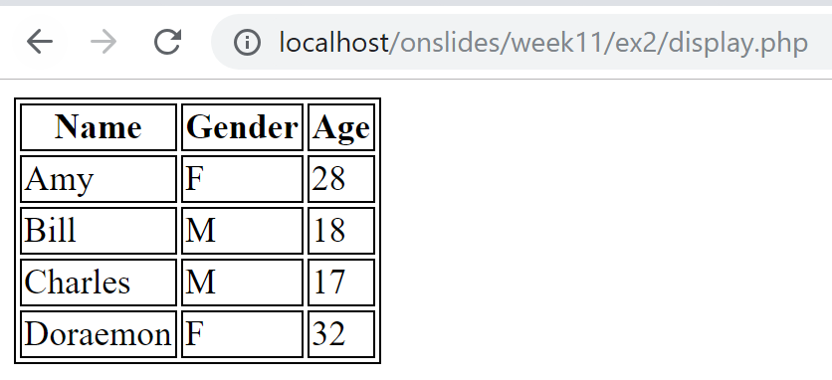
Exercise 2: Display table contents
Given (in ex2 folder):
display.php (incomplete)
To do:
Modify display.php such that it displays the data stored in the person table of the week11 database

Slide 18
Exercise 3: Insert new content
Given (in ex3 folder):
add.html
add.php (incomplete)
Implement add.php such that
If insert operation is successful, print 'Person added'
if insert operation is unsuccessful, print 'Person is not added'

Slide 19
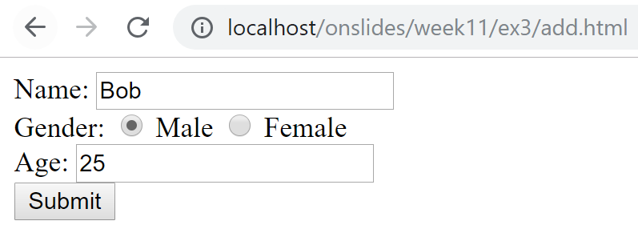
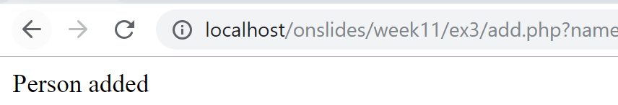
Exercise 3: Insert new content (Success)

Slide 20
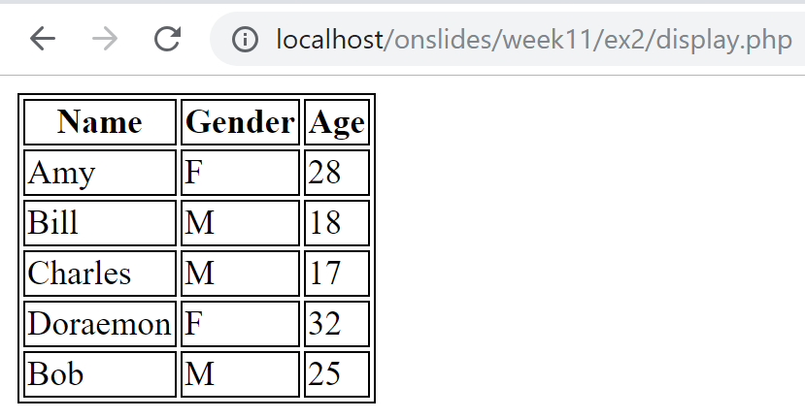
Exercise 3: Insert new content (Success)
Bob added

Slide 21
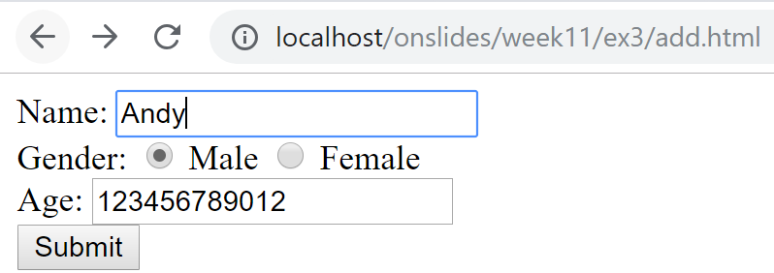
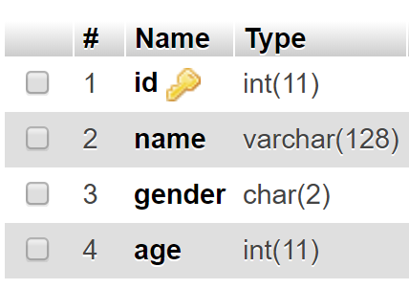
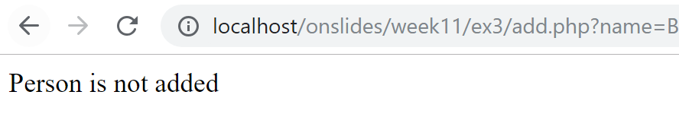
Exercise 3: Insert new content (Failure)

Slide 22
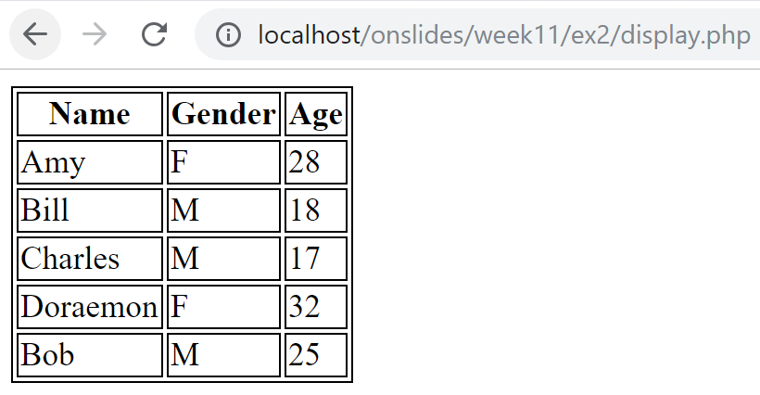
Exercise 3: Insert new content (Failure)
Andy NOT added

Slide 23
Part II
Best Practices

Slide 24
A. Create Data Access Object (DAO) classes
Avoid writing PDO code in multiple PHP pages
A DAO class captures reusable PDO code
Grouped into logical unit
E.g., BookDAO, PersonDAO, EmployeeDAO, etc.

Slide 25
B. Create ConnectionManager class
Common step between many DAOs
Connect to a data source (e.g., database)
Good idea to put this step in one common place
ConnectionManager class
Benefits:
Minimize code change when data source changes
E.g., database being moved to another location

Slide 26
-- BookDAO.php --
<?php
class BookDAO {
public function retrieveAll() {
$sql = 'SELECT * FROM book';
$connMgr = new ConnectionManager();
$pdo = $connMgr->getConnection();
$stmt = $pdo->prepare($sql);
$stmt->execute();
$result = [];
$stmt->setFetchMode(PDO::FETCH_ASSOC);
while($row = $stmt->fetch()) {
$result[] = new Book($row['title'], $row['isbn13'], $row['price']);
}
$stmt = null;
$pdo = null;
return $result;
}
}
?>

Slide 27
C. Use PHP Initialization (.ini) File
Used to configure parameters and initial settings
Benefit:
Put all customization options in one place
Format:
Example:
key1 = value1
; lines that starts with ; are comments
; file name is usually xx.ini, e.g. week11.ini
host = localhost
username = root
password =
dbname = week11
week11.ini

Slide 28
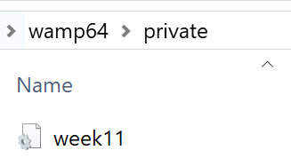
C. Create PHP Initialization (.ini) File
Never expose sensitive configuration files publicly
E.g., files containing username and password
Never allow this: http://example.com/week11.ini
Place it outside the publicly accessible document root on the server

Slide 29
PHP Initialization File
Read the .ini file as an associative array
Get the individual value out
$conf = parse_ini_file($_SERVER["DOCUMENT_ROOT"] . "/../private/week11.ini");
$dsn = "mysql:host={$conf['host']};".
dbname={$conf['dbname']}";
$pdo = new PDO($dsn,$conf['username'],$conf['password']);
Key | Value
host | localhost
username | root
password
dbname | week11
$conf

Slide 30
Read .ini File in ConnectionManager class
-- ConnectionManager.php --
<?php
class ConnectionManager {
public function getConnection() {
// store the ini file outside of www folder
$conf = parse_ini_file($_SERVER["DOCUMENT_ROOT"] . "/../private/week11.ini);
$dsn="mysql:host={$conf['host']};" . "dbname={$conf['dbname']}";
return new PDO($dsn,$conf['username'],$conf['password']);
}
}
?>

Slide 31
Exercise 4: Best Practice - I
Given (ex4 folder):
model/ConnectionManager.php
model/Person.php
model/PersonDAO.php (incomplete)
display.php, add.php (incomplete)
add-view.html, autoload.php, week11.ini
To do:
Put ini file at a safe location (e.g., wamp64/private/week11.ini)
Modify the argument of parse_ini_file (if needed)

Slide 32
Exercise 4: Best Practice - I
To do (con’t):
Implement retrieveAll() and add($person) in PersonDAO.php
Use PersonDAO to implement display.php
Produce the same output as Exercise 1
Use PersonDAO to implement add.php
Produce the same output as Exercise 2

Slide 33
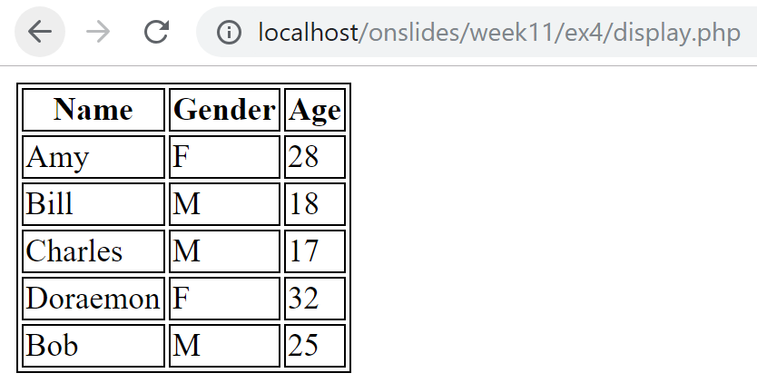
Exercise 4: Best Practice – I (display.php)

Slide 34
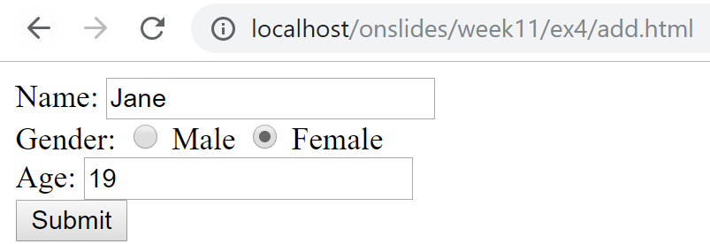
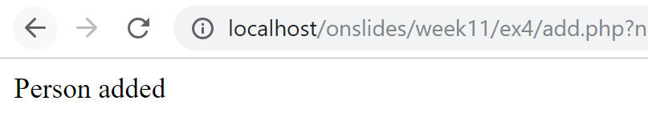
Exercise 4: Best Practice – I (add.html/php)

Slide 35
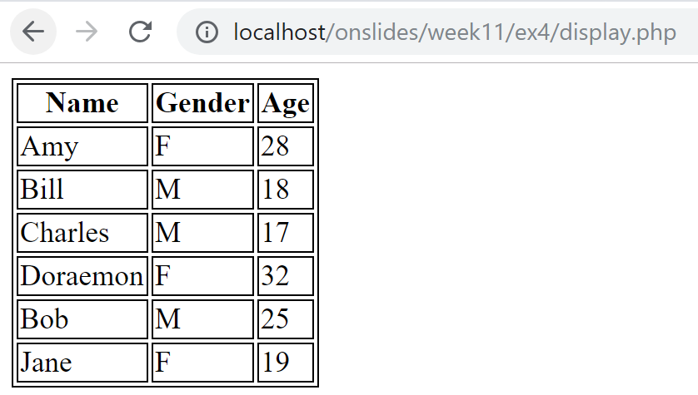
Exercise 4: Best Practice – I (add.html/php)
Jane added

Slide 36
Exercise 5: Best Practice - II
Reusing week11.ini from exercise 4 + the following files in ex5 folder:
Complete the ones marked as incomplete
model/ConnectionManager.php
model/Course.php
model/CourseDAO.php
display.php (incomplete)
add.php (incomplete)
add-view.php
autoload.php

Slide 37
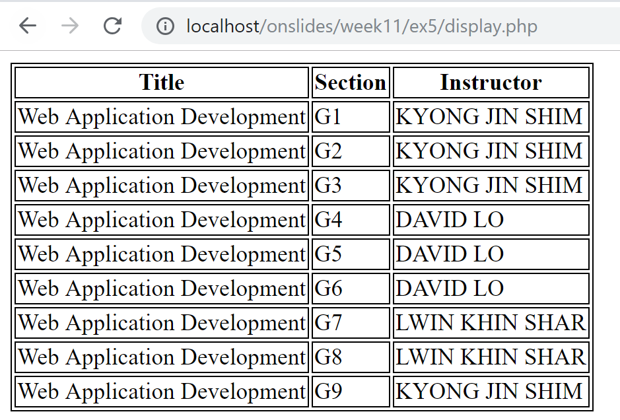
Exercise 5: Best Practice – II (display.php)

Slide 38
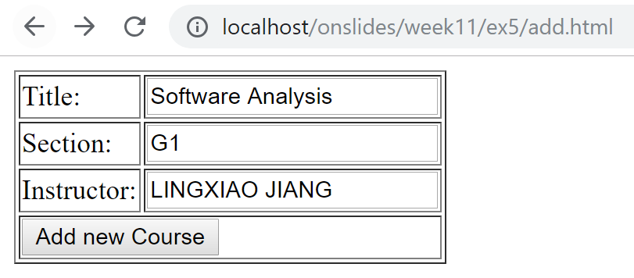
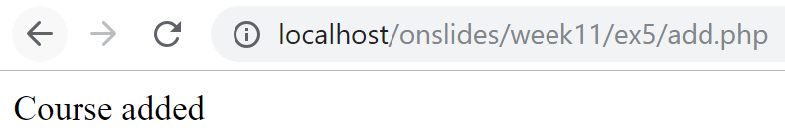
Exercise 4: Best Practice – II (add.html/php)

Slide 39
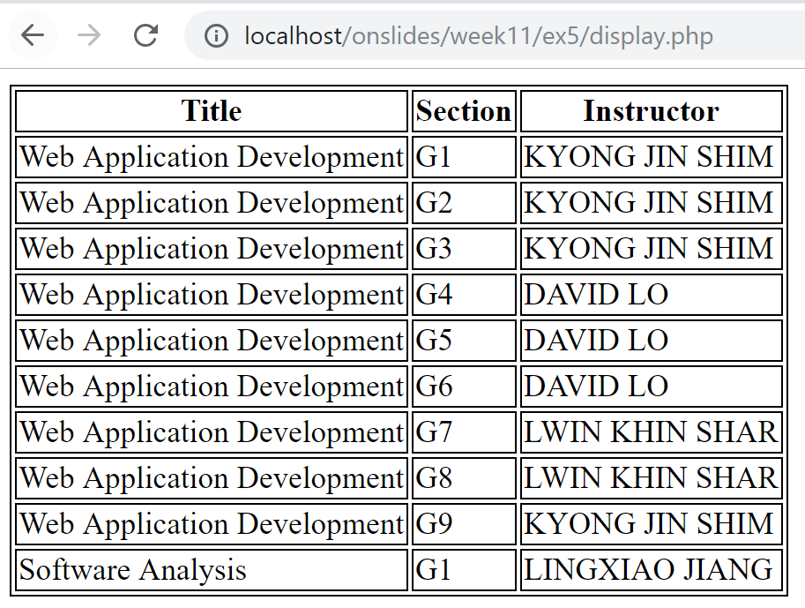

Slide 40

Key Points
PHP-DB interaction
Connect to DB
Specify DSN
Instantiate PDO object
Prepare SQL statement
prepare, bindParam
Execute SQL statement
execute
Retrieve results
setFetchMode
fetch
Free up resources
$stmt = null, $pdo = null
Data Access Object (DAO)
ConnectionManager
Initialization file
.ini file
parse_ini_file(…)

