Slide 1
Class vs. Object vs. DAO vs. DAO using PDO

Slide 2
Concept :
Class
a template that describes what an Object from this Class will look like
class Star {
. . .
}
Properties
name - name of the object
colour – the colour of the object
size – the size of the object
name =
colour =
size =
Methods
_ _ construct ( . . . ) - Initialize the object
getName ( ) – Tell me your name
getColour ( ) – Tell me your colour
getSize ( ) – Tell me your size
_ _ construct ( . . .)
getName( )
getColour( )
getSize ( )

Slide 3
this is my requirement ….

Slide 4
Concept :
Object
making use of the Class template to add meaningful property values to it
name = ‘Sunny Star’
colour = ‘Red’
size = ‘Medium’
name = ‘Faraway Star’
colour = ‘Purple’
size = ‘Small’
name = ‘Bright Star’
colour = ‘Yellow’
size = ‘Big’
_ _ construct ( . . .)
getName( )
getColour( )
getSize ( )
_ _ construct ( . . .)
getName( )
getColour( )
getSize ( )
_ _ construct ( . . .)
getName( )
getColour( )
getSize ( )

Slide 5
Implementation ….
<?php
. . .
$star1 = new Star (‘Bright Star’, ‘Yellow’, ‘Big’)
$star2 = new Star (‘Sunny Star’, ‘Red’, ‘Medium’)
$star3 = new Star (‘Faraway Star’, ‘Purple’, ‘Small’)
. . .
?>
!
Hardcoded
This set of data is only available in this application.
I want to reuse these data …

Slide 6
Concept :
Data Access Object (DAO)
a template that allows an application to manage a list of Objects
class StarDAO {
. . .
}
Properties
list_of_stars = the list of stars
Methods
_ _ construct ( . . . ) - Initialize the object with a set of stars
getStars ( ) – ) – Tell me what stars do you have
list_of_stars =
_ _ construct ( . . .)
getStars ( )

Slide 7
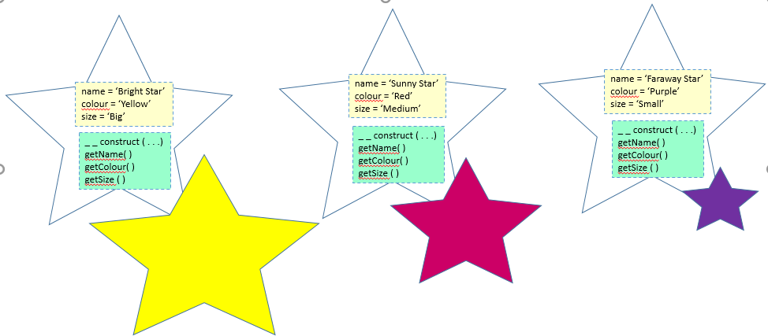
Concept :
Data Access Object (DAO)
template that allows an application to manage a list of Objects
list_of_stars = [ . . . ]
_ _ construct ( . . .)
getStars ( )

Slide 8
Implementation ….
<?php
class StarDAO {
public _ _ construct ( ) {
$list_of_stars = [
new Star (‘Bright Star’, ‘Yellow’, ‘Big’),
new Star (‘Sunny Star’, ‘Red’, ‘Medium’),
new Star (‘Faraway Star’, ‘Purple’, ‘Small’)
]
}
. . .
?>
!
Hardcoded
Any changes or new records will have to be added in this application.
What if the designs of the stars changes …

Slide 9
Concept :
Using a Database to store data
Name | Colour | Size
Bright Star | Yellow | Big
Sunny Star | Red | Medium
Faraway Star | Purple | Small

Slide 10
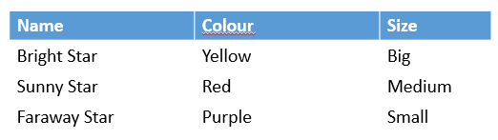
Concept :
Data Access Object (DAO) using PHP Data Object (PDO)
a template that is able to provide a list of specific Objects
list_of_stars = [ . . . ]
_ _ construct ( . . .)
getStars ( )
Making use of
PDO to retrieve an instance of the data

Slide 11
Implementation ….
<?php
class StarDAO {
public _ _ construct ( ) {
}
public getStars ( ) {
// retrieve the data from the database
// E.g. select * from database_table;
}
. . .
?>
Dynamically available
Can be called by any applications
No changes to codes with data changes

Slide 12
if this is a new requirement ….

Slide 13
update the database table to …
Name | Colour | Size
Bright Star | Yellow | Small
Gloomy Start | Blue | Small
Sunny Star | Red | Medium
Happy Star | Pink | Big
Sunset Star | Orange | Medium
Farmland Star | Green | Big
Faraway Star | Purple | Small
Note: Data highlighted in yellow are added or updated.

Slide 14
an implementation example ….
Class
DAO
DAO
Object
Object
Object
. . .
Object
Object
via PDO
Database

