Slide 1

Web Application Development
Selected Topics: Passing Control and Data +
User Authentication
If everyone is moving forward together, then success takes care of itself. Henry Ford
Notes:
Image from: https://pixabay.com/en/spaceship-starship-spacecraft-3141006/

Slide 2
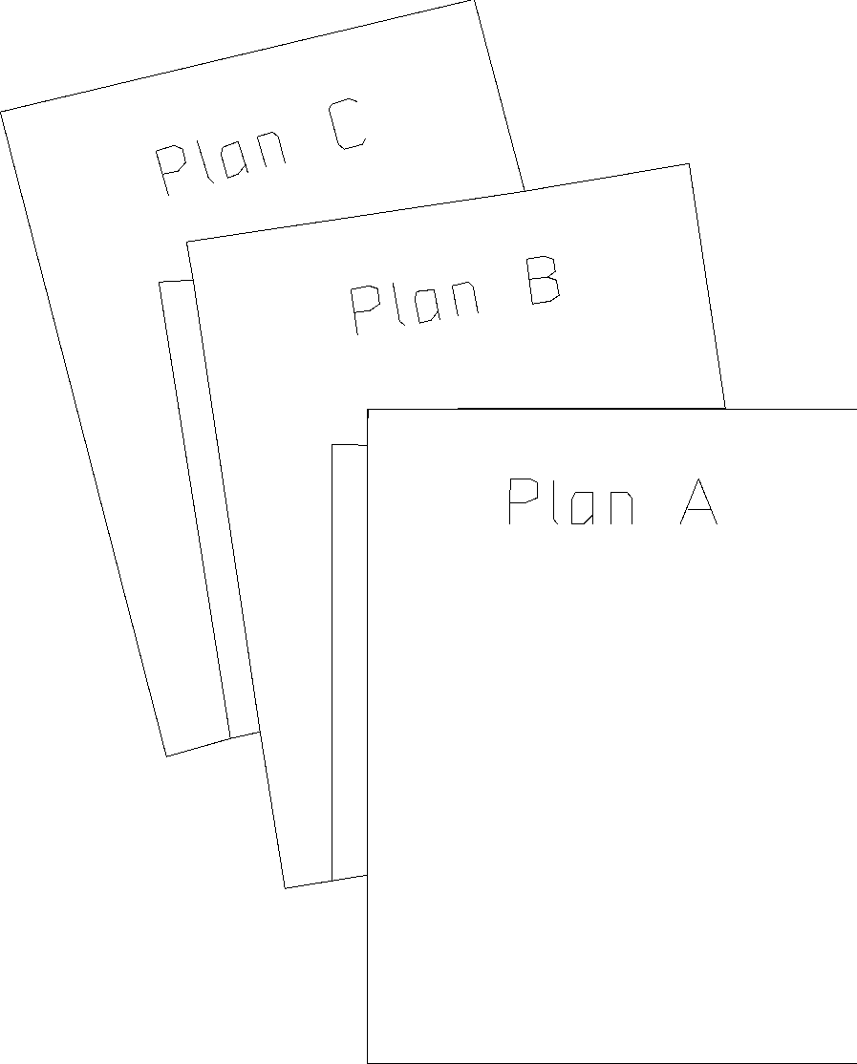
Overview
Objective
Learn about some additional PHP concepts
Content
Passing control across pages
Passing data across pages
Authenticating users
After this module, you should be able to
Write code that pass control from a page to another
Write code that pass data from a page to another
Write code that authenticate users
2

Slide 3
I. Passing Control Across Pages
Method 1: Form Submission
Method 2: Hyperlink
<html>
<body>
<form action='another.php'>
<input type="submit“/>
</form>
</body>
</html>
first.php
<html>
<body>
<a href='another.php'>Go to another page</a>
</body>
</html>
first.php

Slide 4
I. Passing Control Across Pages
Method 3: Automatic page redirection
header("Location: second.php");
exit;
first.php
Server
1.HTTP Request
first.php
2.HTTP Response (I have moved to …)
Browser
3.HTTP Request
second.php
4.HTTP Response
4

Slide 5
HTTP Response
What the server replies
HTTP/1.1 200 OK
Date: Mon, 10 Jan 2019 12:12:12 GMT
Server: Apache Expires: Sun, 19 Mar 2019 09:03:23 GMT Content-Encoding: gzip Content-Length: 19702 Content-Type: text/html; charset=UTF-8
<html>
…
</html>
Status line (version, status code)
Zero or more header(s)
Empty line
Message body (optional)
Status code:
1xx: Informational
2xx: Success
3xx: Redirection
4xx: Client error
5xx: Server error

Slide 6
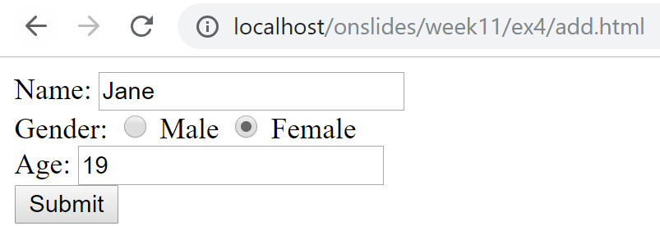
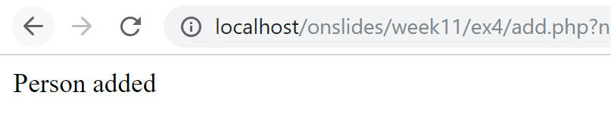
Example (from last week’s Exercise 4)
Prev

Slide 7
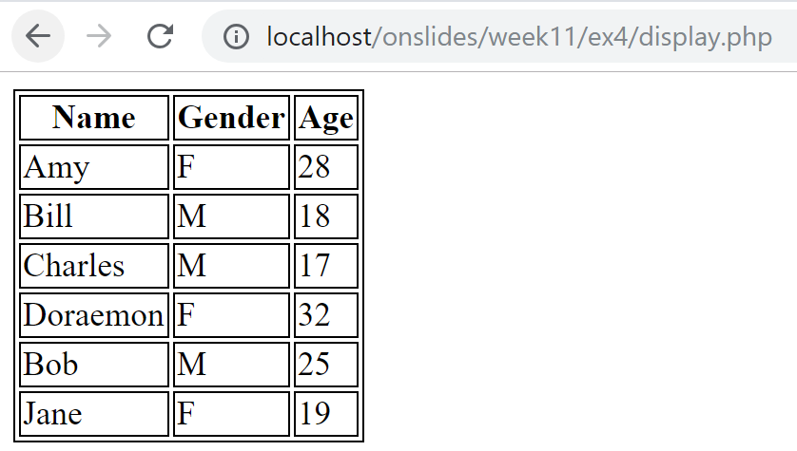
Example (from last week’s Exercise 4)
Need to manually type display.php
Prev
Jane added

Slide 8
Example (from last week’s Exercise 4)
Automatic redirection upon successful addition
add.php
New
Jane added

Slide 9
Example (from last week’s Exercise 4)
<?php
require_once "autoload.php";
$name = $_GET["name"];
$gender = $_GET["gender"];
$age = $_GET["age"];
$person = new Person($name,$gender,$age);
$dao = new PersonDAO();
$insertOK = $dao->add($person);
if ($insertOK){
header("Location: display.php");
exit;
}
else{
echo "Person is not added";
}
?>
add.php

Slide 10
Exercise 1: Passing Control
Given (in ex1 folder):
index.html
process.php (incomplete)
To do:
Modify process.php so that it redirects to different pages depending on what is selected on index.html
See next slide for more information
10

Slide 11
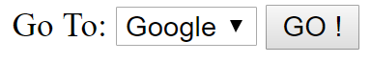
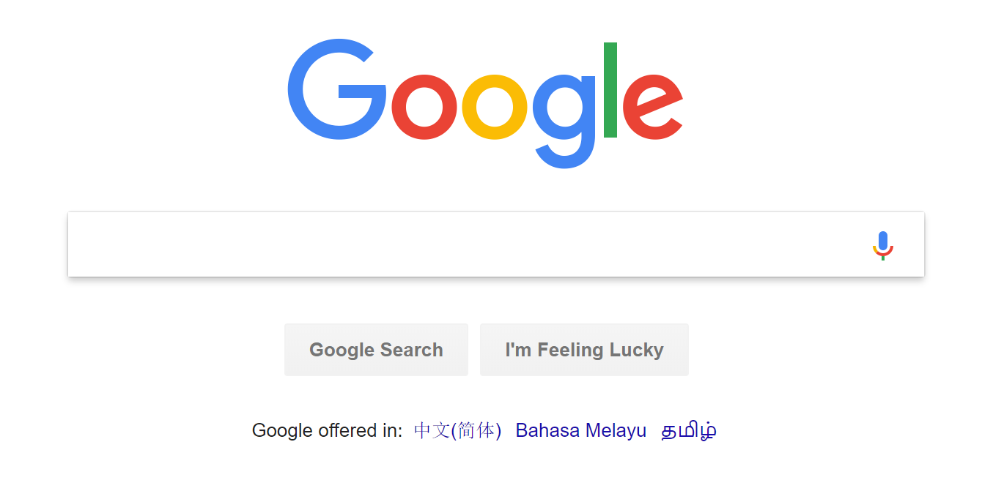
Exercise 1: Passing Control
index.html
process.php
Redirect to different sites depending on selection
11

Slide 12
Homework
Read up: PHP Documentation for header
http://php.net/manual/en/function.header.php
Find out why this code does not work:
<?php
for($i=0;$i<2000;$i++){
echo "$i";
}
header('Location: http://www.example.com/');
exit;
?>
error.php

Slide 13
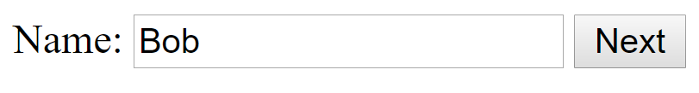

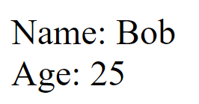
II. Passing Data Across Pages
Method 1: Through form fields, including hidden fields
page1.php
page2.php
summary.php

Slide 14
Hidden Fields
<html><body>
<form method="post" action="page2.php">
Name: <input type="text" name="name"/>
<input type="submit" value="Next"/>
</form>
</body></html>
page1.php
<html><body>
<form method="post" action="summary.php">
Age: <input type="text" name="age"/>
<?php
echo "<input type='hidden' name='name'
value='". $_POST['name'] . "'/>";
?>
<input type="submit" value="Next"/>
</form>
</body></html>
page2.php

Slide 15
Hidden Fields
<?php
echo "Name: " . $_POST["name"];
echo "<br/>";
echo "Age: " . $_POST["age"];
?>
summary.php

Slide 16
Exercise 2: Hidden Fields
Given (in ex2 folder):
page1.php
page2.php
page3.php (incomplete)
summary.php (incomplete)
To do:
Modify the incomplete PHP pages to realize the behavior shown in the next slide.
16

Slide 17

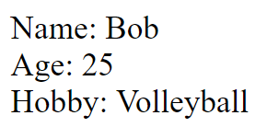
Exercise 2: Hidden Fields
page1.php
page2.php
page3.php
summary.php
17

Slide 18
II. Passing Data Across Pages
Method 2: Through URL
<html>
<body>
<a href="view_object.php?src=cat.png&width=500">
View Object
</a>
</body>
</html>
main.php
<?php
echo "<img src='{$_GET['src']}' width='{$_GET['width']}'/>";
?>
view_object.php

Slide 19
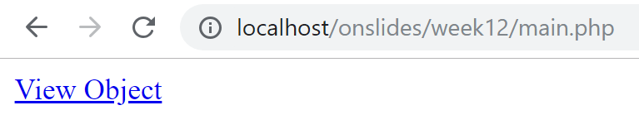
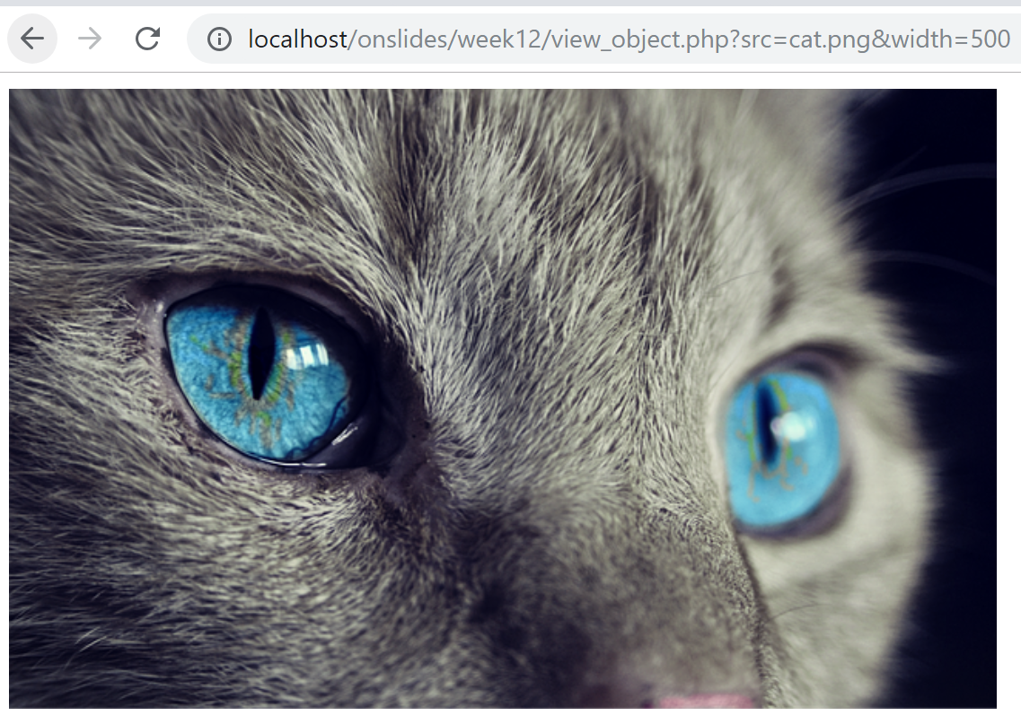
II. Passing Data Across Pages
Notes:
Cat image from: https://pixabay.com/photos/cat-animal-cat-s-eyes-eyes-pet-1285634/

Slide 20
II. Passing Data Across Pages
Method 3: Using HTTP Session
What is HTTP Session?
Stores data shared between a user and a website (e.g., eLearn)
Data available across multiple pages (e.g., IS112, IS113, and other pages in eLearn) or multiple instances of the same page
Data will automatically be reset after a period of time

Slide 21
II. Passing Data Across Pages
Why we need it?
Identify a user across more than a page in a site
Pass data between web pages in the same site

Slide 22
HTTP Session
How to use HTTP Session?
Call session_start()
Initialize a session OR
Resume an existing session
Use $_SESSION superglobal to add new key-value pairs into the HTTP Session
Note: Make sure session_start() is called before accessing $_SESSION superglobals

Slide 23
HTTP Session
session1.php
session2.php
summary-session.php
23

Slide 24
HTTP Session
<html><body>
<form method="post" action="session2.php">
Name: <input type="text" name="name"/>
<input type="submit" value="Next"/>
</form>
</body></html>
session1.php
<?php session_start(); ?>
<html><body>
<form method="post" action="summary-session.php">
Age: <input type="text" name="age"/>
<?php
$_SESSION['name'] = $_POST['name'];
?>
<input type="submit" value="Next"/>
</form>
</body></html>
session2.php

Slide 25
HTTP Session
<?php
session_start();
echo "Name: " . $_SESSION["name"];
echo "<br/>";
echo "Age: " . $_POST["age"];
?>
summary-session.php

Slide 26
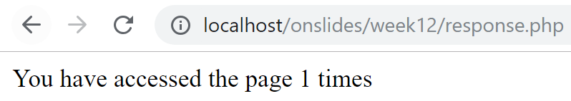
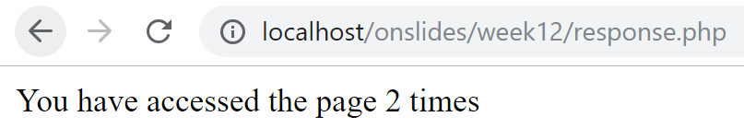
HTTP Session: Another Example

Slide 27
HTTP Session: Another Example
<?php
session_start();
if(!isset($_SESSION["count"])){
$_SESSION["count"] = 0;
}
$_SESSION["count"]++;
echo "You have accessed the page ".$_SESSION["count"]." times";
?>
response.php

Slide 28

HTTP Session: Another Example
1. Client sends HTTP request
2. Server creates a session and generates a unique session id
3. Session id is returned to the client
HTTP/1.1 200 OK
Connection: Keep-Alive
Date: Sun, 3 Jan 2018 11:02:15 GMT
Set-Cookie:PHPSESSID=12345;path=/
12345
Session
count
1
Client
Server
28

Slide 29
HTTP Session: Another Example
5. Server retrieves the session and use value stored in the session during previous request.
4. Client sends another HTTP request
GET / HTTP/1.1
Host: blue.smu.edu.sg
Cookie: PHPSESSID=12345
6. Increment count.
12345
Session
6. Server sends response.
count
1
2
Client
Server
29

Slide 30
HTTP Session: Clearing Contents
Session would be cleared automatically after some period of time has lapsed
What can we do to clear it earlier?
On server side (i.e. PHP file):
We can set $_SESSION to an empty array, or
We can use unset($_SESSION[<key>]), e.g., unset($_SESSION["count"])
30

Slide 31
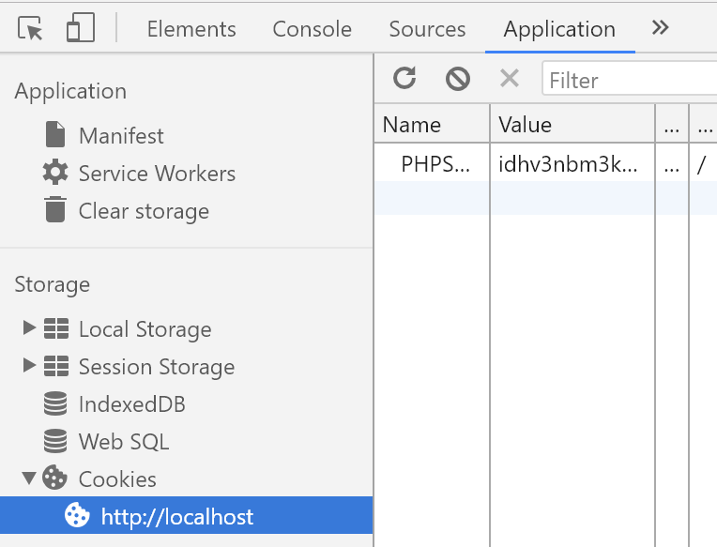
HTTP Session: Clearing Contents
On client side (i.e., web browser):
Session id can be forced to be cleared using, e.g., Chrome Dev Tools (Ctrl+Shift+I)
31

Slide 32
Exercise 3: Session
Given (in ex3 folder):
session1.php
session2.php
session3.php (incomplete)
summary-session.php (incomplete)
To do:
Modify the incomplete PHP pages to realize the behavior shown in the next slide.
32

Slide 33
Exercise 3: Session
session1.php
session2.php
session3.php
summary-session.php
33

Slide 34
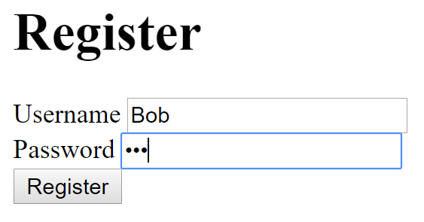
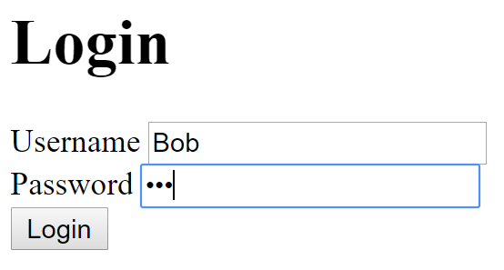
III. Authenticating Users

Slide 35
III. Authenticating Users
The user creates an account and his/her password is stored in the database.
For security reasons, we do not want to store plain text password (i.e., exactly what the user typed in) in the database.
PHP
DB
register.php
process_register.php

Slide 36
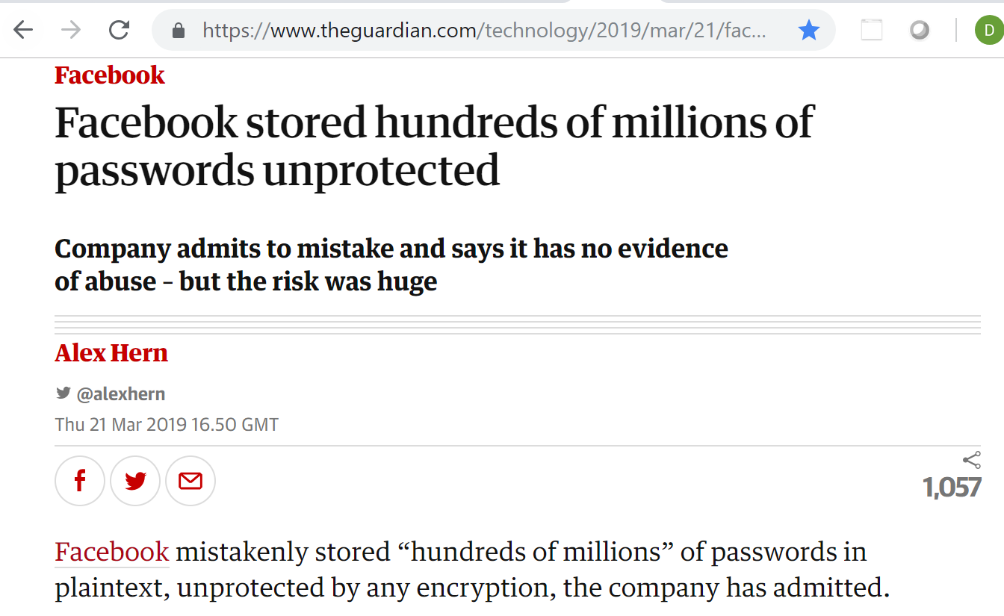
III. Authenticating Users

Slide 37
Solution: Password Hashing
A one-way transformation on a password
Turn the password into another string
Password can be transformed to its hashed string
But, not the other way round
We want to store hashed password in the DB

Slide 38
III. Authenticating Users
User
- $username - $hashedPassword
+ __construct($username,$hashed_password) + getUsername() + getHashedPassword()
UserDAO
+ add($username,$hashed_password) + retrieve($username)

Slide 39
Register a New User
<!DOCTYPE html>
<html>
<body>
<h1>Register</h1>
<form method="post" action="process_register.php">
Username <input type="text" name="username"/>
<br/>
Password <input type="password" name="password"/>
<br/>
<input type="submit" value="Register"/>
</form>
</body>
</html>
register.php

Slide 40
Register a New User
<?php
spl_autoload_register(
function($class){
require_once "model/$class.php";
}
);
$username = $_POST["username"];
$password = $_POST["password"];
$hashed = password_hash($password, PASSWORD_DEFAULT);
$dao = new UserDAO();
$status = $dao->add($username,$hashed);
if($status){
echo "Registered successfully";
}
else{
echo "Failed to register";
}
?>
process-register.php

Slide 41
Login with Password Hashing
When the user attempts to login:
Get the hash of the user’s real password from DB
It will be checked against the entered password.
PHP
DB
login.php
process_login.php

Slide 42
Login with Password Hashing
<!DOCTYPE html>
<html>
<body>
<h1>Login</h1>
<form method="post" action="process_login.php">
Username <input type="text" name="username"/>
<br/>
Password <input type="password" name="password"/>
<br/>
<input type="submit" value="Login"/>
</form>
</body>
</html>
login.php

Slide 43
<?php
spl_autoload_register(
function($class){
require_once "model/$class.php";
}
);
$username = $_POST["username"];
$password = $_POST["password"];
$dao = new UserDAO();
$user = $dao->retrieve($username);
$success = false;
if($user != null){
$hashed = $user->getHashedPassword();
$success = password_verify($password,$hashed);
if($success){
echo "Successful Login";
}
}
if (!$success){
echo "Failed Login";
}
?>
process-login.php

Slide 44
Code Sample 1: Register + Login
Given (sample1 folder):
database/week12.sql
model/ConnectionManager.php
model/User.php
model/UserDAO.php
register.php
process_register.php
login.php
process_login.php

Slide 45
Code Sample 1: Register + Login
To do:
Open and check the given files
Import week12.sql
Open register.php in your web browser and register a new user
Open login.php and login with the newly created user credentials

Slide 46
Homework: Why this code does NOT work?
<?php
spl_autoload_register(
function($class){
require_once "model/$class.php";
}
);
$username = $_POST["username"];
$password = $_POST["password"];
$dao = new UserDAO();
$user = $dao->retrieve($username);
$success = false;
if($user != null){
$hash = $user->getHashedPassword();
$success = (password_hash($password,PASSWORD_DEFAULT)===$hash);
if($success){
echo "Successful Login";
}
}
if (!$success){ echo "Failed Login";}
?>
process-login.php
Notes:
Hint: See https://security.stackexchange.com/questions/188137/how-does-password-hash-password-verify-in-php-work

Slide 47

Using Session to Protect Your Pages
process_login.php
PHP
DB
login.php
Successful login
welcome.php

Slide 48
<?php
spl_autoload_register(
function($class){
require_once "model/$class.php";
});
session_start();
$username = $_POST["username"];
$password = $_POST["password"];
$dao = new UserDAO();
$user = $dao->retrieve($username);
$success = false;
if($user != null){
$hashed = $user->getHashedPassword();
$success = password_verify($password,$hashed);
if($success){
$_SESSION["user"] = $username;
header("Location: welcome.php");
exit;
}
}
if (!$success){
echo "Failed Login";
}
?>
1
Create a session entry for successful login
process-login.php

Slide 49
Using Session to Protect Your Pages
For every page that needs to be protected
<?php
session_start();
// No session variable "user" => no login
if ( !isset($_SESSION["user"]) ) {
// redirect to login page
header("Location: login.php");
// stop all further execution
// (if there are statements below)
exit;
}
echo "<h1>Welcome to Secure System</h1>";
?>
2
welcome.php

Slide 50
Using Session to Protect Your Pages
To avoid repeating code everywhere:
<?php
session_start();
// No session variable "user" => no login
if ( !isset($_SESSION["user"]) ) {
// redirect to login page
header("Location: login.php");
exit;
}
?>
protect.php
<?php
require_once "protect.php";
echo "<h1>Welcome to Secure System</h1>";
?>
welcome.php

Slide 51
Code Sample 2: Register + Login + Protect
Given (sample2 folder):
model/ConnectionManager.php
model/User.php
model/UserDAO.php
register.php
process_register.php
login.php
process_login.php
welcome.php
protect.php

Slide 52
Code Sample 2: Register + Login + Protect
To do:
Open and check the files highlighted in red
Try to access welcome.php without logging in
Login with a valid username and password
Clear your session using information on slide 31 to simulate logout
Repeat step 2

Slide 53
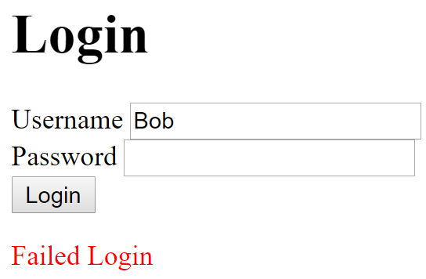
Exercise 4: Failed Login
Modify functionality of login.php and process_login.php when login fails
process_login.php
PHP
DB
login.php
Failed login
login.php?username=Bob

Slide 54
Exercise 4: Failed Login
Given (ex4 folder):
model/ConnectionManager.php,
model/User.php
model/UserDAO.php
register.php
process_register.php
login.php (incomplete)
process_login.php (incomplete)
welcome.php
protect.php

Slide 55
Exercise 4: Failed Login
Pass information from process_login.php to login.php through URL and session
Pass username through the URL given as part of the string argument of the header function
Pass error message (“Failed Login”) through session
See comments in PHP files for more information
Use <p style='color: red'></p> to display text in red color

Slide 56
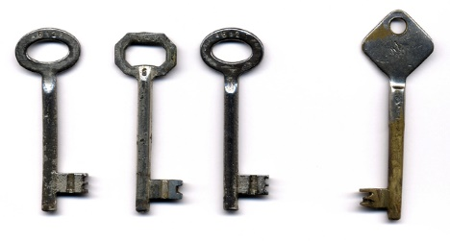
Key Points
Passing Controls
Form submission
Hyperlink
Automatic page redirection
Passing Data
Form fields
Hidden fields
URL
Session
Authenticating Users
Password hashing
Using session to protect pages

