Slide 1
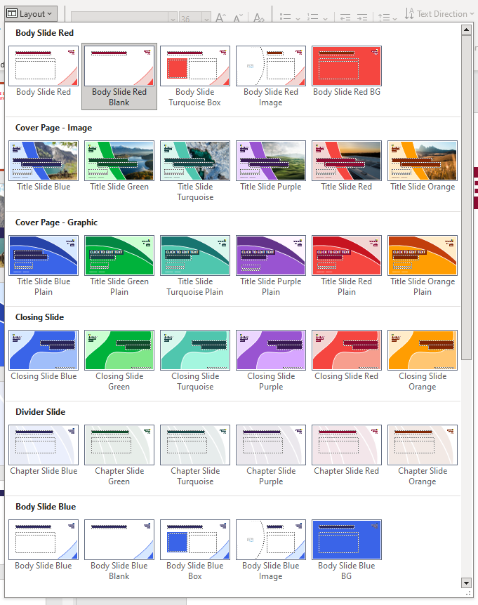
PLEASE DELETE THIS SLIDE BEFORE CREATING YOUR PRESENTATION
TUTORIAL SLIDE
Changing slide layout
There are six different colour variations for each slide from the European Climate Pact colour palette. To select from these options click on ‘Layout’ in the top ribbon under ‘Home’ and then select your slide.

Slide 2
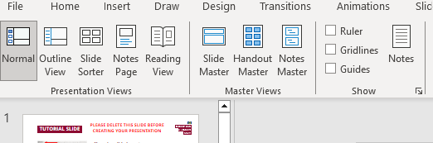
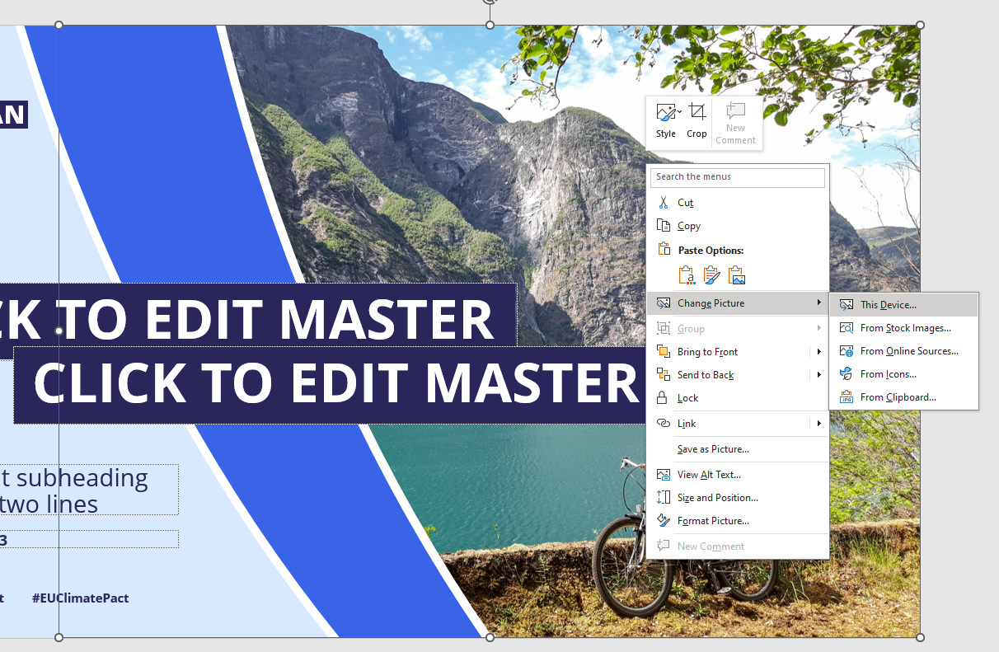
PLEASE DELETE THIS SLIDE BEFORE CREATING YOUR PRESENTATION
TUTORIAL SLIDE
Changing front cover image
To change the cover image click ‘Slide Master’ under ‘View’ in the top ribbon.
Once in the Slide Master editing, right-click on the image and select ‘Change Picture’. From there you can select your saved image from your device. The image will automatically fill the space provided.
To exit Slide Master editing mode click on ‘Slide Master’ in the top ribbon and then ‘Close Master View’.

Slide 3
First Line Here

