Slide 1
Detecting SVs in Cancer Genomes Through a Direct Cancer/Somatic Comparison
Cody Weinberger

Slide 2
Reference Guided Assembly of Genomes
Human Reference Genome (Ensembl GRCh37)
Reference-guided somatic genome assembly
Reference-guided cancer genome assembly
(to assembled somatic genome)
assembly with SHEAR

Slide 3
Map soft-clipped reads to opposing assembly
Unmatched
Matched
Putative breakpoint
Putative breakpoint
Matched
Unmatched

Slide 4
Why Compare Directly 1) Detect more novel insertions
Socrates only detected 65% of simulated small, templated novel insertions
Detected 94% of simulated deletions
Only tested insertion size 1-20nts
Socrates is the only available method that outputs the inserted sequence

Slide 5
Why Compare Directly 1) Detect more novel insertions
Pindel, PRISM, CREST also have large deletion bias
Pindel/PRISM medium-size indels:
25-40% recall
3-10% precision
“Other methods do not predict non-templated inserts at all”

Slide 6
Why Compare Directly 1) Detect more novel insertions
Somatic
X
DOES NOT MAP
Cancer

Slide 7
Why Compare Directly 1) Detect more novel insertions
Can map reads bidirectionally
By mapping onto both genomes, novel insertions will also be detected as a deletion in one genome

Slide 8
Why Compare Directly 2) Detect nested insertions
Indels in a novel region of the somatic genome (relative to human reference) cannot be detected indirectly
Easily detected by directly comparing somatic to cancer genome

Slide 9
Detecting SVs Traditional Soft-Clip Approach Nested Insertions
Reference
Somatic
Cancer
S/?
?
?
?/S

Slide 10
Detecting SVs Proposed Direct Approach Nested Insertions
Somatic
Cancer
C
C

Slide 11
Detecting SVs Traditional Soft-Clip Approach Nested Insertions
Reference
Somatic
Cancer
S/?
?
?/S

Slide 12
Detecting SVs Proposed Direct Approach Nested Insertions
Somatic
Cancer
C

Slide 13
Why Compare Directly 3) Improve confidence of putative breakpoints
Calling 2 of every breakpoint (1 for each genome)
Greater confidence in breakpoints predicted by both

Slide 14
Why Compare Directly 4) Work with full genomes
Want methods that output actual SV sequences
Want to move towards obtaining full personalized genome

Slide 15
Additional Notes
Could be pipelined with any breakpoint detector
Next step to compare reads directly and bidirectionally without needing assembly

Slide 17
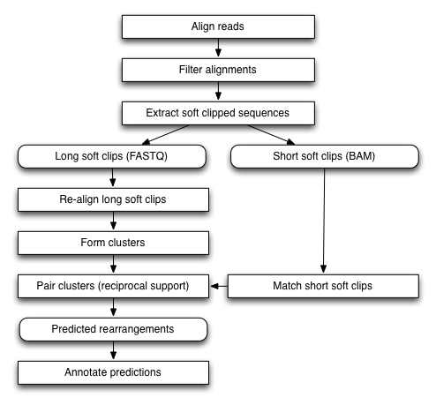
Socrates Schroeder and Hsu et. al. 2014

Slide 18
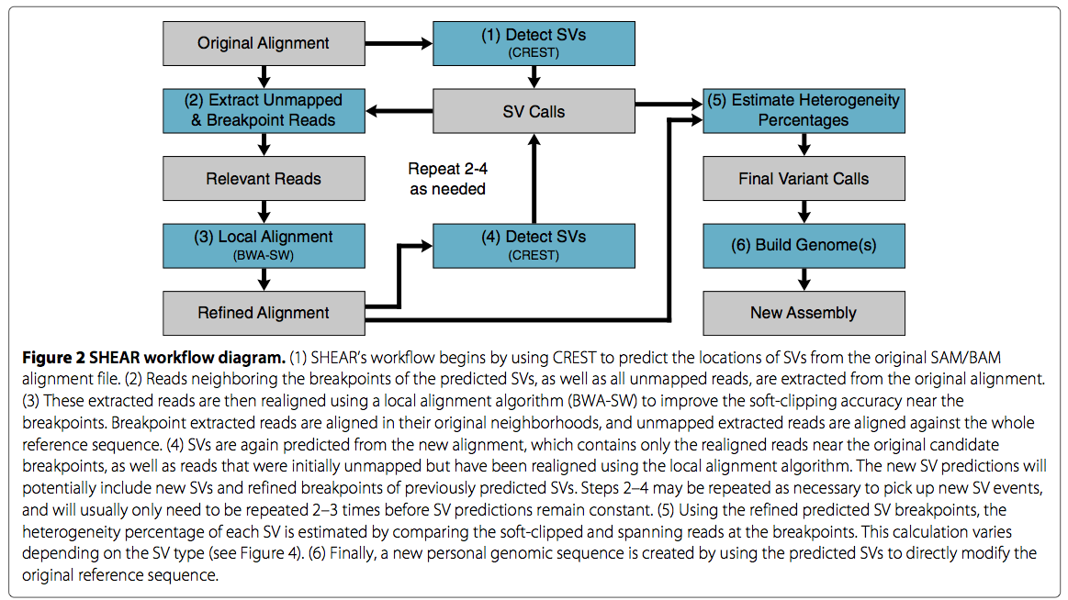
SHEAR

Slide 19
Match Breakpoints on 2 Genomes
Search flanking regions for sequence similarity
<deletion>
Breakpoints (indel)
Orphan breakpoint
Breakpoints (inversion)
Breakpoints (indel)
<insertion>

Slide 20
Match orphan breakpoints (translocations)
<deletion>
<transloc>
Breakpoints (indel)
Orphan breakpoints
Breakpoints (inversion)
Orphan breakpoints
<transloc>

