Slide 1
Detecting SVs in Cancer Genomes Direct Cancer/Somatic Comparison
Cody Weinberger

Slide 2
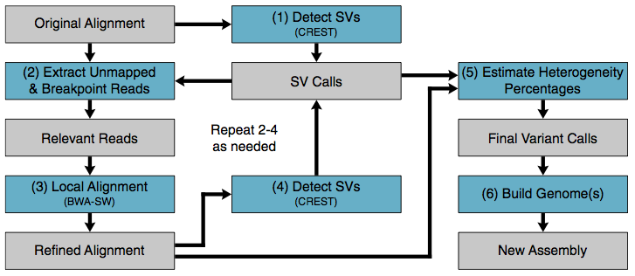
Step 1
Reference guided assembly of somatic reads to human reference genome
Reference guided assembly of cancer reads to resulting assembled somatic genome
Possibly use SHEAR

Slide 3
Reference Guided Assembly of Genomes
Human Reference Genome (Ensembl GRCh37)
Reference-guided somatic genome assembly
Reference-guided cancer genome assembly
(to assembled somatic genome)

Slide 4
Step 2
Index the assembled somatic and cancer genome with bowtie2
Command: bowtie2-build <reference sequence fastas> <output name root>

Slide 5
Step 3
Build alignments of reads to opposing genome
Command: bowtie2 –x <reference sequence root> -l <fastq reads 1st mate pairs> -2 <fastq reads 2nd mate pairs> -U <unpaired reads> -S <choose SAM output root name>

Slide 6
Map soft-clipped reads to opposing assembly
Unmatched
Matched
Putative breakpoint
Putative breakpoint
Matched
Unmatched

Slide 7
Step 4
Run Socrates on resulting SAMs
command: ./Socrates all <input bam file> --bowtie2_db <root of opposing bowtie ref>
Output: putative breakpoints

Slide 8
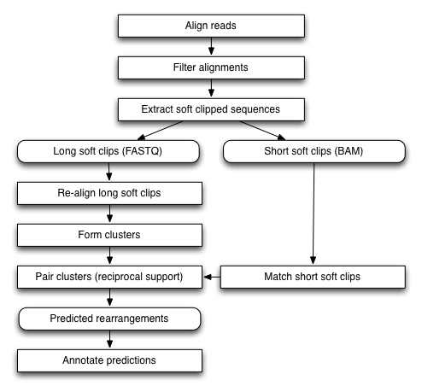
Socrates Schroeder and Hsu et. al. 2014

Slide 9
Step 5
Output flanking bases to FASTA from each set of breakpoints (using java)
command: exportFlanks <input file> <char genome type (‘C’ or ’S’)> <output file name>
Output: all short sequences flanking putative breakpoints

Slide 10
Step 6
Index flanking FASTA files with bowtie2
command: bowtie2-build <breakpoint sequences fasta> <output name root>

Slide 11
Step 7
map flanking fasta sequences (from opposing) to own flanking fast sequences (DO EACH WAY)
command: bowtie2 -x <flanking FASTA bowtie root> -c -f <flanking FASTA to align> > <output file name>

Slide 12
Step 8
Sort into matched and unmatched breakpoints (using java)
command: java exportMatches <remapped somatic reads SAM> <remapped cancer reads SAM>
Output lists of matched and unmatched breakpoints

Slide 13
Python Driver Script
One you have somatic and cancer assemblies:
command: python main.py --s_ref <somatic reference bowtie root> --c_ref <cancer reference bowtie root> --s_reads <somatic reads> --c_reads <cancer reads>
output: matchedBPs.txt, unmatchedBPs.text

Slide 14
Why Compare Directly 1) Detect more novel insertions
Socrates only detected 65% of novel insertions
PRISM detected 97%
Pindel detected 93%
CREST, another soft-clip cancer genome tool, has same difficulty with novel insertions

Slide 15
Why Compare Directly 1) Detect more novel insertions
By mapping onto both genomes, novel insertions will also be detected as a deletion in one genome

Slide 16
Why Compare Directly 1) Detect more novel insertions
Somatic
X
DOES NOT MAP
Cancer

Slide 17
Why Compare Directly 2) Improve confidence of putative breakpoints
Calling 2 of every breakpoint (1 for each genome)
Greater confidence in breakpoints predicted by both

Slide 18
Match Breakpoints on 2 Genomes
Search flanking regions for sequence similarity
<deletion>
Breakpoints (indel)
Orphan breakpoint
Breakpoints (inversion)
Breakpoints (indel)
<insertion>

Slide 19
Match orphan breakpoints (translocations)
<deletion>
<transloc>
Breakpoints (indel)
Orphan breakpoints
Breakpoints (inversion)
Orphan breakpoints
<transloc>

Slide 20
Why Compare Directly 3) Detect nested insertions
Any indels in a region inserted in the somatic genome relative to (human reference) cannot be detected indirectly
But they can be easily detected directly comparing somatic to cancer genome
Expect preference for same regions to vary (e.g. transposable elements)

Slide 21
Detecting SVs Traditional Soft-Clip Approach Nested Insertions
Reference
Somatic
Cancer
S/?
?
?
?/S

Slide 22
Detecting SVs Proposed Direct Approach Nested Insertions
Somatic
Cancer
C
C

Slide 23
Detecting SVs Traditional Soft-Clip Approach Nested Insertions
Reference
Somatic
Cancer
S/?
?
?/S

Slide 24
Detecting SVs Proposed Direct Approach Nested Insertions
Somatic
Cancer
C

Slide 25
Detecting SVs Traditional Soft-Clip Approach Multiple Deletions
Reference
Somatic
Cancer
S
Breakpoint detected in both cancer and somatic genomes so not counted

Slide 26
Why Compare Directly 4) Work with full cancer genome
Want to start using methods that output SVs on a full personalized genome

Slide 27
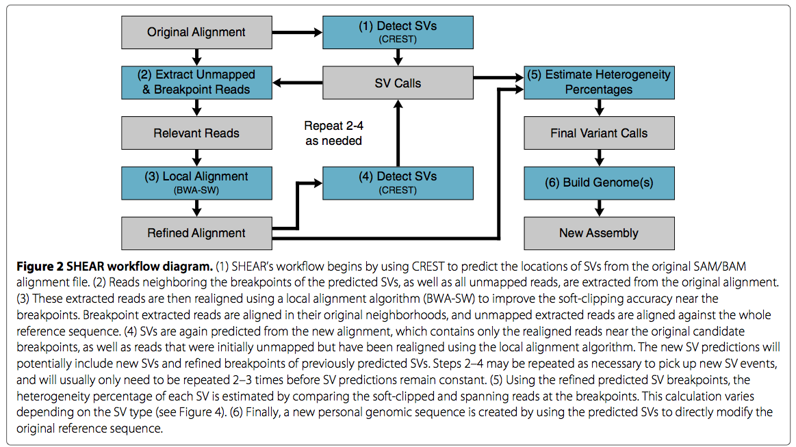
SHEAR

Slide 29
Detecting SVs Traditional Soft-Clip Approach Nested Insertions
Reference
Somatic
Cancer
S/?
?
?
?/S

Slide 32
Complex Overlapping SVs Traditional Soft-Clip Approach Double Translocation
S
C
S
C
C
S
May be called as somatic, but really cancer (depends which side anchored)

Slide 33
Detects Complex Overlapping SVs Proposed Direct Comparison Approach Double Translocation

Slide 34
Match orphan breakpoints (translocations)
<deletion>
<transloc>
Breakpoints (indel)
Orphan breakpoints
Breakpoints (inversion)
Orphan breakpoints
<transloc>

Slide 35
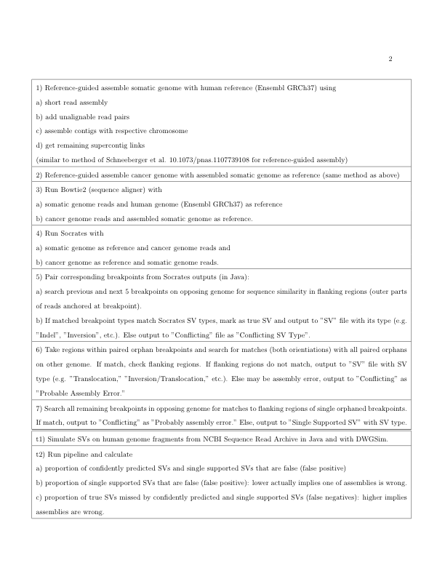

Slide 37
Human Reference Genome (Ensembl GRCh37)
Reference-guided somatic genome assembly
Reference-guided cancer genome assembly
(to assembled somatic genome)

Slide 38
Unmatched
Matched
Putative breakpoint
Putative breakpoint
Matched
Unmatched

Slide 39
Somatic
X
DOES NOT MAP
Cancer

Slide 40
<deletion>
Breakpoints (indel)
Orphan breakpoint
Breakpoints (inversion)
Breakpoints (indel)
<insertion>

Slide 41
<deletion>
<transloc>
Breakpoints (indel)
Orphan breakpoints
Breakpoints (inversion)
Orphan breakpoints
<transloc>

Slide 42
Reference
Somatic
Cancer
S/?
?
?
?/S

Slide 43
Somatic
Cancer
C
C

Slide 44
Reference
Somatic
Cancer
S/?
?
?/S

Slide 45
Somatic
Cancer
C

Slide 46
Reference
Somatic
Cancer
S

