Slide 1



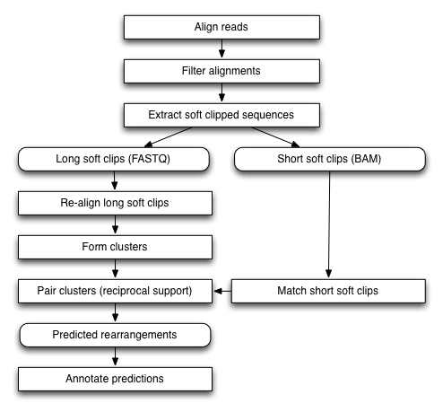
Detecting SVs in Cancer Genomes Through Direct Cancer/Somatic Comparison
Cody J. Weinberger^{1,*} and Wen-Hsiung Li, PhD²
¹ The Department of Ecology and Evolution, University of Chicago, 1101 E 57th Street, Chicago, IL 60615, USA; email: cweinberger@uchicago.edu
² Biodiversity Research Center, Academia Sinica, 128 Academia Road Sec. 2, Nankang Taipei 115, Taiwan
Introduction
Advantages
As next generation sequencing technology (NGS) increasingly allows for cheap sequencing of entire genomes, the challenge of obtaining accurate sequences is largely computational. While it has become routine to detect single nucleotide polymorphisms, detecting large scale structural variants (SVs) is a much more complex issue primarily due to short read length. A promising avenue of SV detection is using soft-clipped reads, which allows for single nucleotide resolution of potential breakpoints. When using NGS to detect somatic mutations, the traditional approach has been to compare both somatic and cancer soft-clipped reads to a reference and subtract the somatic breakpoints from the cancer breakpoints to obtain those that have occurred only in somatic cells. However, comparing the cancer and somatic genomes indirectly prevents detection of some types of mutations, e.g. any mutation nested within a novel insertion. There is also a large bias towards detecting deletions over insertions using this method, as novel regions of soft-clipped reads cannot map to the reference. A method for comparing cancer and somatic genomes directly is presented here to avoid these issues.
1) Detect More Novel Insertions
Socrates only detected 65% of novel insertions
PRISM detected 97%
Pindel detected 93%
CREST, another soft-clip cancer genome tool, has same difficulty with novel insertions
By mapping onto both genomes, novel insertions will also be detected as a deletion in one genome
X
DOES NOT MAP
Somatic
Cancer
Method
2) Improve Confidence of Putative Breakpoints
Calling 2 of every breakpoint (1 for each genome)
Greater confidence in breakpoints predicted by both
Step 1
Step 2
Step 3
3) Detect nested SVs
Reference guided assembly of somatic reads to human reference genome (using SHEAR)
Reference guided assembly of cancer reads to resulting assembled somatic genome
Build alignments of reads to opposing genome
Run Socrates on resulting SAMs to output putative breakpoints
Any indels in a region inserted in the somatic genome relative to (human reference) cannot be detected indirectly
But they can be easily detected directly comparing somatic to cancer genome
Expect preference for same regions to vary (e.g. transposable elements)
Socrates Schroeder and Hsu et. al. 2014
Human Reference Genome (Ensembl GRCh37)
Detecting SVs Traditional Soft-Clip Approach Nested Insertions
Detecting SVs Proposed Direct Approach Nested Insertions
Unmatched
Matched
Putative breakpoint
Reference-guided somatic genome assembly
Putative breakpoint
Matched
Unmatched
Reference
Somatic
Reference-guided cancer genome assembly
(to assembled somatic genome)
Somatic
C
C
Cancer
Step 4
Step 5
Step 6
S/?
?
?
?/S
Cancer
Output flanking bases to FASTA from each set of breakpoints (using java) and index with bowtie2
Crossmap flanking sequences (short fasta sequences) to look for matches
Sort and output matched and unmatched breakpoints (using java)
Detecting SVs Traditional Soft-Clip Approach Nested Insertions
Detecting SVs Proposed Direct Approach Nested Insertions
1
1
Reference
Somatic
2
2
<deletion>
<deletion>
<transloc>
Somatic
C
Cancer
3
3
Breakpoints (indel)
Orphan breakpoint
Breakpoints (inversion)
Breakpoints (indel)
Breakpoints (indel)
Orphan breakpoints
Breakpoints (inversion)
Orphan breakpoints
Cancer
4
4
<insertion>
<transloc>
S/?
?
?/S
4) Output breakpoints on full cancer genome
Traditionally only view breakpoints in the context of a reference genome which contains extraneous regions and lacks all novel regions of the individual of interest
Instead obtain somatic and cancer genomes with breakpoints annotated on each – much more information and all pertinent to the sequenced individual

