Slide 1

BI Project 1 Customer Churn Analysis – Part 1
Grégory PINCHINAT

Slide 2
Problem
Our client is a Telecommunications company which has a massive market share, but also competitors trying to attract the customers.
The problem they’re facing is : Customers churning
The stakeholders impacted are:
The investors;
The board.
This problem is important to the organization, because customers that are churning are a potential source of decrease on the company’s revenues

Slide 3
Methodology
The « Churn » dataset provided by the company was used to carry out the analysis.
A descriptive method was used with a some inferences involving t-test comparisons on proportions. When said comparisons are made, a tuple of three values accompanies the chart where the first value represents the t-statistic calculated over the sample, the second represents the p-value and the last one represents the degrees of freedom.
The most important of the three is the p-value. If it is lesser than 0.05, then we will conclude that we have enough evidence to reject the null difference between the two proportions under study. Otherwise, we may not reject the null difference and simply assume it might be significant.

Slide 4
RESULTS

Slide 5
1.- CHURN

Slide 6
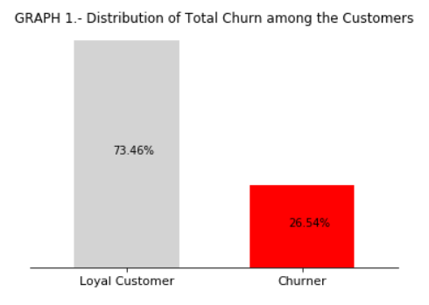
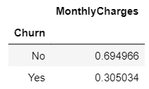
The impact of the Churn
The company has had a total of 7043 customers up to the past month and has lost about 26.54% of them, 1869 of them churning.
The Churn problem is significantly prejudicial to the business because it affects the monthly revenue generated by the charges customers are paying every month (see the pivot table under Graph 1)
If the current churning rate holds and the current number of customers doesn’t increase, then we should expect a sustained decrease of about 30% monthly in the revenue of the company.

Slide 7
2.- EXPLANATIONS BEHIND WHAT’S HAPPENING

Slide 8
2.-a) Explanation by the Demographics

Slide 9
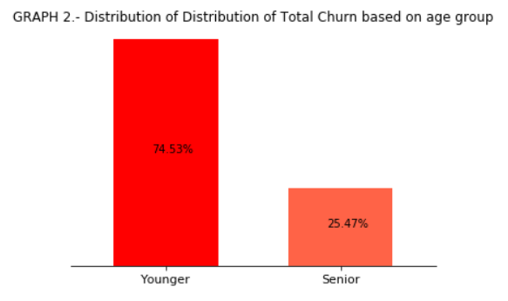
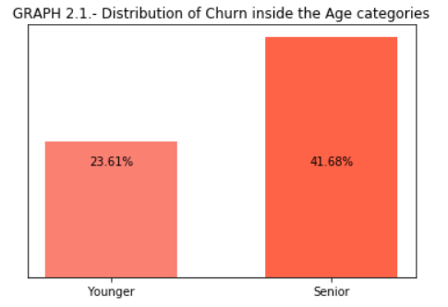
2.-a.1) Churn through the demographics – AGE
According to the data, 25.47% of the Total Churn only comes from the Seniors. But this is because the other company’s customers are mostly Youngsters. (Graph 2)
In fact, as we look inside each group separately, we discover another reality. The Younger customers tend to churn less: about 24 % of all the Youngsters churn while almost 42% of the Seniors churn monthly. (Graph 2.1)
So the company should expect the probability of churn as higher for their senior customers.

Slide 10
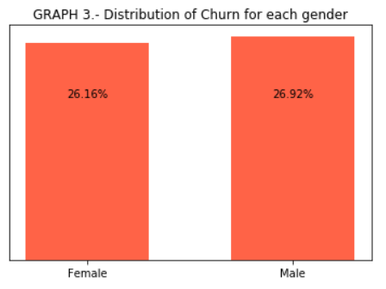
2.-a.2) Churn through the demographics – GENDER
The Gender of the customers doesn’t seem to affect their propensity to churn. Almost as many women as men have churned during the past month.
To test the non-significance of the difference, we’ve run a t-test on the difference of proportions. The results (p-value is the second value in the tuple beneath Graph 3) have not given us enough evidence to reject the hypothesis of null difference.
Therefore, we may state that the Gender has no real impact on the Churn, so far.

Slide 11
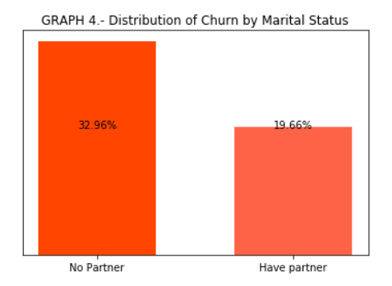
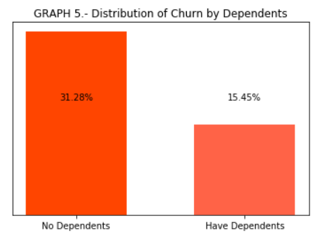
2.-a.3) Churn through the demographics – RELATIVES
About 32 percent of customers who don’t have any partner or dependents are prone to churn, while 20% of those who have a partner and 15% of those who have dependents churn.
Such results inform us that the distribution of the proportion of churn by the Relatives doesn’t change much, it’s practically the same whether it’s viewed from the Relationship perspective, or from the Dependents themselves.
They also tell us that the Marital status and the Dependents affect the churn the same.

Slide 12
2.-b) Explanation by Subscription to diverse Services offered by the company

Slide 13
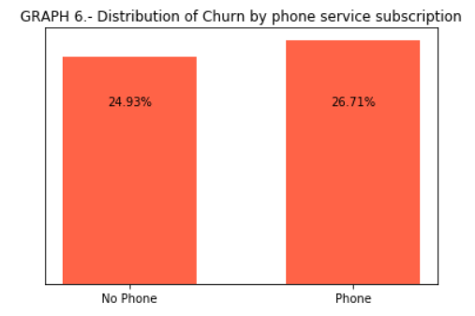
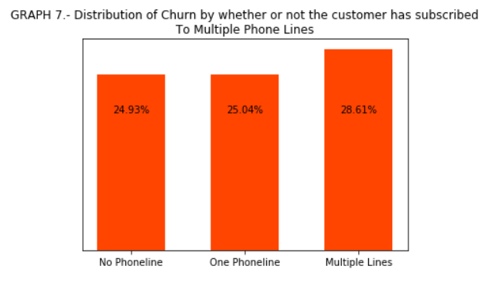

2.-b.1) Churn through the Services – PHONELINES
The customers who haven’t subscribed for any phone service churn about as much as those who have purchased at least one (between 25 and 27%).
But among those who have subscribed to our phoneline service, those who have purchased more than one phoneline tend to churn more (about 29% of them) than those who have purchased one or no phone at all.
Thus having bought multiple phonelines is an indicator that the customer is likely to churn.

Slide 14
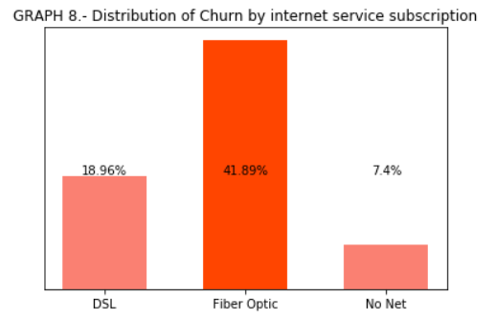
2.-b.2.) Churn through the Services – INTERNET
Among the people who bought internet services from us, those who churn the more are the Fiber-optic users (42% of them churn), followed by 19% of the DSL users. The rest of the Churn might be explained by services other than the Internet.
This might be because of the prices, since the DSL users pay an average 49$ monthly while the Fiber-optic users are paying an average 88$ monthly.
We might also want to check with the IT Department and the customer care service to see if there’s been any complaint about the quality of the Internet.
But what is sure is the Internet users account for a big deal of share out of the churn proportion observed.

Slide 15
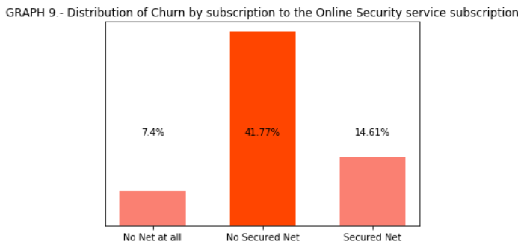
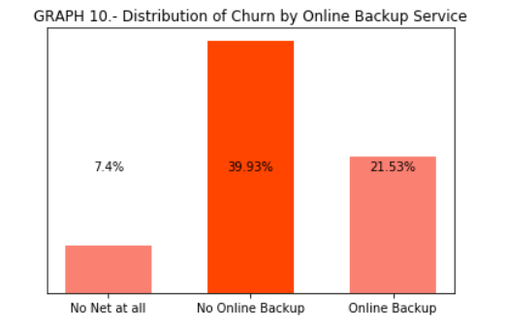
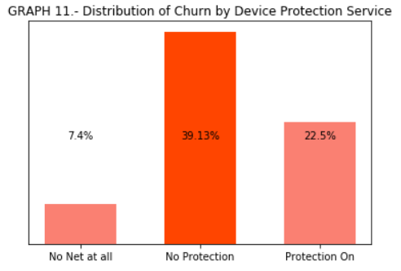
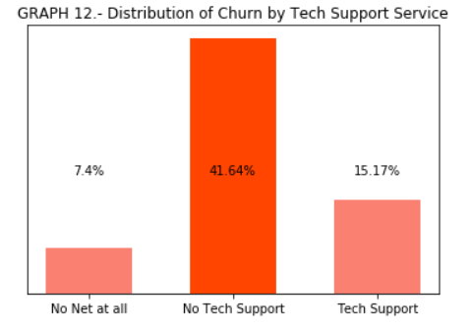
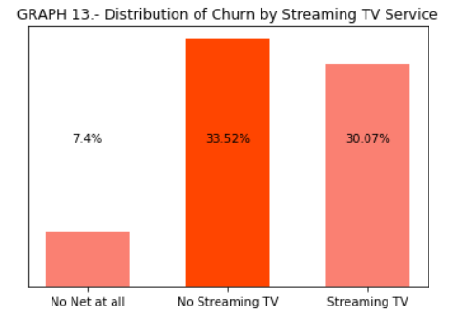
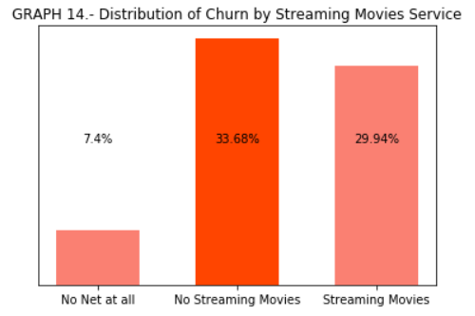
2.-b.2.) Churn through other Online Services (1) – SECURITY | BACKUP | PROTECTION | IT | STREAMING

Slide 16
2.-b.2.) Churn through other Online Services (2) – SECURITY | BACKUP | PROTECTION | IT | STREAMING
We are considering all these services together because the distribution of Churn relative to each of them has practically the same shape and varies with the same trend, as can be seen on the graphs from the previous slide.
We have already seen that people who have no internet at all churn less (7.4%) of them. This percentage hasn’t changed. But what all these graphs (graphs 9 thru 14) tell us is that when people do have internet and don’t have at least one of these online services with the company, then they will be more prone to churn (from 34 to 42% of them according to the past month data).
We could believe it is because they are paying quite high for these services: people who use at least of the company’s 6 online services pay monthly about 82$ in average. This is quite close to the average 88$ paid by the Fiber-optic users.

Slide 17
2.-b.2.) Churn through other Online Services (2) – SECURITY | BACKUP | PROTECTION | IT | STREAMING
So the Fiber-optic users are also those who can afford any of our online services. So maybe the DSL users might want to churn if other companies are offering them a full package (net + online service) at a better price.
Also maybe if they had online security on their bandwidth, or Data backed up on our servers, or that their computers were protected through our internet, or that they had real support from our IT Department, or could stream TV and online movies to enjoy, maybe they’d have more reasons to feel the need to keep on paying for the internet.
Actually, the graphs 9 thru 14 allow us to assume the right-above paragraph is true. Because we can observe a lower proportion of churn (between 15 and 30% only) among those who have internet and have purchased at least one of these online services.

Slide 18
2.-c) Explanation by Billing Information

Slide 19
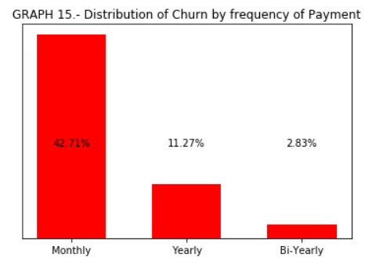
2.-c.1.) Churn by the Billing Info – PAYMENT FREQUENCY (1)
The customers who churn the most are the monthly contractors (42%). This makes sense because someone who pays for a service monthly either doesn’t intend to take any long-term commitment with the provider, or just can’t afford paying for it on the long-term.
The trend is negative. Meaning that the longer the contract lasts, the lesser the churn (11.27% for yearly contractors and 2.83% for bi-yearly contractors). Which also makes sense, because once the contract is paid, the customers would be the only one to use something if they churned before the next term.

Slide 20
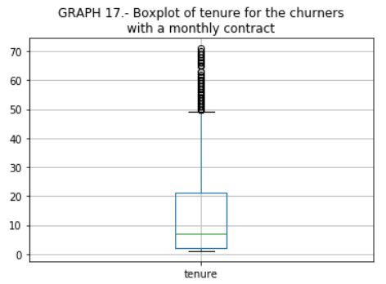
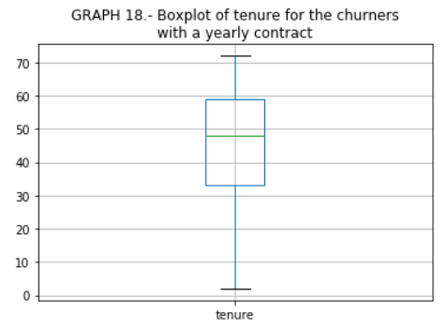
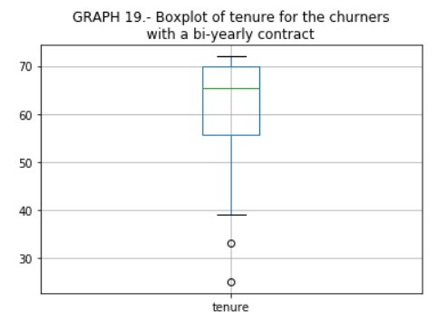
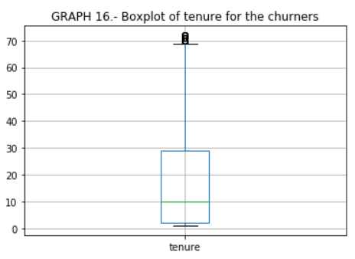
2.-c.1.) Churn by the Billing Info – TENURE & PAYMENT FREQUENCY (2)
These additional graphs show reinforce the existence of the negative trend we discussed in the previous slides, but also give us a more precise idea of how long we may expect a customers to stay with the company before deciding to churn:
50% of the churners churn on the 10th month. Of those 50%, the monthly contractors contribute the most to the churn with 50% of them churning after the 7th month of subscription. Then, the 50% of the yearly contractors churn around the 49th month, while bi-yearly ones do after 66th month and may stay until over the 70^{th.}

Slide 21
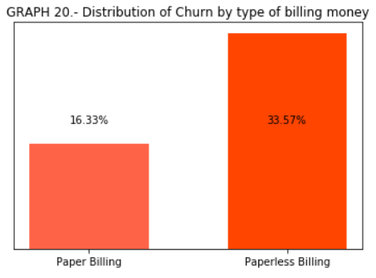
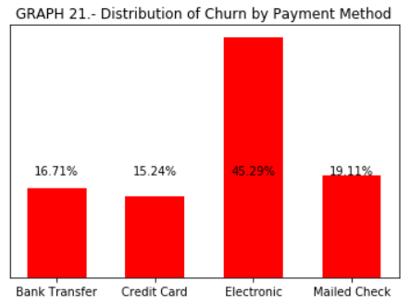
2.-c.2.) Churn by the Billing Info – BILLING MONEY & PAYMENT METHOD
Only 16.33% of the customers who pay with the means of paper churn, while 35.57% of the paperless billed customers churn. The company then should prioritize or encourage its customers to pay paperlessly.
The electronic mode of payment seems to favor churning (45% churn, which is 2 to 3 times more than the other payment methods)
We might want to reach to these customers thru the IT or customer care department to know whether the problem is technical.

Slide 22
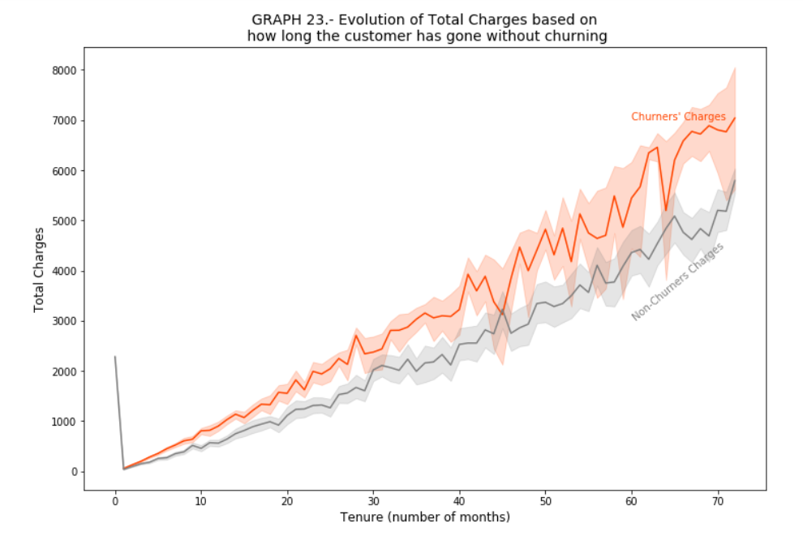
2.-c.3.) Churn by the Total Charges – Trend of charges over tenure periods
The churners’ charges remain higher that the charges of the non-churners. So customers might be churning because of too much they’re paying.

Slide 23
Discussion & Recommendations
Communicate your recommendations to your audience. Based on your results, how might you propose solving the business problem? (June 15, 2020)
What is your proposed solution?
What are strengths of the organization that you have leveraged in your solution?
What are weaknesses of the organization that could undermine your solution?
What are challenges that you might encounter? How can you mitigate them?

Slide 24



BONUS : How long before the company loses all its customers and which demographics will it lose first?
By plugging in the values of N=7043 and p=0.2654, we find n=29 months, which is the tenure after which all current customers will have churned if nothing is done to change anything

Slide 25
References & Appendices
Provide citations for your work and provide resources for your audience to learn more about the technical aspects of your project. Share links to your GitHub repository or accompanying spreadsheets.

