Slide 1

BI Project Customer Churn Analysis
Weiner-Kervens PIERRE
Email : wienerpeter5@gmail.com
Phone : (509) 43884750

Slide 2
Problem
Our client is a Telecommunications company which has a massive market share, but also competitors trying to attract the customers.
The problem they’re facing is : Customers churning
The stakeholders impacted are:
The investors;
The board.
This problem is important to the organization, because customers that are churning are a potential source of decrease on the company’s revenues.

Slide 3
Methodology
We performed a univariate analysis of the Churn variable, and a bivariate analysis of the latter by each of the other variables using python language tools for data Scientist which does statistical analysis and visualization.

Slide 4
RESULTS

Slide 5
1.- CHURN

Slide 6
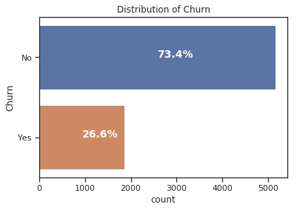
The impact of the Churn

Slide 7
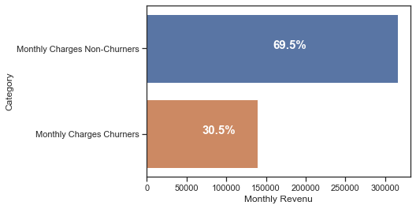
How much is churn affecting the business?

Slide 8
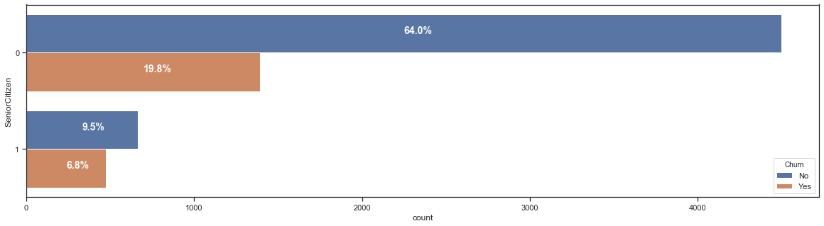
Distribution of CHURN by AGE

Slide 9
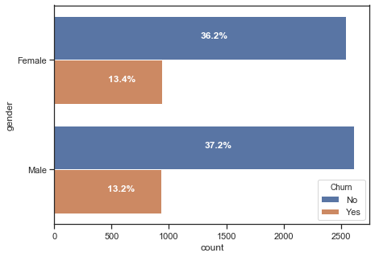
Distribution of CHURN by GENDER

Slide 10
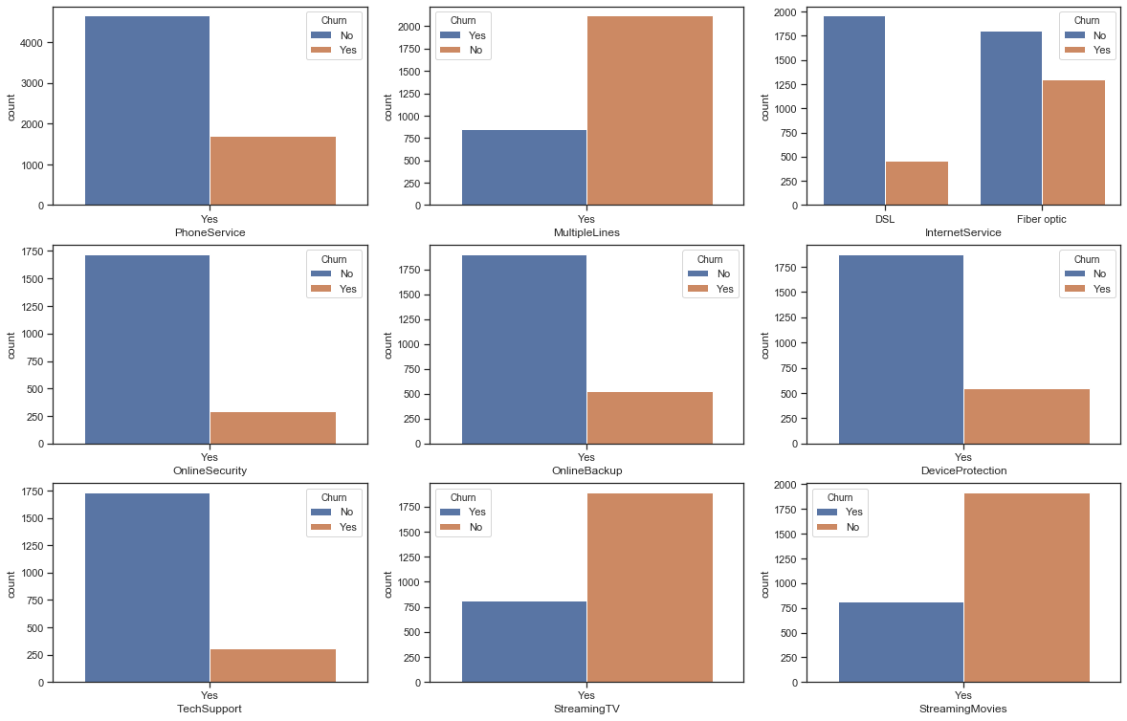
Distribution of CHURN by SERVICES USED

Slide 11
Distribution of CHURN by SERVICES USED

Slide 12
Distribution of CHURN by SERVICES USED

Slide 13
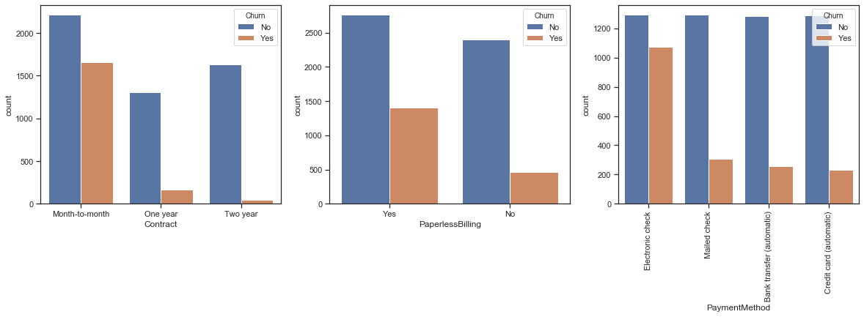
Distribution of CHURN by BILLING INFORMATION

Slide 14
Distribution of CHURN by BILLING INFORMATION

Slide 15
Distribution of CHURN by BILLING INFORMATION

Slide 16
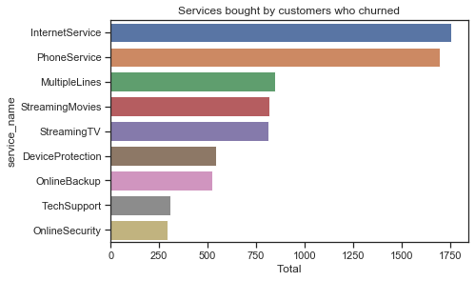
Distribution of CHURN by BILLING INFORMATION

