Slide 1

BI Project Customer Churn Analysis
Weiner-Kervens PIERRE
Email : wienerpeter5@gmail.com
Phone : (509) 43884750

Slide 2
Problem
Our client is a Telecommunications company which has a massive market share, but also competitors trying to attract the customers.
The problem they’re facing is : Customers churning
The stakeholders impacted are:
The investors;
The board.
This problem is important to the organization, because customers that are churning are a potential source of decrease on the company’s revenues.

Slide 3
Methodology
We performed a univariate analysis of the Churn variable, and a bivariate analysis of the latter by each of the other variables using python language tools for data Scientist which does statistical analysis and visualization.

Slide 4
RESULTS

Slide 5
1.- CHURN

Slide 6
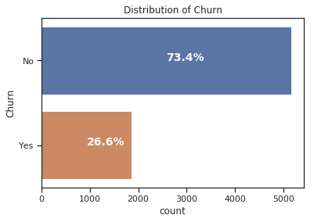
The impact of Churn
Compared to the existing base customer, churners represent about 26.6%.

Slide 7
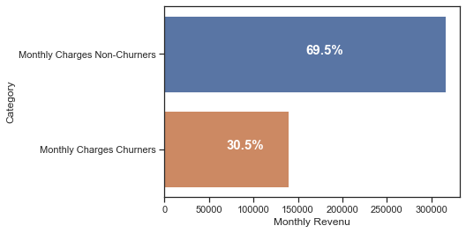
How much is churn affecting the business?
This amount of churners represent a monthly loss of revenue around 30.5 %

Slide 8
DISTRIBUTION OF CHURN BY
DEMOGRAPHICS

Slide 9
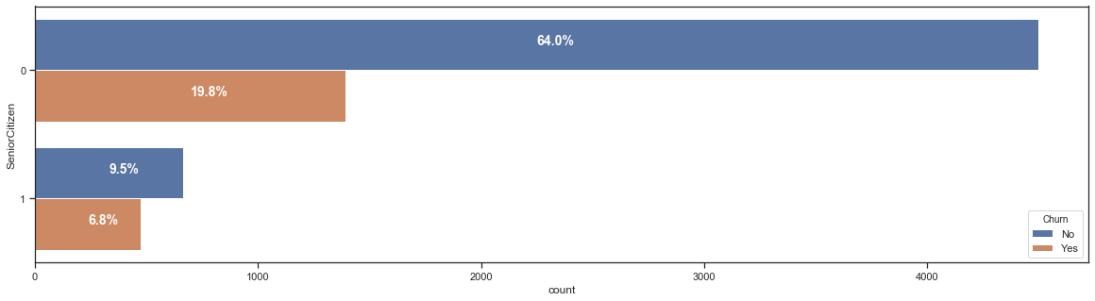
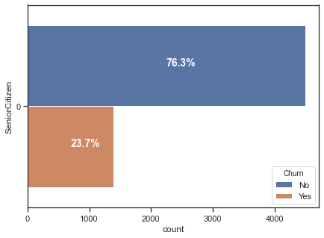
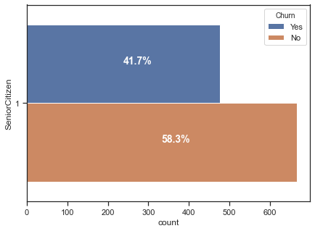
Distribution of CHURN by AGE
At first sight Juniors seems most likely to churn. But by looking closely, Seniors are most likely to churn but represent a smaller quantity compared to Juniors.

Slide 10
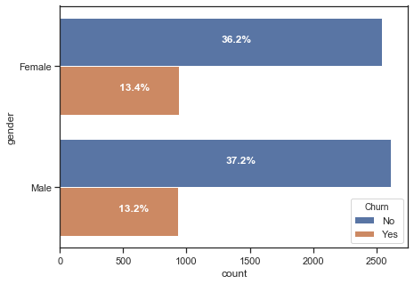
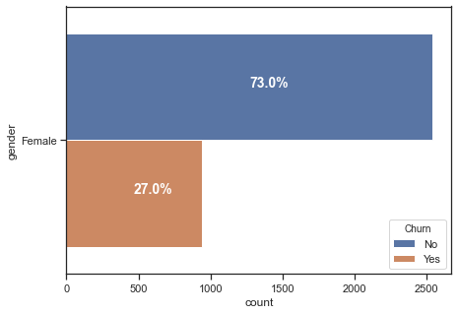
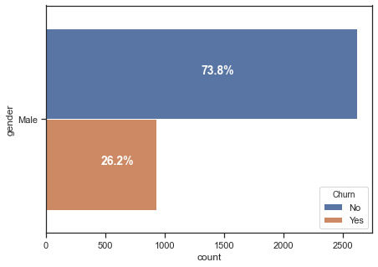
Distribution of CHURN by GENDER
There is no big difference in the distribution of churn by gender. Churn rate is almost equally distributed in both genders.

Slide 11
DISTRIBUTION OF CHURN BY
SERVICES USED

Slide 12
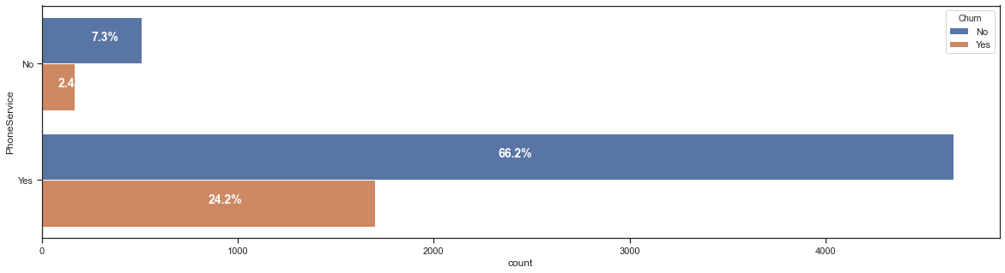
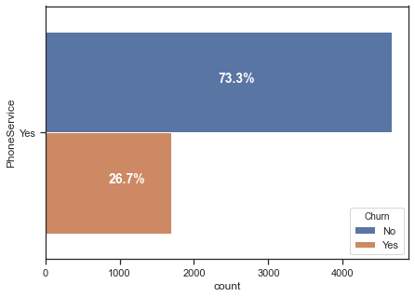
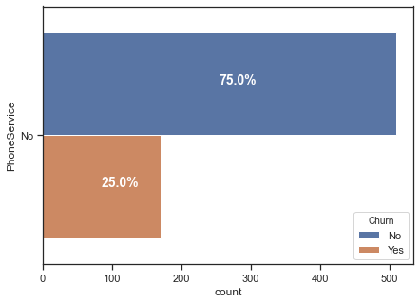
PHONE SERVICE users
At first sight people with phone service seems most likely to churn. But by looking closely, There is almost no difference in the distribution of churn in each group. There is just more people with a phone service.

Slide 13
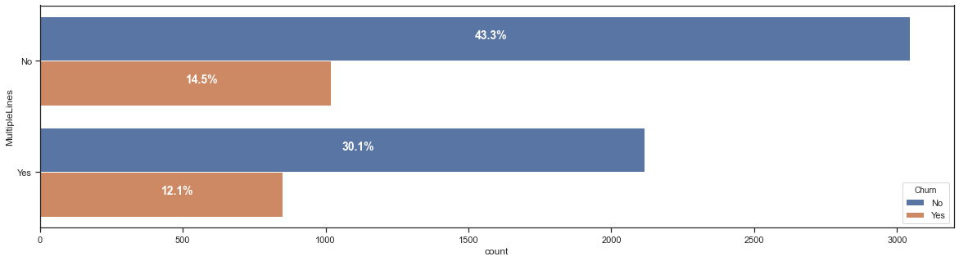
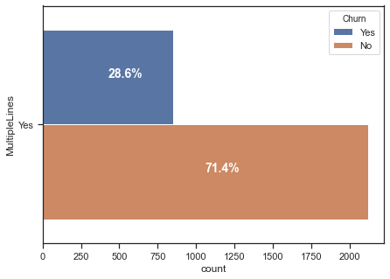
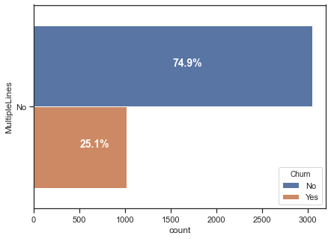
MULTIPLE LINES users
This amount of churners represent a monthly loss of revenue around 30.5 %

Slide 14
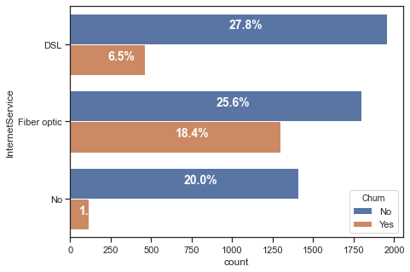
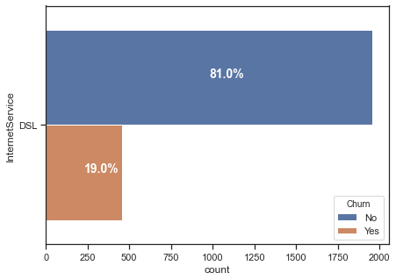
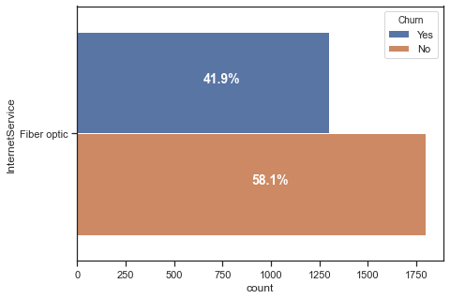
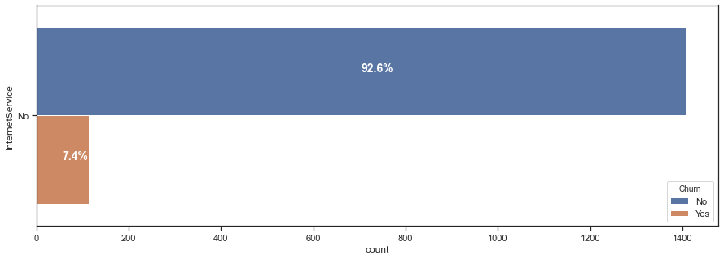
INTERNET SERVICE users
It is pretty obvious that people with Fiber optic tend to churn more often. And by contrast, people with DSL or No Internet Service tend to churn less often.

Slide 15
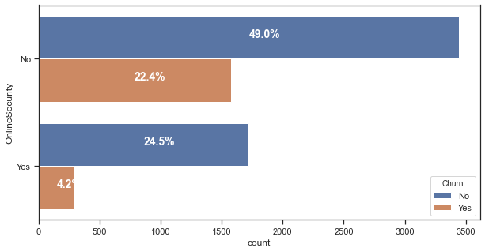
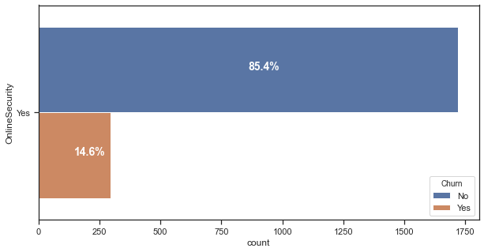
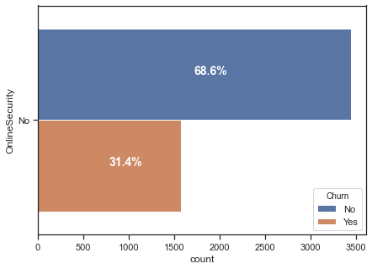
ONLINE SECURITY users
It is pretty obvious that people with No Online Security tend to churn more often.

Slide 16
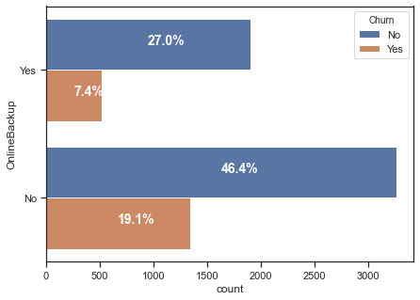
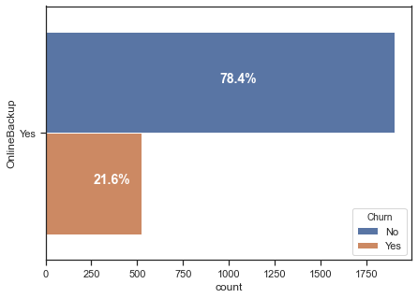
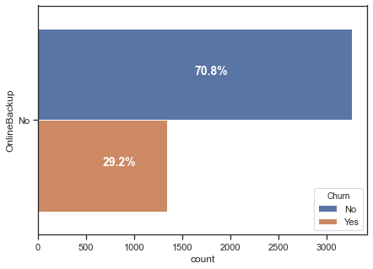
ONLINE BACKUP users
There is a slightly difference in the distribution of people with No Online Backup and people with Online Backup.

Slide 17
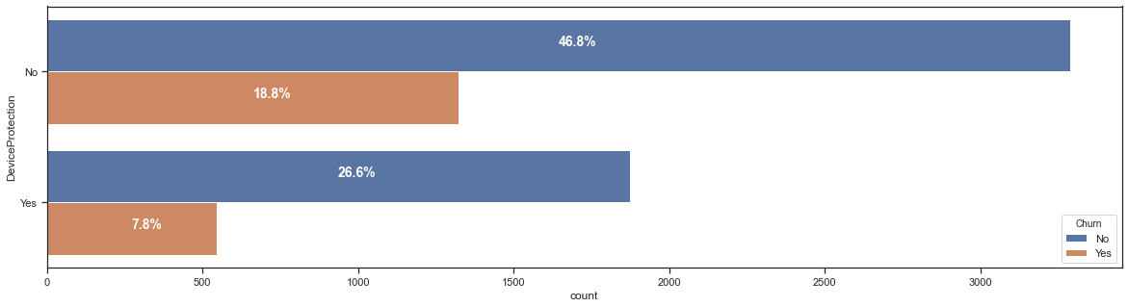
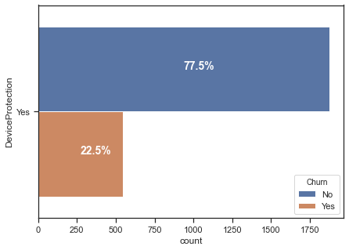

DEVICE PROTECTION users
There is a slightly difference in the distribution of people with No Device Protection and people with Device Protection.

Slide 18
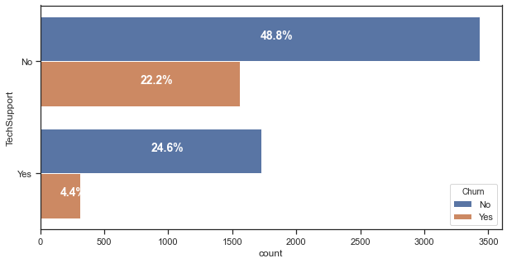


TECHNICAL SUPPORT users
It is pretty obvious that people with No Technical Support tend to churn more often. And by contrast, people with Technical Support tend to churn less often.

Slide 19
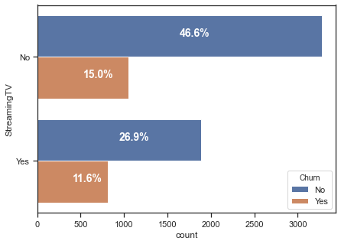
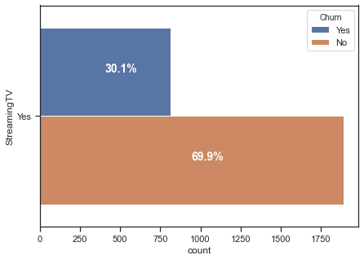

STREAMING TV users
There is a slightly difference in the distribution of people with Streaming TV subscription and people without any Streaming TV subscription.

Slide 20
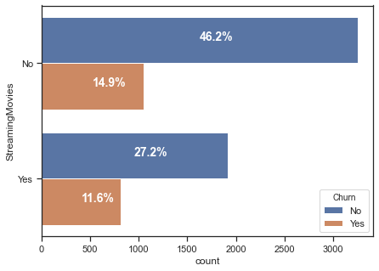
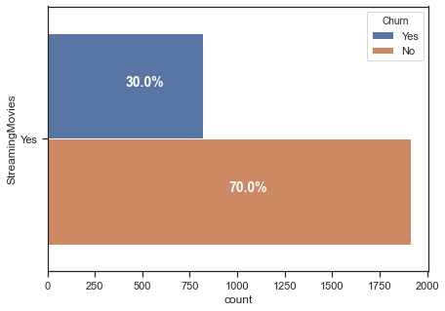

STREAMING MOVIES users
There is a slightly difference in the distribution of people with Streaming Movies subscription and people without any Streaming Movies subscription.

Slide 21
DISTRIBUTION OF CHURN BY
BILLING INFORMATION

Slide 22
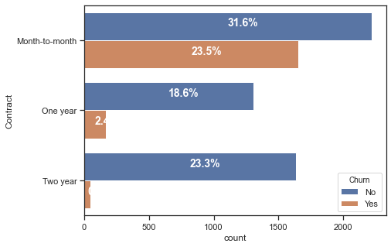
Type of CONTRACT
It is pretty obvious that people with Month-to-month contract tend to churn more often. And by contrast, people with One year or Two year contract tend to churn less often.

Slide 23
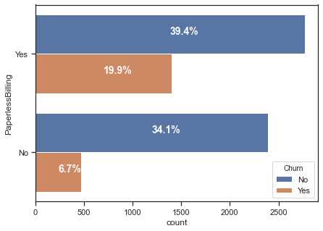
BILLING type

Slide 24
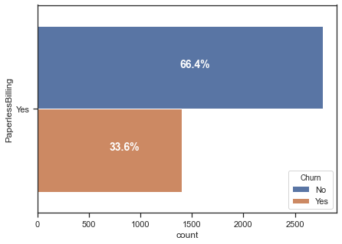
PAPERLESS BILLING

Slide 25
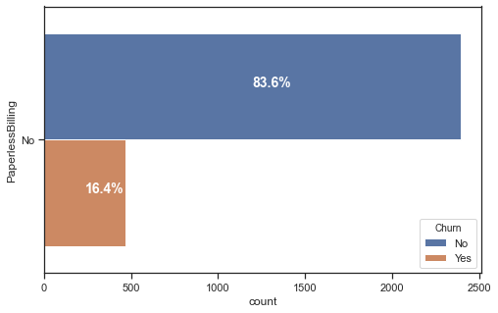
PAPERLESS BILLING

Slide 26
SERVICES TYPICALLY PURCHASED
BY CHURNERS

Slide 27
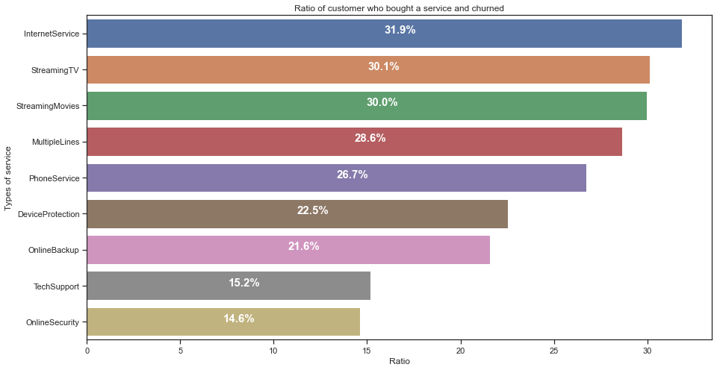
Services Typically Purchased by customers
Churners tend to buy Internet service more often. And by contrast, churners tend to neglect Online Security and Tech Support.

Slide 28
SERVICES ESPECIALLY HELPFUL
IN RETAINING CUSTOMERS

Slide 29
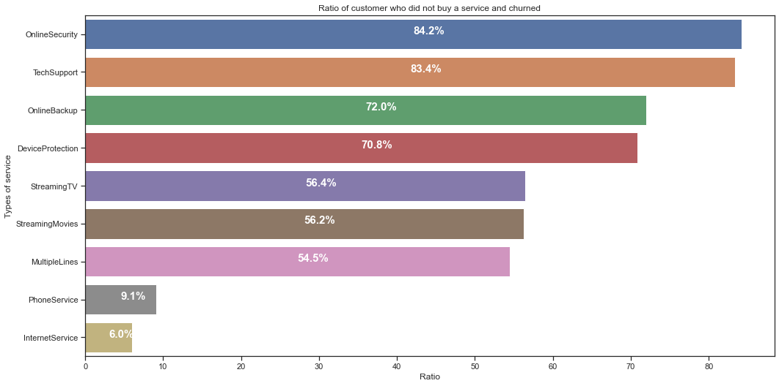
Services Helpful in retaining customers
Online Security and Tech Support are the types of services very helpful in retaining customers.

Slide 30
TYPE OF PEOPLE WHO
CHURN AT HIGHER RATE

Slide 31
Profile 1
Characteristics
A Junior
Has a Month-to-month contract
Has Fiber optic
Has Paperless Billing
No Online Security
No Online Backup
No Technical Support
Pay by Electronic Check
Churn rate
70^{.1%}

Slide 32
Profile 2
Characteristics
A Male
Has a Month-to-month contract
Has Fiber optic
Has Paperless Billing
Has Monthly Charges > 80
No Dependents
No Partner
No Online Security
No Online Backup
No Technical Support
Pay by Electronic Check
Churn rate
77^{.5%}

