Slide 1

BI Project Customer Churn Analysis
Weiner-Kervens PIERRE
Email : wienerpeter5@gmail.com
Phone : (509) 43884750

Slide 2
Problem
Our client is a Telecommunications company which has a massive market share, but also competitors trying to attract the customers.
The problem they’re facing is : Customers churning
The stakeholders impacted are:
The investors;
The board.
This problem is important to the organization, because customers that are churning are a potential source of decrease on the company’s revenues.

Slide 3
Methodology
We performed a univariate analysis of the Churn variable, and a bivariate analysis of the latter by each of the other variables using python language tools for data Scientist which does statistical analysis and visualization.

Slide 4
RESULTS

Slide 5
1.- CHURN

Slide 6
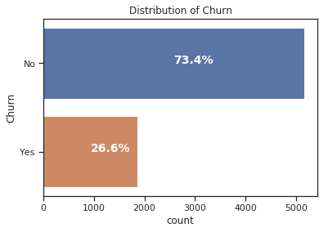
The impact of the Churn

Slide 7
How much is churn affecting the business?

