Slide 1
Predicting NYC Green Taxis Tip Percentage
An application of linear regression model
Weining Hu
March 8, 2020

Slide 2
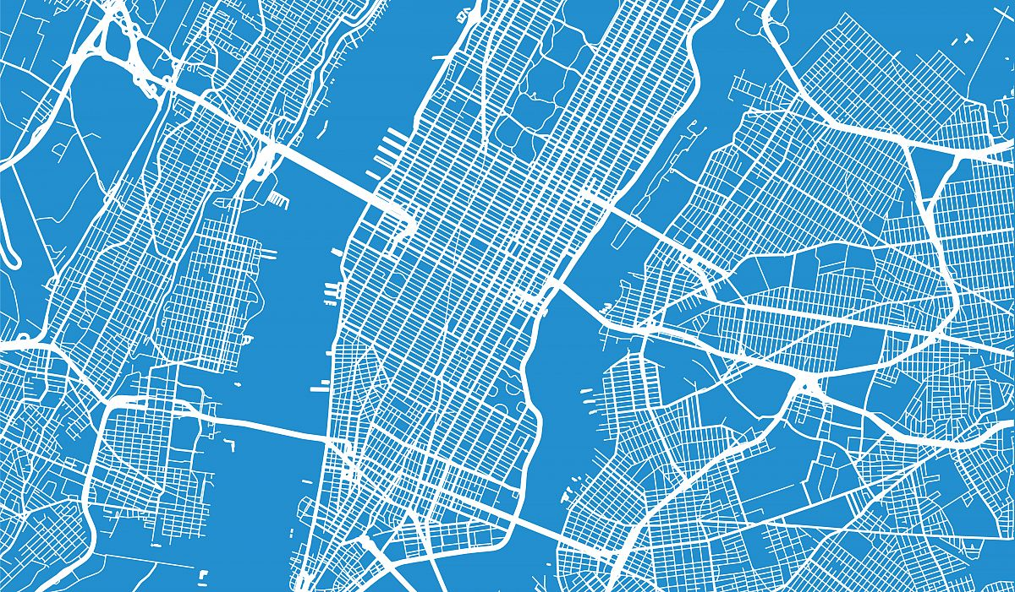
Agenda
Problem Statement
Methodology
Dataset Description
Feature Engineering
Data Preprocessing
Visualization
Future Work
Exploratory Data Analysis
Model fitting and evaluation
Reference

Slide 3
Problem Statement
General Problem Statement
In 2013, the New York City government launched the Green Taxis program as a mechanism to serve the outer boroughs (Bronx, Queens, Brooklyn, Staten Island and Manhattan above the 110th Street) and to tackle the illegal taxi problem. Analyzing the trip data fetched by the green taxi meters can help policy makers to understand how the green taxis are performing to serve the program’s initial purposes.
Task 1:
Are green taxis still predominantly serving the outer boroughs of Manhattan?
Task 2:
Predicting tip percentage

Slide 4
Dataset Description
New York City Taxi and Limousine Commission (TLC)
Green taxi trips in June 2019
471,052 observations
20 columns
Admin related (2): VendorID, Store_and_fwd_flag
Trip related (7): lpep_pickup_datetime, lpep_dropoff_datetime, passenger_count, Trip_distance, PULocationID, DOLocationID, Trip_type
Trip fare related (11): RateCodeID, Payment_type, Fare_amount, Extra, MTA_tax, Improvement_surcharge, Tip_amount, Tolls_amount, Total_amount, congestion surcharge, ehail_fee
Column datatypes: categorical, numeric (int64 and float64)
All columns are non-null (except for ehail_fee)
Taxi Zone Shapefile
Taxi Zone Lookup Table
locationid | borough | zone | Service zone
1 | EWR | Newark Airport | EWR
2 | Queens | Jamaica Bay | Boro Zone

Slide 5
Feature Engineering
PULocationID | DOLocationID
74 | 263
75 | 74
df.merge
pu boro | pu zone | pu sz | do boro | do zone | do sz
Manhattan | East Harlem North | Boro Zone | Manhattan | Yorkville West | Yellow Zone
Manhattan | East Harlem South | Boro Zone | Manhattan | East Harlem North | Boro Zone
PU Datetime | DO datetime
2019-06-01 00:25:27 | 2019-06-01 00:33:52
2019-06-01 00:39:13 | 2019-06-01 00:46:38
pd.to_datetime
df.dt.hour
df.dt.weekday_name
pu hour | pu day | do hour | do day | trip time
0 | 0 | Saturday | Saturday | 8.0 (minutes)
0 | 0 | Saturday | Saturday | 7.0
DOLocationID
1
2
gpd.read_file
df.merge
DOLocationID | geometry | borough | zone
1 | POLYGON ((933100.9183527103 192536.0856972019,... | EWR | Newark Airport
2 | (POLYGON ((1033269.243591294 172126.0078125, 1... | Queens | Jamaica Bay

Slide 6
Data Preprocessing
Raw dataset (471,052 Observations)
Remove Criteria | # of R | Pct of S
Distance of 0 mile or > 40 miles (99.99% pctl was 39.27 miles) | 6,671 | 1.42%
Trip time of 0 min or > 82 minutes (99% pctl was 82 mins) | 8,164 | 1.73%
Fare amount < USD 2.50 | 1,628 | 0.35%
Tip amount > twice the fare amount | 81 | 0.01%
Trip speed >=240 MPH | 36 | ~0.01%
Analytical dataset (454,472 Observations)
Impute Data | # of R | Pct of DS
Impute valid observations with distance of 0 mile and/or 0 min | 4,484 | 0.99%
Replace [‘passenger_count’] == 0 by 1 (mode) | 672 | 0.15%

Slide 7
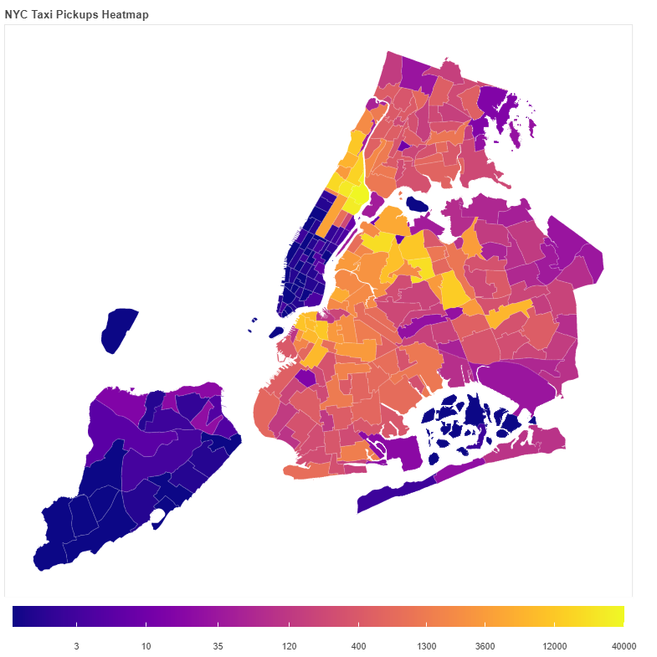

Visualization – Popular PU Locations
Name: East Harlem North
Borough: Manhattan
Zone ID: 74
# of Trips: 38,459
Rank | Popular PULoc | # Trips
1 | East Harlem North | 38,459
2 | East Harlem South | 29,943
3 | Central Harlem | 27,901
4 | Elmhurst | 22,084
5 | Astoria | 20,849

Slide 8
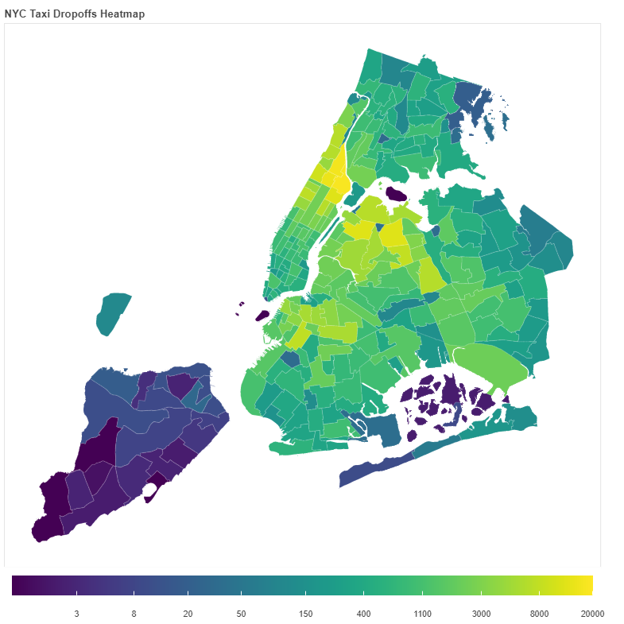

Visualization – Popular DO Locations
Name: East Harlem North
Borough: Manhattan
Zone ID: 74
# of Trips: 18,586
Rank | Popular DOLoc | # Trips
1 | East Harlem North | 18,586
2 | Central Harlem North | 16,854
3 | Central Harlem | 15,057
4 | East Harlem South | 12,888
5 | Astoria | 12,662

Slide 9
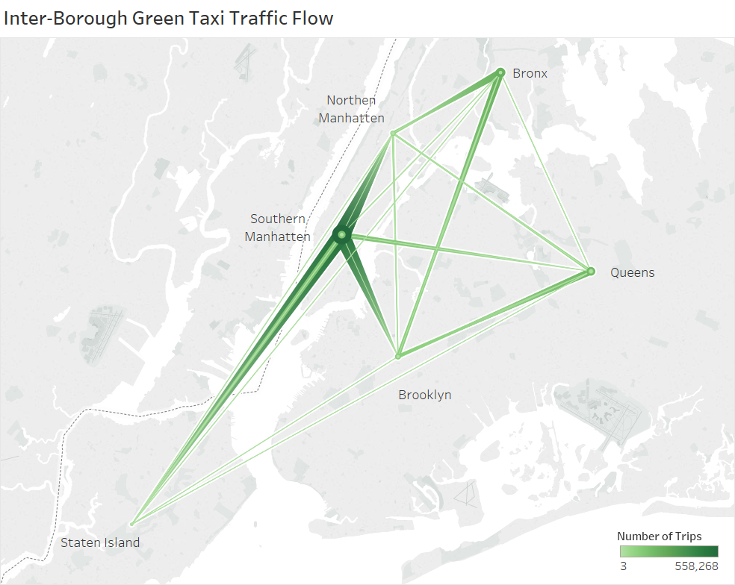
Future Work
Exploratory Data Analysis
Tips distribution by hour and by day of week
Modeling
Prepare dataset for predicting tip percentage
Feature selection
Model fitting
Linear regression with ordinary least square
Logistic regression + linear regression
Polynomial model
Regularization and gradient boosting
Model evaluation
Impact of extreme data
Design evaluation matrix (R^2)

Slide 10
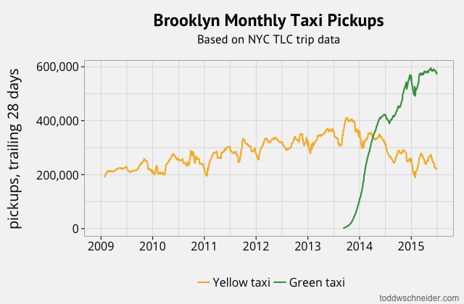
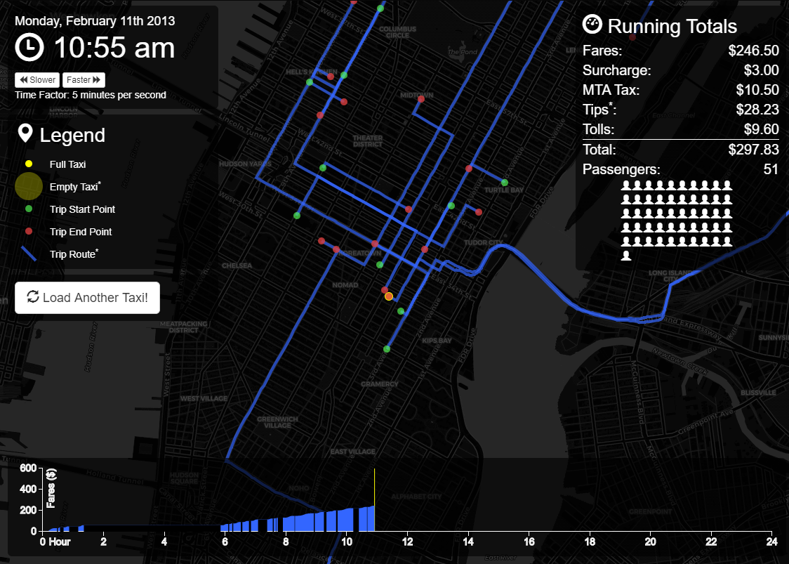
Reference
Borough Trends, and the Rise of Uber
Todd Schneider
NYC Taxis: A Day in the Life
Chris Whong

Slide 11
Reference
NYC Green Taxi Data Visualization – Gshahane link
NYC Green Taxi of September 2015 Data Analysis – kthouz link
Looking Through the Taxi Meter – Analysis of NYC Green Taxi data of September 2015 – Jiamin Han link
Predict New York City Taxi Demand – Yunrou Gong, Bin Fang, Shuo Zhang, and Jingyu Zhang link
Visualizing NYC Taxi Cab Data – Network Graph link
Geospatial joining and Bokeh heatmap visualization – Shekhar link

