Slide 1
From Bare Metal Up: Leveling Up the Rust Embedded Ecosystem
Tiago Manczak

Slide 2



whoami?
Brazilian
Master in Electronics Engineering @ UTFPR
6 years as Electrical Engineer @ COPEL
7 years as Firmware Engineer @ Infineon
Infineon Rust Community Coordinator
Augsburg Rust Meetup
Husband, father
Innovation, Ice Hockey, board games
Linkedin: tiago-manczak
Github: tiagomanczak
Email: tiagomanczak@gmail.com

Slide 3
Disclaimer
Rust enthusiast
Restricted to personal opinions
No advertisement is intended

Slide 4


Rust Scalability
wasmtime
AWS Rust SDK
Tauri
Google Cloud Rust API
Rust on Linux
Azure Rust SDK
Microsoft Symcrypt
Prossimo - ISRG
Caliptra
OpenTitan
Eclipse S-core
Pluton
Rust on Volvo Cards

Slide 5


How low can you go… with Rust?

Slide 6

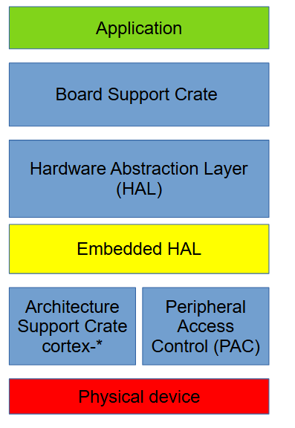


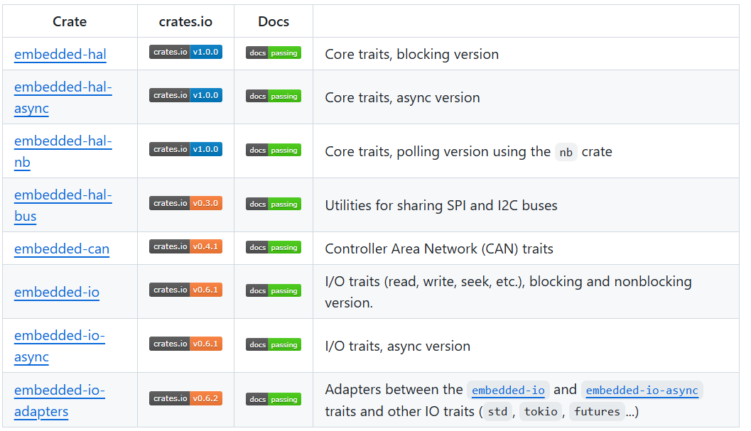
Embedded Architecture
Application/OS
https://github.com/embassy-rs/embassy

Slide 7
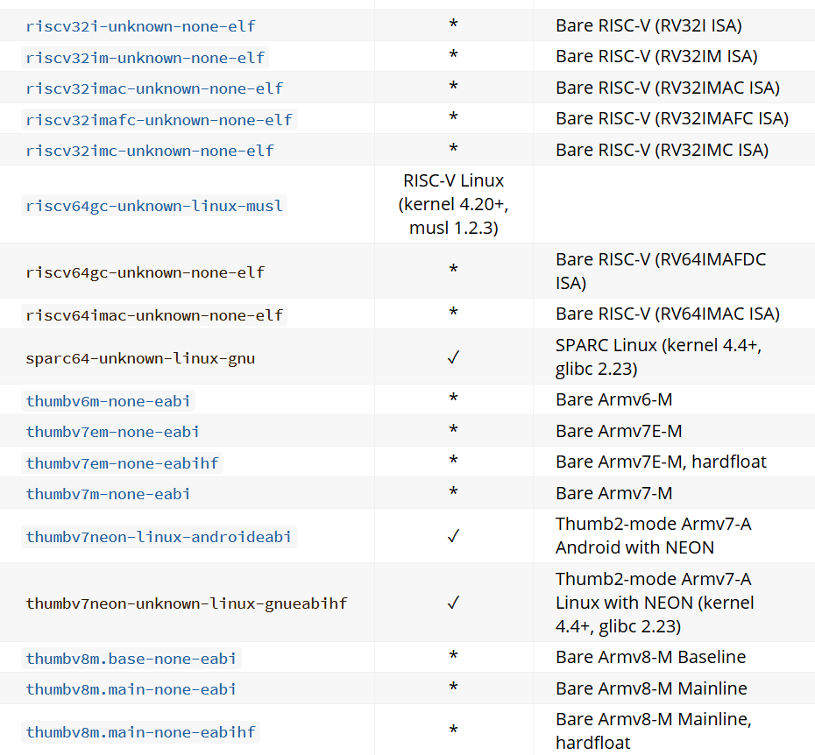
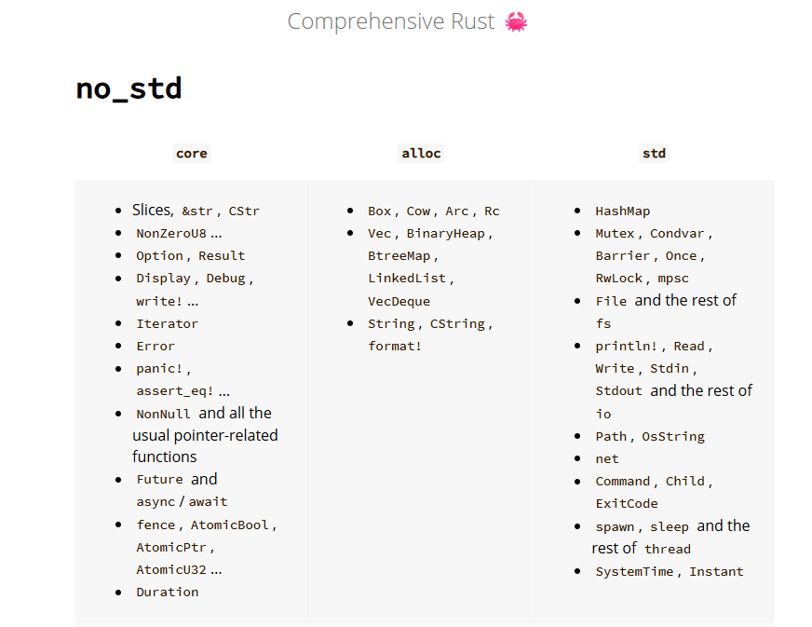
https://doc.rust-lang.org/beta/rustc/platform-support.html
https://google.github.io/comprehensive-rust/bare-metal/no_std.html

Slide 8
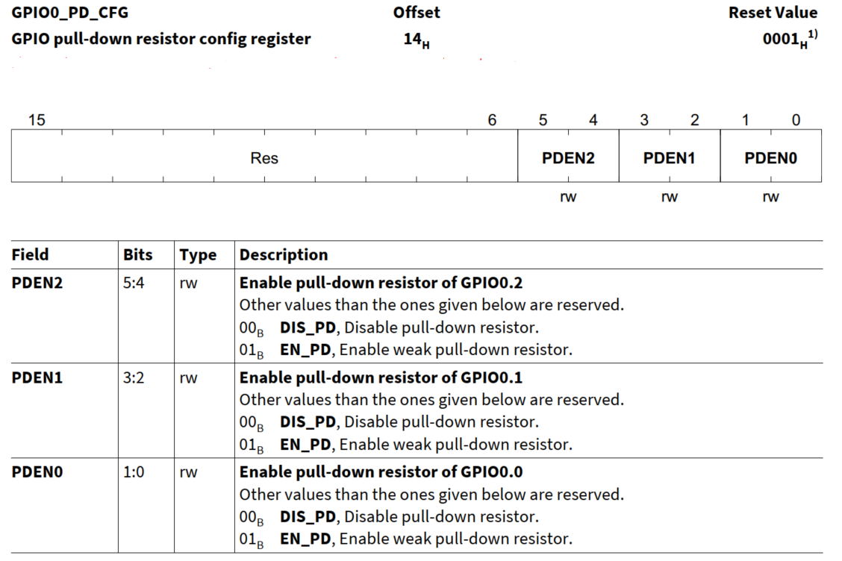
Hardware representation in software
typedef struct
{
__IM uint32_t GPIO0_IN;
__IOM uint32_t GPIO0_OUT;
__IOM uint32_t GPIO0_CTRL;
__IOM uint32_t GPIO0_OUT_CFG;
__IOM uint32_t GPIO0_PU_CFG;
__IOM uint32_t GPIO0_PD_CFG;
} Cxx_GPIO0_TypeDef;
#define GPIO0_PD_CFG_PDEN0_Pos 0
#define GPIO0_PD_CFG_PDEN0_Msk (0x3ul << GPIO0_PD_CFG_PDEN0_Pos)
#define GPIO0_PD_CFG_PDEN0_DIS_PD 0x00ul
#define GPIO0_PU_CFG_PUEN0_Pos 0
#define GPIO0_PU_CFG_PUEN0_Msk (0x3ul << GPIO0_PU_CFG_PUEN0_Pos)
#define GPIO0_OUT_CFG_OD0_Pos 0
#define GPIO0_OUT_CFG_OD0_Msk (0x1ul << GPIO0_OUT_CFG_OD0_Pos)
#define GPIO0_OUT_CFG_OD0_OPENDRAIN 0x01ul

Slide 9
How to use it
Direct access over pointer
unsafe {
// Pull down disable
let mut value = ptr::read_volatile(GPIO0_PD_CFG as *const u32);
value = value & !GPIO0_PD_CFG_PDEN0_Msk;
ptr::write_volatile(
GPIO0_PD_CFG as *mut u32,
value | GPIO0_PD_CFG_PDEN0_DIS_PD << GPIO0_PD_CFG_PDEN0_Pos,
);
}
With SVD2Rust API
// Pull down disable
p.GPIO0.pd_cfg.modify(|_, w| w.pden0().dis_pd());

Slide 10
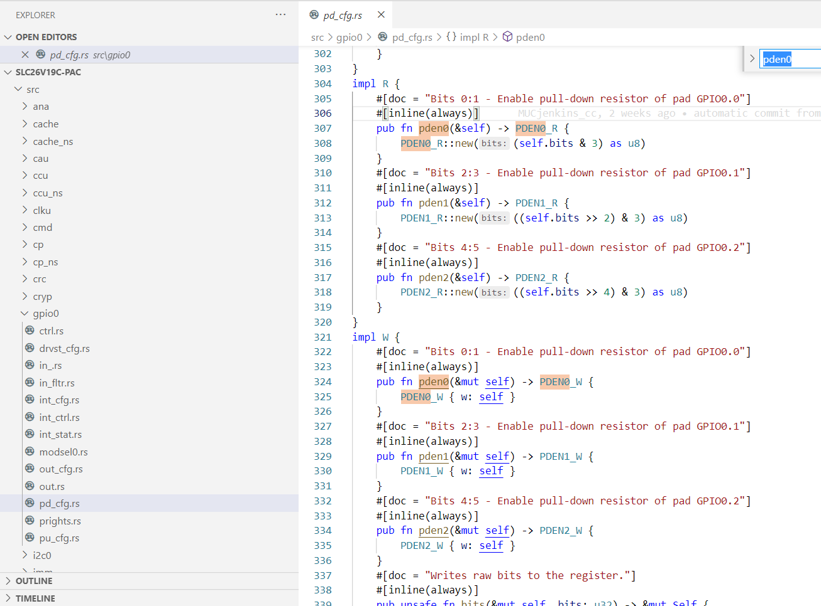
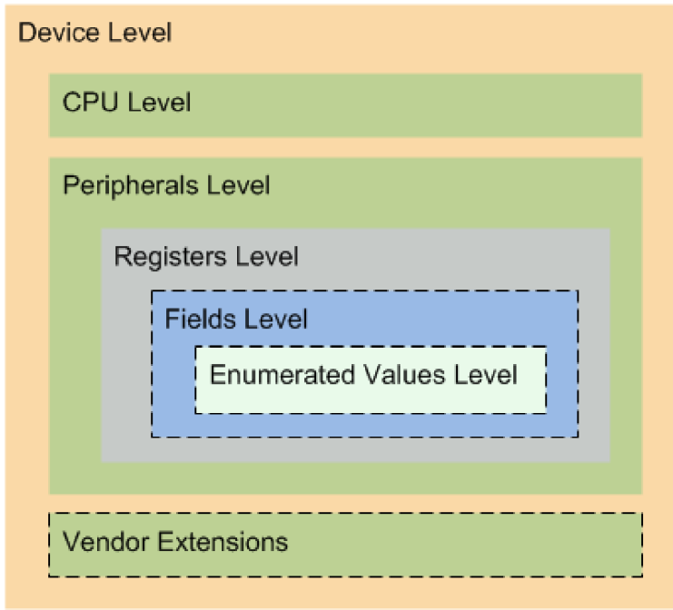

Support for embedded development
SVD
svd2rust
$ cargo install svd2rust
$ svd2rust -i slc26v19c.svd
$ rm -rf src
$ form -i lib.rs -o src/
$ rm lib.rs
$ cargo fmt
https://arm-software.github.io/CMSIS_5/SVD/html/index.html

Slide 11
Current landscape
svd2rust
https://docs.rs/svd2rust/latest/svd2rust/
Philosophical Differences
chiptool
svd2pac
https://github.com/embassy-rs/chiptool
https://github.com/Infineon/svd2pac

Slide 12
svd2pac
less of
adds
Safe code Unsafe API
No ownership
No enums
No dependencies
read-modify-write support
page-select register support
different read/write layouts
testing API

Slide 13

How about testing?
Hardware-in-the-loop?
Testing faults/attacks?
Test before tapeout?
The is no spoon hardware … only data!
https://www.linkedin.com/in/jacobbeningo/

Slide 14
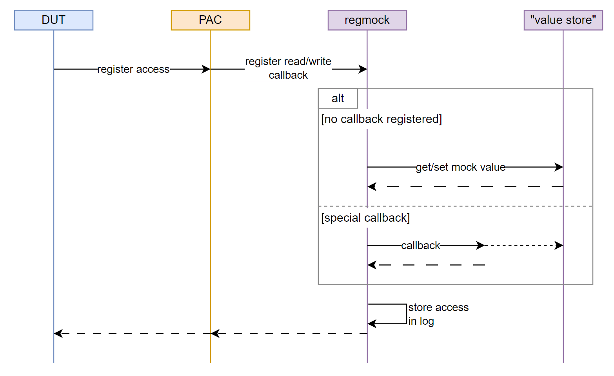
The idea behind regmock-rs

Slide 15

Brace yourselves…

Slide 16
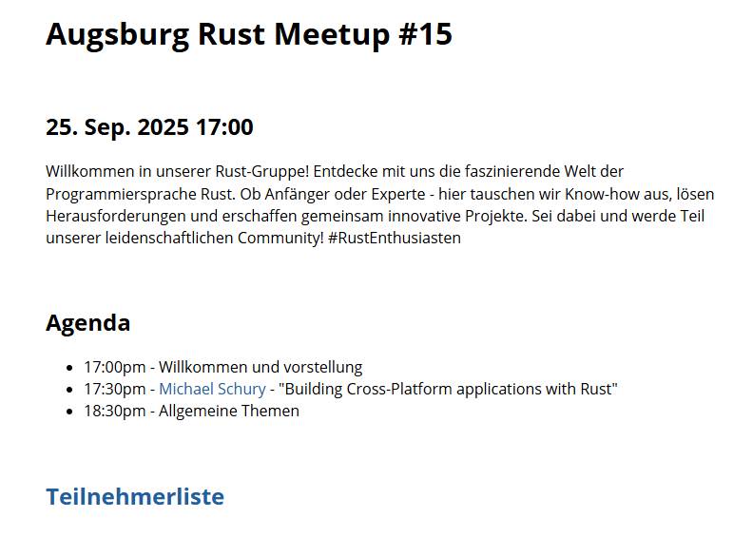
Join us in Ausgburg!
https://rust-augsburg.github.io/meetup/introduction.html
https://matrix.to/#/#rust-augsburg:matrix.org

Slide 17

Thank you!
Ferris with a soldering iron by Barnaby Walters.

