Slide 1
Training an object autoencoder using synthetic data
Shile Li
Project Praktikum kick-off meeting

Slide 2
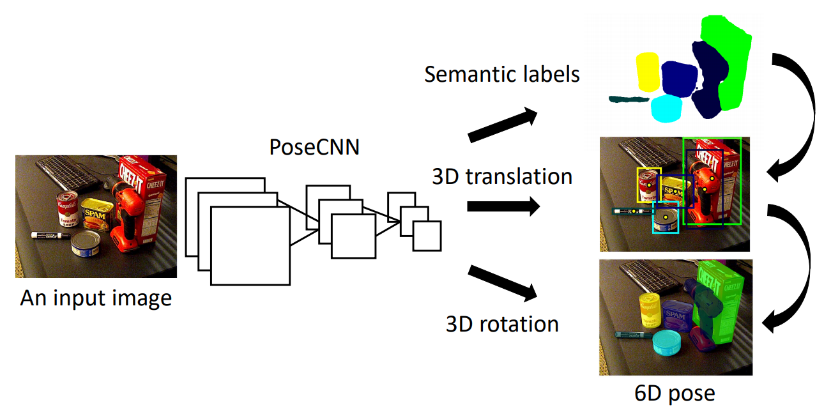
Object pose estimation
Deep leanring based object pose estimation
Direct regression 6 DoF pose from image
Does not need markers
Works in cluttered environment
However, large amount of labeled training data is needed. And pose annotation is costly.
What can we do without with unlabeled data? --> Autoencoder
Beispielfolien
2

Slide 3

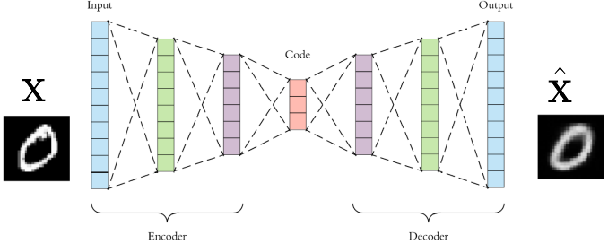
Autoencoder
Learn to reconstruct self with reduced dimensions.
Unsupervised, no label needed
Beispielfolien
3

Slide 4
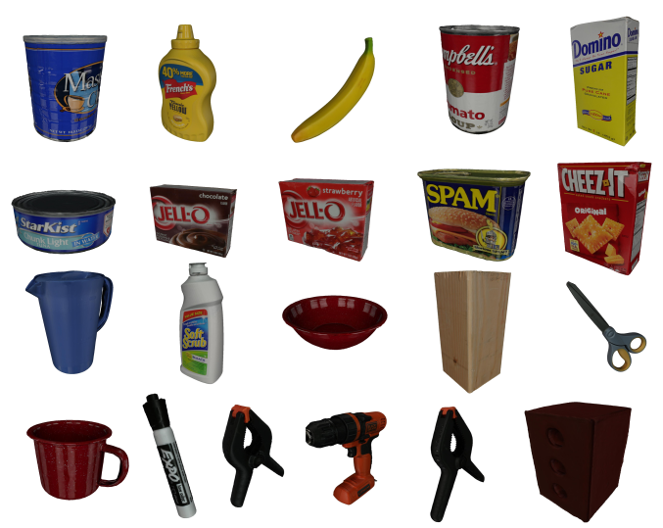
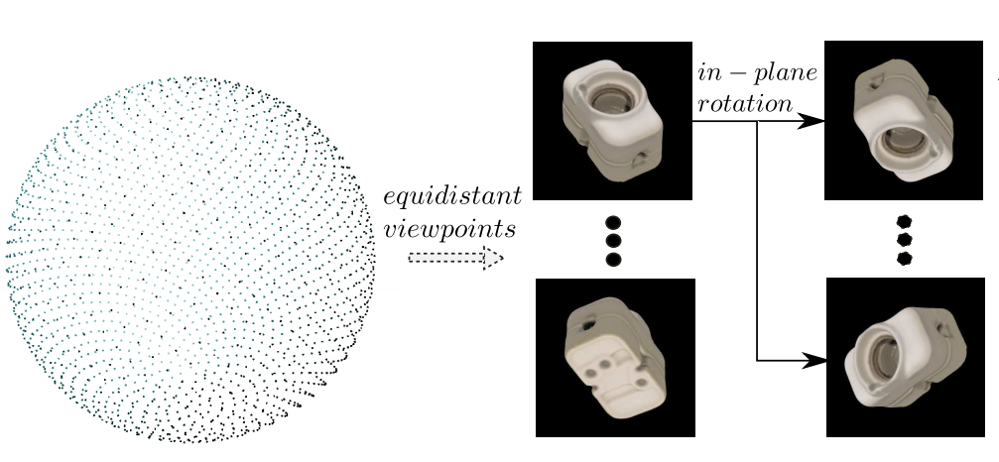
Generation of a synthetic dataset
Known precise textured object mesh model
Rendering from different viewpoints
Beispielfolien
4

Slide 5
Tasks
Literature study
Generate synthetic dataset by rendering mesh model
Training and testing on several object models
Evaluation of real captured image
Prerequisite
Python
Basic knowledge of deep learning
References:
1] Berk Calli, Arjun Singh, Aaron Walsman, Siddhartha Srinivasa, Pieter Abbeel, and Aaron M Dollar. The ycb object and model set: Towards common benchmarks for manipulation research. In 2015 international conference on advanced robotics (ICAR), pages 510{517. IEEE, 2015.
[2] Martin Sundermeyer, Zoltan-Csaba Marton, Maximilian Durner, Manuel Brucker, and Rudolph Triebel. Implicit 3d orientation learning for 6d object detection from rgb images. In Proceedings of the European Conference on Computer Vision (ECCV), pages 699{715, 2018.
[3] Yu Xiang, Tanner Schmidt, Venkatraman Narayanan, and Dieter Fox. Posecnn: A convolutional neural network for 6d object pose estimation in cluttered scenes. arXiv preprint arXiv:1711.00199,
Beispielfolien
5

