Slide 1
Training an Object Autoencoder for Pose Estimation with Synthetic Data
Weiqi Luo
Projektpraktikum Human Centered Robotik
Project plan presentation
Supervisor: M.Sc. Shile Li

Slide 2
Outline
Motivation
Pose estimation with object auto-encoder
Creating synthetic dataset
Training an object auto-encoder
Time Schedule

Slide 3
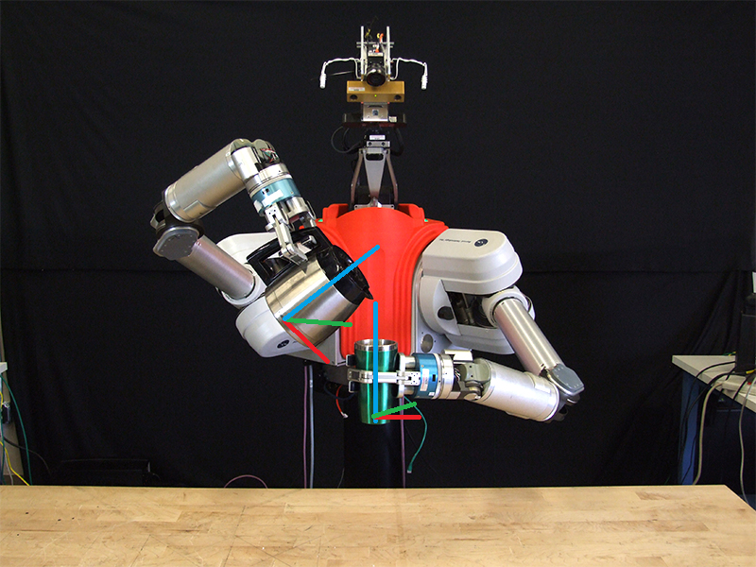
Motivation
The precise 6D pose estimation of object is crucial for robots to perform autonomous manipulation.
Notes:
6D pose estimation is the task of detecting the 6D pose of an object, which include its location and orientation. This is an important task in robotics, where a robotic arm needs to know the location and orientation to detect and move objects in its vicinity successfully. This allows the robot to operate safely and effectively。

Slide 4
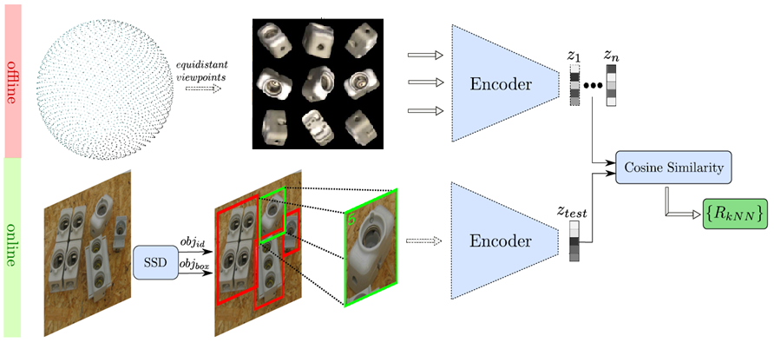
Pose Estimation with Object Auto-encoder [Sundermeyer, ECCV18]
Remove the need of manually labeling data
Avoid the problem of symmetrical ambiguities
codebook
codeword

Slide 5
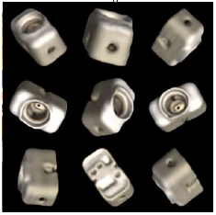
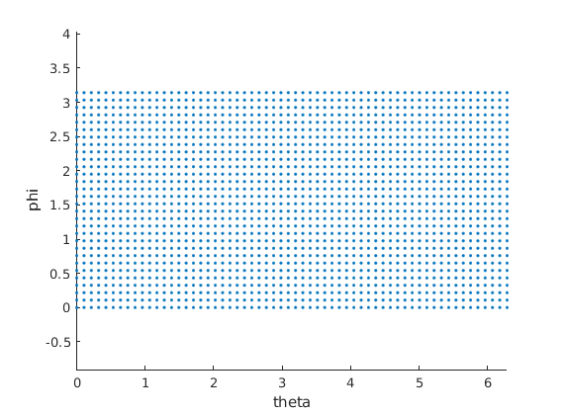
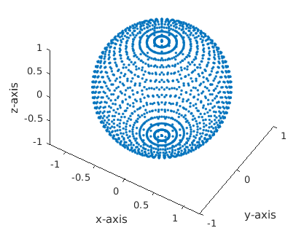
Step 1. Creating synthetic dataset with YCB_Video_Models dataset [Calli, IEEE15]
Sample equidistant viewpoint
Simply sampling uniformly from spherical coordinates gives incorrect result

Slide 6
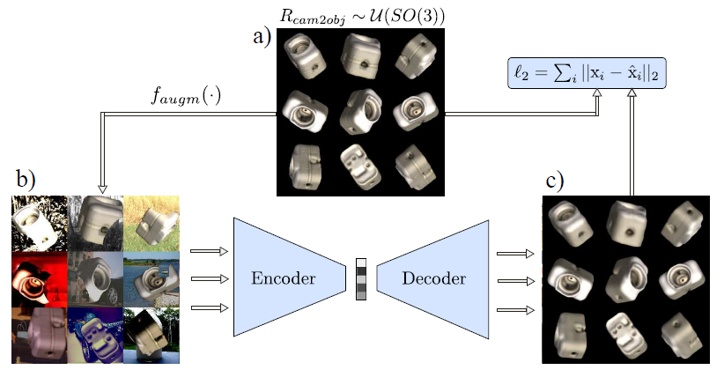
Step 2. Training object auto-encoder

Slide 7
Time Schedule
Report submission
Jan 27
Project start
Plan presentation
Progress presentation
Final presentation
Oct 23
Nov 15
Dec 13
Jan 31
2019
Oct
Nov
Dec
2020
2020
Today
Literature study
Oct 24 - Oct 30
Creating synthetic dataset
Nov 1 - Nov 20
Training auto-encoder
Oct 23
Nov 15
Nov 21 - Jan 26
Preparing for the plan presentation
Nov 13 - Nov 15
Nov 16
Dec 13
Preparing for the progress presentation
Dec 11 - Dec 13
Writting final report
Jan 21 - Jan 26
Preparing for the final presentation
Jan 27 - Jan 31

Slide 8

References
1] Berk Calli, Arjun Singh, Aaron Walsman, Siddhartha Srinivasa, Pieter Abbeel, and Aaron M Dollar. The ycb object and model set: Towards common benchmarks for manipulation research. In 2015 international conference on advanced robotics (ICAR), pages 510{517. IEEE, 2015.
[2] Martin Sundermeyer, Zoltan-Csaba Marton, Maximilian Durner, Manuel Brucker, and Rudolph Triebel. Implicit 3d orientation learning for 6d object detection from rgb images. In Proceedings of the European Conference on Computer Vision (ECCV), pages 699{715, 2018.
[3] Yu Xiang, Tanner Schmidt, Venkatraman Narayanan, and Dieter Fox. Posecnn: A convolutional neural network for 6d object pose estimation in cluttered scenes. arXiv preprint arXiv:1711.00199,

Slide 9
Challenges
Object occlusions
Background clutter
Dynamic environment
texture-less or symmetric objects
Non-real-time

Slide 10
Related works
 | Feature-based pose estimation | Template matching | Existing deep neural networks
 | Fast and robust for well-textured objects | Effective for texture-less objects | Better handle the texture-less and occluded objects
Chellenges | Poorly-textured objects Heavy occlusion | Occlusions Cluttered background | Large amount of labeled data required Symmetrical ambiguities

Slide 11
Project start
Plan presentation
Progress presentation
Final presentation
Oct 23
Nov 15
Dec 13
Jan 31
2019
2020
Oct
Nov
Dec
Jan
2020
Today

Slide 12
Time Schedule
Report submission
Jan 27
Project start
Plan presentation
Progress presentation
Final presentation
Oct 23
Nov 15
Dec 13
Jan 31
2019
Oct
Nov
Dec
2020
2020
Today
Creating synthetic dataset
Oct 23 - Nov 15
Preparing for the plan presentation
Nov 13 - Nov 15
Training auto-encoder
Oct 23
Nov 15
Nov 16 - Jan 26
Preparing for the progress presentation
Nov 16
Dec 11 - Dec 13
Dec 13
Writting final report
Jan 21 - Jan 26
Preparing for the final presentation
Jan 27 - Jan 31

Slide 13
Related Works
Feature-based pose estimation
Fast and robust for well-textured objects
Struggles with texture-less and heavily-occluded objects
Template matching
Effective for poorly-textured objects
Fails in the presence of mild occlusions and cluttered background
Existing approached using deep neural networks
Handle the texture-less and occluded objects better
large amount of labeled training data is needed, while pose annotation is costly.

