Slide 1
Training an Object Autoencoder for Pose Estimation with Synthetic Data
Weiqi Luo
Projektpraktikum Human Centered Robotik
Project plan presentation
Supervisor: M.Sc. Shile Li

Slide 2
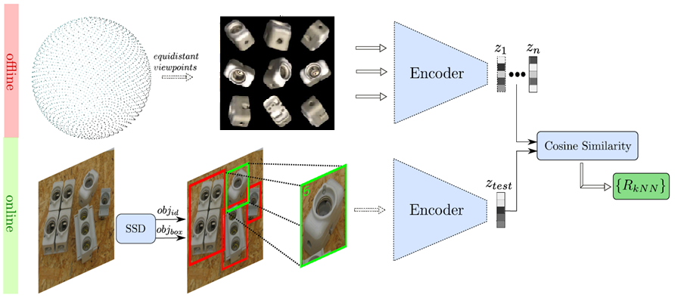
Pose Estimation with Object Auto-encoder [Sundermeyer, ECCV18]
codebook
codeword

Slide 3
Project progress
Completed work:
Created synthetic dataset
Built the framework for training object auto-encoder
On-going work:
Building and Training object auto-encoder

Slide 4
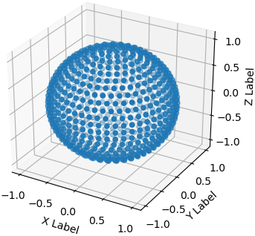
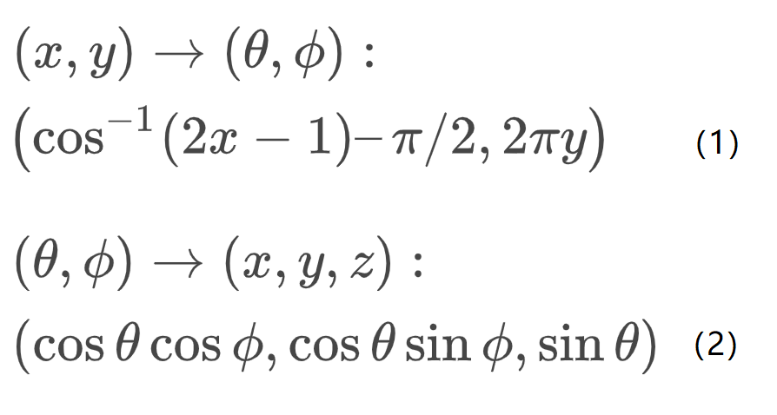
Creating synthetic dataset with YCB_Video_Models dataset
Sampling 2562 uniformly distributed view points using Spherical Fibonacci Lattice [Deserno, Polymerforshung04]
Sample (x,y) uniformly from unit square [0,1]

Slide 5
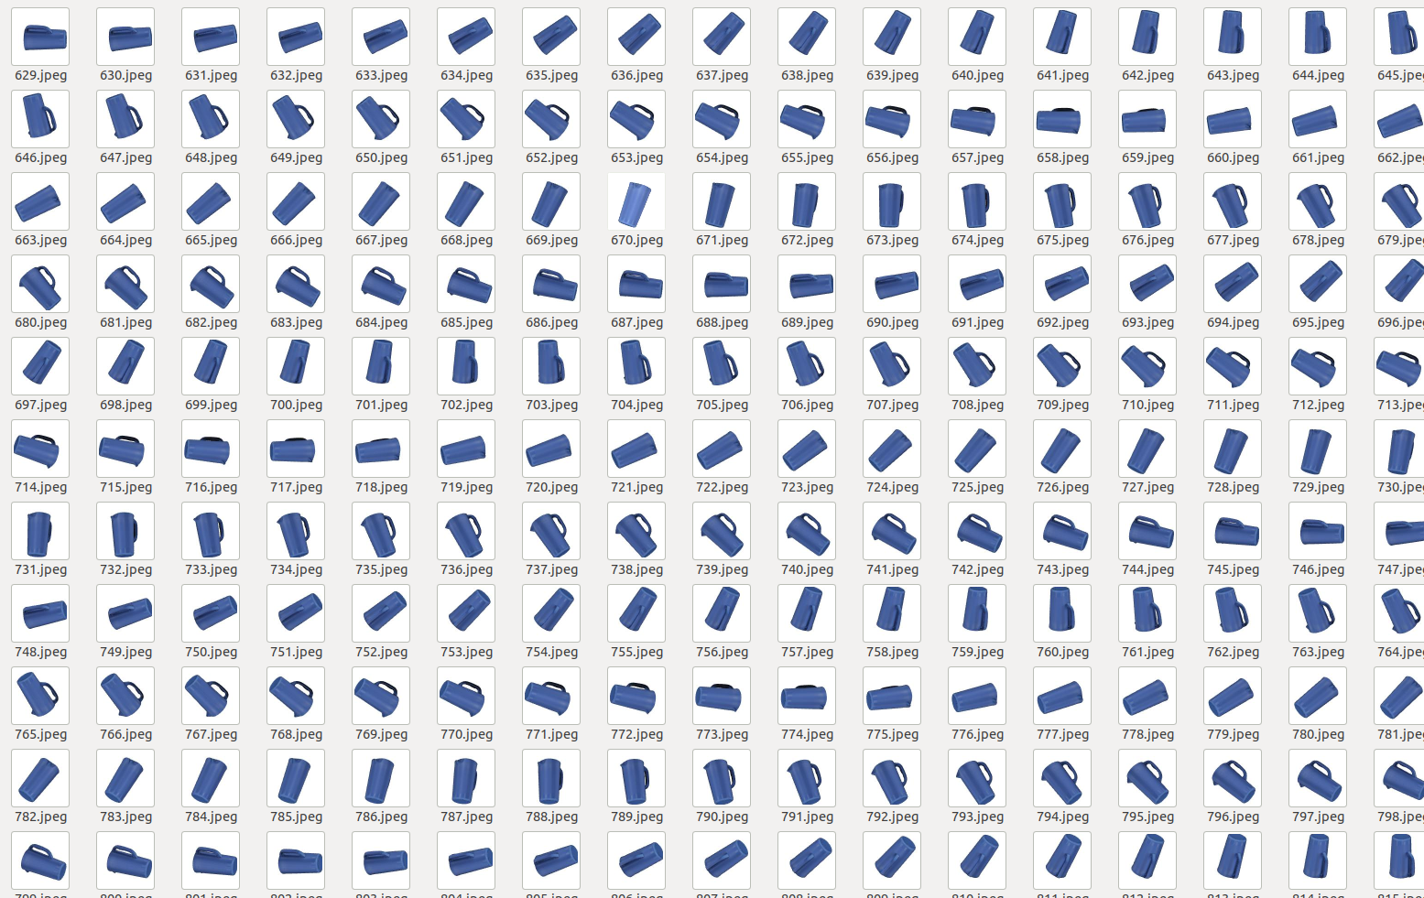
Creating synthetic dataset with YCB_Video_Models dataset
At each view point, point the camera to the object 3D mesh

Slide 6
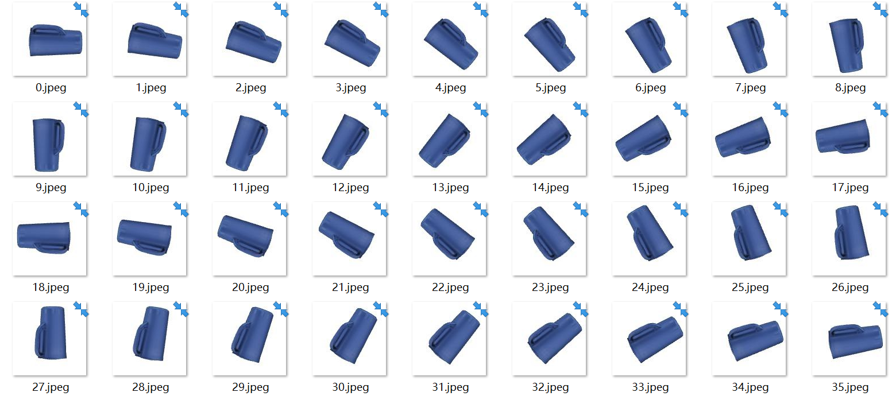
Creating synthetic dataset with YCB_Video_Models dataset
At each viewpoint, rotate the camera in-plane at 36 times to cover the whole SO(3)

Slide 7
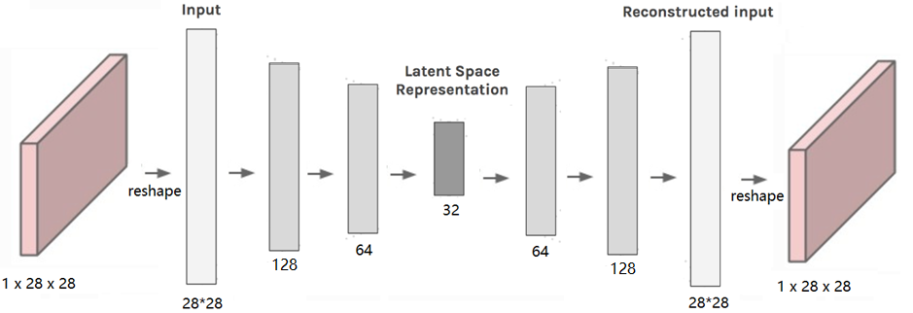
Building and training object auto-encoder
Fully connected auto-encoder

Slide 8
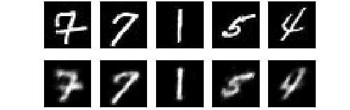
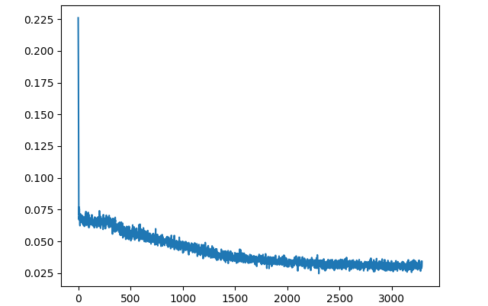
Building and training object auto-encoder
Fully connected auto-encoder
MNIST dataset of handwritten digits
MSE loss

Slide 9
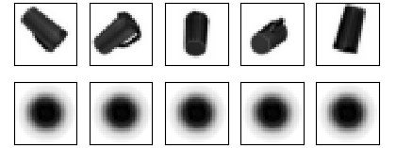
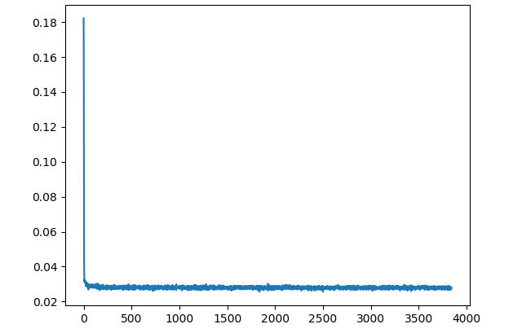
Building and training object auto-encoder
Fully connected auto-encoder
MNIST dataset of handwritten digits Synthetic object dataset
MSE loss
MSE loss

Slide 10
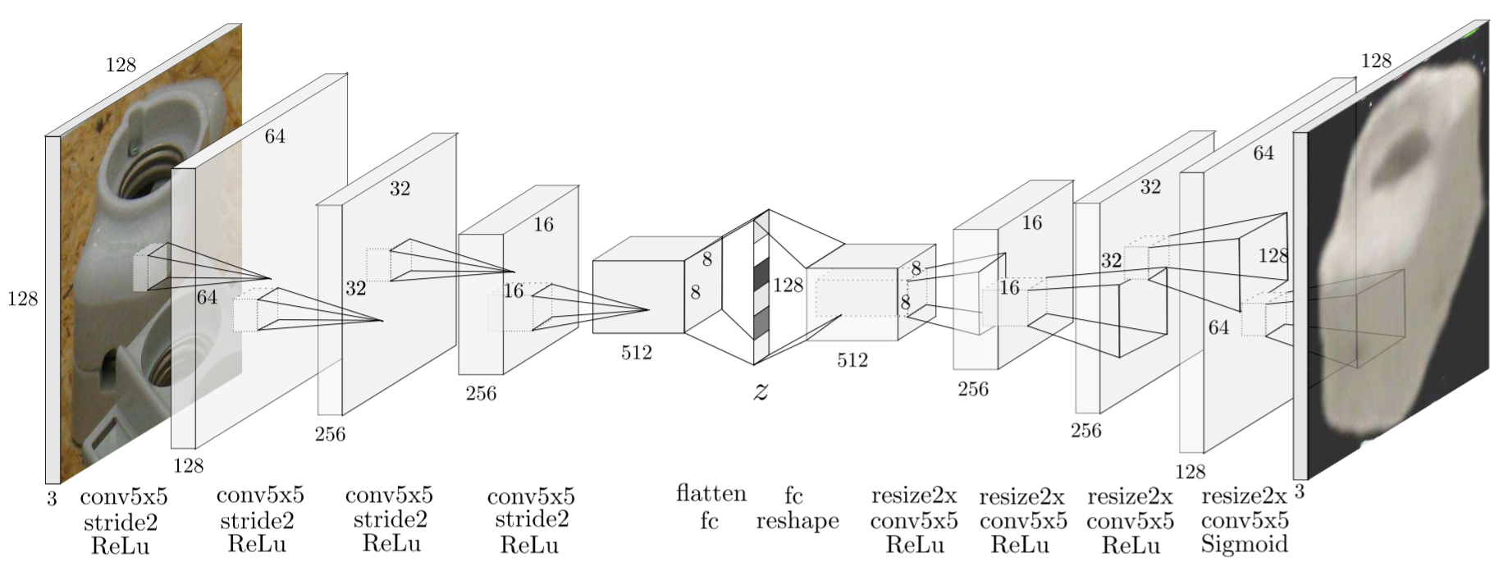
Building and training object auto-encoder
Convolutional auto-encoder [Sundermeyer, ECCV18]

Slide 11

References
1] Berk Calli, Arjun Singh, Aaron Walsman, Siddhartha Srinivasa, Pieter Abbeel, and Aaron M Dollar. The ycb object and model set: Towards common benchmarks for manipulation research. In 2015 international conference on advanced robotics (ICAR), pages 510{517. IEEE, 2015.
[2] Martin Sundermeyer, Zoltan-Csaba Marton, Maximilian Durner, Manuel Brucker, and Rudolph Triebel. Implicit 3d orientation learning for 6d object detection from rgb images. In Proceedings of the European Conference on Computer Vision (ECCV), pages 699{715, 2018.
[3] Yu Xiang, Tanner Schmidt, Venkatraman Narayanan, and Dieter Fox. Posecnn: A convolutional neural network for 6d object pose estimation in cluttered scenes. arXiv preprint arXiv:1711.00199.
[4] Deserno M. How to generate equidistributed points on the surface of a sphere[J]. If Polymerforshung (Ed.), 2004: 99.

Slide 12
Time Schedule
Report submission
Jan 27
Project start
Plan presentation
Progress presentation
Final presentation
Oct 23
Nov 15
Dec 13
Jan 31
2019
Oct
Nov
Dec
2020
2020
Today
Literature study
Oct 24 - Oct 30
Creating synthetic dataset
Nov 1 - Nov 20
Training auto-encoder
Oct 23
Nov 15
Nov 21 - Jan 26
Preparing for the plan presentation
Nov 13 - Nov 15
Nov 16
Dec 13
Preparing for the progress presentation
Dec 11 - Dec 13
Writting final report
Jan 21 - Jan 26
Preparing for the final presentation
Jan 27 - Jan 31

