Slide 1

WebLogic Server 7.0
New Features
Alexander Berry, Jr.
WLS Sr. Systems Engineer

Slide 2
WebLogic Server 7.0
Delivers integration foundation services
Improves developer productivity
Enhances administrator productivity
Continued Leadership
  Standards compliance
  New Security Framework
  Performance/caching enhancements
3.5 4.0 4.1 4.5 5.1 6.0 6.1 7.0
Notes:
WebLogic Server 7.0 represents a further development of the industry’s #1 application server. Now in its seventh generation, WebLogic Server 7.0 continues the pattern established by the number of recent releases – it’s the leading application server on the market, holding the biggest market share,used by over 12,000 customers, used by the most number of packaged applications, and supported by all the largest global system integrators.
This reputation was earned by the hard work of our engineers who made WebLogic server always standards compliant, reliable, highly scalable,
Over the years, WebLogic server has enjoyed the luxury of being a favorite application server for developers, administrators, and system architects.
When planning the roadmap for this latest release, our engineers decided to go to the root to find out what exactly features and qualities our customers expect from the product that ties their whole business application infrastructure together.
Based on the results of this survey, the major themes of the new release are the following: developer productivity, administrator and operational productivity, integration foundation services, along with continued leadership in the field.

Slide 3
WebLogic Server 7.0 delivers integration foundation services
Notes:
Another big pain that we heard from the customers is integration. Especially for large corporations that have collected different platforms and environments through acquisitions, mergers, or just historically. And we do have a lot of customers who are in this situations.
They are looking for a reliable, proven, and standards based integration solution from the vendor they know and trust. With the new release, we are providing just that.
The bottom line is - no application today is developed, and deployed in isolations – there is data to be shared, functionality to be re-used, management to be integrated with, and so on. Those functional are provided by WebLogic Server integration foundation services.
Not to be confused with WebLogic Integration – higher level integration, B2B, BPM, and so on – another great product within BEA WebLogic Enterprise Platform

Slide 4
Integration foundation services
Web Services
  Native support for Web Services (SOAP, WSDL, XML, UDDI, JAX-RPC)
  Interoperability with Microsoft .Net and other Web Services
  Development utilities for the J2EE developer
  New high speed XML pull parser
  UDDI v2 compliant registry implementation
BEA WebLogic Server
Serializer
SOAP
Client
SOAP
Request
Protocol
Adapter
(HTTP)
SOAP
Request
Serializer
SOAP
Request
Deserializer
Java
Handler
Chain
Stateless
EJB
SOAP
Response
SOAP
Response
SOAP
Response
Serializer
Java
Notes:
Web Services, as you know, is the new integration model that allows heterogenous applications to talk to each other. This is in a way a universal integration solution that is promising to revolutionize the world of distributed computing and enterprise application integration.
With the new release, WLS offers a lot in this new area. While Web Services infrastructure was available with the previous release of WebLogic server, with this release we are taking it further.
Couple of the most important points here:
.Net interoperability
….
SOAP handlers provide access to SOAP message before the request is delivered to the implementing J2EE component. Can access headers, attachments, and individual fields. Work like message interceptors.
Serializers/Deserializers allow mapping complex user classes (custom Java types) to and from SOAP messages. Autotyper tools help developing these.
…
Built-in UDDI registry and API
…

Slide 5
Integration foundation services
WebLogic Workshop
  IDE and framework for developing Web Services
  Shields user from complexities of J2EE
Enterprise Messaging
  New highly available JMS
    Virtual queues and migratable destinations
  3rd party Messaging integration i.e. MQSeries
    Pluggable architecture – no coding needed to integrate
    Supports store-and-forward
J2EE Connector Architecture
  Support for JCA 1.0
  Enhancements in Connection and Security Management
Notes:
Reliable messaging:
Clustered, distributed JMS factories and destinations. Allows building a interoperable, reliable, and fault tolerant enterprise messaging back bone based on WebLogic Serve messaging infrastructure.
Third party messaging integration – allows integration with other JMS compliant solutions like MQ series and other. Uses J2EE connector architecture to facilitate messaging bridge.
J2EE 1.3 built-in integration features:
IIOP support and EJB interoperability
Web Service enabled EJB and JMS
J2EE connector architecture for standards based enterprise application integration.
jCom provides a completely integrated, built-in Java to COM+ bridge that allows accessing J2EE components from VB, C++, ASP and other COM+ enabled clients, and also access from J2EE applications deployed on WLS to COM+ clients or products.

Slide 6
Integration foundation services
RMI/IIOP Enhancements
  Bi-directional support for transactions and security context propagation between WLS and CORBA
  Full EJB/OTS/IIOP spec compliance
WebLogic Tuxedo Connector
  Bi-directional support for transactions and security context propagation between WLS and Tuxedo
Microsoft Interoperability
  WebLogic jCOM- Java to COM+ bi-directional bridging
Notes:
Robust RMI/IIOP implementation allows integration with CORBA world, including the propagation of transactional and security context.
Tuxedo integration – built-in, fully integrated, administered from WLS administration console. Bi-directional, transactional, secure.
Mention WebLogic Workshop again as another powerful integration facility for building distributed, loosely coupled applications based on Web Services while utilizing a scalable and reliable WLS J2EE architecture.

Slide 7
Integration foundation services: Customer Benefits
Web Services
  Interoperability with Microsoft and other Web Service platforms
  Shield users from complexities of SOAP and WSDL
  Hooks for extensibility
  Synchronous or asynchronous
Messaging
  No need for a separate messaging platform
  Integrate with existing messaging platforms
  Increases availability of applications leveraging messaging
J2EE Connector Architecture
  Standards based integration to legacy systems
jCOM
  Allow for interoperability between WebLogic and COM
  Leverage VB and other MS clients
RMI/IIOP
  Leverage and integrate CORBA clients
  EJB interoperability
  Integration with Tuxedo
Notes:
Summary of integration features of WLS.
Mention that we call these integration foundation services. These are further extended by the WebLogic Integration product that adds business process management, B2B collaboration, complex transformation, and other enterprise level integration features, and is based on WLS.

Slide 8
WebLogic Server 7.0 radically improves developer productivity
Notes:
Developer productivity is a huge factor effecting customer’s ROI, TTM, uniformity of environment and technology, and by these, their core business. The requirement to make development with WLS simple, fast, standards-compliant is the first release theme we will look at. WebLogic Server 7.0 has features, tools, and technologies that radically improve developer’s productivity in multiple areas.

Slide 9
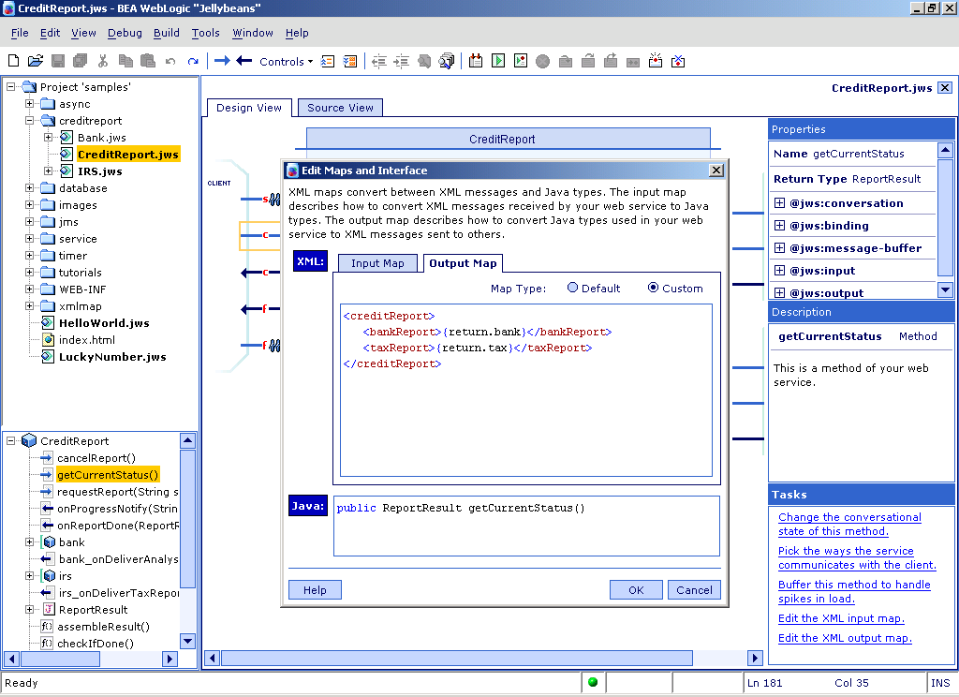




Developer productivity
WLS 7.0 improves developer productivity with new tools, utilities, services and 3rd party development tool integration
WebLogic Workshop
Tightly integrated with all leading development tools
3rd party J2EE IDE support
  IBM, WebGain, Rational, Borland, Sun Forte, NetBeans, TogetherSoft, Mercury Interactive, etc.
Notes:
Even before 7.0, development of applications for WLS could be done with any Java development tool. WLS is more tightly integrated with jBuilder and Visual Café, which allow you to debug applications deployed on WLS, and are integrated with WLS at the administration and management level as well. There is also a very good level of integration with multiple other Java design, development, testing, and profiling tools on the market.
Now, with WebLogic Workshop – the new Web Services development tool that is fully integrated and based on WebLogic Server, developers’ productivity while building distributed loosely couple Web Services is taken to a completely new level. With just several high level operations facilitated by the Workshop’s comprehensive IDE,and a few lines of procedural code representing pure business logic, developers can create highly optimized enterprise scale applications at 1/10 th of time that it would take if using any other tool or environment on the market today. Discussing WebLogic workshop is out of the scope of this presentation, however it’s important to mention that it is integrated and built on top of WebLogic Server 7.0, and applications build with it are J2EE-compliant, WLS-deployed scalable and reliable applications.
A small sample of WLW IDE is shown on this slide

Slide 10
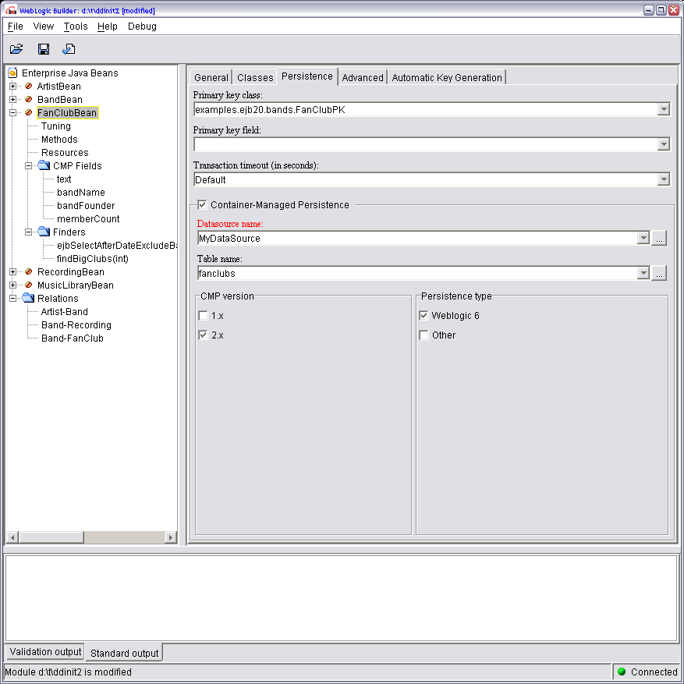
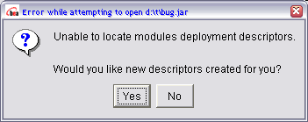
Developer productivity
New WebLogic Server Java Development Utilities
WebLogic Builder – J2EE application assembly, packaging, configuration, and deployment tool
EJBGen – EJB development utility
You write business logic only. EJBGen will generate the rest of the files
Notes:
WebLogic Builder radically simplifies the assembly, configuration, packaging, and deployment of applications on WLS. Imagine when you’ve finished developing your EJBs and Servlets, and now need to write several deployment descriptors in XML, configure numerous standard and WLS-specific configuration paramenters, run EJB compile, produce a deployable package consiting of doesens of files, and deploy it on the server.
WLB shields this all from you. It will generate your default DD, let you edit in through a convenient GUI while validating your input, run EJB compile with meaningful error and diagnostics messages for you, and finally packages it all and deploy it into your WLS if you have one available. No manual XML coding required, or even allowed. In the process, WLB will introspect your Java classes, connect to your WLS and get information on your database and CMP fields, JMS destinations, J2CA adaptors, and other entities that have already been configured in the server. It will help you map your CMP fields into your database tables, and will help you write and validate your EJB QL statements.
This is a true enhancement to the developer, especially if you are in unit testing mode and need to do this several times a day.
A screen shot of WLB is shown on this slide.
Another productivity enhancement utility is EJBGen. This command line tool allows you to develop your EJB as a single Java source file with business logic only. It will automatically create Home, Remote interfaces for you, compile your class, and make it ready for WebLogic Builder to pick it up from there. No more multiple source file EJB development hustle!

Slide 11
Developer productivity
WebLogic Server Web Services Development Utilities
Ant tasks for automating the creation of Web Services
  Generate deployment descriptors
  Generate serializers for complex data types
  Generate home page, testing harness
  Generate client proxy
Notes:
Several important developer-oriented enhancements in the Web services area.
Service Gen – allows exposing EJB or JMS component deployed in the WLS as a Web Service.
Autotyper – helps generating pluggable components that map user-defined complex Java data types (or, classes) to and from SOAP message. The generated components, called serializers and deserializers, are then plugged into WLS Web Services container and are accessed every time a new SOAP message arrives.
HomePageGen – generates WebLogic Server Web Services home page, with the links to download client proxy, WSDL file, and other useful information. This page is automatically deployed on the WebLogic server and is available on the Web.
ClientGen – generates a thin client proxy (in a form of a jar file) that can be used to develop clients for WLS-deployed Web Services.
All the above tools are seamlessly integrated with WLS Web Services frmamework and make developing Web Services with WLS fast and simple.

Slide 12
Developer productivity:
Customer benefits
Maximum choice in development tools
Reduced manual programming
Increased quality of code, reduced time debugging
Reduced packaging and deploying time
Reduced number of developers and/or time to market
Reduced TCO and Increased ROI
Notes:
This slide summarizes the developer’s productivity enhancement features.
All these points make the WLs 7.0 message of radically improving developer’s productivity a reality, and we are sure they will be highly appreciated by the WLS development community.

Slide 13
WebLogic Server 7.0 enhances administrator productivity
Notes:
At the point when the application has been developed, tested, and is ready for production – some of the most painful moments may begin. But, not for WebLogic Server customers. We take good care of you administration and operational needs, especially so with the new WLS 7.0

Slide 14
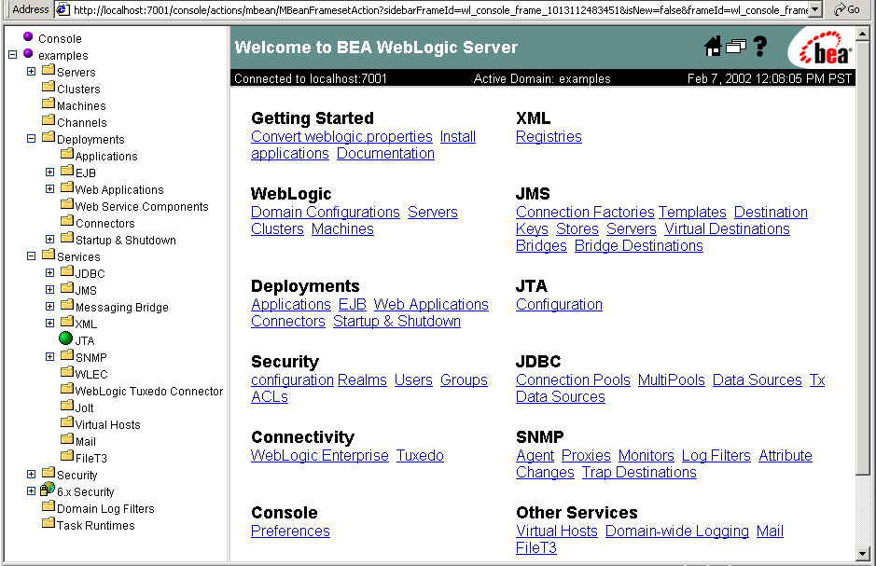
Administrator productivity
WLS 7.0 enhances administrator productivity with complete and extensible deployment, configuration, security and monitoring infrastructure.
Further enhanced Web-based graphical administration console
  Extensible
  Role based admin,deployer,operator,monitor
  Reports on statistics, performance, system health
  Usability, look-and-feel improvements
Notes:
WLS 7.0 provides a more powerful, flexible, extensible administration and mangement environent that allows your administrators to take a good care of the applications deployed on WLS 7.0.
New monitoring metrics are now available to the administrator. These metrics can also be extended through WLS extensible administration interface.

Slide 15
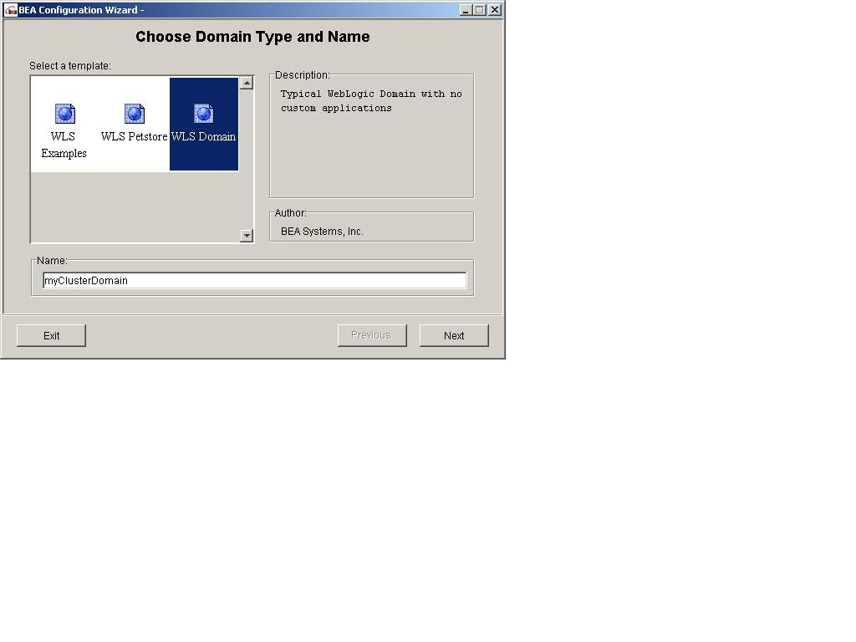
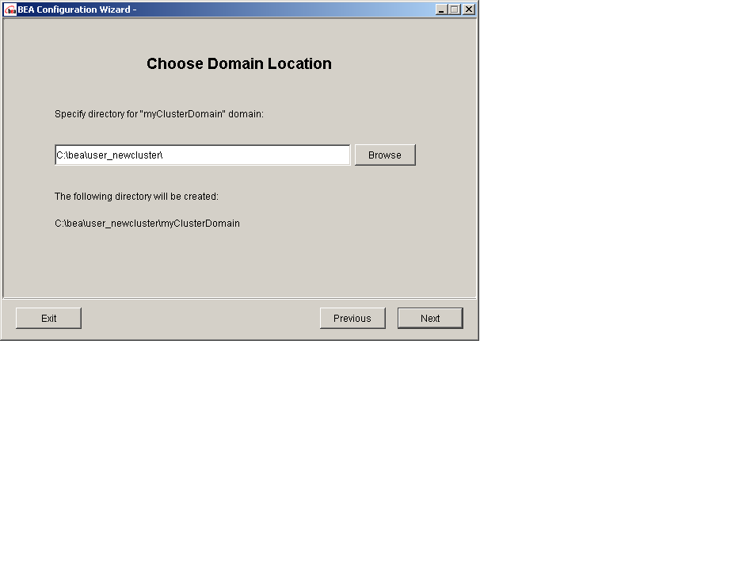
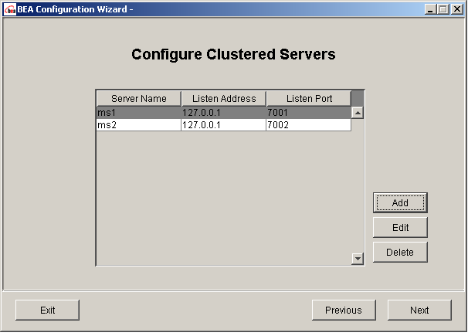
Administrator productivity
Simplified cluster configuration and management
  Configuration wizards help creating new domains, clusters, and configurations
Two phase install for massive deployments
New server health monitoring metrics
Single IP address across the cluster (multiple ports)
Notes:
Administrators can remember how complex configuring a cluster has been. Not any more: Configuration wizard walks you through creating and configuring new domains, clusters, and configurations. It let’s you edit the most essential configuration parameters, while shielding you from all the complexities of the process.
Two phase install helps rolling out massive application deployments while keeping every server in a consistent state. This feature works in a similar way to transaction support: the installation is considered successful and committed only if the whole process was successful. Otherwise, the environment is rolled back to its original state, and is ready for another attempt.
For the environment where multiple IP addresses can be an issue, a cluster can be configured to share a single IP address while utilizing multiple ports.

Slide 16
Administrator productivity
Node manager
  Monitors each cluster node
    Reports on the node health
    Can restart the failed node
    Continuously reports on a set of metrics
  Administrators can set up a notification system based on specific events
A new “stand by” server state
  React to load increase faster, with less effort
  Server in “stand by” state is ready to receive requests
  Can be brought on line immediately
Notes:
Smart Update feature allows to roll out new releases of your application fast and easy, even without having to shut down the cluster! Imagine how important this feature is for some mission critical system that can not be brought down.
Node manager is a separate process that monitors each node in the cluster. By being separated from the server, it will not be affected the serve failure, and can take certain action in the even when the server fails, or hangs, or does not process correctly.
Node manager continuously reports on the node’s health. A flexible notification system based on specific configurable events can be set up with the node manager, providing administrators with a greater control of the cluster.
Stand-by and Suspended server states – allow quick reaction to load changes.
Stand-by server can be configured and started, but brought on-line immediately when there is need. When the load is down, it can be suspended with gracious completion of all the transactions.

Slide 17
Administrator productivity
Open administration and management interface
  Can build your own Mbeans, or use open API to WebLogic Mbeans
  3rd party management tools can be integrated with WLS administration console
  New pages can be added to admin console
  Allows programmatic management of the WLS-based applications
  A common framework for all administration tasks
Server Independence from the Administrative Console
  Command line start-up and shut-down without Admin Server
Notes:
Extensible administration and management interface – Administration console can be extended to report on application-specific set of metrics. WebLogic Server management can be integrated with the industry leading administration and management solutions.
Through the same open API, your WLS-based application can be programmatically controlled from another application, or a batch.
One more very important point – administration service compatibility with prior and future releases. This means you can rollout a new release of WLS in phases, or just mix and match different releases in your environment while managing them from a single administration console.

Slide 18
Administrator and Operational productivity: Customer benefits
Increased uptime
Easy installation, configuration, monitoring and maintenance of applications
Reduced number of administrators and skills needed
Move visibility into application metrics
Integration with existing system infrastructure, including the leading security and management products
Increased security
Reduced TCO and Increased ROI
Notes:
As you could see yourself, we have done a lot to make the life of your system administrator easy, and your application run fast, reliable, and execute your business functionality to the best of its business abilities.
Isn’t that what this whole story should be abut at the end of the day?

Slide 19
Continued Leadership
Notes:
All the above mentioned features further strengthen WLS leadership in the application server market space. Today, it provides the most comprehensive set of our-of the box features and functionality, and is the most complete enterprise application infrastructure product on the market.
As the leader, it offers many benefits to the customers that you’d expect from the market leader.

Slide 20

Standards Compliance
WebLogic Server is the first to market with the leading standards, such as J2EE and Web Services
WebLogic Server is certified J2EE 1.3 complaint
Support for SOAP, WSDL, JAX-RPC, UDDI
Notes:
WebLogic Server is the first major Java application server on the market to be certified J2EE 1.3 compliant by Sun. This results to:
You find the latest APIs and features in WLS 7.0
You future proof you application by developing to the latest standards
J2EE 1.3 means: read the slide.

Slide 21
New Security Framework
WebLogic 7.0 will offer the most comprehensive, open security model for enterprise infrastructure
Open APIs for authentication, authorization, auditing, and PKI management
Full support of JAAS
LDAP integration & “out of the box” experience
Principal
Authenticator
Authorization
Manager
Role
Manager
Credential
Manager
User
Profile
Auditor
Security Framework
Authentication
& Identity
Module(s)
Authorization
Module(s)
Auditing
Module(s)
Role Mapping
Module(s)
Credential
Mapping
Module(s)
UserProfiler
Module(s)
Notes:
Most significant advances of WebLogic Server 7.0 is the pluggable policy-based security security architecture.
Built on open standards including JAAS
Pluggable for authentication, authorization, auditing, and PKI
LDAP integration & out of the box experience
Service-based framework that delegate requests to appropriate provider
Authenticates, verifies, and maps security tokens to internal format for SSO Support
Enforces authorization policies for resources that takes business policy into consideration
Audits all security actions in support of non­repudiation
Maps roles to users/groups based on policy
Maps authentication credentials for a user to legacy application for SSO

Slide 22
Industry leading performance
Cache Filters
  Web cache
  Easily cache files of a specific type, entire directories, or specific files
  Cache uses soft references, so it cannot cause the server to run out of memory
Entity EJB caching enhancements
  Optimistic concurrency
  Automatic invalidation on update

Slide 23
Continued leadership: customer benefits
Standards compliance
  Investment protection
Security
  Removing security code from Business Logic decreases maintenance costs.
  Increased security, reduced development
  Leverage corporate standard security frameworks or pick best of breed
Caching
  Faster applications
  Less load on network, database

Slide 24


Download your free evaluation copy of the new WebLogic Server 7.0 Now!
To learn about other BEA developer resources, check out
http://dev2dev.bea.com

Slide 25

How Business Becomes E-Business™
www.bea.com

