Slide 1

Jakarta Struts
Presented by
Object Computing, Inc. (OCI)
http://www.ociweb.com
Written by Greg Elliott
elliott_g@ociweb.com

Slide 2
What is Struts?
An open source development framework for building web applications
Based on Model-View-Controller (MVC) design paradigm
Implementation of JSP Model 2 Architecture
Created by Craig McClanahan and donated to Apache Software Foundation (ASF) in 2000
2nd release candidate of version 1.1 released
Consists of 8 Top-Level Packages
Approximately 250 Classes and Interfaces

Slide 3
Alternatives to Struts
No framework (use straight JSP)
Build your own framework
Webwork
Expresso
Barracuda
Cocoon
SiteMesh
Freemarker, Velocity and WebMacro
XML/XSLT
???

Slide 4
Why consider Struts?
Developed by industry experts
Stable & Mature
Manageable learning curve
Open source
Probably similar to what you would build if you weren’t going to use Struts
Good documentation – both javadoc api as well as numerous books on topic
Feature-rich
Supported by many 3rd party tools
Flexible and extendable

Slide 5
Struts Framework Features
Model 2 – MVC Implementation
Internationalization support
Rich JSP tag libraries
Based on JSP, Servlet, XML and Java
Supports different model implementations (JavaBeans, EJB, OJB, etc.)
Supports different presentation implementations (JSP, XML/XSLT, etc.)

Slide 6
Struts Dependencies
Java 1.2 or newer
Servlet 2.2 and JSP 1.1 container
XML parser compliant with JAXP 1.1 or newer (ie, Xerces)
Jakarta Commons packages
JDBC 2.0 optional package

Slide 7
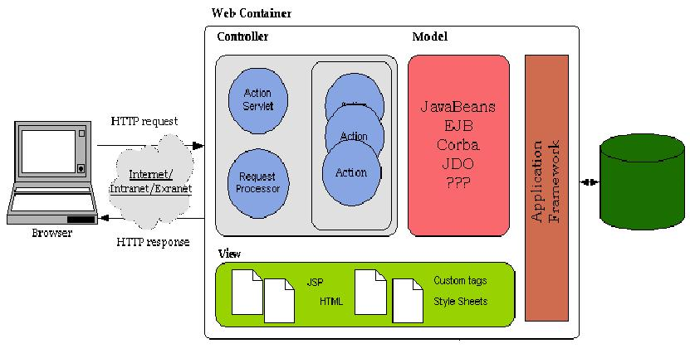
Logical Architecture

Slide 8
Aspects of the Framework
Controller
Model
View
Configuration issues

Slide 9
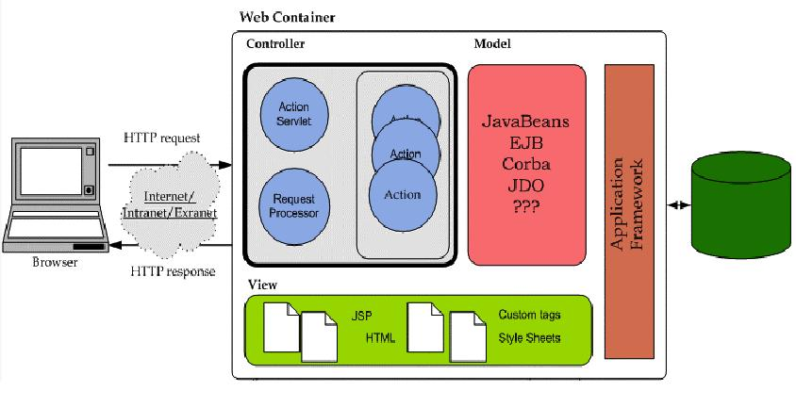
Controller Components

Slide 10
Controller Components
ActionServlet – (provided by the Framework)
RequestProcessor – (provided by the Framework)
Action Classes – (You build these)

Slide 11
The ActionServlet and RequestProcessor
Receive the HttpServletRequest
Automatically populate a JavaBean (ActionForm) from the request parameters
Handle Locale and Content Type Issues
Based on the URI, select the appropriate Action to handle the request

Slide 12
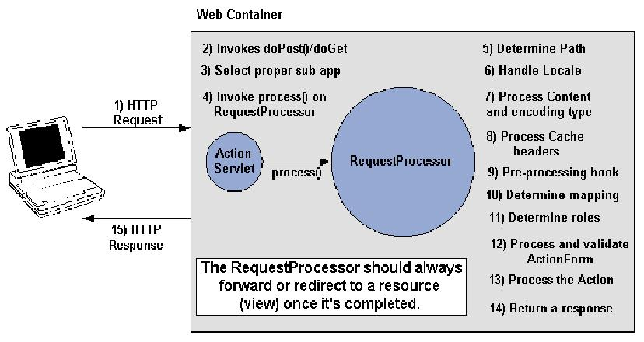
ActionServlet and RequestProcessor

Slide 13
The Action Class
Extends org.apache.struts.action.Action
Override the execute() method
Bridge between the user-invoked URI and the business method residing in the Model class (Command pattern)
Based on success/failure of processing in Model, determines which view should be rendered next
Actually part of the Controller, not the Model

Slide 14
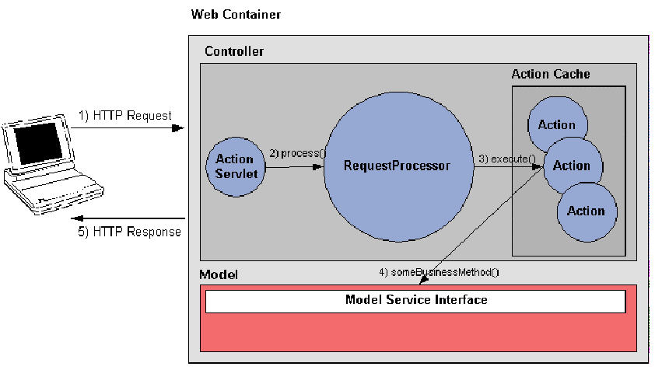
Action Class Diagram

Slide 15
Action Class Example
import javax.servlet.http.*;
import org.apache.struts.action.*;
import example.model.*;
public class TransformTextAction extends Action {
public ActionForward execute(
ActionMapping mapping,
ActionForm form,
HttpServletRequest request,
HttpServletResponse response) throws Exception
{
TransformForm myForm = (TransformForm) form;
String inputText = myForm.getInputText();
Integer transformType = myForm.getTransformType();
String resultText =
TransformModel.transformText(inputText, transformType);
myForm.reset();
request.setAttribute("resultText", resultText);
// Forward control to the specified success URI
return mapping.findForward("continue");
}
}

Slide 16
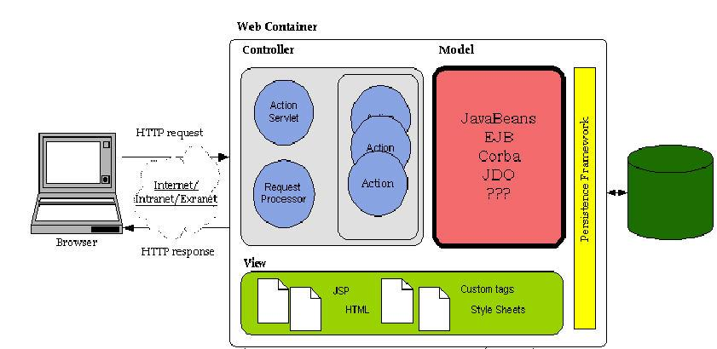
The Model Components

Slide 17
Struts Model Components
No model components provided
Any component model supported by Struts (JavaBeans, EJB, CORBA, JDO, OJB, etc.)
Should always attempt to maintain a clean separation from Action and Model

Slide 18
Model Class Example
package example.model;
public class TransformModel
{
public static String transformText(String origText, Integer transType)
{
String rc = origText;
switch(transType.intValue())
{
case TransformerConstants.TO_UPPER:
rc = origText.toUpperCase();
break;
case TransformerConstants.TO_LOWER:
rc = origText.toLowerCase();
break;
}
return rc;
}
}

Slide 19
Model Class Example (cont.)
package example.model;
public class TransformerConstants
{
public static final int TO_UPPER = 0;
public static final int TO_LOWER = 1;
public static final int CAP_EACH_WORD = 2;
public static final int SENTENCE_FORM = 3;
}

Slide 20
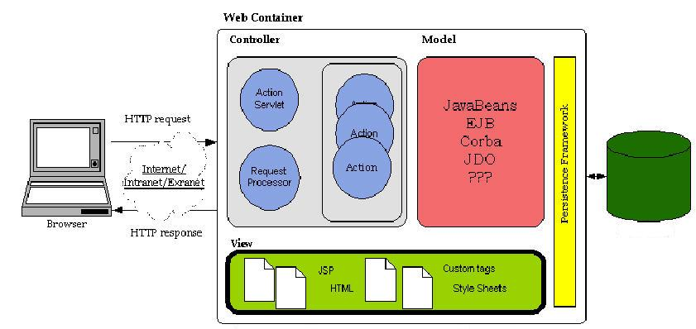
The View Components

Slide 21
The View Components
Java Server Pages
HTML
JavaScript and Stylesheets
Multimedia Files
Resource Bundles
JavaBeans (Value Objects populated by Model components)
JSP Custom Tags
ActionForms

Slide 22
Struts JSP Tag Libraries
HTML
Bean
Logic
Nested
Tiles
Template

Slide 23
HTML Tag Library
Tags used to create Struts input forms
Examples include checkbox, image, link, submit, text, and text area

Slide 24
Bean Tag Library
Tags used for accessing JavaBeans and their properties
Examples include define, message, write

Slide 25
Logic Tag Library
Managing conditional generation of output text
Looping over objects in a collection for repetitive generation of output text
Application flow management
Examples include empty, lessThan, greaterThan, redirect, iterate

Slide 26
Bean, Logic, HTML Tag Example
<%@ taglib uri="/tags/struts-bean" prefix="bean" %>
<%@ taglib uri="/tags/struts-html" prefix="html" %>
<%@ taglib uri="/tags/struts-logic" prefix="logic" %>
<head>
<title>Text Transformer</title>
<html:base/>
</head>
<body bgcolor="white">
<html:form name="transformForm"
type="TransformForm" action="transformer.do">
Please enter the text you would like tranformed:<br/>
<html:text name="transformForm" property="inputText"/>
<p/>
Please select the type of transformation to be performed:<br/>
<!-- radio buttons -->
<html:radio name="transformForm" property="transformType" value="0"/>
UPPER<br/>
<html:radio name="transformForm" property="transformType" value="1"/>
lower<br/>
<logic:present name="resultText" scope="request">
<b><bean:write name="resultText"/></b>
</logic:present>
<p/>
<html:submit/>
</html:form>
</body>

Slide 27
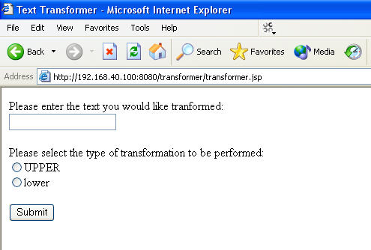
Sample Application

Slide 28
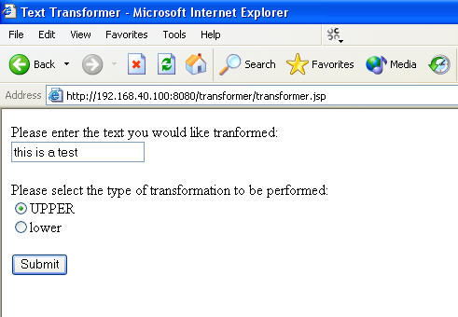
Sample Application (cont.)

Slide 29
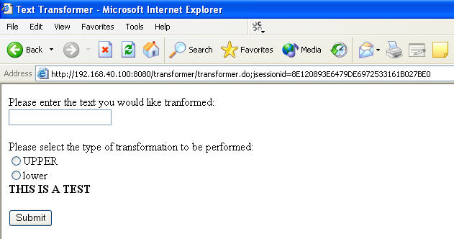
Sample Application (cont.)

Slide 30
The ActionForm
Java class that extends org.apache.struts.action.ActionForm
Captures user data from the HttpRequest
Stores data temporarily
Acts as a boundary/go-between between the View and the Controller
Provides ability to validate the user input

Slide 31
ActionForm Example
public class TransformForm
extends org.apache.struts.action.ActionForm {
private String inputText;
private Integer transformType;
public void setInputText(String aInputText) {
inputText = aInputText;
}
public String getInputText() {
return inputText;
}
public void setTransformType(Integer aTransformType) {
transformType = aTransformType;
}
public Integer getTransformType() {
return transformType;
}
public void reset() {
inputText = "";
transformType = null;
}
}

Slide 32
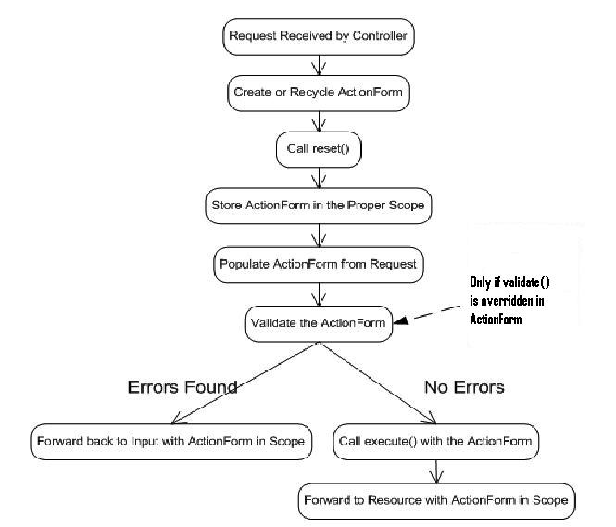
ActionForm Sequence of Events

Slide 33
ActionError and ActionMessage
Used to signify general purpose informational and error messages
Rely on the ResourceBundles
JSP Tags have access to them

Slide 34
ActionError and ActionMessage Example
<tr class="RED">
<td>
</td>
<td>
<html:messages id="error">
<li><bean:write name="error"/></li>
</html:messages>
</td>
</tr>

Slide 35
Configuring a Struts Application
Create/edit the web application deployment descriptor (web.xml)
Create/edit the struts-config.xml file
Other configuration files as necessary (tiles, validator, etc.)

Slide 36
Configuring the web.xml File
Add the servlet element
Configure servlet-mapping element
Add taglib elements

Slide 37
Sample web.xml
<web-app>
<!-- Standard Action Servlet Configuration (with debugging) -->
<servlet>
<servlet-name>action</servlet-name>
<servlet-class>
org.apache.struts.action.ActionServlet
</servlet-class>
<init-param>
<param-name>config</param-name>
<param-value>/WEB-INF/struts-config.xml</param-value>
</init-param>
<init-param>
<param-name>debug</param-name>
<param-value>2</param-value>
</init-param>
<init-param>
<param-name>detail</param-name>
<param-value>2</param-value>
</init-param>
<load-on-startup>2</load-on-startup>
</servlet>
<!-- Standard Action Servlet Mapping -->
<servlet-mapping>
<servlet-name>action</servlet-name>
<url-pattern>*.do</url-pattern>
</servlet-mapping>

Slide 38
Sample web.xml (cont.)
<!-- The Usual Welcome File List -->
<welcome-file-list>
<welcome-file>transformer.jsp</welcome-file>
</welcome-file-list>
<!-- Struts Tag Library Descriptors -->
<taglib>
<taglib-uri>/tags/struts-bean</taglib-uri>
<taglib-location>/WEB-INF/struts-bean.tld</taglib-location>
</taglib>
<taglib>
<taglib-uri>/tags/struts-html</taglib-uri>
<taglib-location>/WEB-INF/struts-html.tld</taglib-location>
</taglib>
<taglib>
<taglib-uri>/tags/struts-logic</taglib-uri>
<taglib-location>/WEB-INF/struts-logic.tld</taglib-location>
</taglib>
</webapp>

Slide 39
The struts-config.xml File
Uses xml
Defines the set of “rules” governing a particular Struts application
As of 1.1, can have multiple configuration files (acting as subordinates to master config file)
Gets parsed and loaded into memory at startup
Elements include:
  Action mappings
  Form bean definitions
  Static parts: controller attributes, message resources, plug-in information, and data source definitions

Slide 40
struts-config.xml Example
<?xml version="1.0" encoding="ISO-8859-1" ?>
<!DOCTYPE struts-config PUBLIC
"-//Apache Software Foundation//DTD Struts Configuration 1.1//EN"
"http://jakarta.apache.org/struts/dtds/struts-config_1_1.dtd">
<struts-config>
<form-beans>
<form-bean
name="transformForm"
type="TransformForm"/>
</form-beans>
<action-mappings>
<action
path="/transformer"
type="TransformTextAction"
name="transformForm"
scope="request"
input="transformer.do">
<forward name="continue"
path="/transformer.jsp"/>
</action>
</action-mappings>
</struts-config>

Slide 41
Internationalization Support
Much of the framework’s functionality is based on java.util.Locale
Struts uses Java ResourceBundles
The support from the JDK for normal I18N issues can still be used in a Struts application (date/time formatting, currency formatting/converting, color conventions, etc.)

Slide 42
Packaging and Deployment
Package as you would any other web application (Web ARchive = WAR file)
Deploy to any Servlet 2.2/JSP 1.1 compliant container

Slide 43
What to watch for in the future
Incorporation/closer integration/replacement of Struts tag libraries with those from JSTL
Java Server Faces – new form of View, allowing more custom component creation on server prior to showing to user

Slide 44
Struts Resources
Struts home page (http://jakarta.apache.org/struts/)
Struts user and mailing lists

