Slide 1
JavaTM Management Extensions (JMXTM)
Adam Quan

Slide 2
Agenda
JMX Technology Updates
  JMX Architecture (JSR 3)
    MBeans
    MBean server
    JMX security
  JMX Remoting (JSR 160)
  JMX and J2SE (JSR 77)
  JMX and J2EE (JSR 174)
Real-World JMX Applications
A Simple Demo

Slide 3
Why Management & Monitoring?
Infrastructure Software is Getting More Complicated
  Administration
  Configuration
  Monitoring
Enterprise Business Application Characteristics:
  Distributed
  Complex
  Mission Critical
  High-Volume
  Dynamic

Slide 4
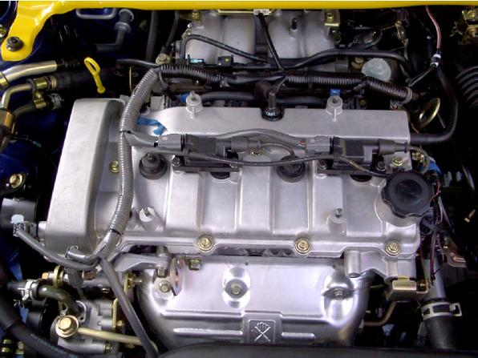
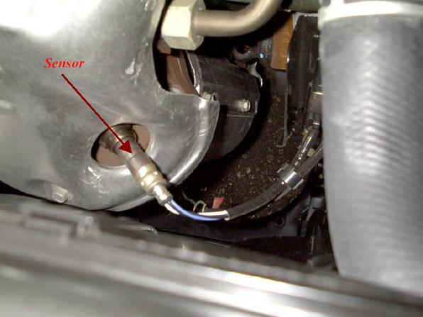
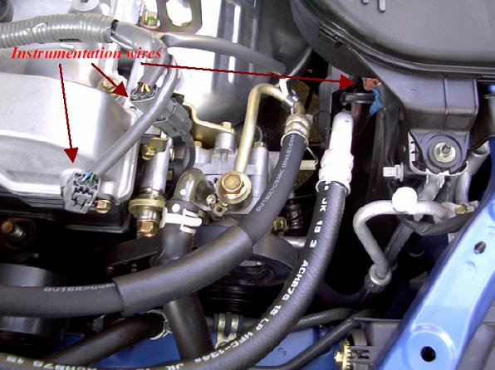
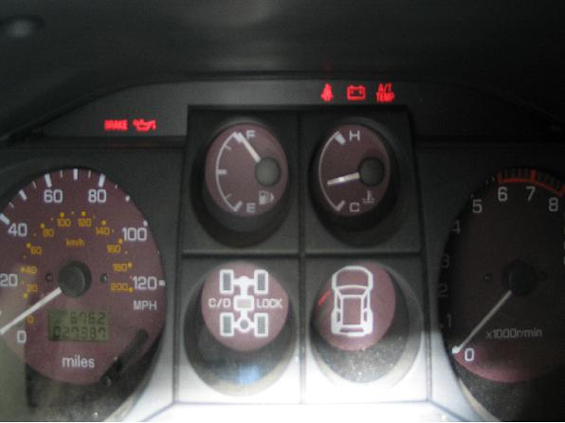
An Analogy First

Slide 5
What is JMX?
Defines the Architecture, Design Patterns, APIs and the Services for exposing and managing applications and network devices.
Provides a means to:
  Instrument Java code.
  Implement distributed management middleware and managers.
  Smoothly integrate these solutions into existing management systems.
From Opaque Applications to Transparent Processes

Slide 6
JMX Benefits
Low Cost
Scalable Management Architecture – Modularization of agent services
Easy Integration – JMX smart agents manageable through various protocols
Dynamic Management
Integrates Existing Management Solutions
Leverages Existing Standard Java Technologies
Applicable to a Wide Range of Applications
Possible Automatic Instrumentation

Slide 7
Typical JMX Usage
Reading and Changing Application Configurations
Infrastructure and Business Level Operational Statistics
  Availability
  Early Detection of Capacity Problems
  Application Performance, Business Process Productivity
  Resources usage
  Problems
Signaling events
  Faults
  State changes
  Improving Services via Proactive Alerting

Slide 8
Management Before JMX
Firewall
Primary Servers
Web Server
Application
Server
Database
Failover
Hardware
Web Server
Management
Console
App Server
Management
Console
Database
Management
Console
Failover
Management
Console
Web Server
Management
Console
App Server
Management
Console
Database
Management
Console
Firewall
Management
Console
Secondary Servers
Web Server
Application
Server
Database

Slide 9
Management With JMX
Firewall
Primary Servers
Web Server
Application
Server
Database
Failover
Hardware
MBean Server
Management
Application
Console
Connector/
Adaptor
Instrumentation Layer
Secondary Servers
Web Server
Application
Server
Database

Slide 10
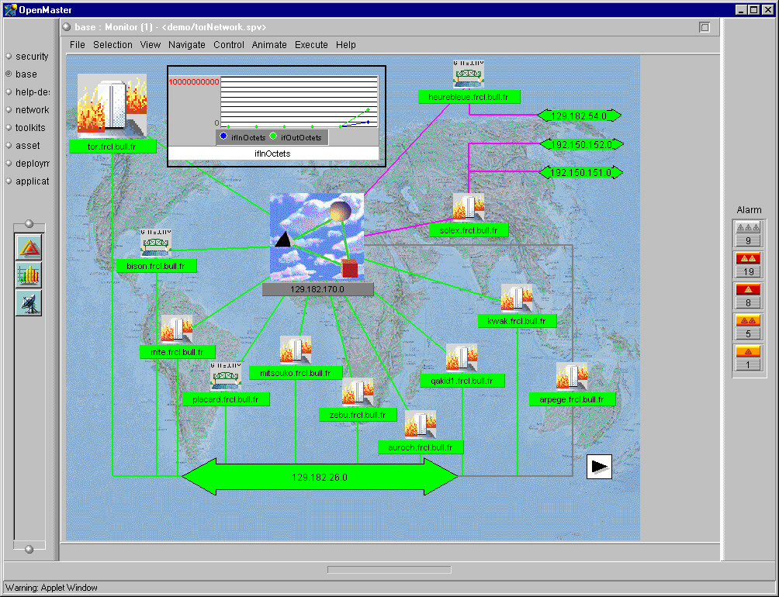
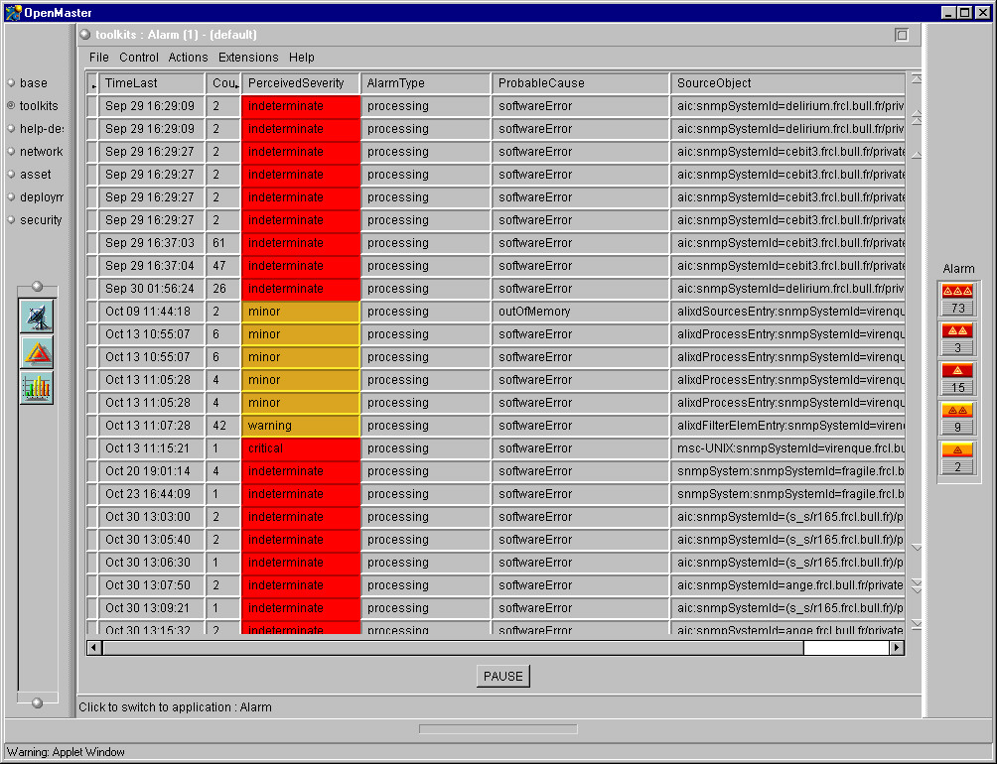
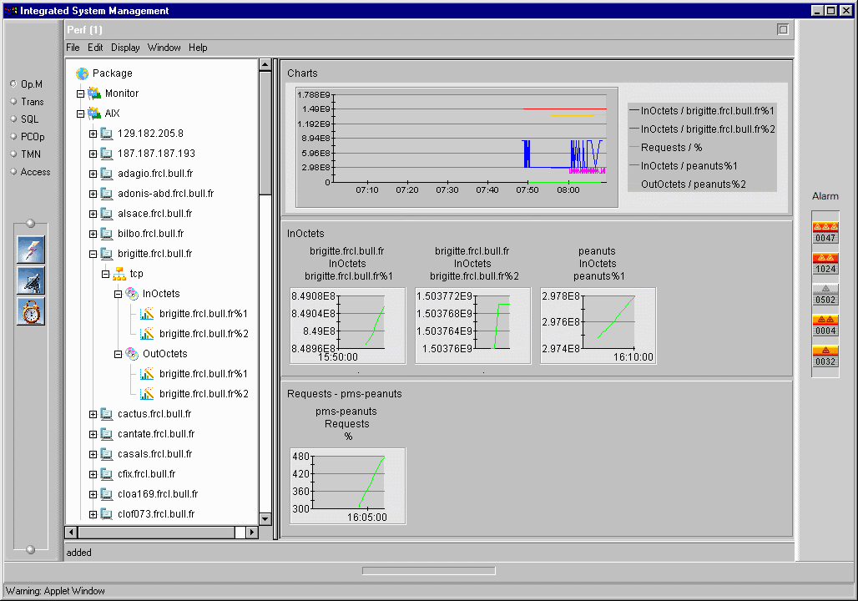
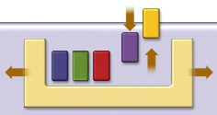






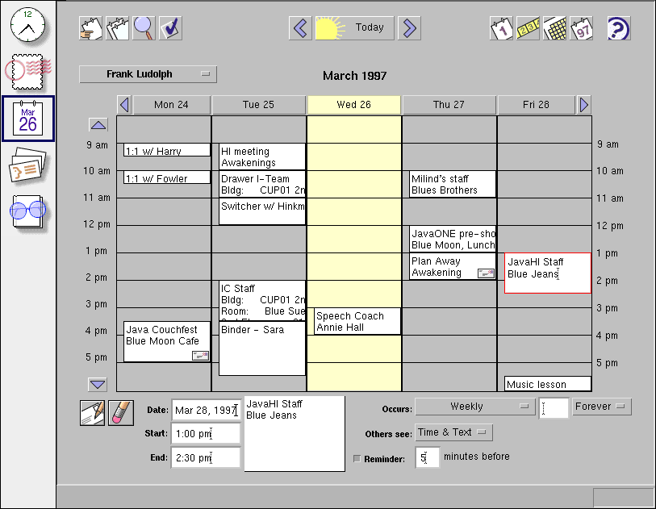
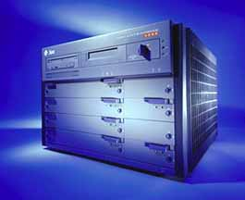
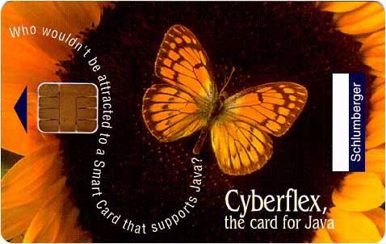

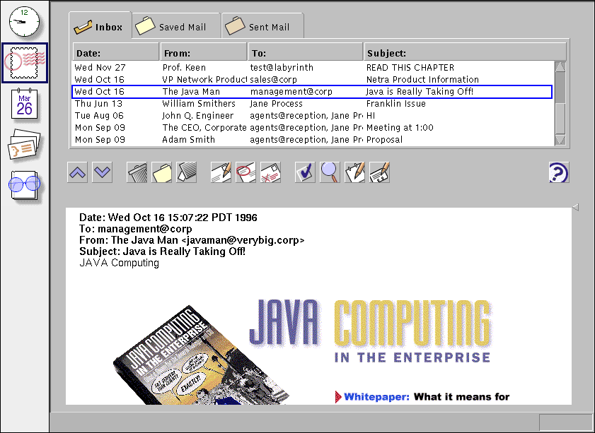
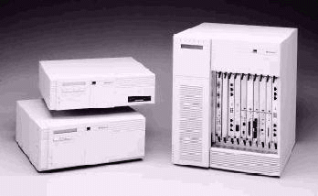
JMX Architecture
Management
Applications
Protocol and InfoModel independent
JMX Distributed
Services
JMX Agent
Services
JMX
Instrumentation
Instrumentation
MBeans
Managed
Resources
Source: JavaSoft

Slide 11
What Is an MBean?
A Java object that implements a specific interface and conforms to certain design patterns.
The management interface specifies:
  Attributes (fields) which may be accessed
  Operations (methods) which may be invoked
  Notifications (events) which may be emitted
  Constructors of the MBean‘s Java class

Slide 12
MBean Types
Four Types of MBeans:
  Standard MBean - Simple, Static
  Dynamic MBean - Flexible, Dynamic
  Open MBean - Basic Data Types Only
  Model MBean - Run Time Support
Differ in Implementations, Not the Way They Are Managed

Slide 13
Standard MBean
For static management information.
Follows naming conventions.
The MBean server constructs the MBeanInfo for standard MBeans via reflection.
Constructors – Any public constructors
Attributes – getters/setters
Operations – Any remaining public methods
Notification

Slide 14
Standard MBean Example – The Management Interface
public interface PrinterMBean {
public int getPrintJobCount();
public String getPrinterName();
public int getPrintQuality();
public void setPrintQuality(int q);
public void cancelPrintJobs();
public void performSelfCheck();
}

Slide 15
Standard MBean Example – The MBean Implementation
public class Printer extends NotificationBroadcasterSupport implements PrinterMBean {
private int printJobCount;
private String printerName;
private int printQuality;
…
public void performSelfCheck(){
…
if ( error ) {
sendNotification(notification);
}
}

Slide 16
Dynamic MBean
Supports management information that is known only at runtime
Implements DynamicMBean interface
Responsible for building its own MBeanInfo structure
Generic methods expose:
  Attributes
  Operations
For changing resources

Slide 17
Dynamic MBean:
Generic Method Access
Agent Layer
Distribution
Layer
Instrumentation Layer
Dynamic
MBean
getAttribute
Protocol
Adaptor
setAttribute
Management
Application
getAttributes
setAttributes
invoke(…)
getMBeanInfo()
Managed
Resource
Version 1
Managed
Resource
Version 2

Slide 18
Open MBean
Why are Open MBeans “Open”?
  Dynamic MBeans that use a subset of universal Java types
  Descriptively rich metadata
  “Open” to widest range of management applications
Does Not Require Serialization – supports management applications not written in Java
No Custom Classloading
Required in 1.2

Slide 19
Model MBean
Generic, Configurable Dynamic MBean
Common Template for Different MBeans
Configured at Runtime: Descriptors
Default Implementation – RequiredModelMBean
Rapid Instrumentation – No need to write an MBean
Model MBean Features
  Persistence – survive JMX agent crash
  Notification Logging
  Attribute Value Caching – better performance
  Operation Delegation – multiple manageable resources

Slide 20
Model MBean Example
ObjectName oName = new ObjectName(…);
createMBean(“javax.management.modelmbean.RequiredModelMBean”, oName );
Object managedResource = …;
setManagedResource(…);
ModelMBeanInfo info = buildModelMBeanInfo( mbeanDesc );
setModelMBeanInfo(…);
1
2
3

Slide 21
JMX Notification
Notification – Java objects emitted by MBeans and the MBean server to encapsulate events, alerts, or general information.
Based on the Java event model
Specifies notification objects, the broadcaster, the listener and filter interfaces that notification senders and receivers must implement.
Management applications listen to the MBean and MBean server notifications remotely.

Slide 22
Object Name
Uniquely identifies MBean
Two parts
  domain name
  key/value property list (unordered)
[domainName]:name=value[,name=value]*
ObjectName class

Slide 23
JMX Agent Layer
JMX Agent – A Java process that provides a set of services for managing a set of MBeans. The container for an MBean server.
JMX Agent Level
  MBean Server(s)
  Agent Services
Four Mandatory Standard Services (MBeans)
  M-Let Service
  Timer Service
  Monitoring Service
  Relation Service

Slide 24
MBean Server
A registry for MBeans – MBeans have to be registered.
Exposes management interfaces:
  Creates MBeans
  Registers MBean
  Handles notifications – add/remove listeners.
  Handles access to MBeans – get/set attributes, invoke operations.
  Handles MBean queries – based on object names and attributes.
MBeanServer mbeanServer = MBeanServerFactory.createMBeanServer(“HelloAgent“);

Slide 25
Standard Agent Services:
M-Let Service
Expand JMX agent CODEBASE.
Dynamically load new components to the MBean server.
Allows network-enabled application to load its MBean components from remote hosts.
Enables hot deployment.
<MLET
CODE = “com.foo.HelloWorld”
ARCHIVE = “helloWorld.jar"
CODEBASE = “http://www.foo.com/jars”
NAME = “helloWorld:name=hello,url=www.foo.com”>
</MLET>

Slide 26
Standard Agent Services:
Timer Service
Schedule notifications for tasks that need to be run once or at regular intervals.
  Specific Times
  Intervals
More elegant solution than background threads in a J2EE environment.

Slide 27
Standard Agent Services:
Monitoring Service
Common Monitor Management Interface Attributes
  ObservedObject
  ObservedAttribute
  GranularityPeriod
  Active
MonitorNotification
Three monitor implementations
  Counter monitor: threshold
  Gauge monitor: high/low threshold
  String monitor: matches /differs

Slide 28
Standard Agent Services:
Relation Service
Define relations between MBean components and react to changes in case of MBean dependencies.
Consistency
Cardinality
Conceptually relate MBeans
Allows to manage MBeans as related groups
Typically grouped based on managed resources or workflows they participate in.

Slide 29
Distributed Services Level
Connectors
  Contains connector client and connector server
  Hide the actual protocol being used to contact the agent.
  Can use any convenient transport – RMI, RMI/IIOP, HTTP, SOAP, JMS, JINI, “Raw” TCP/UDP, …
Protocol Adaptors
  Listen for incoming messages that are constructed in a particular protocol like HTTP, SNMP
JMX Remoting API (JSR-160) – The Standardization

Slide 30
JMX Remote API (JSR 160)
Allows Any Java Client To:
  Discover JMX Connectors
  Connect to Any Running JMX Server
  Access to a Running JMX Server via a Protocol-Independent Client API
JMX Remoting API Goals
  Interoperable – Completely defines standard protocols
  Transparent – Remote access like local
  Secure – Built on JSSE, JAAS, SASL
  Flexible – New transport protocols can be added easily

Slide 31
JMX Remoting Connectors
RMI Connector – Required
JMXMP Connector – Based on Java serialization over TCP
Generic Connector – Configurable by plugging in modules to define Transport Protocol and Object Wrapping
Connector Server Address
  service:jmx:rmi://host/…
  service:jmx:jmxmp://host:port

Slide 32
JMX Remoting Example:
Remote Access Like Local
Local Access:
MBeanServer mbs = MBeanServerFactory.createMBeanServer();
mbs.createMBean( className, obName );
Object a = mbs.getAttribute( obName, “attr” );
Set names = mbs.queryNames(…);
Remote Access:
JMXConnector c = JMCConnectorFactory.connect(url);
MBeanServerConnection mbs = c.getMBeanServerConnection();
mbs.createMBean( className, obName );
Object a = mbs.getAttribute( obName, “attr” );
Set names = mbs.queryNames(…);
c.close();

Slide 33
JMX Security
JMX Security Risks:
  MBeanServer API Access
  MBean API Access
  Trusted MBean Sources
JMX Security introduced in JMX 1.2
Based on Standard Java Security Model by defining Permissions (javax.security.Permission)
  MBeanServerPermission
  MBeanPermission
  MBeanTrustPermission
Why not J2EE Role-base Security Model?

Slide 34
MBean Permission Example
grant applone.jar { permission javax.management.MBeanServerPermission
“createMBeanServer, releaseMBeanServer”; };
grant applone.jar {
permission javax.management.MBeanPermission “com.Foo#doIt[d1]”, “invoke”; };
grant signedBy “MyOrg” { permission javax.management.MBeanTrustPermission “register”;};

Slide 35
JMX and J2SE
JMX is going into J2SE 1.5
JSR 174 – Monitoring and Management Specification for Java
Health Indicators:
Class load/unload
Memory allocation statistics
Garbage collection statistics
Monitor info & statistics
Thread info & statistics
Object info
…
Runtime Control:
Heap size
Verbose GC on demand
Garbage collection control
Thread creation control
Just-in-time compilation control
…

Slide 36
JMX and J2EE:
J2EE Management (JSR 77)
JMX is Going into J2EE 1.4
Further J2EE Standardization: Vendor Independent Management of J2EE Servers
Defines a Model of J2EE Managed Objects
No Java Classes
Managed EJB (MEJB)
Management Capability:
  Event Handling – state/attribute change, creation/destruction
  State Management – manage an object’s state
  Performance Monitoring – statistics data

Slide 37
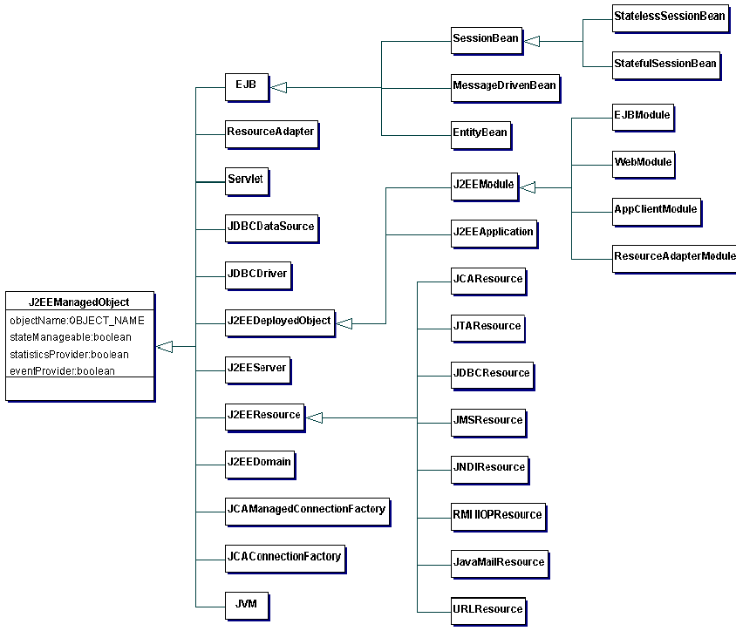
J2EE Managed Objects

Slide 38
Managed EJB (MEJB)
Context ctx = new InitialContext();
ManagementHome home = (ManagementHome)PortableRemoteObject.narrow(
ctx.lookup(“ejb/mgmt/MEJB”), ManagementHome.class);
Management mejb = home.create();
String domain = mejb.getDefaultDomain();
Set names = mejb.queryNames(
new ObjectName(domain+”:j2eeType=EJBModule,*”),null);
Iterator itr = names.iterator();
while( itr.hasNext() ) {
ObjectName name = (ObjectName)itr.next();
ObjectNames[] ejbs = (ObjectName[])mejb.getAttribute(name, “ejbs”);
}
1
All EJB Modules
2
All EJBs in a Module
3

Slide 39
JMX In Use Today
All Major Application Servers
  BEA WebLogic
  IBM WebSphere
  JBoss
Management Applications
  Tivoli Web Component Manager
  AdventNet Middleware Manager
  Dirig Softare
Performance Management Tools
  Existing instrumentation
  Custom instrumentation

Slide 40
JMX Use Case: WebLogic
Administration and Configuration MBeans
Runtime MBeans – information about open servlet sessions, active JDBC connections, JTS transactions, pooled EJBs, JMS messages
Anything deployed into WebLogic is automatically manageable
EJBComponentRuntime
1 … n
EJBHomeRuntime
1 … n
EJBRuntime
EJBTransactionRuntime
1 … 1

Slide 41
Real-World JMX Usage
Log4j Runtime Control
JDBC Connection Pool Management
HTTP Session Management
Generic Cache Control
  Cache Size
  Cache Policy
  Cache Hit Rate
  Cache Refresh

Slide 42
Real-World JMX Usage (cont.)
Socket Adaptor for Integration
Monitoring Tool to Collect Data
Key Application Transaction Monitoring
Pluggable Security Providers
Timer
Queue Management
  Custom Queue
  JMS Queue
…

Slide 43
Summary
JMX technology is a standard, mature and complete open solution to manage and monitor both Java applications and underlying infrastructure.
Developers should have application management and monitoring in mind during design phase, not as an after-thought.
Developer’s main task will be writing interfaces and reporting tools that make use of the instrumentation already provided by Application Servers.

Slide 44
A Simple Demo: Log4j Control
LoggerController
MBean
Web
Browser
HTTP Adaptor
MBean
Server
JRMP Adaptor
MC4J
Console
Log4j Logger

Slide 45
A Simple Demo: Log4j Control (cont.)
public interface LoggerControllerMBean {
public String getLevel(String loggerName);
public void setLevel(String loggerName,String level);
}
public class LoggerController implements LoggerControllerMBean{
public String getLevel(String loggerName) {
Logger logger = Logger.getLogger(loggerName);
return logger.getLevel().toString();
}
public void setLevel(String loggerName, String level) {
Level level = Level.toLevel(level); Logger.getLogger(loggerName).setLevel(level);
}
}

Slide 46
References
JMX in Action
Benjamin G. Sullins, Mark Whipple
Publisher: Manning Publications Company
JMX: Managing J2EE with Java Management Extensions
Marc Fleury, Juha Lindfors
Publisher: Sams
Java and JMX: Building Manageable Systems
Heather Kreger, Ward K. Harold, Leigh Williamson, Ward Harold
Publisher: Pearson Education
Sun JMX Page: http://java.sun.com/products/JavaManagement
AdventNet: www.adventnet.com
MC4J: http://mc4j.sourceforge.net
MX4J: http://mx4j.sourceforge.net

