Slide 1
Effective Testing
Brian M. Coyner
Senior Software Engineer
Object Computing, Inc.
Co-Author of O’Reilly’s Java Extreme Programming Cookbook

Slide 2
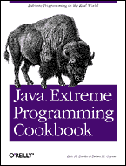
References
Java Extreme Programming Cookbook
        Eric M. Burke and Brian M. Coyner
        O’Reilly
        http://www.oreilly.com/catalog/jextprockbk/
        Available March 2003
Information contained in this presentation is courtesy of O’Reilly’s Java Extreme Programming Cookbook book.

Slide 3
Introduction
Introduction To Testing
Continuous Integration
Getting Started With JUnit
Mock Objects
Testing Swing Code
Testing Server Side Code
Wrap Up

Slide 4
Who, What, When, How??
Who should test?
  Everyone
What is a test?
  Pass or Fail
  Automated
What should you test?
  Everything possible
When do you test?
  New code/ Refactored code
How do you test?
  Practice (lots of it)
  More to come…
No human interpretation
Testing is an art

Slide 5
Why Tests Are Important
Confidence your code works
Confidence when refactoring
Confidence other programmers will not break anything
Some programmers feel it’s not important to test the “simple” stuff. THIS IS WRONG!
It’s the “simple” stuff that usually breaks. Therefore writing tests provides confidence that new features do not break existing code.

Slide 6
Continuous Integration
Fully automated build and test process
  http://martinfowler.com/articles/continuousIntegration.html
Making it work
  Source control repository
    All developers must have read privileges
    Example: CVS, StarTeam
  Automated build process
    Execute with one command
    Ant is the tool of choice for Java projects
  Automated test process
    Execute entire test suite with one command
    Ant’s junit task

Slide 7
JUnit
Java testing framework
  Written by Erich Gamma and Kent Beck
  Pass or Fail tests
Open source
http://junit.org
  hosted on SourceForge
Tons of extensions
Integrates with Ant!!
  junit task
Released under the IBM's Common Public License Version 1.0
Optional task included in Ant’s (1.5.1) optional.jar file

Slide 8
Writing A JUnit Test
public class TestCustomer extends junit.framework.TestCase {
// define instance variables
public void setUp() {
// initialize test
}
public void tearDown() {
// clean up test
}
public void testXXX() {
// assertions
}
public void testYYY() {
// assertions
}
}
* Test methods should execute as quickly as possible *
Why?
As more tests are added to the test suite the longer it
takes for ALL tests to run.
Consequences?
Developers may grow tired of waiting and quit running
the tests.

Slide 9
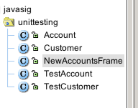
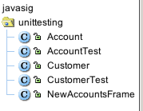




What’s In A Name?
Class names are personal preference
Just be consistent
  Consistency facilitates automation

Slide 10
JUnit and Ant
The junit task is contained in Ant’s optional JAR library (already on Ant’s classpath).
<junit printsummary="on" fork="false" haltonfailure="false">
<classpath refid="classpath.project"/>
<formatter type="xml"/>
<batchtest fork="false" todir="${dir.build}">
<fileset dir="${dir.src}">
<include name="**/Test*.java"/>
</fileset>
</batchtest>
</junit>
Other types: brief and plain
Consistent naming conventions serve two purposes:
1.) They make your code more maintainable
2.) Consistency facilitates automation

Slide 11
JUnit Pretty Printing junitreport
<junitreport todir="${dir.build}">
<fileset dir="${dir.build}">
<include name="TEST-*.xml"/>
</fileset>
<report format="frames" todir="${dir.build}"/>
</junitreport>
<exec executable="open" os="Mac OS X">
<arg value="${dir.build}/index.html"/>
</exec>

Slide 12
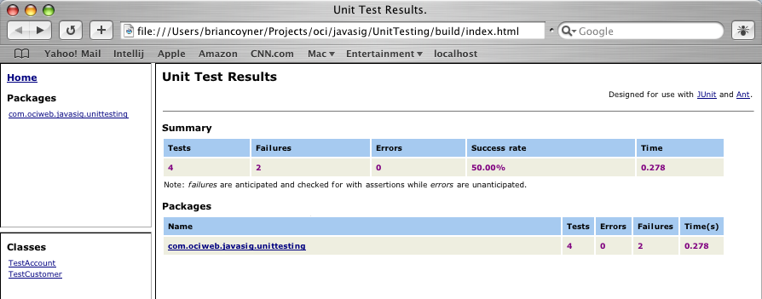
JUnit Pretty Printing junitreport output
ALWAYS NEEDS TO BE 100%

Slide 13
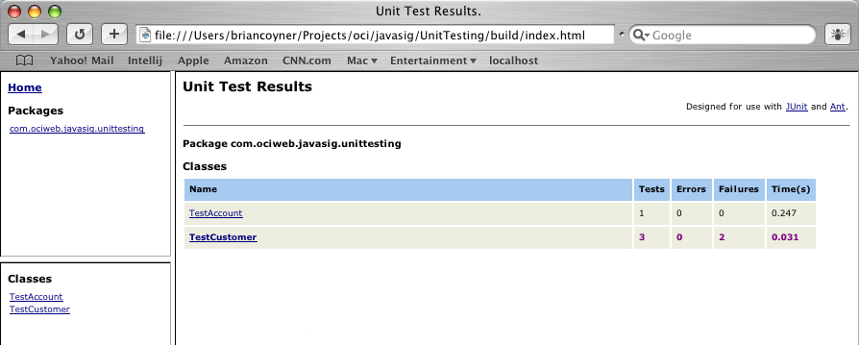
JUnit Pretty Printing junitreport output

Slide 14
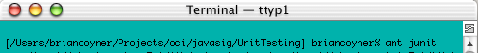
Ant Diagram
One command
prepare
compile
jar
junit
If executing server side tests you’ll need to deploy first
junit
Depends On
junitreport
References
exec
User-defined Target
Task Definition

Slide 15
Mock Objects
Fake implementation of a class or interface
Utilized in “advanced” unit testing
  Should only provide functionality needed for testing
  May provide self-validation
You can refactor Mock Objects as more functionality is needed.
Fail fast if unexpected or invalid state is detected.
Collect results during execution and validate against expected results.

Slide 16
Mock Objects
Two Schools Of Thought
  Any dummy object that stands in for a real object
  Has the ability to set expectations and provide self-validation
    http://www.mockobjects.com
These guys are trying to create a central point of reference for all Mock Objects.

Slide 17
Why Use Mock Objects?
Test difficult aspects of system
  Provide “fake” server layer
Factory is configured to return a Mock Implementation.
Example:
-Ddao.factory=mock
Mock
Data Access Layer (DAO)
Oracle
Business Object
Test
MySQL
Ask DAO Factory for mock object
Set expectations on mock object
- Invalid data throws exception
- Data not found throws exception
Invoke DAO method
Assert expectations
Files

Slide 18
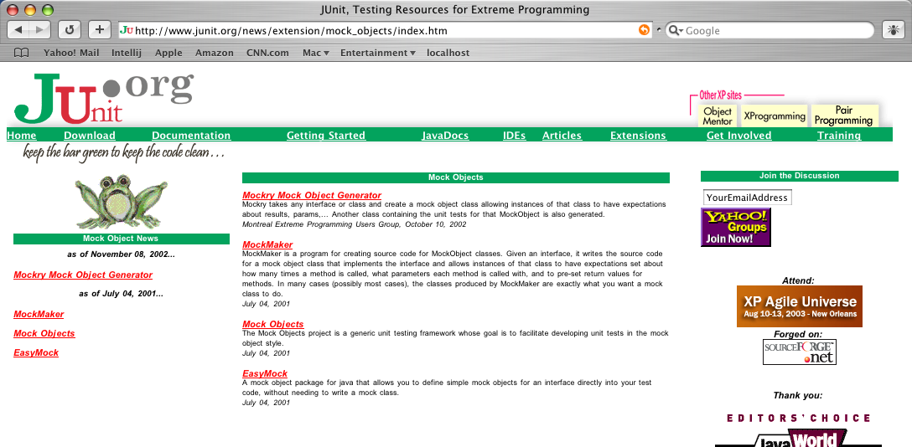
Mock Object Frameworks

Slide 19
Testing Swing Code
Swing relies on models and views
Communicates using events
Use Mock Objects to simulate event listeners
Example:
  TableModels communicate using TableModelListeners
Example:
We want to test that models fire the correct events.
The next few slides show this…

Slide 20
Testing Swing Code
Example Diagram
TableModelListener
valueChanged(TableModelEvent)
implements
TableModelEvent
Fires Event
JTable
TableModel
public void valueChanged(TableModelEvent) {
// updates the view
}
Add Row
Delete Row
Swap Rows

Slide 21
Testing Swing Code
Example Diagram
TableModelListener
valueChanged(TableModelEvent)
implements
TableModelEvent
Fires Event
MockTableModelListener
TableModel
public void valueChanged(TableModelEvent) {
// see next slide
}
Add Row
Delete Row
Swap Rows

Slide 22
Testing Swing Code
MockTableModelListener
Mock objects typically perform assertions
import junit.framework.Assert;
import javax.swing.event.TableModelEvent;
import javax.swing.event.TableModelListener;
import javax.swing.table.TableModel;
import java.util.ArrayList;
import java.util.List;
public class MockTableModelListener implements TableModelListener {
private static final int NONE_EXPECTED = -1;
private List events = new ArrayList();
private List expectedEvents = null;
private int expectedEventCount = NONE_EXPECTED;
public void tableChanged(TableModelEvent e) {
this.events.add(e);
if (this.expectedEventCount > NONE_EXPECTED
&& this.events.size() > this.expectedEventCount) {
Assert.fail("Exceeded the expected event count: "
+ this.expectedEventCount);
}
}
Fail Fast!

Slide 23
Testing Swing Code
MockTableModelListener
public void addExpectedEvent(TableModelEvent e) {
if (this.expectedEvents == null) {
this.expectedEvents = new ArrayList();
}
this.expectedEvents.add(new ComparableTableModelEvent(e));
}
public void setExpectedEventCount(int n) {
this.expectedEventCount = n;
}
public void verify() {
if (this.expectedEventCount > NONE_EXPECTED) {
Assert.assertEquals("Expected event count",
this.expectedEventCount,
this.events.size());
}
if (this.expectedEvents != null) {
Assert.assertEquals("Expected events",
this.expectedEvents,
this.events);
}
}

Slide 24
Testing Swing Code
MockTableModelListener
public int getEventCount() {
return this.events.size();
}
public List getEvents() {
return this.events;
}
class ComparableTableModelEvent extends TableModelEvent {
public ComparableTableModelEvent(TableModelEvent orig) {
super((TableModel) orig.getSource(), orig.getFirstRow(),
orig.getLastRow(), orig.getColumn(), orig.getType());
}
public boolean equals(Object obj) {
TableModelEvent tm = (TableModelEvent) obj;
return getSource() == tm.getSource()
&& getFirstRow() == tm.getFirstRow()
&& getLastRow() == tm.getLastRow()
&& getColumn() == tm.getColumn()
&& getType() == tm.getType();
}
}
}

Slide 25
Testing Swing Code
Using The MockTableModelListener
public void testAddAccountFiresCorrectEvent() {
MockTableModelListener mockListener = new MockTableModelListener();
mockListener.setExpectedEventCount(1);
TableModelEvent evt = new TableModelEvent(
this.acctTableModel,
this.accounts.length,
this.accounts.length,
TableModelEvent.ALL_COLUMNS,
TableModelEvent.INSERT);
mockListener.addExpectedEvent(evt);
this.acctTableModel.addTableModelListener(mockListener);
this.acctTableModel.addAccount(
new Account(Account.CHECKING, "12345", 100.50));
mockListener.verify();
}
Don’t forget to add the listener to the model.

Slide 26
Breaking Out Logic
Refactoring
If your GUI code contains business logic
  Create testable helper classes
new JButton(new AbstractAction("Calculate") {
public void actionPerformed(ActionEvent event) {
// perform calculation
int value = Integer.parseInt(valueField.getText());
double newValue = value * 100.0D;
calculatedValue.setText(String.valueOf(newValue));
}
});
We want to test our calculation, but it’s very hard because the UI components get in the way.
Now test this class independently of Swing.
public class CalculationHelper {
public static double calculateSomething(int value) {
return value * 100.0D;
}
}

Slide 27
Swing Testing Pyramid
Simulation
Component
Integration
- java.awt.Robot
- Abbot
JUnit
JUnit
- Lots of Mock Event Listeners
More mock objects
Test state
Test colors
etc
Events
Components

Slide 28
Swing Possibilities
Easy
  Document Objects
  Graphics
    Shapes and Bounds (Rectangles)
  Swing Models
  Swing Actions
Difficult (but possible)
  Focus
  User interactions

Slide 29
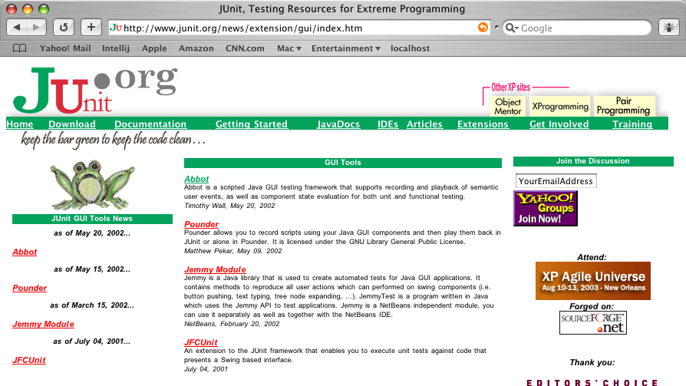
GUI Testing Frameworks

Slide 30
Testing Server Code
Before resorting to server side testing
  Try to design/ refactor your code into standalone classes (testable with JUnit)
    Remove dependency for
      javax.ejb.*
      javax.servlet.*
  Ask yourself
    “Do I need a full-blown container?”
    “Could I use mock objects?”

Slide 31
Testing Server Code
Avoid EJB Testing
public class AccountBean implements SessionBean {
// a bunch of EJB methods
public void ejbCreate() { ... }
public void ejbActivate() { ... }
public void ejbPassivate() { ... }
public double getBalanceAsOf(Date date) {
// fetch data
...
// apply interest
...
// deduct bank fees
...
}
}
Way too hard to test this stuff. Break it out!!

Slide 32
Testing Server Code
Avoid EJB Testing (better solution)
public class AccountBean implements SessionBean {
// a bunch of EJB methods
public void ejbCreate() { ... }
public void ejbActivate() { ... }
public void ejbPassivate() { ... }
etc...
public double getBalanceAsOf(Date date) {
// delegate to a business object
return AccountBO.getBalanceAsOf(date);
}
}
Now we can test the AccountBO class outside of a container (just use JUnit)

Slide 33
Cactus
Used for server side testing
http://jakarta.apache.org/cactus
Provides in-container testing
Direct access to invoking methods on servlets, JSPs, filters, EJBs
Executes on both the client and server
Really hard to configure
In my opinion! Of course, the book shows recipes on how to setup Cactus with Ant. ;-)

Slide 34
Cactus
A Simple Test
import org.apache.cactus.ServletTestCase;
import org.apache.cactus.WebRequest;
public class TestLoginServlet extends ServletTestCase {
private LoginServlet servlet;
public void setUp() {
this.servlet = new LoginServlet();
}
// executes on the client
public void beginValidFormParameters(WebRequest webRequest) {
webRequest.addParameter("username", "coyner_b",
WebRequest.POST_METHOD);
webRequest.addParameter("password", "secret",
WebRequest.POST_METHOD);
}
// executes on the server
public void testValidFormParameters() {
assertTrue("Valid Parameters.",
this.servlet.validateParameters(this.request));
}
}

Slide 35
HttpUnit
Used to interact with HTTP servers
Not a testing tool
  Uses JUnit, though
Provides API for:
  Parsing HTML
  Submitting Form Data
  Following hyperlinks

Slide 36
HttpUnit
A Simple Test
import com.meterware.httpunit.*;
import junit.framework.TestCase;
public class TestNewsletter extends TestCase {
public void testIndexPageExists() throws Exception {
// throws HttpNotFoundException if the URL is invalid
new WebConversation().
getResponse("http://localhost:8080/news");
}
}
A WebConversation is HttpUnit’s browser
getResponse() opens a connection to the web server and requests the URL

Slide 37
Testing A Data Layer
Dummy Data Access Objects
Mock the SQL (JDBC stuff)
Have a static DB
  Hard to keep a good state
  Here’s a cool idea:
The folks at www.mockobjects.com provide a set of JDBC mock objects.
If using MS Access you can create a populated DB (*.mdb file) for your tests. After each test just replace the file with the master file and you have a clean DB.

Slide 38
Summary
Have a test-first mindset
Create a stable build environment using Ant
Break up code into testable classes
  Break up Swing code
  Break up server code
Be patient, testing is an art

Slide 39
References
Java Extreme Programming Cookbook
        Eric M. Burke and Brian M. Coyner
        O’Reilly
        http://www.oreilly.com/catalog/jextprockbk/
        Available March 2003
Information contained in this presentation is courtesy of O’Reilly’s Java Extreme Programming Cookbook book.

