Slide 1
Powering EII with MOA
Brad Wright
Randall M. Hauch
January 8, 2004

Slide 2
Topics
What is an MOA and why is it important?
EII as a case study for MOA
MOA “in action”, a demonstration…
Attributes of an MOA
Miscellaneous Topics

Slide 3
MOA and EII Defined
Model-Oriented Architecture (MOA)
  An architecture which utilizes models and metadata describing solutions to control behavior and deliver a solution or result.
  “Data-driven” architectures where the “data” are formal metadata describing solutions in formal ways
  Architectures which maximize result while minimizing code
Enterprise Information Integration (EII)
  Middleware-based integration of diverse, disparate data in real-time and on-demand
  Data “federation”
  A collection of products & technologies which mediate access to data on behalf of applications.

Slide 4
Why are MOA and EII important?
MOA represents a new trend in application architecture
  Maximize adaptability, flexibility
  Minimize development time
  Reduce maintenance costs
  Don’t confuse with SOA!
    SOA are an approach for how to componentize a solution and how the component find and interact with one another
    MOA are an approach for how individual application components control and define behavior
EII represents a new trend in data access
  Decouple solutions from data
  Minimize development time
  Reduce maintenance costs

Slide 5
Powering EII with MOA
MetaMatrix has developed an EII
product that is an MOA

Slide 6
About MetaMatrix
Leading provider of Enterprise Information Integration (EII) products
  MetaBase: modeling and metadata management
  MetaMatrix Server: enterprise-grade integration engine
Founded in 1998
Headquartered in NYC
Development in St. Louis
Currently about 65 employees worldwide
Privately held, backed by leading venture firms
  Kleiner, Perkins, Caufield and Byers
  Invus, Schroder’s Finance Partners, Gateway Ventures
www.metamatrix.com

Slide 7


About MetaMatrix
Customers
  Financial: Merrill Lynch, CSFB, and others
  Government: various departments in US, UK, and Canada
  OEM: SAP
News
Intelligent Enterprise selects MetaMatrix as 2004 company to watch - Dec 2003
MetaMatrix recognized as one of SDTimes' Top 100 Innovators and Leaders - June 2003
MetaMatrix Named One of Top 100 Private Companies by AlwaysOn - July 2003
New Enterprise Information Integration Sector to Fuel
$7.5 Billion Market by 2003
- May 2002

Slide 8
About MetaMatrix Products
Currently working on 8th release
  4.0 General Availability (GA) in about 3 weeks
All products are written in Java
  Except our ODBC driver!
Process:
  Mixture of XP, RUP and others to suit our needs
  Iterative development and release
  Currently on 6 month release cycles
  Automated (constant) builds and unit/regression tests w/ reports
  Organized around 4 product teams, testing team

Slide 9
About MetaMatrix Products
Our products run in or on:
  App Servers: WebLogic, WebSphere, JBoss, SAP
  RDBMs (our data): Oracle, DB2, SQL Server, Sybase
  Platforms: Win2K, XP, Solaris, Linux
  JREs: 1.3.1, 1.4.2
Statistics (excluding test cases):
  1,109,790 lines of code
  606,880 non-comment LOC
  7,221 Classes
  51,413 Methods
  8,113 Unit tests (28.3% total coverage)
  31 external libraries (all of Eclipse is counted as 1)

Slide 10
Applications and Data
As Java developers, we have many different frameworks for working with application data
  JDBC, JCA, DOM, JAXP/JAXR/JAXM, EJB, etc.
  Each framework helps isolate developers and applications from some of the low-level intricacies of various technologies
These frameworks do not help with the bigger data problem: integrating the data
What can help us when our application needs data
  From multiple sources?
  Is logically similar but not technically equivalent?
  Is not in the form our application needs?
  Is much more complex than our application needs?

Slide 11
The World of Enterprise Information
It’s Shared
  Developers may not be in control of structure or content
  Multiple applications may be using the same data
It’s Distributed
  Data is spread across multiple locations
It’s Disparate
  Similar or related data is managed in different places
  Each store may have its own protocols, semantics, behaviors
It’s Dynamic
  Content and structure undergo changes
It’s Valuable
  Often critically important to the enterprise

Slide 12
The World of Enterprise Information
Typical Global 1000 company (or gov’t agency)
  Hundreds (or more!) of relational databases
  Hundreds of tables in each database
  Dozens of relationships in each database
  Dozens of columns in each table
That’s many tens of thousands of columns!
Data is isolated into silos
Business processes require data from many isolated sources developed using varying technologies over decades

Slide 13
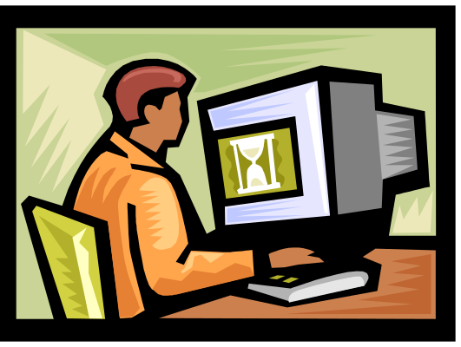
Challenges of
Enterprise Information Integration
How to integrate all this data in a usable manner?
How to easily describe the desired integration?
How to decouple applications from data sources and changes in those sources?
?

Slide 14

EII Needs MOA
EII needs a familiar metaphor: virtual database
EII needs to be model-driven
Given the large diversity in systems to be integrated, EII needs to be an MOA – an architecture whose behavior is defined by models not code.
applications
virtual database
sources

Slide 15
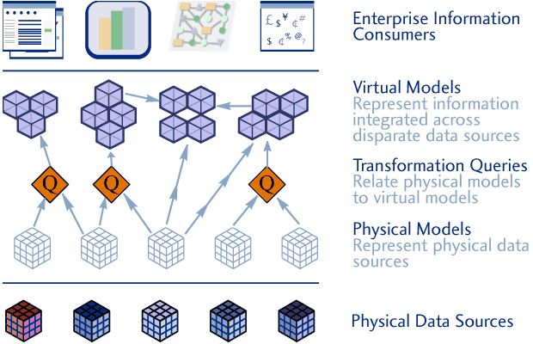
What is EII?
Custom
Applications
Web Services,
Business Processes
EAI, Data Warehouses
Reporting, Analytics
Packaged Applications
JDBC/ODBC/SOAP
Models
Virtual Database
CRM, ERP
Siebel, SAP …
DBMS
Oracle, DB2 …
Web Service
XML, SOAP …
Mainframe
Data Warehouse
Flat File
Notes:
The result, conceptually, is a virtual database that simplifies disparity and hides complexity.

Slide 16
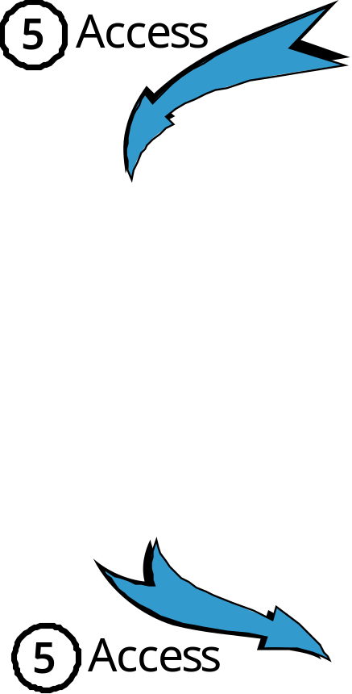
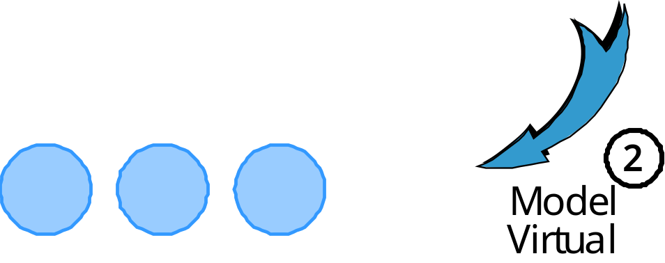
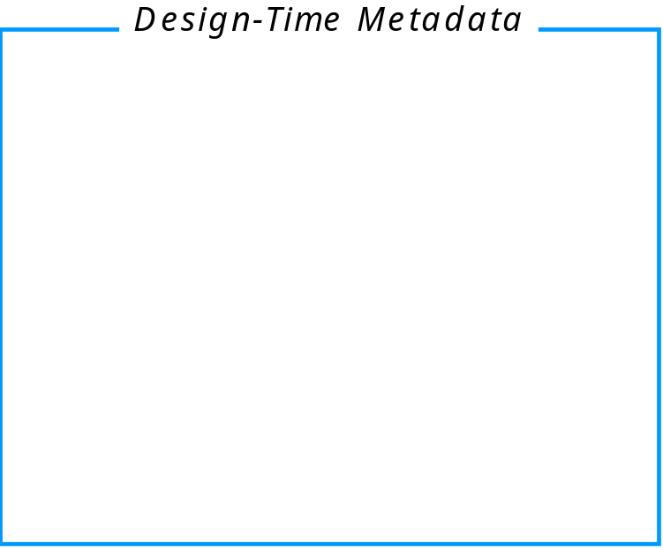
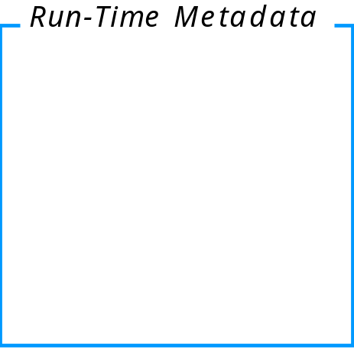
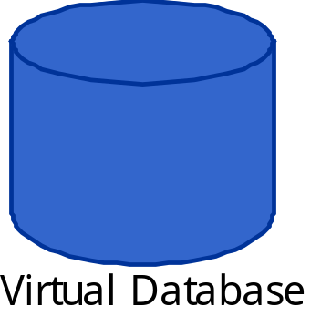
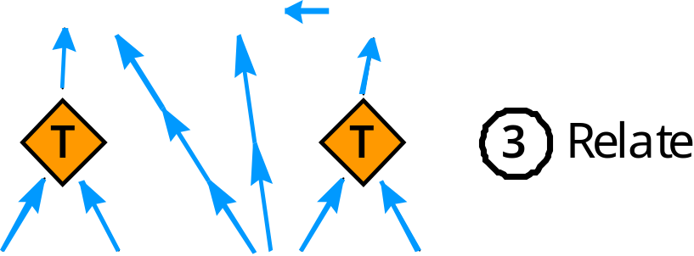
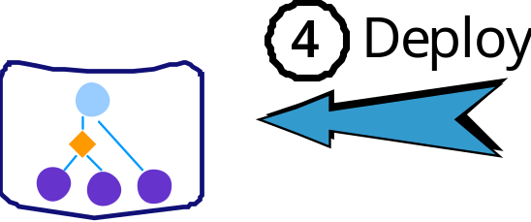
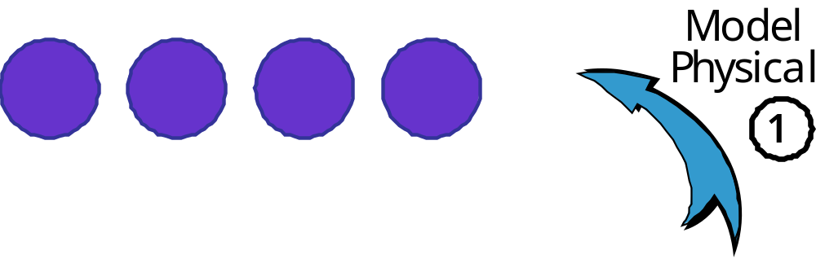
The “Process” of an EII MOA
Apps
Data Sources

Slide 17
Enterprise Information Integration
Applications make single/unified requests to the virtual database, which accesses and integrates the data
Virtual database appears as a normal database, but
  Data from multiple disparate source is accessed and integrated without client having to know those details
  Only necessary data is accessed and integrated
  Allows access to real data in real-time without copies
  Updates are allowed
applications
virtual database
sources

Slide 18
Enterprise Information Integration
Makes it easier for applications to get and use the information they need
  In the form and structure needed by the application
  Efficiently and in real-time on demand
The EII engine is designed to
  Return the correct data (!)
  Scale to large numbers of clients and sources
  Be fault tolerant of failures
  Abstract the applications from the details of the sources
  Process requests efficiently and very quickly
  Make use of many different types of sources (not just DBMSs)
  Support updates and use distributed transactions

Slide 19
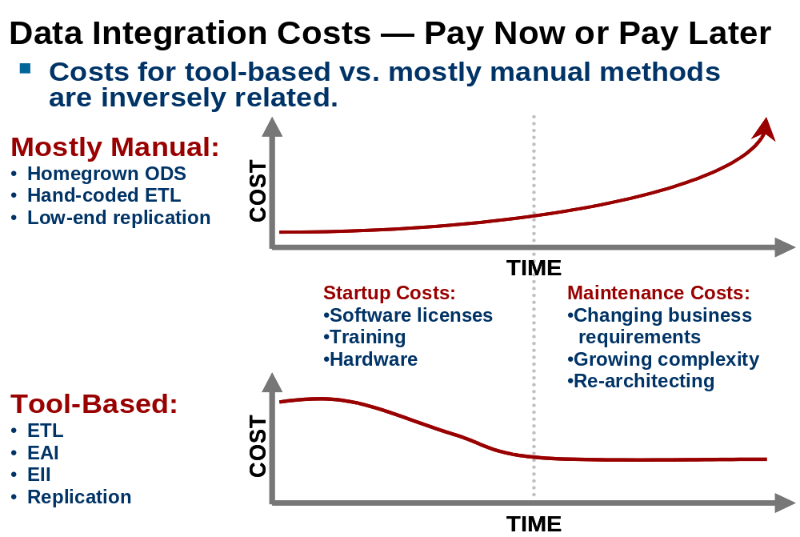
Build it yourself?
Some of our best customers tried to do it themselves!
GIGA Reseach’s Perspective:

Slide 20
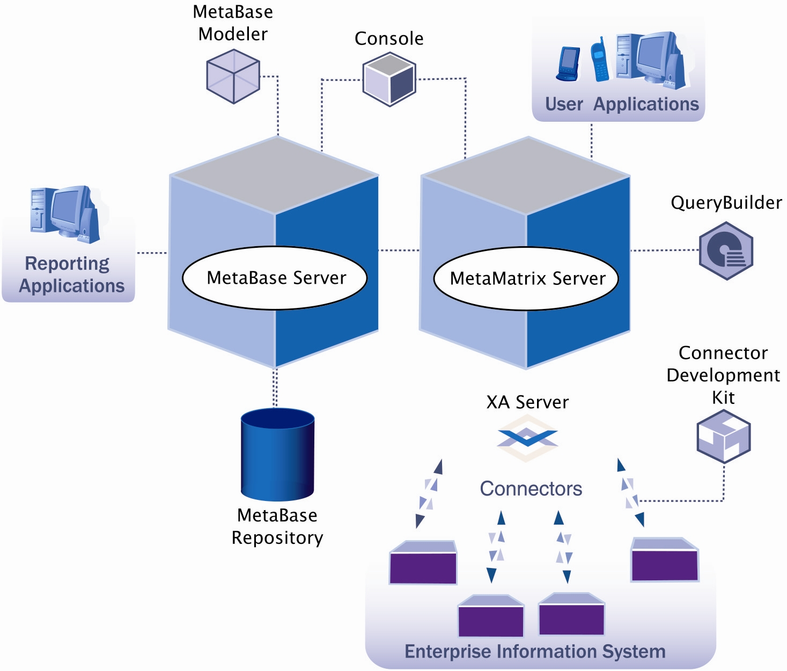
The MetaMatrix System
MetaMatrix
Server
MetaBase

Slide 21
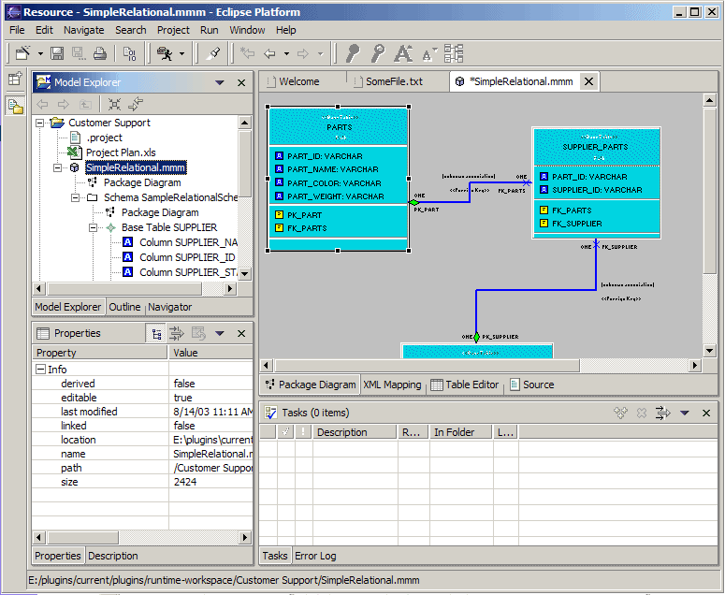
MetaMatrix and EII
Step 1: Model Integration Behavior
Use Modeler to create models of
  The physical information sources
  The virtual information needed by information consumers
  The transformation between the virtual and physical
Manage models in repository
  Allows sharing, searching and configuration control
sources
model
applications
(consumers)

Slide 22
MetaMatrix and EII
Step 2: Deploy Models and Execute
Deploy the models to the MetaMatrix Server
  Multiple VDBs and multiple versions of same VDB
Clients connect to VDB via JDBC, SOAP or ODBC
  Submit queries or execute procedures
  Obtain result sets or XML documents
JDBC, SOAP or ODBC
sources
clients
MetaMatrix Server

Slide 23
Model-Oriented Architectures

Slide 24
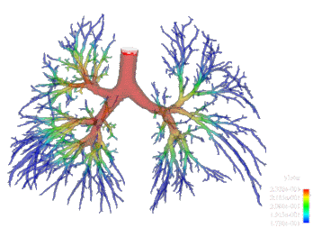
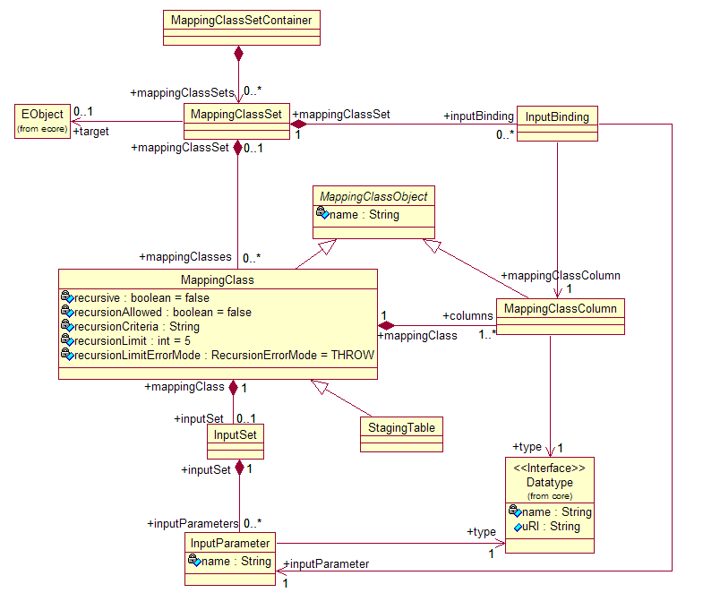
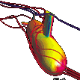
Terminology
A model is a precise and accurate description of a system that is used for a purpose
  Often graphical ways of viewing and manipulating the models
  Usually make it easier to understand the real system
A software system is model-oriented if it uses models to dictate its behavior or functionality at runtime

Slide 25
Benefits of being Model-Oriented
Do not write code to define integration logic
Models are easier to create and maintain than would be code
  They are rich yet more abstract (hide much of the detail)
  Can view graphically
Models can be easily reused and exchanged
Models describe what sources are available
  Repository of models provides an enterprise catalog

Slide 26
Demonstration
MOA In Action:
MetaBase Modeler

Slide 27
Modeling-Related OMG Standards
Meta-Object Facility (MOF)
  Defines an architecture for modeling
  Uses “metamodels” to define behavior and structure of models
Model-Driven Architecture (MDA™)
  Defines architecture using models to drive processes and systems
    Unfortunately interpreted by many to be for application development
XML Metadata Interchange (XMI)
  Defines rules that dictate how models defined with MOF are serialized to XML files
Common Warehouse Metamodel (CWM)
  Defines metamodels for various types of information systems
  Relational, record, hierarchical, OLAP, etc.
Unified Modeling Language (UML)
  The well-known metamodel for object-oriented systems

Slide 28
Conclusion
An MOA System
  Uses (OMG) standards to define, manage and exchange models
  Uses models to describe systems and their behavior
  Consumes models at runtime to produce the behavior
MOA Benefits to MetaMatrix
  Solve a very complex problem
  Makes EII easy to our customers
  Minimized our development effort

Slide 29
Miscellaneous Topics
About Java Development
At MetaMatrix

Slide 30
Our Use of Open Source
Our approach is to use best-of-breed tools
Many open source products are considered best-of-breed
  Apache: Xerces, Axis, Ant, Commons, Lucene, RegExp
  Eclipse: JDT, SDT, PDE, Team, EMF, XSD,
  Others: JUnit, JAXEN, JBoss, JDOM, SAXON, ConcurrentUtil (Doug Lea)
The Eclipse plug-in architecture fits into this philosophy
  Widespread adoption by companies and open-source community
  Many plug-ins are open-source
  Plug-ins contribute new functionality to other plug-ins
  Very active and responsive newsgroups

Slide 31
Development Tools
Eclipse (SDT/PDE)
  Plus various plugins
Builds
  ANT, Cruise Control,
Coverage and Testing
  Clover, JUnit
Apps and Tools:
  DefectTracker, Wiki, Quickbase
  Squirrel, DBVisualizer
Java APIs:
  J2SE/J2EE 1.3 and 1.4
  JDBC, JMS, JAXP, JSP, Servlet, EJB, JNDI, JTA/JTS, RMI, …

