Slide 1
J2EE 1.4 Web Services
Object Computing, Inc.
Mark Volkmann, Partner
11/21/03

Slide 2
Fundamental Web Service Specs.
Simple Object Access Protocol (SOAP)
  specifies the structure of XML-based request and response messages
  used by web services
  specifies how certain data types can be encoded (called SOAP encoding)
Web Services Description Language (WSDL)
  describes all aspects of a web service in an XML document
    message structure (typically defined using XML Schema)
    style (RPC or document)
    encoding details (SOAP, literal, …)
    transport details (HTTP, SMTP, JMS, …)
    service location (endpoint URL)
  often used by tools to generate client proxies/stubs
  that invoke the web service

Slide 3
Fundamental Web Service Specs. (Cont’d)
Universal Description, Discovery and Integration (UDDI)
  most common type of XML registry
  supports querying and updating via web service operations
  provides information about companies and services
    not necessarily web services
  run-time selection?
    a goal of XML registries was to allow applications to
    select web service implementations at run-time
    this idea has not been embraced
    today, XML registries are used to select web services at design-time

Slide 4
WS-I Basic Profile
Specification from
Web Services Interoperability (WS-I) organization
  http://www.ws-i.org
Clarifies ambiguities in
XML, SOAP, WSDL and UDDI specs.
Recommends how to increase interoperability
when using them
  what features to use and avoid
Web service APIs in J2EE 1.4 support
features recommended by Basic Profile
  in addition to some that are not such as
  attachments and RPC/encoded messages

Slide 5
Web Services in J2EE 1.4
From the J2EE 1.4 spec.
  “The primary focus of J2EE 1.4 is support for web services.”
Java-specific web service APIs supported
  Java API for XML Remote Procedure Calls (JAX-RPC)
  SOAP with Attachments API for Java (SAAJ)
  Java API for XML Registries (JAXR)
detail on these is coming up

Slide 6
JAX-RPC
Supports invoking web services in three ways
  generated stubs (from WSDL)
    can be used with both RPC and document style services
  dynamic proxies
    benefit of this approach is questionable so it won’t be covered
  Dynamic Invocation Interface (DII)
    used internally by generated stubs to invoke web service operations
    similar to calling methods using reflection
    can be used with both RPC and document style services
Supports implementing web services in two ways
  plain Java classes
    called Java Service Endpoint (JSE)
  EJB stateless session beans
    can utilize transactional capabilities of EJBs
When using generated stubs with document-style services, the return type of all operations is a SAAJ SOAPElement.
When using DII with document-style services, custom serializers must be generated at build-time for non-primitive parameter/return types (defined using XML schema in WSDL). If a tool must be run at build time, why not run the tool that generates a client stub instead?

Slide 7
SAAJ
Pronounced “sage”
Provides classes that model SOAP messages
Used by JAX-RPC
Can be used by itself to write SOAP clients
  provides maximum control of building requests and processing responses
  ideal for document-style services, but works with RPC-style too
Useful even when attachments aren’t being used
Relationship to the Java API for XML Messaging (JAXM)
  the contents of the SAAJ spec. used to be part of the JAXM spec.
    JAXM and JAX-RPC now both depend on SAAJ
  JAXM also defines capabilities similar to JMS for web services
    asynchronous, guaranteed messaging
  support for JAXM is waning and it may not survive

Slide 8
JAXR
Provides a Java API for querying and updating
XML registries such as UDDI
Hides details of
  creating and sending SOAP requests to registry operations
  receiving and parsing SOAP responses from registry operations

Slide 9
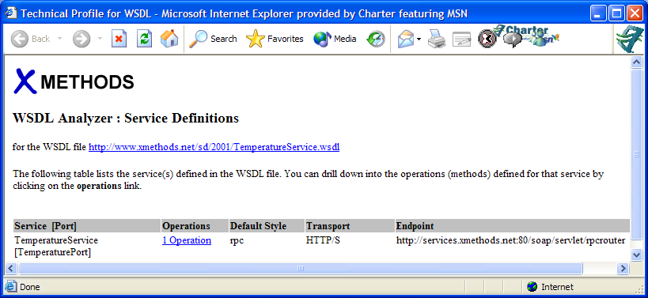
Demonstration Web Service
“Weather - Temperature” service at http://xmethods.com
Clicking “Analyze WSDL” link displays the following

Slide 10
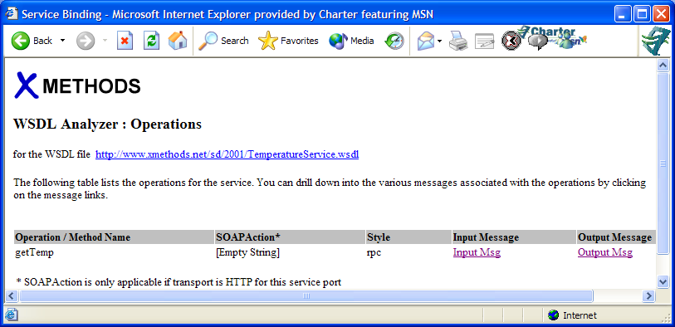
Demonstration Web Service (Cont’d)
“Operation” page

Slide 11
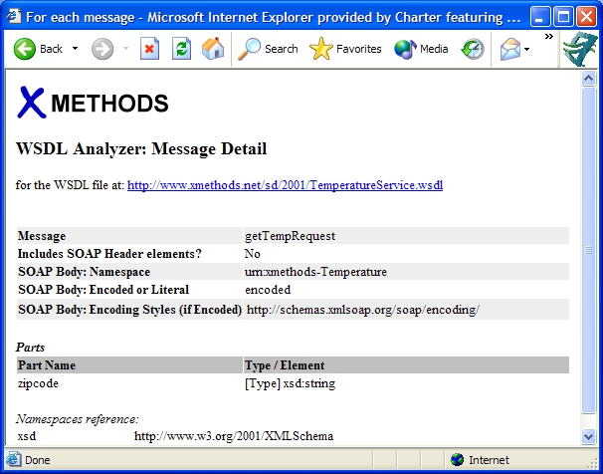
Demonstration Web Service (Cont’d)
“Input Msg” page

Slide 12
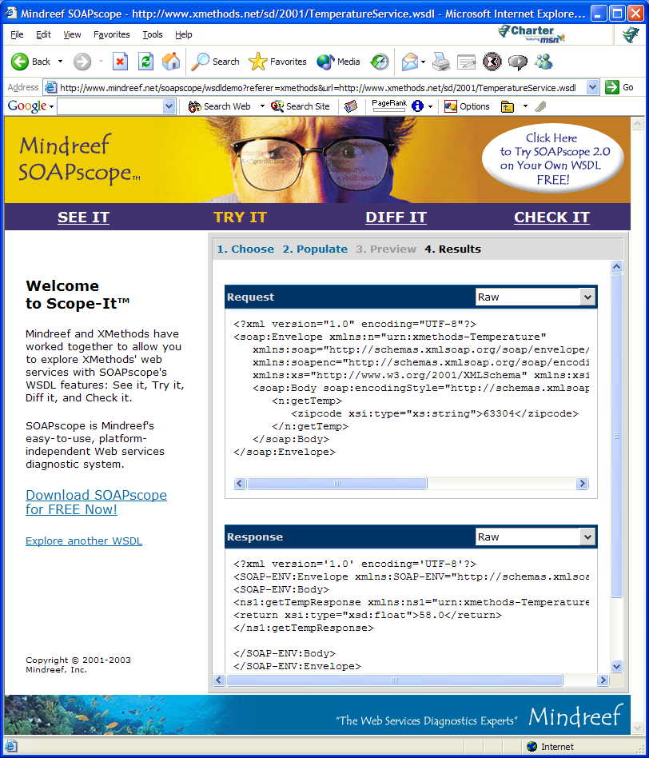
Demonstration Web Service (Cont’d)
“Try It” page

Slide 13
Temperature Service WSDL
<?xml version="1.0"?>
<definitions name="TemperatureService"
targetNamespace="http://www.xmethods.net/sd/TemperatureService.wsdl"
xmlns:tns="http://www.xmethods.net/sd/TemperatureService.wsdl"
xmlns:xsd="http://www.w3.org/2001/XMLSchema"
xmlns:soap="http://schemas.xmlsoap.org/wsdl/soap/"
xmlns="http://schemas.xmlsoap.org/wsdl/">
<message name="getTempRequest">
<part name="zipcode" type="xsd:string"/>
</message>
<message name="getTempResponse">
<part name="return" type="xsd:float"/>
</message>
<portType name="TemperaturePortType">
<operation name="getTemp">
<input message="tns:getTempRequest"/>
<output message="tns:getTempResponse"/>
</operation>
</portType>

Slide 14
Temperature Service WSDL (Cont’d)
<binding name="TemperatureBinding" type="tns:TemperaturePortType">
<soap:binding style="rpc"
transport="http://schemas.xmlsoap.org/soap/http"/>
<operation name="getTemp">
<soap:operation soapAction=""/>
<input>
<soap:body use="encoded" namespace="urn:xmethods-Temperature"
encodingStyle="http://schemas.xmlsoap.org/soap/encoding/"/>
</input>
<output>
<soap:body use="encoded" namespace="urn:xmethods-Temperature"
encodingStyle="http://schemas.xmlsoap.org/soap/encoding/"/>
</output>
</operation>
</binding>

Slide 15
Temperature Service WSDL (Cont’d)
<service name="TemperatureService">
<documentation>
Returns current temperature in a given U.S. zipcode
</documentation>
<port name="TemperaturePort" binding="tns:TemperatureBinding">
<soap:address
location="http://services.xmethods.net:80/soap/servlet/rpcrouter"/>
</port>
</service>
</definitions>

Slide 16
Temperature Service Request
<?xml version="1.0" encoding="UTF-8"?>
<soap:Envelope xmlns:n="urn:xmethods-Temperature"
xmlns:soap="http://schemas.xmlsoap.org/soap/envelope/"
xmlns:soapenc="http://schemas.xmlsoap.org/soap/encoding/"
xmlns:xs="http://www.w3.org/2001/XMLSchema”
xmlns:xsi="http://www.w3.org/2001/XMLSchema-instance">
<soap:Body
soap:encodingStyle="http://schemas.xmlsoap.org/soap/encoding/">
<n:getTemp>
<zipcode xsi:type="xs:string">63304</zipcode>
</n:getTemp>
</soap:Body>
</soap:Envelope>

Slide 17
Temperature Service Response
<?xml version='1.0' encoding='UTF-8'?>
<SOAP-ENV:Envelope
xmlns:SOAP-ENV="http://schemas.xmlsoap.org/soap/envelope/"
xmlns:xsi="http://www.w3.org/2001/XMLSchema-instance"
xmlns:xsd="http://www.w3.org/2001/XMLSchema">
<SOAP-ENV:Body>
<ns1:getTempResponse
xmlns:ns1="urn:xmethods-Temperature”
SOAP-ENV:encodingStyle="http://schemas.xmlsoap.org/soap/encoding/">
<return xsi:type="xsd:float">58.0</return>
</ns1:getTempResponse>
</SOAP-ENV:Body>
</SOAP-ENV:Envelope>

Slide 18
SAAJ API
(in javax.xml.soap package)
org.w3c.dom.Node
SOAPMessage
Node
org.w3c.dom.Text
1
*
SOAPPart
AttachmentPart
SOAPElement
Text
*
1
SOAPEnvelope
SOAPFaultElement
SOAPHeader
SOAPBody
1
1
*
*
*
SOAPHeaderElement
SOAPBodyElement
*
1
*
SOAPFault
Detail
DetailEntry

Slide 19
SAAJ Web Service Client
package com.ociweb.temperature;
import java.io.IOException;
import java.net.MalformedURLException;
import java.net.URL;
import javax.xml.soap.*;
import org.w3c.dom.Node;
public class Client {
private static final String ENDPOINT =
"http://services.xmethods.net:80/soap/servlet/rpcrouter";
private static final String NAMESPACE = "urn:xmethods-Temperature";
private static final String OPERATION = "getTemp";
private static final String SOAP_ENCODING_NS =
"http://schemas.xmlsoap.org/soap/encoding/";
private static final String SOAP_ENVELOPE_NS =
"http://schemas.xmlsoap.org/soap/envelope/";

Slide 20
SAAJ Web Service Client (Cont’d)
private SOAPElement zipElement;
private SOAPMessage request;
public static void main(String[] args) throws Exception {
Client client = new Client();
String zip = "63304";
System.out.println("temperature in " + zip +
" is " + client.getTemperature(zip));
}

Slide 21
SAAJ Web Service Client (Cont’d)
public Client() throws MalformedURLException, SOAPException {
MessageFactory mf = MessageFactory.newInstance();
request = mf.createMessage();
request.getSOAPHeader().detachNode(); // not using SOAP headers
SOAPBody body = request.getSOAPBody();
// Specify that the SOAP encoding style is being used.
SOAPFactory soapFactory = SOAPFactory.newInstance();
Name name = soapFactory.createName
("encodingStyle", "SOAP-ENV", SOAP_ENVELOPE_NS);
body.addAttribute(name, SOAP_ENCODING_NS);
SOAPElement operationElement =
body.addChildElement(OPERATION, "n", NAMESPACE);
zipElement = operationElement.addChildElement("zipcode");
}
builds request like on p. 16

Slide 22
SAAJ Web Service Client (Cont’d)
public float getTemperature(String zipCode)
throws IOException, SOAPException {
// Populate request message with parameter values.
zipElement.addTextNode(zipCode);
dumpMessage("request", request); // for debugging
// Make the call.
SOAPConnectionFactory scf = SOAPConnectionFactory.newInstance();
SOAPConnection connection = scf.createConnection();
SOAPMessage response = connection.call(request, new URL(ENDPOINT));
connection.close();
dumpMessage("response", response); // for debugging

Slide 23
SAAJ Web Service Client (Cont’d)
// Get result out of response message using DOM.
SOAPBody body = response.getSOAPBody();
SOAPElement responseElement =
getFirstChild(body, OPERATION + "Response");
SOAPElement returnElement =
getFirstChild(responseElement, "return");
String value = returnElement.getValue();
zipElement.removeContents(); // prepare for future calls
return new Float(value).floatValue();
}
parses response like on p. 17

Slide 24
SAAJ Web Service Client (Cont’d)
private static void dumpMessage(String name, SOAPMessage message)
throws IOException, SOAPException {
System.out.println(name + " message is");
message.writeTo(System.out);
System.out.println();
}
private static SOAPElement getFirstChild
(Node parent, String localName) {
Node child = parent.getFirstChild();
while (child != null) {
if (localName.equals(child.getLocalName())) break;
child = child.getNextSibling();
}
return (SOAPElement) child;
}
}
Creating and using a class containing SAAJ-related utility methods would simplify this code!

Slide 25
JAX-RPC DII Web Service Client
package com.ociweb.temperature;
import java.rmi.RemoteException;
import javax.xml.namespace.QName;
import javax.xml.rpc.*;
public class Client {
private static final String ENDPOINT =
"http://services.xmethods.net:80/soap/servlet/rpcrouter";
private static final String NAMESPACE = "urn:xmethods-Temperature";
private static final String OPERATION = "getTemp";
private static final String PORT = "TemperaturePort";
private static final String SERVICE = "TemperatureService";
private Call call;

Slide 26
JAX-RPC DII Web Service Client (Cont’d)
public static void main(String[] args) throws Exception {
Client client = new Client();
String zip = "63304";
System.out.println("temperature in " + zip +
" is " + client.getTemperature(zip));
}
public float getTemperature(String zipCode) throws RemoteException {
Float temperature = (Float) call.invoke(new Object[] {zipCode});
return temperature.floatValue();
}

Slide 27
JAX-RPC DII Web Service Client (Cont’d)
public Client() throws ServiceException {
ServiceFactory factory = ServiceFactory.newInstance();
Service service = factory.createService(new QName(SERVICE));
QName port = new QName(NAMESPACE, PORT);
QName operation = new QName(NAMESPACE, OPERATION);
call = service.createCall(port, operation);
call.setTargetEndpointAddress(ENDPOINT);
call.addParameter("zipcode", XMLType.XSD_STRING, ParameterMode.IN);
call.setReturnType(XMLType.XSD_FLOAT);
call.setProperty(Call.ENCODINGSTYLE_URI_PROPERTY,
NamespaceConstants.NSURI_SOAP_ENCODING);
// Some services require setting the SOAPAction HTTP header,
// but this one doesn't.
//call.setProperty(Call.SOAPACTION_USE_PROPERTY, Boolean.TRUE);
//call.setProperty(Call.SOAPACTION_URI_PROPERTY, "");
}
}
The code for getting the Service object in a J2EE client such as a servlet
or an EJB uses JNDI.

Slide 28
JAX-RPC Generated Stub
Web Service Clients
Supplied tool reads WSDL and generates stubs
  web service toolkits such as Axis, JWSDP and WebLogic
  provide such a tool
  details differ
    Axis provides wsdl2java
    Java Web Service Developer Pack (JWSDP) provides wscompile
    WebLogic provides clientgen
  also generates data holder classes for types defined in WSDL
    defined using XML Schema

Slide 29
JAX-RPC Generated Stub
Web Service Clients
JWSDP includes a script to generate stubs
  ${jwsdp.home}/jaxrpc/bin/wscompile.bat or .sh
  generates several source files and compiles them
Generating stub classes using JWSDP and Ant
  <exec executable="${jwsdp.home}/jaxrpc/bin/wscompile.bat">
  <arg line="-classpath ${classes.dir}"/>
  <arg line="-gen:client"/>
  <arg line="-keep"/>
  <arg line="-d ${classes.dir}"/>
  <arg line="config.xml"/>
  </exec>
config.xml (JWSDP-specific)
  <configuration xmlns="http://java.sun.com/xml/ns/jax-rpc/ri/config">
  <wsdl location="http://www.xmethods.net/sd/TemperatureService.wsdl"
  packageName="com.ociweb.temperature"/>
  </configuration>
This is also a custom Ant task now.
Use that instead
of the exec task.
to keep generated source files
can be a local file

Slide 30
JAX-RPC Generated Stub
Web Service Client
package com.ociweb.temperature;
public class Client {
public static void main(String[] args) throws Exception {
// Get the stub.
ServiceFactory sf = ServiceFactory.newInstance();
TemperatureService service = (TemperatureService)
sf.loadService(TemperatureService.class);
TemperaturePortType stub = service.getTemperaturePort();
// Use the stub.
String zip = "63304";
float temperature = stub.getTemp(zip);
System.out.println("temperature in " + zip + " is " + temperature);
}
}
The code for getting the Service object in a J2EE client such as a servlet
or an EJB uses JNDI.
no casting or conversion of the response is needed

Slide 31
Summary
Clearly using generated stubs is easier than SAAJ and DII
SAAJ and DII are useful when
  WSDL isn’t available
    but it should always be available
  web service to be invoked isn’t known until runtime
    not a likely scenario
SAAJ provides maximum control over
  building request messages
  processing response messages
DII is still necessary since it is used by generated stubs
SAAJ can be used by DII implementations

Slide 32
What About Ruby?
Web services in Ruby are supported by SOAP4R
SOAP4R includes wsdl4ruby.rb script
  parses WSDL
  generates Ruby class that invokes operations described in WSDL
  generates sample Ruby client class
Example
  wsdl2ruby.rb \
  --wsdl http://www.xmethods.net/sd/TemperatureService.wsdl \
  --type client
    generates TemperatureServiceDriver.rb and TemperatureServiceClient.rb
  code in generated client is similar to the following
    require 'TemperatureServiceDriver.rb'
    stub = TemperaturePortType.new() # can pass endpoint URL
    zipcode = '63304'
    temperature = stub.getTemp(zipcode)
    puts "temperature in #{zipcode} is #{temperature}"

