Slide 1
Xdoclet Introduction
Ross Sponholtz
rsponholtz@connectria.com

Slide 2
Agenda
XDoclet Overview
Todo List
EJB File Generation
Servlet File Generation
Hibernate File Generation
Custom File Generation

Slide 3
What is Xdoclet
Code generation framework
Attribute based (@ doclet tags)
Popular (95,000 downloads in 2003)
Originated as EJBDoclet to generate EJB artifacts (interfaces, deployment descriptors, etc.)
Evolved to generate even more stuff (Hibernate mapping files, web.xml, TLD files, etc.)
Built in support for many leading tools (Jboss, WebLogic, WebSphere, Castor, Hibernate, Struts, etc.)

Slide 4
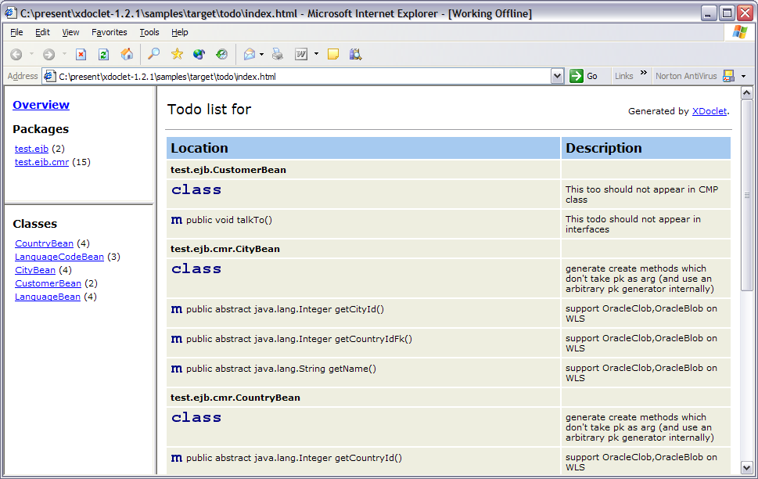
ToDo List Example

Slide 5
Usage of todo tag
/**
* This is a customer bean. It is an example of how to use the XDoclet tags.
*
* ...
*
* @todo This too should not appear in CMP class
*/
public abstract class CustomerBean
extends PersonBean {
private EntityContext ctx;

Slide 6
Ant task
<taskdef name="documentdoclet"
classname="xdoclet.modules.doc.DocumentDocletTask"
classpathref="samples.class.path"
/>
<target name="todo" depends="prepare">
<echo>+-----------------------------------------+</echo>
<echo>| R U N N I N G T O D O |</echo>
<echo>+-----------------------------------------+</echo>
<mkdir dir="${samples.todo.dir}"/>
<documentdoclet destdir="${samples.todo.dir}" >
<fileset dir="${samples.java.dir}">
<include name="**/*.java"/>
</fileset>
<info tag="todo"/>
</documentdoclet>
</target>

Slide 7
Generation of EJB Artifacts
Session
Bean
XDoclet Process
Home
Interface
Remote
Interface
Value
Object
Ejb-jar.xml
Jboss.xml

Slide 8
Session Bean Example
/**
* This is a teller bean. *
* @ejb.bean name="Teller"
* description="Teller example bean"
* jndi-name="ejb/bank/Teller"
* type="Stateless"
*
*/
public abstract class TellerBean extends BaseTellerBean implements SessionBean {
…
}

Slide 9
Session Bean Details
/**
* This is a teller bean. It is an example of how to use the XDoclet tags.
*
* @ejb.bean name="Teller"
* description="Teller example bean"
* jndi-name="ejb/bank/Teller"
* type="Stateless"
*
* @ejb.ejb-ref ejb-name="Account"
* ref-name="ejb/bank/Account"
*
* @ejb.ejb-ref ejb-name="Customer"
*
* @ejb.security-role-ref role-link="Administrator"
* role-name="admin"
*
* @ejb.permission role-name="Teller"
* @ejb.permission role-name="Administrator"
*
* @ejb.transaction type="Required"
* @ejb.transaction-type type="Container"
*
* @ejb.resource-ref res-auth="Container"
* res-name="jdbc/DBPool"
* res-type="javax.sql.DataSource"
*
* @soap.service urn="TellerService"
*
* @jboss.resource-ref res-ref-name="jdbc/DBPool"
* resource-name="MyDataSourceManager"
*
* @jboss.container-configuration name="Standard Stateless SessionBean"
*
* @jboss.ejb-ref-jndi jndi-name="ejb/bank/Account"
* ref-name="bank/Account"
*
* @weblogic.pool initial-beans-in-free-pool="1"
* max-beans-in-free-pool="3"
*
* @weblogic.stateless-clustering stateless-bean-call-router-class-name="Whatever"
* stateless-bean-is-clusterable="True"
* stateless-bean-load-algorithm="Whazzup"
* stateless-bean-methods-are-idempotent="Sure"
*/

Slide 10
Session Bean Method
/**
* Transfer money between accounts.
*
* @ejb.interface-method view-type="remote"
*/
public void transfer(Account from, Account to,
  float amount) {
try {
from.withdraw(amount);
to.deposit(amount);
}
catch (java.rmi.RemoteException e) {
throw new EJBException(e);
}
}

Slide 11
Ant Task
<target name="ejbdoclet" depends="prepare">
<ejbdoclet
destdir="${samples.gen-src.dir}"
mergedir="parent-fake-to-debug"
excludedtags="@version,@author,@todo"
addedtags="@xdoclet-generated at ${TODAY},@copyright The XDoclet Team,@author XDoclet,@version ${version}"
ejbspec="2.0"
force="${samples.xdoclet.force}"
verbose="false"
>
<fileset dir="${samples.java.dir}">
<include name="test/ejb/*Bean.java"/>
<include name="test/ejb/cmr/*Bean.java"/>
<include name="test/ejb/jdo/*.java"/>
<exclude name="test/ejb/Base*.java"/>
<exclude name="test/ejb/SecurityOfficerBean.java"/>
</fileset>
<packageSubstitution packages="ejb" substituteWith="interfaces"/>
<remoteinterface/>
<localinterface/>
<homeinterface/>
<localhomeinterface/>
<dataobject/>
<valueobject/>
<entitypk/>
<entitycmp/>
<entitybmp/>
<session/>

Slide 12
Ant Task (cont.)
<deploymentdescriptor
destdir="${samples.meta-inf.dir}"
validatexml="true"
mergedir="fake-to-debug"
description="bæbæ"
>
<configParam name="clientjar" value="blah.jar"/>
</deploymentdescriptor>
<jboss
version="3.2"
unauthenticatedPrincipal="nobody"
xmlencoding="UTF-8"
destdir="${samples.meta-inf.dir}"
validatexml="true"
preferredrelationmapping="relation-table"
/>
</ejbdoclet>
</target>

Slide 13
Generated EJB Descriptor
<session >
<description><![CDATA[Teller example bean]]></description>
<ejb-name>Teller</ejb-name>
<home>test.interfaces.TellerHome</home>
<remote>test.interfaces.Teller</remote>
<local-home>
test.interfaces.TellerLocalHome</local-home>
<local>test.interfaces.TellerLocal</local>
<ejb-class>test.ejb.TellerSession</ejb-class>
<session-type>Stateless</session-type>
<transaction-type>Container</transaction-type>

Slide 14
Generated EJB Descriptor
<ejb-ref >
<ejb-ref-name>ejb/bank/Account</ejb-ref-name>
<ejb-ref-type>Entity</ejb-ref-type>
<home>test.interfaces.AccountHome</home>
<remote>test.interfaces.Account</remote>
<ejb-link>Account</ejb-link>
</ejb-ref>
<ejb-ref >
<ejb-ref-name>ejb/Customer</ejb-ref-name>
<ejb-ref-type>Entity</ejb-ref-type>
<home>test.interfaces.CustomerHome</home>
<remote>test.interfaces.Customer</remote>
<ejb-link>Customer</ejb-link>
</ejb-ref>

Slide 15
Generated EJB Descriptor
<security-role-ref>
<role-name>admin</role-name>
<role-link>Administrator</role-link>
</security-role-ref>
<resource-ref >
<res-ref-name>jdbc/DBPool</res-ref-name>
<res-type>
javax.sql.DataSource</res-type>
<res-auth>Container</res-auth>
</resource-ref>
</session>

Slide 16
JBoss Descriptor
<session>
<ejb-name>Teller</ejb-name>
<jndi-name>ejb/bank/Teller</jndi-name>
<local-jndi-name>TellerLocal</local-jndi-name>
<configuration-name>
Standard Stateless SessionBean</configuration-name>
<ejb-ref>
<ejb-ref-name>ejb/bank/Account</ejb-ref-name>
<jndi-name>ejb/bank/Account</jndi-name>
</ejb-ref>
<resource-ref>
<res-ref-name>jdbc/DBPool</res-ref-name>
<resource-name>MyDataSourceManager</resource-name>
</resource-ref>
<method-attributes>
</method-attributes>
</session>

Slide 17
WebLogic Descriptor
<weblogic-enterprise-bean>
<ejb-name>Teller</ejb-name>
<stateless-session-descriptor>
<pool>
<max-beans-in-free-pool>3
</max-beans-in-free-pool>
<initial-beans-in-free-pool>1
</initial-beans-in-free-pool>
</pool>
</stateless-session-descriptor>
<reference-descriptor>
</reference-descriptor>
<jndi-name>ejb/bank/Teller</jndi-name>
<local-jndi-name>TellerLocal</local-jndi-name>
</weblogic-enterprise-bean>

Slide 18
Home Interface
/*
* Generated by XDoclet - Do not edit!
*/
package test.interfaces;
/**
* Home interface for Teller.
* @xdoclet-generated at 9-06-04
* @copyright The XDoclet Team
* @author XDoclet
* @version ${version}
*/
public interface TellerHome
extends javax.ejb.EJBHome
{
public static final String COMP_NAME="java:comp/env/ejb/Teller";
public static final String JNDI_NAME="ejb/bank/Teller";
public test.interfaces.Teller create()
throws javax.ejb.CreateException,java.rmi.RemoteException;
}

Slide 19
EJB Summary
Write bean class
  Everything is in one place
Generate:
  Descriptors
  Interfaces
Support for many app servers:
  JBoss, BEA WebLogic, IBM WebSphere, Oracle IAS, Orion, Borland, MacroMedia JRun, Jonas, Pramati, Sybase EAServer and many more
Entity & Message driven beans also
  CMRs
  Value Objects

Slide 20
Servlet
/**
* Simple Servlet.
* @web.servlet
* display-name="Simple Servlet"
* load-on-startup="1"
* name="SimpleServlet"
*
* @web.servlet-init-param
* name="param1"
* value="value1"
*
* @web.servlet-init-param
* name="param2"
* value="value2"
*
* @web.servlet-mapping
* url-pattern="/simple/*"
*/
public class SimpleServlet extends VelocityServlet {
/**
* Called by the server (via the service method) to allow a
* servlet to handle a POST request.
*/
public void doPost(HttpServletRequest request, HttpServletResponse response)
throws IOException, ServletException {
// just print Hi!
response.getWriter().println("Hi!");
}
}

Slide 21
Servlet web.xml descriptor
<servlet>
<servlet-name>SimpleServlet</servlet-name>
<display-name>Simple Servlet</display-name>
<servlet-class>test.web.SimpleServlet</servlet-class>
<init-param>
<param-name>param1</param-name>
<param-value>value1</param-value>
</init-param>
<init-param>
<param-name>param2</param-name>
<param-value>value2</param-value>
</init-param>
<load-on-startup>1</load-on-startup>
</servlet>
<servlet-mapping>
<servlet-name>SimpleServlet</servlet-name>
<url-pattern>/simple/*</url-pattern>
</servlet-mapping>

Slide 22
Servlet Filter
/**
*
* @web.filter
* display-name="Timer Filter"
* name="TimerFilter"
*
* @web.filter-init-param
* name="param1"
* value="value1"
*
* @web.filter-mapping
* url-pattern="*.xml"
*
*/
public class TimerFilter implements Filter {
...
}

Slide 23
Filter Descriptor
<filter>
<filter-name>TimerFilter</filter-name>
<display-name>Timer Filter</display-name>
<filter-class>test.web.TimerFilter</filter-class>
<init-param>
<param-name>param1</param-name>
<param-value>value1</param-value>
</init-param>
</filter>
<filter-mapping>
<filter-name>TimerFilter</filter-name>
<url-pattern>*.xml</url-pattern>
</filter-mapping>

Slide 24
Hibernate
package test.hibernate;
import java.util.Set;
/**
* @author Administrator
*
* @hibernate.class
* table="ANIMALS"
* dynamic-update="true"
*/
public class Animal extends Persistent {
private Set prey;
private char sex;
/**
* Constructor for Animal.
*/
public Animal() {
super();
}

Slide 25
Hibernate (cont)
/**
* @hibernate.set
* lazy="true"
* table="PREDATOR_PREY"
* order-by="PREY_ID"
* @hibernate.collection-key
* column="PREDATOR_ID"
* @hibernate.collection-many-to-many
* column="PREY_ID"
* @return Set
*/
public Set getPrey() {
return prey;
}
/**
* @hibernate.property
* not-null="true"
* Returns the sex.
* @return char
*/
public char getSex() {
return sex;
}
}

Slide 26
Custom Generation
Write your own templates for the standard subtask
Use the <template> task
Write tag handlers / subtasks in Java

Slide 27
Example of custom template
/*
* <XDtI18n:getString bundle="xdoclet.ejb.Messages" resource="do_not_edit"/>
*/
package <XDtPackage:packageOf><XDtClass:fullClassName/></XDtPackage:packageOf>;
<XDtClass:importedList currentClass="<XDtClass:fullClassName/>"/>
import java.sql.*;
import org.apache.log4j.Logger;
/**
<XDtClass:forAllClassTags superclasses="false">
<XDtClass:ifTagNameEquals value="@ejb:bean">
* @ejb:bean
<XDtClass:ifHasClassTag tagName="ejb:bean" paramName="type"> * type="<XDtClass:classTagValue tagName="ejb:bean" paramName="type" />"</XDtClass:ifHasClassTag>
<XDtClass:ifHasClassTag tagName="ejb:bean" paramName="cmp-version"> * cmp-version="<XDtClass:classTagValue tagName="ejb:bean" paramName="cmp-version" />"</XDtClass:ifHasClassTag>
<XDtClass:ifHasClassTag tagName="ejb:bean" paramName="name"> * name="<XDtClass:classTagValue tagName="ejb:bean" paramName="name" />"</XDtClass:ifHasClassTag>
<XDtClass:ifHasClassTag tagName="ejb:bean" paramName="jndi-name"> * jndi-name="<XDtClass:classTagValue tagName="ejb:bean" paramName="jndi-name" />"</XDtClass:ifHasClassTag>
<XDtClass:ifHasClassTag tagName="ejb:bean" paramName="local-jndi-name"> * local-jndi-name="<XDtClass:classTagValue tagName="ejb:bean" paramName="local-jndi-name" />"</XDtClass:ifHasClassTag>
<XDtClass:ifHasClassTag tagName="ejb:bean" paramName="view-type"> * view-type="<XDtClass:classTagValue tagName="ejb:bean" paramName="view-type" />"</XDtClass:ifHasClassTag>
<XDtClass:ifHasClassTag tagName="ejb:bean" paramName="primkey-field"> * primkey-field="<XDtClass:classTagValue tagName="ejb:bean" paramName="primkey-field" />Impl"</XDtClass:ifHasClassTag>
* generate="true"
*
</XDtClass:ifTagNameEquals>
<XDtClass:ifTagNameEquals value="@ejb:pk">
</XDtClass:ifTagNameEquals>
<XDtClass:ifTagNameNotEquals value="@ejb:bean">
<XDtClass:ifTagNameNotEquals value="@ejb:interface">
<XDtClass:ifTagNameNotEquals value="@ejb:pk">
* <XDtClass:getTag/> </XDtClass:ifTagNameNotEquals></XDtClass:ifTagNameNotEquals></XDtClass:ifTagNameNotEquals>
</XDtClass:forAllClassTags>
*/

Slide 28
Lessons Learned
Errors may be difficult to track down
  Error reporting is bad to non-existant
  Get the tags Exactly right
Don’t do source control on generated files!

Slide 29
What’s wrong with XDoclet 1.2?
Based on JavaDoc (limited to Java).
Difficult and fixed template language (XDT).
LARGE codebase (largely made up of unmaintained modules).
Tightly coupled with Ant.
No unit-tests.
No tag validation.

Slide 30
Future Developments
Velocity Templating
XDoclet2 development in progress
JBoss-IDE support for XDoclet tags
  Didn’t work for me

Slide 31
Conclusion
Q&A
Demos?

