Slide 1

The Future of Object Persistence
St Louis JUG
13 January 2005
Patrick Linskey
pcl@solarmetric.com

Slide 2

About Me
Patrick Linskey
CTO at SolarMetric
Involved in object/relational mapping and EJB since 1999
Frequent JDO presenter at JUGs, Java conventions and seminars
Member, JDO Expert Group
Member, EJB Expert Group
Luminary, JDOcentral
Co-author of Bitter EJB along with Bruce Tate, Mike Clark, and Bob Lee

Slide 3
Corporate Profile
International Company Based in Austin, TX
  Offices in London, California, Massachusetts
  Through partners, reach is worldwide
Founded in 2001 by MIT alums.
  Core team has been together since 1997.
Frustrated with trying to do Java object persistence with:
  Proprietary Tools – Vendor Lock-in
  Entity beans – difficult, slow, impose undesirable constraints on object model and development patterns
Committed to Technical Quality and Innovation, Customer Support
Leading JDO implementation
Client base is diverse, both in terms of industry and size
  300+ customers
Regular JDO Training courses throughout the world
Notes:
Necessity really drove the development of Kodo JDO.

Slide 4
SolarMetric’s Role
JSR 220 (EJB 3)
Actively contributing member
Actively developing preview version of the EJB 3 specification
JSR 243 (JDO 2)
Will continue active role on the development and release of JDO 2
Will continue active development of Kodo’s JDO bindings, for JDO 2 and for future JDO versions

Slide 5
Object / Relational Mapping

Slide 6
Object / Relational Mapping
Object-oriented programming languages are vastly different than relational data languages.
Object / relational “impedance mismatch” has plagued enterprise programmers for years.
  Mapping
  Remoteness of data
Proprietary O/R mapping products exist for a variety of languages: Smalltalk, C++, Java, others.
JDO and EJB3
  designed for object/relational mapping and
  designed to work inside and outside a container
Notes:
First, what is O/R mapping? Why is this an important problem to solve?

Slide 7
Why not just JDBC?
JDBC misses the “O” part of O/R mapping
  Interface is not at an object level but rather at SQL (row and column) level
  Not Java
  Creates complexity especially when leveraging OO concepts e.g., inheritance, polymorphism
JDBC is a low level API
  Used as a building block by most O/R mapping tools
Sadly, SQL is not portable
  Many different dialects

Slide 8
Goals of an O/R specification
Abstract API for object persistence
No need to write persistence infrastructure
Standard means of persisting objects. Low risk of vendor lock-in
Portability between data stores

Slide 9
Requirements of an O/R Specification
Persist objects whether simple or complex mapping is required
Query those persisted objects
Minimize visibility of O/R mapping APIs
Connection management
Transaction management
Allow object model and data model to be optimized independently

Slide 10
Mapping Objects to RDBMS
Many ways to “map” (describe the relationship) between an object model and a schema
  Map directly to a column
  Relationships between objects can be mimicked with foreign key relationships in schema
  Collections of objects can be:
    One-to-many
    Many-to-many with a join table
Schema and classes are not tied together
Most good O/R Solutions Have Tools To Help with Mappings

Slide 11
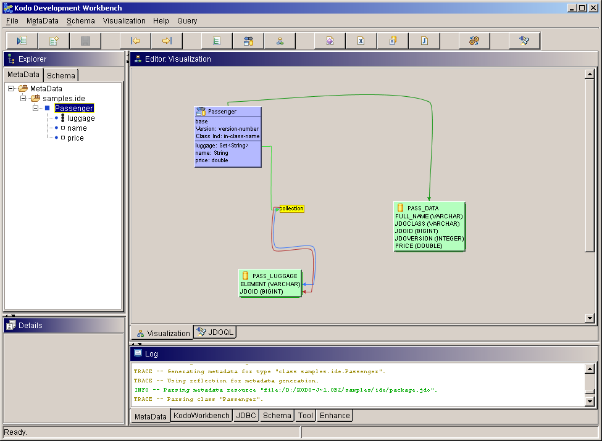
Kodo Development Workbench

Slide 12
Benefits of these specs
There are already a number of persistence solutions out there. What does JDO and EJB3 UPS bring to the table?
Defer decisions
Focus on core competencies
Use Java to its fullest
Project maintainability

Slide 13
Defer data store decisions
Choice of persistence technology should not require any other architecture decisions
Entity beans prior to EJB3: require the use of a container
JDBC and proprietary object-relational mapping: require a relational database
  often, results in dependencies to a particular SQL variant
Changes to schema would cause pain and large amounts of code rewriting
JDO and EJB3: seamlessly work with J2EE, but do not require it. Can be used with all sorts of data stores (relational, legacy EISs, J2ME devices, ...)

Slide 14
Focus on core competencies
20% to 40% of typical JDBC projects is persistence infrastructure
JDBC code is repetitive and difficult, and therefore prone to errors

Slide 15
Focus on core competencies
O/R mapper’s infrastructure is typically closer to 5%
No boilerplate code, so less room for cut-and-paste errors

Slide 16
Use Java to its fullest
O/R mapping is designed to integrate seamlessly with Java
Polymorphism, both in queries and relations
  Show me all the Vehicles in the warehouse
Data encapsulation supported
Developers need not re-learn new rules and limitations. Regular Java concepts behave exactly as expected.

Slide 17
Maintenance over time
Most interaction happens through object model
Direct use of APIs is minimal, so is readily understandable
  query for objects
  transaction demarcation (when used outside a JTA environment)
  adding objects to database

Slide 18
Why O/R mapping?
To sum up, an O/R mapping framework enables you to:
Make architecture and data store decisions as needed
Do more “real work” in a given amount of time
Do the same amount of “real work” in less time
Write regular Java, without learning all sorts of restrictions
More easily maintain your code base through its lifecycle

Slide 19
JDO 2 Status / Schedule

Slide 20
JDO 2 is an Evolution from JDO 1, Not a Revolution
Maintain Java Data Objects 1.0 Compatibility
Standardize Mapping to Relational DB
  SQL as a supported query language
Multi-tier Development Improvements
  Disconnected Object Graphs
Usability Improvements
Better Object Modelling
Richer Queries
  Single-line format
  Projections
  Aggregates
  Paging Query Results
More Vendor Support
  Remove PersistenceCapable requirement

Slide 21
JDO 2.0 schedule
Public Draft currently available
TCK, RI being developed in the Apache project
JDO2 jars should be available in the next few weeks
Final JDO2 specification (including TCK and RI) in four to eight months

Slide 22
Unnamed Persistence Specification (UPS)
Status
Enterprise Java Beans 3

Slide 23
The Announcement
http://java.sun.com/j2ee/letter/persistence.html
Historical background
Core of EJB and JDO specs have included persistence
Data persistence models have differed
Sun is leading a community effort to have a single POJO persistence model
Notes:
Necessity really drove the development of Kodo JDO.

Slide 24
The Announcement
http://java.sun.com/j2ee/letter/persistence.html
Summary of announcement
Added 6 JDO members to JSR-220 (EJB3 Spec Team)
All current JDO experts are listeners on JSR-220 list
Work will start under JSR-220 but independent of EJB3
Goal: Single O/R Mapping Framework for J2EE, J2SE
Timeframe: J2EE 5.0 (January 2006 currently)
Notes:
Necessity really drove the development of Kodo JDO.

Slide 25
EJB 3
Unnamed Persistence Specification (UPS) is part of EJB3
Work in progress on a second Early Release Draft
Heavy utilization of annotations
Lots of mis-information out there
  No existing product is UPS
Notes:
You, the Java community, will decide what will happen with these two specifications. Maybe 5 years from now there will only be 1 standard (with a full merging between JDO and UPS). Then again, 5 years from now one of the specs may define basic behavior and the other will define advanced behavior.

Slide 26
Criteria to Consider When Choosing a Persistence Solution

Slide 27
Looking for a Persistence Solution? (1 of 3)
Criteria to Consider
Standards based vs. Proprietary
  Portability – avoid vendor lock-in
  Specification created by experienced community members vs. 1 individual or 1 company with other goals
Which standard?
  JDO (27+ implementations)
  EJB3
  Both
Total Cost of Ownership
  Upfront Costs vs. Runtime Costs
  Support Costs
  Maintenance Costs
  Training Costs

Slide 28
Looking for a Persistence Solution? (2 of 3)
Criteria to Consider
Ease of Use
  Tooling
Ability to Optimize Scalability & Performance Trade-Offs
Supported Mappings
  Custom Mappings Available?
Extensibility
Datastore Flexibility
  Relational
  Non-relational (legacy, hierarchical, object, etc.)
Architecture flexibility
  In container – session beans, CMP, BMP
  Outside container – servlets, Spring, JSP, client-server

Slide 29
Looking for a Persistence Solution? (3 of 3)
Criteria to Consider
Performance and Scalability Issues
  Lazy Loading
  Dirty Field Tracking
  Caching (pluggable caching with variety of invalidation strategies)
  Minimize Round-Tripping
Legacy Database Support
  Stored Procedure Support
  SQL Support
Supporting Organization
  Tied to another product?
  Organization’s thought leadership
  Support response times
Legal Issues
  Indemnification

Slide 30
Kodo Product Suite

Slide 31
Kodo Roadmap
Continue to build an underlying engine that promotes:
  Performance
  Scalability
  Flexibility
  Ease of Use
Will offer multiple bindings to the underlying Kodo engine
  Kodo JDO – JDO bindings
  Kodo “UPS” – “UPS” (Unnamed Persistence Spec) bindings
Interoperability between Kodo JDO and Kodo “UPS”
  Will be possible to simultaneously use both APIs with same domain model
Notes:
Kodo’s roadmap wrt. the new spec

Slide 32
Current Situation – Kodo JDO
JDO
Kodo Persistence Kernel

Slide 33
Future Situation – Kodo JDO and Kodo “UPS”
JDO
“UPS”
Kodo Persistence Kernel

Slide 34
Kodo JDO 3.2
Significant support for JDO 2 including:
  JDO 2 Queries (single string JDOQL queries, implicit parameters / variables, named query support, subqueries)
  More flexibility with detachment APIs, including automatic detachment on PM close
Improvements to Kodo Development Workbench, Management Console, and Profiler
Reverse Mapping Tool is accessible via a guided wizard
Improved eager fetching
Support for managed inverses
Intersystems Caché database support

Slide 35
Tools – Workbench and Management Console
High-performance database cache
Prepared statements, statement caching, statement batching
Intelligent handling of large result sets
SQL as query language
flat, vertical, horizontal inheritance mappings
Extensible architecture
Reverse and forward engineering of database schema
Schema evolution

Slide 36
Kodo Development Workbench

Slide 37
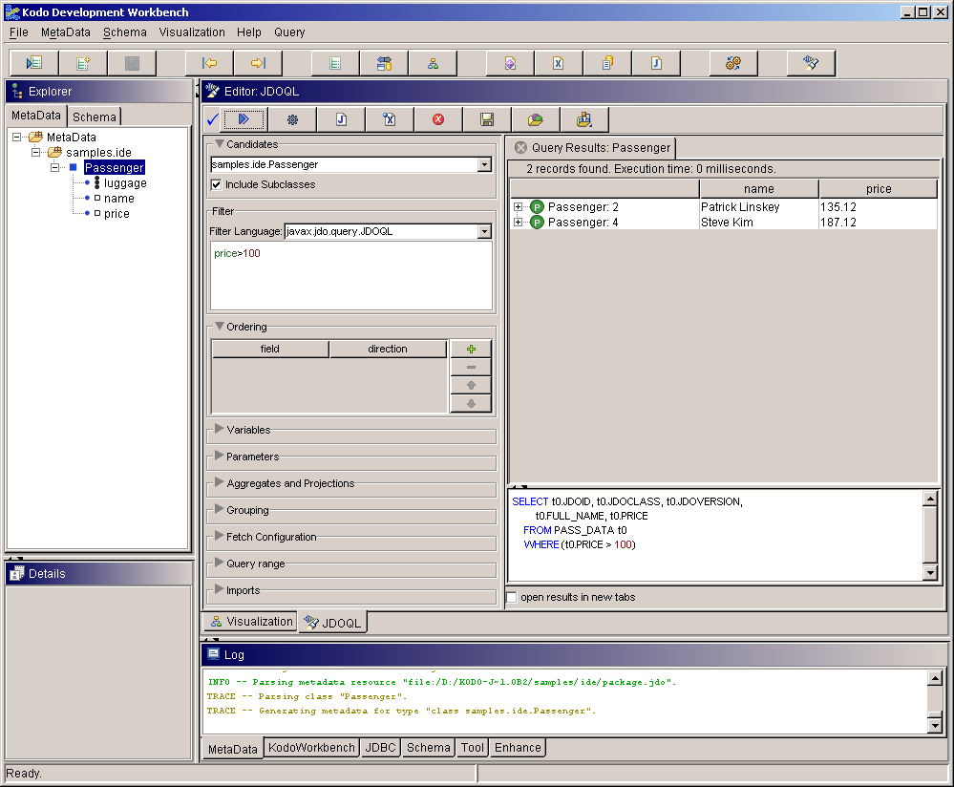
Kodo JDOQL Editor

Slide 38
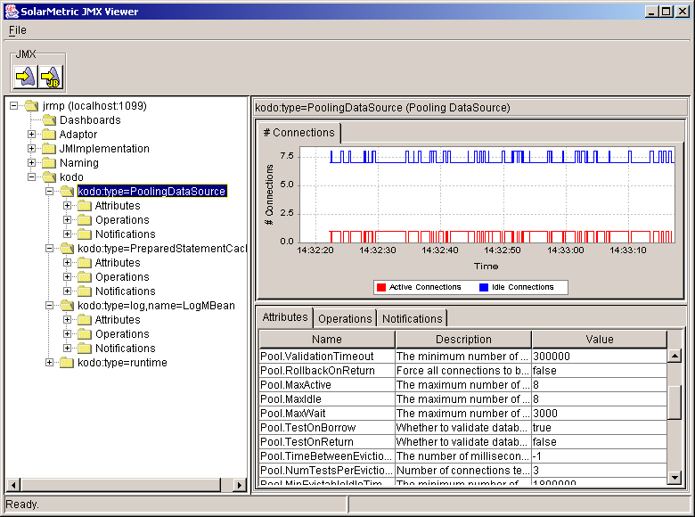
Management Console (JMX)

Slide 39
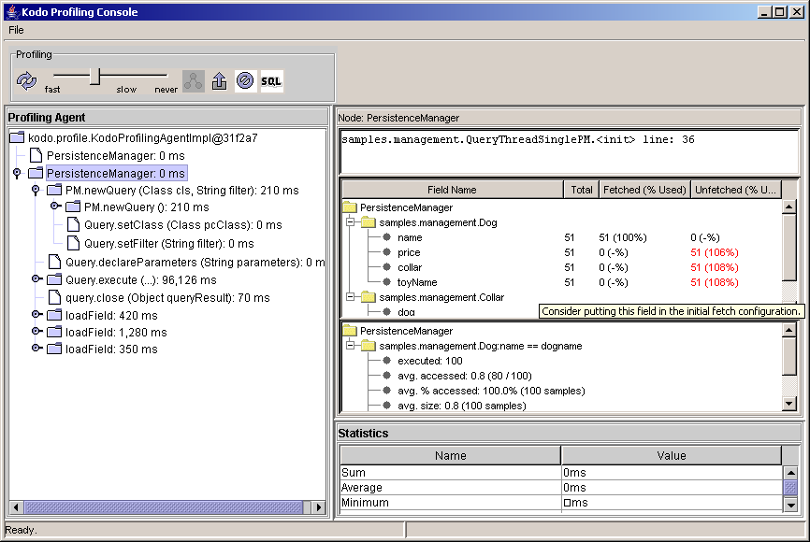
Profiler
Notes:
Notice the multiple PersistenceManager nodes in the agent panel. Each PM node represents a different context in code (a PM obtained from a different location). This means that the fetch group analysis is on a per-use-case basis, more-or-less.

Slide 40
Supported Databases
Relational:
Oracle 8i/9i/10
Microsoft SQL Server
IBM DB2
Sybase Adaptive Server Enterprise
Informix IDS
MySQL
PostgreSQL
Firebird
Interbase
Hypersonic SQL
JDataStore
FoxPro
MS Access
Pointbase
Cloudscape
InstantDB
Empress
Extensible database support
Non-Relational:
Legacy EIS (CICS, Unisys, others) (ask for details)
LDAP (coming soon)
BerkeleyDB (coming soon)
InterSystems Caché

Slide 41
Kodo JDO IDE Support
All IDEs with Ant Support
Tight integration with:
  Borland JBuilder 7 or newer
  Sun One Studio / NetBeans
  Eclipse / WSAD / WSED
Standalone Development Workbench
Kodo JDO Supported App Servers
WebLogic 6.2 – 8.1
WebSphere 5
JBoss 3.0 – 3.2
SunONE
Trifork
JRun 4
Borland Enterprise Server

Slide 42
More Info
Web site: http://www.solarmetric.com
On-site and off-site Kodo JDO training available
Professional Services available
Email contact: info@solarmetric.com
Speaker
  Patrick Linskey: pcl@solarmetric.com
Advanced Webinar – December 9 – 10:00 AM Pacific
  Covers Performance and Scalability
  Using JDO with J2EE
  Other Advanced Topics
  Register at http://www.solarmetric.com

Slide 43
Backup Slides

Slide 44
What’s New In JDO 2?

Slide 45
Goals for Java Data Objects 2.0
Maintain JDO 1.0 Compatibility
Standardize Mapping to Relational DB
  SQL as a supported query language
Multi-tier Development Improvements
  Disconnected Object Graphs
Usability Improvements
Better Object Modelling
Richer Queries
  Single-line format
  Projections
  Aggregates
  Paging Query Results
More Vendor Support
  Remove PersistenceCapable requirement

Slide 46
Standardize Mapping to RDBMS
Simple Mapping
  Class ⬄ Table
  Field ⬄ Column
  1-1 relationship ⬄ unique foreign key
  1-many relationship ⬄ foreign key
  many-many relationship ⬄ join table
Complex Mapping
  Inheritance strategies
  Multiple tables per class
  List, Map, Embedded

Slide 47
Multi-tier Development
Disconnected Object Graphs
  Disconnect objects from PersistenceManager
  Close PersistenceManager
  Modify disconnected objects
    send to different tier, or
    apply changes directly to objects
  Begin new transaction
  Reconnect objects to PersistenceManager
  Commit transaction (applies changes)
Disconnected Objects keep original identity and version

Slide 48
Usability (Bootstrap)
How do you find a PersistenceManagerFactory?
Java Data Objects 1.0 Properties:
javax.jdo.PersistenceManagerFactoryClass:\
com.sun.jdori.fostore.FOStorePMF javax.jdo.option.ConnectionURL:\
fostore:/shared/databases/jdo/dbdir javax.jdo.option.ConnectionUserName:craig javax.jdo.option.ConnectionPassword:faster javax.jdo.option.Optimistic:true
javax.jdo.option.RetainValues:true
javax.jdo.option.NontransactionalRead:true

Slide 49
Bootstrap
JDO 1.0 Properties instance:
    getPersistenceManagerFactory (Properties props)
JDO 2.0 Properties loaded from:
  stream
    getPersistenceManagerFactory (InputStream props)
  File (use to get a stream)
    getPersistenceManagerFactory (File propsFile)
  resource name (use to get a stream)
    getPersistenceManagerFactory (String propsResource)
JDO 2.0 JNDI lookup
    getPersistenceManagerFactory (String name, Context c)

Slide 50
Usability
JDO 2.0 Transaction adds:
  boolean getRollbackOnly();
  void setRollbackOnly();
JDO 2.0 Query can be defined in metadata and accessed by name

Slide 51
Usability
ThreadLocal JDOHelper methods
    getThreadLocalPersistenceManager
    setThreadLocalPersistenceManager
    getThreadLocalPersistenceManagerFactory
    SetThreadLocalPersistenceManagerFactory
Allows business delegates to be independent of their environment
  Web server
  App server
  Two tier

Slide 52
Better Object Modeling
Persistent Abstract Class Support
  map abstract classes to tables
  map properties, fields to columns
  create new implementation instances
Persistent Interface Support
  map interfaces to tables
  map properties to columns
  create new implementation instances
  use interfaces in queries

Slide 53
Richer Queries
Projections
Aggregates
More String expressions
More numeric, Map functions
Paging query results
Native SQL
User-defined Result Class
Preserve Expressability in SQL

Slide 54
Projections
JDO 1.0: query results are a subset of instances in the candidate collection
JDO 2.0: query results can be projections of:
  candidate collection instances;
  variable instances;
  fields;
  parameters;
  combinations of the above.

Slide 55
Projections: Example
Query q = pm.newQuery (Employee.class,
"dept.name.startsWith(deptName)");
q.declareParameters ("String deptName");
q.setResult("name, salary, boss");
Collection names = (Collection) q.execute("R&D");

Slide 56
Aggregates
Query Results can be aggregates
Aggregates have standard semantics
  min
  max
  avg
  sum
  count
Group by projected fields
“Having” allows conditional filtering

Slide 57
Aggregates: Example
Query q = pm.newQuery (Employee.class,
"dept.name.startsWith(deptName)");
q.declareParameters ("String deptName");
q.setResult("dept.name, min(salary), max(salary)");
q.setGrouping("dept.name having count(dept.name) > 1");
Collection names = (Collection) q.execute("R&D");
for (Object[ ] i : (Collection<Object[ ]>) results) {
println(i[0], i[1], i[2]);
}

Slide 58
String Expressions
toLowerCase(), toUpperCase()
indexOf(String), indexOf(String, int)
matches(String pattern)
  pattern is a subset of regular expressions:
    (?i) global case-insensitive
    . match any one character
    .* match any number (0 to n) of characters
    pattern is literal or parameter only
substring(int), substring(int, int)

Slide 59
Other Query Filter Methods
Math.abs(numeric expression)
Math.sqrt(numeric expression)
Map.containsKey(Object)
Map.containsValue(Object)

Slide 60
Paging Query Results
Improves performance for some applications
  Skips already-returned results
  Limits number of results
Query.setRange (int fromIncl, int toExcl);
default
  fromIncl = 0
  toExcl = Integer.MAX_VALUE

Slide 61
User-Defined Result Class
JDO 1.0 query results are of type Collection
JDO 2.0 allows user to specify result class:
  Primitive wrapper (unique results)
  Collection<Primitive wrapper>
  Object[] (projected or aggregate unique results)
  Collection<Object[]>
  User-defined Class (unique results)
  Collection<User-defined Class>

Slide 62
ResultClass: Example
class Info {
public String name;
public Float salary;
public Employee reportsTo;
}
class Employee {
private String name;
private float salary;
private Department dept;
private Employee boss;
}
Query q = pm.newQuery (Employee.class,
"dept.name == deptName");
q.declareParameters ("String deptName");
q.setResult("name, salary, boss as reportsTo");
q.setResultClass(Info.class);
Collection results = (Collection) q.execute("R&D");
for (Info i : (Collection<Info>) results) {
println(i.name, i.salary, i.reportsTo.name);
}

Slide 63
JDO Code Examples

Slide 64
Employee.java
package kodo.example;
import java.util.*;
public class Employee extends Person
{
private float salary;
private Company company;
private Set projects = new HashSet();
public Employee (String firstName,
String lastName) {
super (firstName, lastName);
}
public void giveRaise (float percent) {
salary *= 1 + percent;
}
public Collection getProjects () {
return projects;
}
}
<?xml version="1.0" encoding="UTF-8"?>
<jdo>
<package name=”kodo.example">
<class name=”Employee”
persistence-capable-superclass=“Person”>
<field name=”projects">
<collection element-type=”Project" />
</field>
</class>
</package>
</jdo>
Notes:
Need label. Something like “persistence-capable class = java source + jdo metadata”

Slide 65
JDO Usage Example
import javax.jdo.*;
public class MyPersistenceCode
{
public static void main (String[] args)
{
// configure system
PersistenceManagerFactory pmf =
JDOHelper.getPersistenceManagerFactory (System.getProperties());
PersistenceManager pm = pmf.getPersistenceManager();
// business code
Employee emp = new Employee (“Marc”, “Prud’hommeaux”);
emp.setCompany (new Company (“SolarMetric, Inc.”));
emp.getProjects ().add (new Project (“Kodo”));
emp.giveRaise (.10F);
// persistence code
pm.currentTransaction().begin();
pm.makePersistent (emp);
pm.currentTransaction ().commit ();
pm.close ();
pmf.close ();
}
}
Notes:
The key thing to note here is that the source file doesn’t include any data store infrastructure code.

Slide 66
JDOQL Examples
Basic Query:
String filter = "salary > 30000";
Query q = pm.newQuery (Employee.class, filter);
Collection emps = (Collection) q.execute ();
Basic Query with Ordering:
String filter = "salary > 30000";
Query q = pm.newQuery (Employee.class, filter);
q.setOrdering ("salary ascending");
Collection emps = (Collection) q.execute ();

Slide 67
JDOQL Examples
Query with Relation Navigation and Parameters:
String params = “float min, float max”;
String filter = ”company.revenue > min”
+ “ && company.revenue <= max";
Query q = pm.newQuery (Employee.class, filter);
q.declareParameters (params);
Collection emps = (Collection) q.execute
(new Float (500000F), new Float (1000000F));

Slide 68
JDOQL Examples
Query with Multi-value Navigation:
String vars = “Project p”;
String filter = ”projects.contains (p)”
+ “ && p.name == \”Kodo\”";
Query q = pm.newQuery (Employee.class, filter);
q.declareVariables (vars);
Collection emps = (Collection) q.execute ();

Slide 69
Native SQL
JDO 1.0 does not recognize SQL
JDO 2.0 supports:
  obtaining java.sql.Connection from PersistenceManager
  defining SQL queries
    may improve performance (good)
    makes query non-portable (bad)
    may support SQL-specific constructs (?)
    may allow SQL DBA more control (!)

Slide 70
More Vendor Support
Remove PersistenceCapable requirement
  Remove pre-processor, post-processor requirement
  Allow non-enhancer versions of JDO implementation
  All other compliance requirements remain

