Slide 1
Building JavaServer Faces Applications
St. Louis Java User Group
Tim Saunders
ITS
Rational Software
tim.saunders@us.ibm.com

Slide 2
Agenda
JSF Vision
JSF Overview
IBM Rational Application Developer v6.0
Build a JSF application

Slide 3
JSF Vision – Bring RAD to J2EE
... ease the burden of writing (UI) applications
... accessible to a wide variety of developer types
Mission:
Deliver an easier, visual way to build, test and deploy rich Web applications that leverage the J2EE runtime environment with minimal coding
... JSF is designed to be tooled ...
Eclipse Plugins for JSF
IBM Rational Web Developer v6.0
IBM Rational Application Developer v6.0
IBM WebSphere Studio Application Developer v5.1.2
Notes:
The three sound bites are taken directly from the JSF specification. Assemble application allows divers developers to build applications. Actual assemble of they application becomes quite trival.
The Mission repsents the goal of the JSR 127 team
The presentation and demos should give a flavour of how working with JSF feels and hence allow attendees to decide whether the objectives have been realised. In my opinion, they have.
Beta JSF tooling was availble in WSAD 5.1.1, and following the JSF spec release us fully supported in 5.1.2 and The Rational v6.0 product set.

Slide 4
J2EE Technology before JSF
Servlet + JSP using MVC pattern
  JSP 0.92 spec patterns: “Model 2”
Good:
  Separation of concerns
    Servlet is Controller
    JSP is View
  Potential for reuse
  Comparative ease of maintenance
Bad:
  Repetitive coding – especially in controller
Notes:
This combination of Servlet and JSP technology became widely used. We then discover that much of the coding in a the servlet is highly repetitive.
Keep Java out of your JSP’s. MVP is a very good idea, it gives use the potential for reuse. But if you’ve been doing this for a while you may have experienced that there is a repetitive coding going on here expecially in the controller.
1). Parse request
2). Validate
3). Call Model
4). Select View
5). Delegate to View
Items 1,2, 4 and 5 all tend to be so routine that then are open to some form of meta-data driven coding. Hence the emergence of Web App frameworks ….

Slide 5
J2EE Technology before JSF
Struts
  Framework for controller and view
Good:
  Repetitive work in config and framework
  Widely used (e.g. WAS 5.x console)
  Studio Tooling
Bad:
  Still complex
  Low productivity compared to RAD tools
  Lack of flexibility in View
Notes:
Because of the repetitive coding that was going on a number of frame works emerged.
One of the most popular frameworks that emerged was The Struts framework with its Form Beans, Action Classes configurable validation and navigation greatly simplified the writing of the controller. Struts has been widely adopted, in fact the WebSphere 5.0 console is implemented using Struts. WebSphere Studio has helpful tooling for building Struts applications.
While struts is good is still has it’s defeciencies. Struts still doesn’t compete with fully-fledged Rapid Application Development environments. There is little explicit support for managing UI components.
Hence the need for JSF …

Slide 6
JavaServer Faces (JSF)
Standards-based Web Application framework (JSR 127)
  Plug-and-play other JSF components easily
  Library of User Interface components
  Extensible
  IDEs which support JSF will greatly simplify Web Application development
Targeted for Web Application developers with little Java background
  Reduces the skill level required to develop rich Web applications
Event driven architecture
  Server-Side Rich UI components respond to client events
UI components are decoupled from its rendering
  Allows for other technology (e.g. WML, etc) to be used
Designed for use with tools to increase productivity
  Reduces the skill level required to develop complex Web Application
  Eliminates much of the hand-coding involved with integrating web applications into back-end systems

Slide 7
JSF – A Web Framework
JavaServer Faces technology simplifies building user interfaces for JavaServer applications …
developers of varying skill levels can quickly and easily build web applications …
assembling reusable UI components in a page
JSR 127 – JSF specification v1.1
  JSF 1.2 in progress (JSR 252)
  JSP 2.1 (JSR 245) will align with JSF
JSF spec lead was the Struts architect
Notes:
The JSF specification was release in 2004 and is supported by the IBM WebSphere Studio 5.1 and Rational Application Developer 6.0 tooling.
The JSF 1.2 will make minor refinements to JSF, no significant new functionality.
JSP 2.1 aims to ensure that JSP and JSF align fully, most significant is the move towards adopting JSF EL.
The boxed quotes are taken from https://javaserverfaces.dev.java.net/ a JSF technical community run by Sun.
JSF provides developers with varied skill levels to build Java Applications.

Slide 8
Framework for Developing Apps
User Interface Development
  Direct binding of UI components to model data
  Extensive libraries of prebuilt UI components
Navigation
  Layer of separation between business logic and the UI
  Flexible rules control page flow
Session and object management
  Manages model data throughout lifecycle
Validation and error feedback
  Direct binding of reusable validators to UI components
  Simplified error messaging and feedback to the user
Internationalization
  Number, currency, time and data formatting

Slide 9
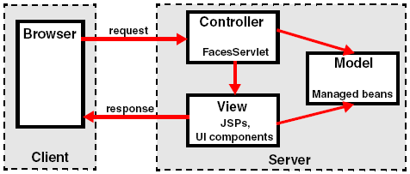
Uses MVC architecture
Model – Managed beans interface with reusable business logic components or external systems
View – JSPs created by combining model data with predefined and custom-made UI components
Controller – FacesServlet drives navigation and object management

Slide 10
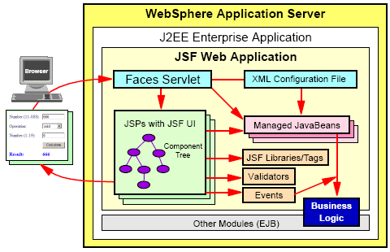
Application Structure

Slide 11
Application Structure
JSF Pages – JSPs built from JSF components; each component has a server-side class
Faces Servlet – One servlet controls execution flow
Configuration file – XML file (faces-config.xml) that contains navigation rules, validators and managed beans
Tag libraries
Validators – Java classes to validate content of JSF components
Managed beans – Hold data from JSF components; passed between business logic and UI; JSF moves data between managed beans and UI components
Events – Java code executed in the server for events; event handling passes managed beans to business logic

Slide 12
FacesServlet Request Life Cycle
Request
Restore Component Tree
Apply Request Values
Process Events
Process Validations
Complete
Process Events
Invoke Application
Process Events
Update Model Values
Process Events
Render Response
Response

Slide 13
JSF and Struts
Some similarities
  Built on JavaServer Page and Servlet technology
  Add custom tag libraries
  Support page navigation
  Use Model View Controller architecture
  Support internationalization
Some differences
  Struts focuses on the Controller dispatching business logic
  JSF focuses on the View (User Interface)
  JSF offers more user interface features since UI components are separate from their rendering (Struts is HTML centric)
JSF will not replace Struts immediately
Lead author of Struts is one of the specification leaders for JSF
  Lead author has written a library to use Struts and JSF together

Slide 14
Struts vs Faces Comparison
 | Struts | Faces
Page Navigation | Struts-config.xml | Faces-config.xml
Form & GUI Processing | ActionForms, Actions | Session & object lifecycle, listener scripts
Visual Controls | Extended JSP Tag Libraries | Standard or custom UI components with events
Validators | Framework and ActionForms | Framework and predefined validators
Data Model | Actions | Service Data Objects, Data Access Beans

Slide 15
Faces HTML UI Component Tags
Check Box
Check Box Group
Combo Box
Command Button
Command Hyperlink
Component Label
Data Table
Display Errors
File Upload
Form
Grid Panel
Group Box Panel
Hidden Field
Image
Inline Message
Input
Input Text Area
Input Password
Label
Link Action
Media Player
Message List
List Box
Output
Output Formatted Text
Panel Menu Bar
Page Fragment Box
Radio Button Group
Rich Text Area
Tabbed Panel

Slide 16
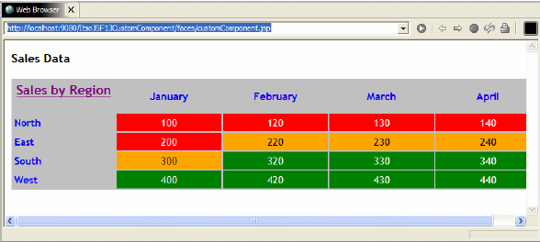
JSF Extensibility - component
Create new UI components
  See JSF Redbook for Traffic Light example
Notes:
You can also write your own components by extening existing components. If interested in understanding how to understand this check out the refreenct book about JSF.

Slide 17
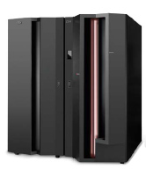
Service Data Objects (SDO)
Emerging Standard
Query data sources, create data graphs containing data objects, apply changes back to the data source
Unified Access to Heterogeneous Data Sources
  Provides a common programming interface to access data from multiple heterogeneous sources
  Supports both static and dynamic data APIs
  Supports disconnected operation
  Decouples application code from data access code
  Designed for use with tools to increase programmer productivity
RDBMS Data Mediator Service
JDBC
JDO
RDBMS
RMI
EJB
Mediator Service
Local/
Remote
EJB
DOM
SAX
Client
XML Data Mediator Service
<XML>
SDO DataGraph
JAXB
JAX-RPC
Web Services Data Mediator Service
SOAP
JCA Data Mediator Service
JCA
Read/Update
Service Data Objects (SDO) is a specification created by IBM & BEA,
submitted to JCP as JSR 235 in December 2003. Expert Group Formation Stage, not part of J2EE yet
Notes:
See more details here: http://www.jcp.org/en/jsr/detail?id=235

Slide 18
Faces Client Components
Library of rich user interface controls for the Web Developer
Easily develop rich interactive User Interfaces in Web Applications (without using plug-ins)
Extends JavaServer Faces, allowing a developer to quickly create highly interactive Web pages that run client-side
  Thin client: low maintenance (no installed client code to upgrade)
  More responsive web applications
  Reduced bandwidth (fewer round trips to the server)
Components:
  Data grid, tabbed panel, rich text editor, input formatters, tree control, chart (bar/line/pie), client-side model object

Slide 19
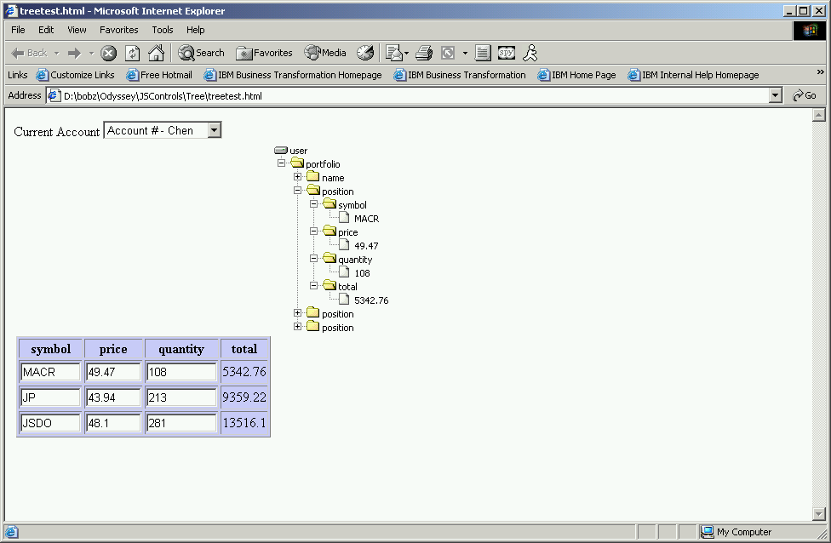
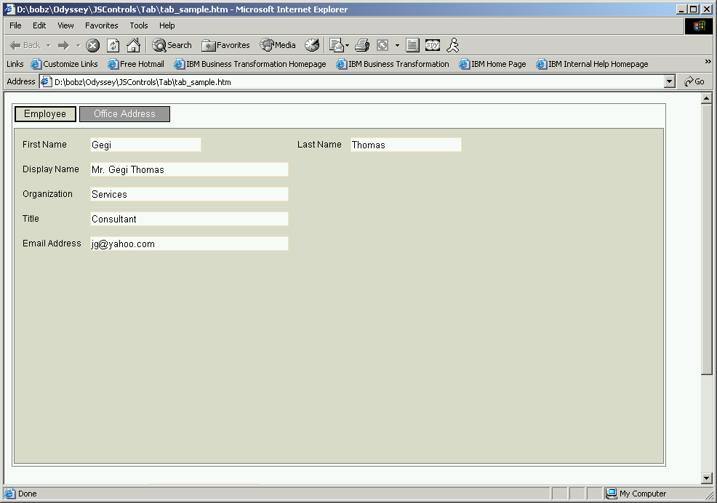
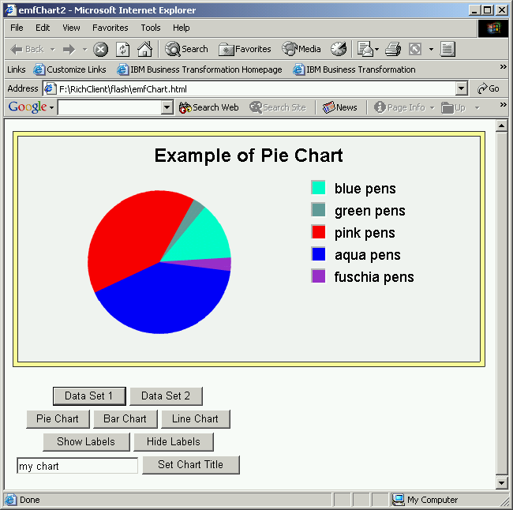
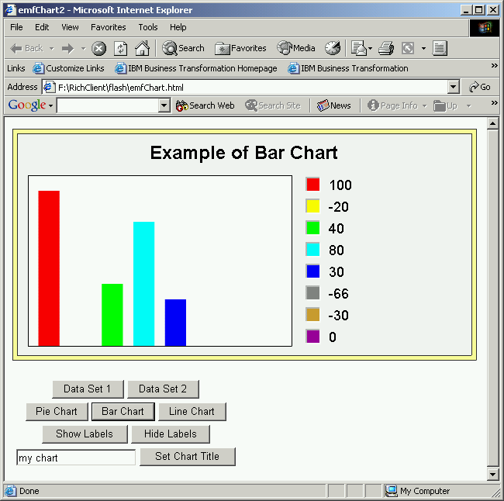
Faces Client Components
Tabbed Panel
Tree Control
Chart

Slide 20
Rational Dev Tool Family
UML Language Transforms
Structural Review & Control
C/C++ Development Tools
Rational Software
Architect
UML 2.0 Pattern/
Transform Authoring
Reusable Asset Browser
Rational Application
Developer
Rational Software
Modeler
Rational Web
Developer
Eclipse
J2EE/EJB & Portal
Development
Component Testing
Code Review & Runtime
Analysis
UML Visual Editors
Configuration Management
Web Development
Web Services Development
Rich Client Development
XML & Database Tools
4GL Development
Notes:
Structural review & control (display structural relationships; expose anti-patterns; deploy rules for pattern and anti-pattern detection)
Component testing (Java and Web Service unit testing)
Code review & runtime analysis (rule-based code validation; memory leak & bottleneck detection, code coverage measurement, execution flow visualization, thread profiling)

Slide 21
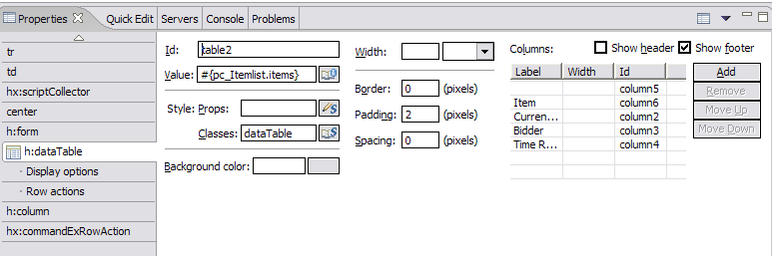
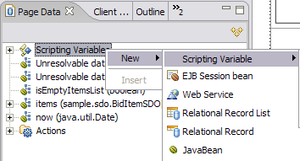

JSF support in Rational Developer Products
Visual development of JSF-based pages using Page Designer
  Built-in Component Property Editor
  Built-in tools simplify/automate event handling
  Built-in tools simplify page navigation
Web Diagram Tool to visually layout the flow of a JSF-based Web Application
Automatic code generation for data validation, formatting and CRUD functions for data access
Data abstraction objects for easy data connectivity (Service Data Objects)
  Relational databases, EJBs, Web Services
  Data objects can be bound easily to user interface components

Slide 22
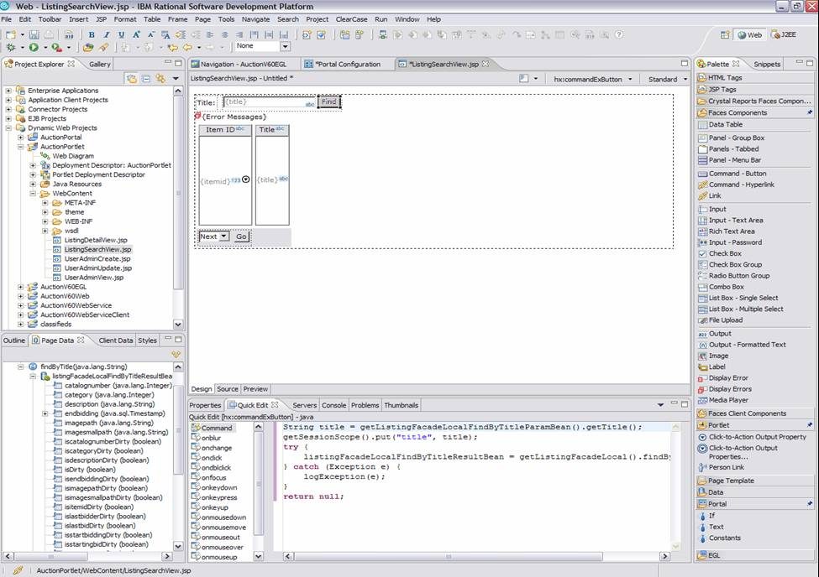
Visual Portlet Development
Construct pages by dragging and dropping rich web components from a customizable Palette
The Data View lets you configure and drag and drop data to automatically create a data bound UI
SDO accesses and updates data without writing any code!
The Quick Edit View allows scripting of client or server side events in Java or Java Script.
Code assist writes the code for you!
Add Click-2-Action and People Awareness capability by dragging and dropping these components
Design, Deploy, Debug, Test and Preview Portlets
  Portlet project wizard to create basic portlets, JSF portlets, and Struts portlets
  Web services client Portlet
  Portlet project support for the IBM portlet API and the JSR 168 portlet API
Business Portlet Development with WPAI (5.1)–SAP, Seibel portlets
Testing and debugging of portlets within the workbench using the WebSphere Portal Test Environment or a remote server
Click-to-Action

Slide 23
Additional Resources
JavaServer Faces Sites
  http://www.jsfcentral.com
  http://java.sun.com/j2ee/javaserverfaces/index.jsp
Service Data Objects
  http://dev2dev.bea.com/technologies/commonj/sdo/index.jsp
  http://www-106.ibm.com/developerworks/library/j-sdo/
Articles on IBM Rational Software developerWorks
  http://www-128.ibm.com/developerworks/library/j-jsf1/
  http://www-128.ibm.com/developerworks/java/library/j-jsf2/
  http://www-128.ibm.com/developerworks/websphere/techjournal/0401_barcia/barcia.html
IBM Redbooks - WebSphere Studio 5.1.2 JavaServer Faces and Service Data Objects
  http://www.redbooks.ibm.com/redpieces/abstracts/sg246449.html
Craig McLanahan’s web log and interview
  http://blogs.sun.com/roller/page/craigmcc/20040927
  http://www.theserverside.com/talks/videos/CraigMcClanahan2/interview.tss?bandwidth=dsl

Slide 24
Demo

Slide 25


Slide 26





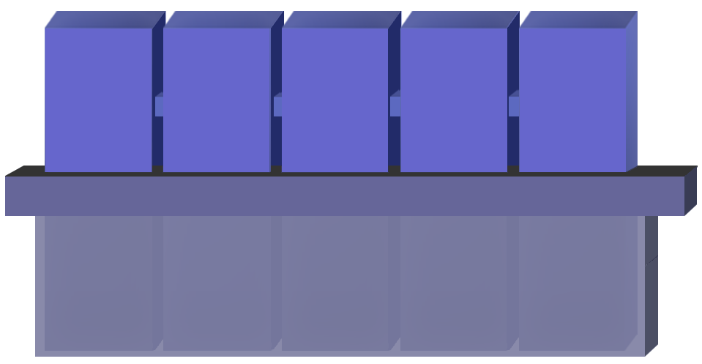


The IBM Rational Software Development Platform
Analyst
Architect
Developer
Tester
Deployment Manager
WebSphere
Business
Integration
Modeler
& Monitor
Rational Functional & Manual
Tester
Rational Application Developer
Tivoli Configuration Manager
Rational Software Architect
Rational Software Modeler
Rational Web Developer
Rational Performance Tester
Tivoli
Monitoring
Customer
Extensions
ECLIPSE
3rd Party
ISV Tools
Project
Manager
Rational Team Unifying Platform
Rational Portfolio Manager
Executive
Notes:
Let’s Take a look at what makes Rational Developer unique in the world Java IDEs.
Part of the IBM Software Development Platform: The IBM Software Development Platform is a set of integrated tools, best practices and services that support a proven end-to-end process for the application development life cycle. Rational Developer fits into a tools framework that supports structured application development, including modeling, proven design practices and patterns and an iterative development process that helps ensure that applications meet user requirements.
Based on the Eclipse Platform: Eclipse is an open source, Java-based, extensible development platform for tools integration. Eclipse-based tools give developers the freedom of choice in an environment supporting multiple languages, platforms and vendors. Eclipse delivers a plug-in–based framework that makes it easy for your team to create, integrate and use software tools together.
Rational Developer is IBM’s core application development offering based on Eclipse 3.0. It provides a comprehensive and productive application development environment for creating and maintaining J2EE-compliant enterprise application systems. It also includes many features not available in Eclipse. And because Rational Developer is built on Eclipse, development teams can adapt and extend the development environment with best-of-breed plug-in tools from IBM, IBM Business Partners and the Eclipse community to match their needs and maximize developer productivity.
While the Eclipse platform does provide an open source IDE that can be used to code applications, it also serves as a platform for building application development tools. We will take a look at those features provided by Rational Developer which are not included in Eclipse 3.0.

Slide 27
IBM Rational Web Developer for WebSphere Software
Follow on to WebSphere Studio Site Developer
New Rapid Application Development capabilities focused on ease of use
Web UI construction
Visual site layout tools
Drag-and-drop web client construction supporting range of web client technologies:
  HTML, JSP, Servlet
  Struts, JSF and SDO
IBM Rational Web Developer
Rich Client UI construction
Visual Editor for Java for rich client composition
Supports Swing, AWT, SWT widgets
Web UI construction
Data tools
Rich Client UI construction
Web Services Tools
Create/manipulate services
WSDL visual editor
UDDI Registry browser
Database tools
Explore and design database schema
SQL Query Builder
Stored procedure builder
Enterprise Generation Language
XML Tools
XML and XSD tooling support
Web Services Tools
EGL
Simplified 4GL for Web Application Development
Text User Interface Programs Support (3270, Curses)
VisualAge Generator -> EGL Migration Tool
Java Runtime Targets
XML Tools
Eclipse Java Development Tools
J2SE development tools
Code completion, search, refactoring
Extensible Team APIs to support CM integration (CVS, ClearCase, and many others)
Plug-in Development Environment for extensibility
Eclipse Java Development Tools

Slide 28
IBM Rational Application Developer for WebSphere Software
Follow on to WebSphere Studio Application Developer
Component/Unit Test
JUnit-based testing of Java components, EJBs and Web Services
Test prioritization recommendation based on code analysis
Automated test case generation through usage of test patterns
Datapool editor for data-driven testing
Optimized unit testing through a set of metrics in the test creation wizard
Test creation wizard offers a set of test patterns to automatically generate test
IBM Rational Application Developer
J2EE/EJB Tooling
J2EE construction tools
Supports WebSphere and WebLogic
Supports J2EE 1.2, 1.3, 1.4
Rapid Deployment for WAS v6
Integrated WAS test environments
O/R mapping
Component/Unit Test
J2EE/EJB Tooling
Portal/Portlet Design Tools
Code Analysis Tools
Both static source code analysis and dynamic runtime analysis
Source code analysis for rule violation detection: Globalization, J2EE/J2SE Best Practices, Private API Usage, Performance
Sequence diagram runtime trace with performance, thread and code coverage annotation
Advanced memory leak detection
Remote data collection across multiple servers
User-defined run-time probes
Interactive reports and metrics
Portal/Portlet Design Tools
Visual Portal site and page layout tools
Visual Portlet layout and preview
Integrated Portal test environment
Code Analysis Tools
UML Visual Editors
UML Visual Editors
Class diagrams for Java/EJB structure
Sequence diagrams for method body visualization
IDEF1X/IE diagrams for Database and XML schema
Dynamic topic diagrams
Javadoc integration
Visual refactoring
IBM Rational Web Developer for WebSphere Software
RUP Configuration for J2EE
ClearCase LT

Slide 29
IBM Rational Software Modeler Product Overview
IBM Rational Software Modeler
“Lifecycle Integrations”
Drag-and-drop association of RequisitePro requirements with models
Interface to CM tools
Visual compare/merge
Document generation with SoDA
“Reusable Asset Browser”
Browse and import assets from a repository
Package model and development artifacts into a RAS bundle
Lifecycle Integrations
Reusable Asset Browser
Pattern/Transformation Authoring
“Pattern/Transform Authoring”
Sample UML-to-code transforms for EJB, Java, and C++
Selective language to UML harvesting
Pattern content
Pattern/Transform authoring framework and services
Report Generation
“Report Generation”
HTML and XML based data extraction and reporting
Extensive printing
Model traceability reporting and custom queries
UML 2.0 Modeling
ClearCase LT
“UML 2.0 Modeling”
UML 2.0 Diagrams for Class, Communication, Component, Composite Structure, Deployment, Activity, Sequence, State, and Use Case
UML Profile Editor
OCL Support
Automatic diagram generation
Extensive open API
Java-based “scripting” for extensibility leveraging the Eclipse JDT

Slide 30
IBM Rational Software Architect Product Overview
“Application Analyzer”
Automatic anti-pattern and pattern detection
Architectural discovery, analysis, metrics, and stability reporting
Implementation level architectural rules
IBM Rational Software Architect
Java Structural Analysis
Sample UML-to-code transforms for EJB, Java, and C++
Selective language to UML harvesting
“Modeler”
UML 2.0 Diagrams for Class, Communication, Component, Composite Structure, Deployment, Activity, Sequence, State, and Use Case
OCL Support
Automatic diagram generation
Pattern content
Pattern/Transform authoring framework and services
Extensive open API
Java-based “scripting” for extensibility
HTML and XML based data extraction and reporting
Extensive printing
RAS tools
UML Language Transforms
Software Modeler
C/C++ editors and build management
Compiler and debugger integration
UML code editors
C/C++ Development Tools
“WSAD v6”
JSF, SDO, Struts
Java GUI editor
Web diagram editor
Site designer
Web Services development tools
Database editing tools
EGL
EJB development tools
UML code editors for EJB, Java, and Data
Static Analysis
Runtime Analysis
Component test automation
Portal/Portlet development tools
Application Developer
RUP Configuration for SW Architects
ClearCase LT

