Slide 1
Tuscany: a SOA framework
Jeffrey Guo
jguo@accelrys.com
Accelrys, Inc.

Slide 2
Agenda
SOA and Tuscany
SCA
SDO
Latest development in SCA (Alex)

Slide 3
Agenda
SOA and Tuscany
SCA
SDO
Latest development in SCA (Alex)

Slide 4
SOA this, SOA that
SOA is a concept
  Coarse-grained business components
  Well defined interfaces and contracts
  Loose coupling between services
  Business oriented, not technology focused
SOA is not new:
  Message oriented systems
  RPC infrastructures

Slide 5
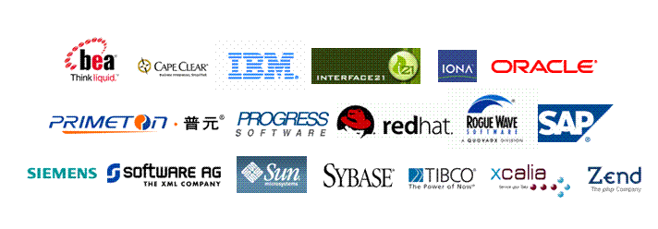
What is Tuscany?
Designed for SOA!
A robust infrastructure that simplifies the development of SOA-based systems
Implementation of specs from Open Service Oriented Architecture (www.osoa.org) collaboration

Slide 6
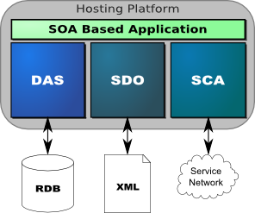
Apache Tuscany:
Underlying Technologies
Service component architecture (SCA):
  a model for the creation of service components in a wide range of languages
  a model for assembling service components into a business solution
Service data object (SDO) :
  consistent means of handling data within applications
  a way of unifying data handling for databases and for services
  Data Access Service (DAS)

Slide 7
Service Component Architecture: Build SOA in Two Steps
Implementation
  Programming languages: Java, C++, PHP, BPEL
  Bindings: web service, message, CORBA/IIOP
  Policy & Profile: security, transaction, RM
Assembly
  Aggregation of components through wiring of references to services

Slide 8
Agenda
SOA and Tuscany
SCA
SDO
Latest development in SCA (Alex)

Slide 9
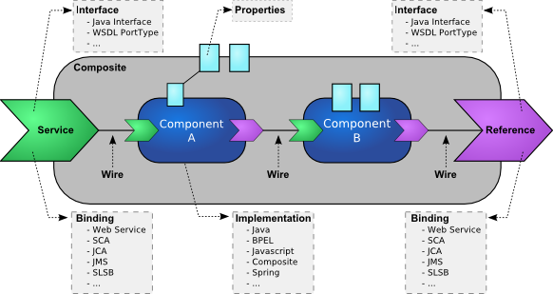
Service Component Architecture

Slide 10
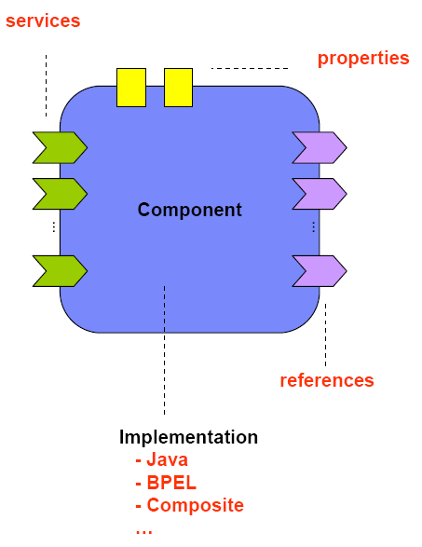
SCA: Component
Configured/instantiated runtime instance of an implementation
Provide and consume services
Implementation technologies:
  Java
  BPEL
  C++
  …(extensibility mechanism)

Slide 11
Service Component Architecture

Slide 12
SCA: Service
Provides interfaces for externally accessible services of an implementation
Defined in xxx.composite file
May specify binding
Types:
  Remotable service: loosely-coupled/pass-by-value
  Local service: tightly-coupled/pass-by-ref

Slide 13
Service Component Architecture

Slide 14
SCA: Reference
Consumes interfaces of externally accessible services
Defined in xxx.composite file
May specify binding

Slide 15
Service Component Architecture

Slide 16
SCA: Property
Allows for configuration of an implementation
An implementation can have zero or more properties
Each property has a type, simple/complex
<composite xmlns=“…“ xmlns:foo="http://foo.com" name="AccountServices">
<property name="complexFoo" type="foo:MyComplexType">
  <foo:a>AValue</foo:a>
  <foo:b>InterestingURI</foo:b>
</property>
<component name="AccountServiceComponent">
…
<property name="currency" source="$complexFoo/a"/>
</component>
…
</composite>

Slide 17
Service Component Architecture

Slide 18
SCA: ComponentType
Component type:
  Configurable aspects of an implementation
  A contract honored by an implementation
Dependency injection:
  Service to be offered
  References to other services
  Properties

Slide 19
Discover ComponentType
Code annotation
“xxxx.componentType” file

Slide 20
ComponentType by external definition
<componentType xmlns="http://www.osoa.org/xmlns/sca/1.0">
<service name="MyValueService">
<interface.java interface="services.myvalue.MyValueService"/>
</service>
<reference name="customerService">
<interface.java interface="services.customer.CustomerService"/>
</reference>
<reference name="stockQuoteService">
<interface.java interface="services.stockquote.StockQuoteService"/>
</reference>
<property name="currency" type="xsd:string">USD</property>
</componentType>

Slide 21
ComponentType by annotation
package services.account;
@Remotable
public interface AccountService{
public AccountReport getAccountReport(String customerID);
}

Slide 22
ComponentType by annotation
public class AccountServiceImpl implements AccountService {
  @Property
  private String currency = "USD";
  @Reference
  private AccountDataService accountDataService;
  @Reference
  private StockQuoteService stockQuoteService;
…
}

Slide 23
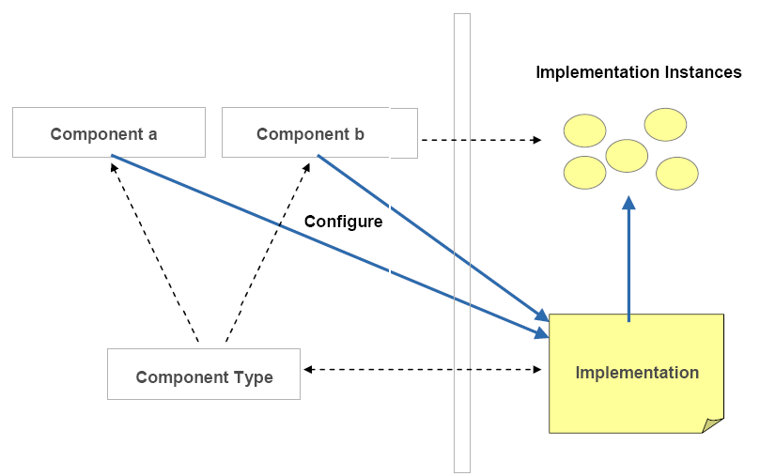
Component ~ ComponentType ~ Implementation

Slide 24
Service Component Architecture

Slide 25
SCA: Interface
Local and remotable interfaces
  Remotable
    No method overloading in remotable interface
    Coarse-grained/loosely coupled
    Data exchange by-value
  Local
    Allows method overloading
    Fine-grained/tightly coupled
    Data exchange by-reference
Bidirectional interfaces
  Models peer-to-peer business relationship
  <interface.java interface="services.invoicing.ComputePrice"
  callbackInterface="services.invoicing.InvoiceCallback"/>
Conversational interfaces

Slide 26
SCA: Binding
Used by Services and References to define access mechanism
Service: defines access mechanism for calling clients
Reference: defines access mechanism for calling out
Configured and managed independently of the implementation code
Types of binding:
  SCA (non-interoperable)
  WS
  EJB
  Additional types by extensibility mechanism
Local invocations do not require bindings

Slide 27
Binding configuration example
<composite xmlns=“…“ name="MyValueComposite" >
<service name="MyValueService">
<interface.java interface="services.myvalue.MyValueService"/>
<binding.ws port="http://www.myvalue.org/MyValueService#
wsdl.endpoint(MyValueService/MyValueServiceSOAP)"/>
…
</service>
…
</composite>

Slide 28
SCA: Wires
Connect references to services
Within a composite:
  Wire source: component reference, composite service
  Wire target: component service, composite reference
Define wire:
  Configure references of components or composites
  Define wire element within the composite element

Slide 29
Wire definition (I)
Configure references of components or composites
<component name="StockQuoteMediatorComponent">
<implementation.java class="services.myvalue.SQMediatorImpl"/>
<property name="currency">EURO</property>
<reference name="stockQuoteService">StockQuoteService</reference>
</component>

Slide 30
Wire definition (II)
Define wire element within the composite element
  Source:
    <component-name>/<reference-name>
    <service-name>
  Target:
    <component-name>/<service-name>
    <reference-name>
  <wire>*
    <source.uri>wire-source-URI</source.uri>
    <target.uri>wire-target-URI</target.uri>
  </wire>

Slide 31
Rules for wiring:
Both source and target interfaces are remotable or local
Target interface methods are the same as/superset of source interface methods
Method signatures are compatible
Order of the input and output types are the same
Faults and exceptions are the same

Slide 32
No questions asked!
Interface query not allowed
Proxies to allow for additional interfaces

Slide 33
Service Component Architecture

Slide 34
Dependency injection via
Component configuration
Hiding details of service location and instantiation
  Service to be offered
  References to other services
  Properties
Service invocation is invisible to business logic
Access mechanism could evolve over time
Multiple service access mechanism could be used

Slide 35
Component configuration example
<composite … name="MyValueComposite" >
...
<component name="MyValueServiceComponent">
<implementation.java class="services.myvalue.MyValueServiceImpl"/>
<property name="currency">EURO</property>
<reference name="customerService">CustomerService</reference>
<reference name="StockQuoteService">StockQuoteComponent
</reference>
</component>
...
</composite>

Slide 36
Component dependency injection example
public class AccountServiceImpl implements AccountService {
@Reference
private AccountDataService accountDataService;
public AccountReport getAccountReport(String customerID) {
…
SavingsAccount savingsAccount = accountDataService.getSavingsAccount(customerID);
…
}

Slide 37
Service Component Architecture

Slide 38
SCA: Composite
Basic unit of composition within an SCA system
Defined by .composite file
Assembles SCA elements in logical groupings
  Service*
  Component*
  Reference*
  Wire*
  Included composite*
Deployment:
  An implementation in higher level composites
  An inclusion into another composite

Slide 39
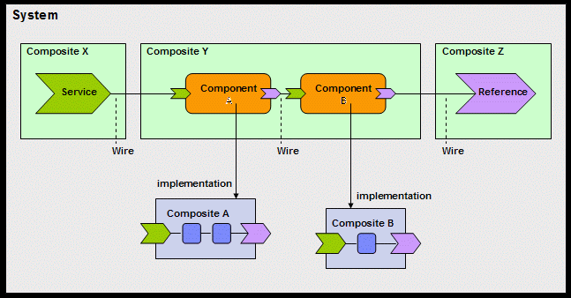
Composite as component implementation example

Slide 40
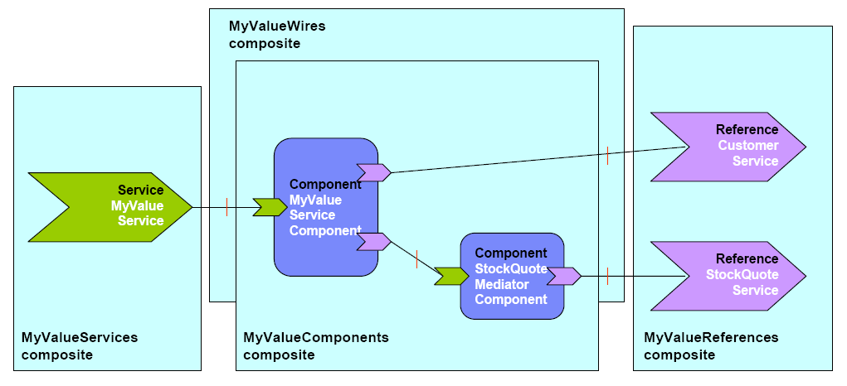
Included composite example

Slide 41
Service Component Architecture

Slide 42
SCA extension model
Assembly extension model supports:
  Interface
  Implementation
  Binding
Based on XML schema substitution groups
  Group heads: interface, implementation and binding
<schema xmlns=“…">
<element name="my-interface-extension" type="tns:my-interface-extension-type"
substitutionGroup="sca:interface"/>
<complexType name="my-interface-extension-type">
<complexContent>
<extension base="sca:Interface">
...
</extension>
</complexContent>
</complexType>
</schema>

Slide 43
Agenda
SOA and Tuscany
SCA
SDO
Latest development in SCA (Alex)

Slide 44
Service Data Object
Unified & consistent data access to heterogeneous data sources
Disconnected client programming model
Simplified programming model for the application programmer
Enable tools and frameworks to work consistently across heterogeneous data sources
SDO
SCA
CustomerInfo
SDO
SDO
Export
SCA
MyValue
MyValue
SDO
SDO
Import
StockQuote
MyValueModule

Slide 45
What’s a Data Object?
The core of SDO framework
Generic representation of business object
Holds data in properties
A property has one or many values
Not tied to any specific persistent storage mechanism

Slide 46
Data object categories
Basic
  getType().getProperties()
  get(Property)
Open
  Allows for open content
  getInstanceProperties()
Sequenced
  Order across properties

Slide 47
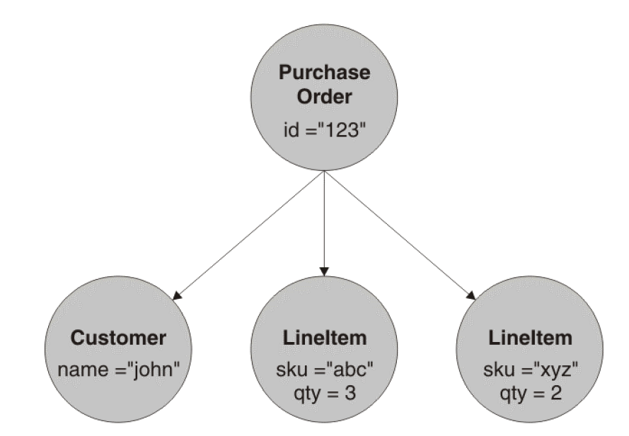
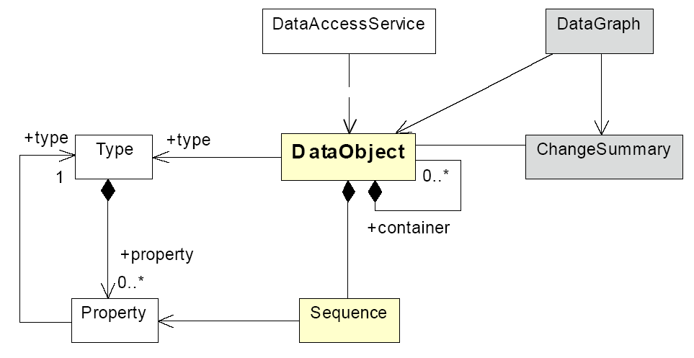
Data Graph
An envelope for a graph of data objects with a ChangeSummary
Created by DAS

Slide 48
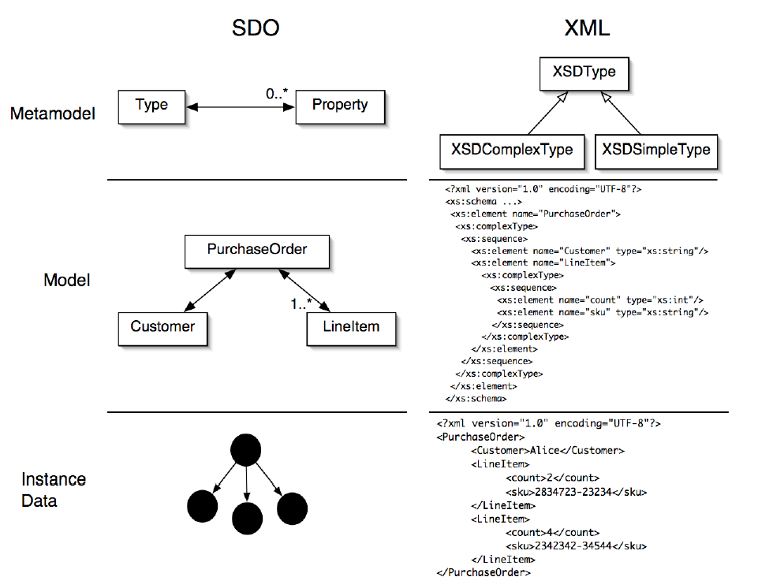
Mapping Data Object to XML

Slide 49
SDO
Generated data API
Dynamic data API

Slide 50
Generated Data API
public interface Student {
String getName();
void setName(String name);
int getID();
void setID(int id);
}
Student p = (Student) dataFactory.create(Student.class);
p.setName("John");
p.setID(12345);
System.out.println(p.getName());

Slide 51
Dynamic Data API
<complexType name=“Student">
<attribute name="name" type="string"/>
<attribute name=“id" type="int"/>
</complexType>
DataObject o = dataFactory.create(tns, “Student");
o.set("name", "John");
o.set(“id", 12345);
System.out.println(o.get("name"));

Slide 52
Data Access Service (DAS)
Represents a standard way to get access to a data graph
Load data graph from a store
Save a data graph back into a store

Slide 53
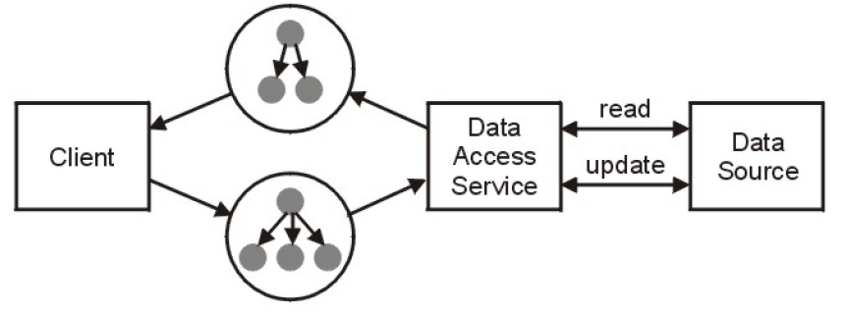
Disconnected data architecture
The client remains disconnected from the DAS expect when reading or writing a data graph

Slide 54
Summary
Tuscany (SCA/SDO):
  Simplified component development
  Simplified assembly and deployment
  Protection of business logic from low level technology (middleware API)
  One model for data across the enterprise
  SOA patterns (disconnected clients, data services)

Slide 55
Reference links
SCA/SDO collaboration
  www.osoa.org
Tuscany project
  http://incubator.apache.org/tuscany/index.html
SCA specs
  http://www.osoa.org/display/Main/Service+Component+Architecture+Specifications
SDO specs
  http://www.osoa.org/display/Main/Service+Data+Objects+Specifications

Slide 56
Agenda
SOA and Tuscany
SCA
SDO
Latest development in SCA (Alex)

